Slide 1

Avoiding Bias & Ensuring a Fair and Equitable Process

Slide 2
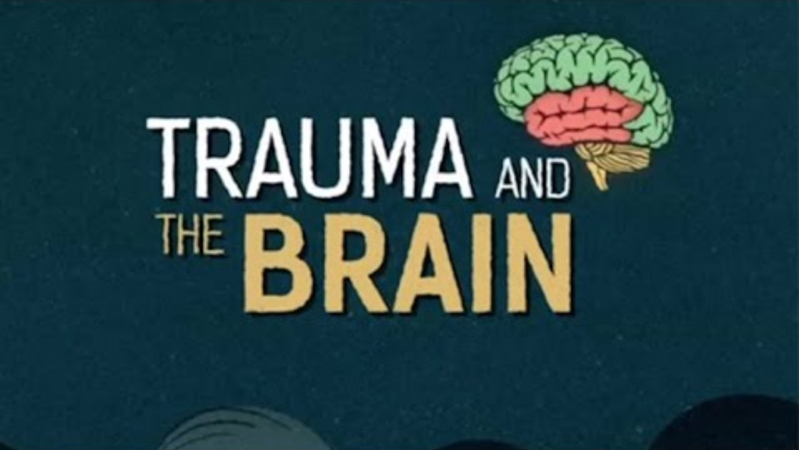
Understanding Trauma’s Effects
NHS Lanarkshire: https://youtu.be/4-tcKYx24aA

Slide 3

Effects of Trauma
Possible impact on memory and memory recall
Inconsistent or incomplete descriptions of facts
Counterintuitive behaviors

Slide 4
Effects of Trauma
Trauma may affect people in different ways, and no particular response establishes that trauma occurred.
An investigator should not assume that inconsistency confirms or disproves an allegation.
Trauma-informed practice concerns how the process is conducted, not what outcome is reached.
Apply the same neutral and evidence-based approach to all parties and witnesses.
A trauma-informed approach does not presume that an allegation is true and must not favor either party. It is intended to reduce unnecessary harm, improve the quality of information gathered, and support a fair and respectful process.

Slide 5

Optional Reflection Activity
Take the implicit bias test from Project Implicit:
https://implicit.harvard.edu/implicit/takeatest.html

Slide 6

Project Implicit Test
What did the exercise suggest about automatic associations?
What limitations should be considered when interpreting a result?
What procedural safeguards can reduce the influence of assumptions in an investigation?

Slide 7

Avoiding Bias, Ensuring Equity & Due Process
Investigations
Training
Outreach

Slide 8
What Is My Role in the Title IX Process?
To make or assist the College in making an impartial, fair and unbiased determination as to whether a College policy or procedure was violated
Temptation to be an advocate
  For Complainant
  For Respondent
Don’t give into it!
  *Except for advisors

Slide 9
Explicit and Implicit Bias
Explicit or conscious bias
When a person is very clear about their attitudes or beliefs and related behaviors occur at a conscious level and with intent.
Implicit or unconscious bias
Bias that operates outside of the person’s awareness and can be in direct contradiction to a person’s espoused beliefs and values.
https://nccc.georgetown.edu/bias/module-3/1.php

Slide 10
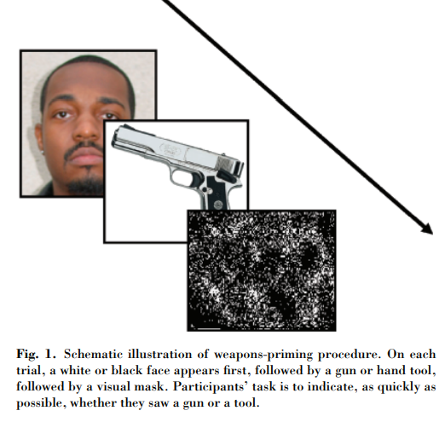
Examples of Bias
Biases are often based on stereotypes, rather than actual knowledge of an individual or circumstance. These prejudgments can lead to poor decisionmaking or discrimination.
Individuals in positions of authority have more power to do harm with their implicit biases than individuals who do not.
Weapon Bias: Split-Second Decisions and Unintended Stereotyping

Slide 11
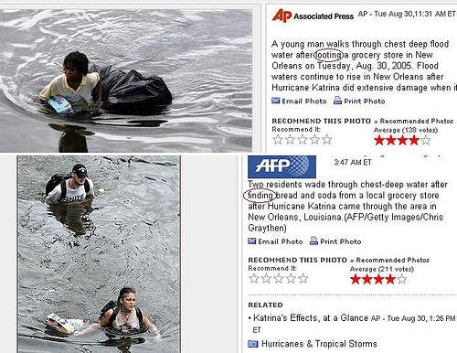
Examples of Bias

Slide 12
Gender and Sex Stereotyping
Gender and sex stereotyping:
“[T]he practice of ascribing to an individual woman or man specific attributes, characteristics, or roles by reason only of her or his membership in the social group of women or men.”
  -Office of the United Nations High Commissioner for Human Rights
Examples of gender or sex stereotyping:
Men are dominant while women are submissive
Women are emotionally sensitive while men are emotionally detached
Men are analytical and perform better at STEM while women are nurturing and perform better at art or music
Men and women should dress according to their gender

Slide 13
Other Considerations – Bias
Bias against:
The Complainant, individually
The Respondent, individually
Complainants in general
Respondents in general
Examples of bias in the investigation and resolution process:
Victim-blaming
Inquiring about irrelevant sexual history
Using unrelated prior interactions, reputation, or character evidence as a substitute for evaluating the evidence concerning the allegations.
Drawing conclusions about motive or credibility from unrelated political views or social media activity.

Slide 14
Perspectives: What Can We Do About It?
Increase awareness of bias and its impact – but awareness alone is not enough
Ongoing process – not a one-time session
Need to manage bias
  Acknowledge stereotyped views
  Give information that contradicts stereotypes
  Gather more individualized information about people
  Reflect on counter-stereotypical examples
  Increase interactions with different kinds of people
Practice new behaviors

Slide 15
Perspectives: What Can We Do About It?
Mitigate:
  Perspective taking – empathy
  What assumptions am I making?
    Would I want someone to make these assumptions about me?
  What evidence supports this?
    Is the evidence reliable?
  What else might be plausible?
  Would I arrive at the same conclusion if the parties’ race(s), gender(s), sexual orientation(s), etc. were different?

Slide 16
Perspectives: What Can We Do About It?
Separate evidence gathering from outcome determination.
Identify the policy elements before assessing the facts.
Use consistent interview and relevance protocols.
Document reasons for credibility and evidentiary-weight determinations.
Test alternative explanations.
Review whether comparable evidence is being evaluated consistently for both parties.
Seek consultation when a potential bias or conflict is identified.

Slide 17
Final Title IX Team Checklist
Identify the applicable policy, allegations, and jurisdiction.
Distinguish the report from any formal complaint.
Provide required notices and discuss supportive measures.
Preserve role separation, neutrality, and equitable opportunities.
Build the investigation around the policy elements.
Gather and assess relevant evidence without applying an automatic hierarchy.

Slide 18
Final Title IX Team Checklist
Document material procedural and evidentiary decisions.
Apply the burden of proof to each allegation separately.
Explain the rationale for the determination and any sanction.
Provide applicable appeal rights.
Maintain required records.
Consider other College obligations even when Title IX does not apply.

Slide 19

Questions?

