Slide 1

The Investigation

Slide 2

Role of the Investigator
Neutral fact-finder
Not a decisionmaker or advocate for either party
Investigates under applicable institutional policies
Ensures fairness and thoroughness

Slide 3

Investigator Responsibilities
Identify scope of allegations
Provide parties with process information
Schedule and conduct interviews
Request, receive, and review evidence
Maintain organized records and notes
Prepare and submit investigation report

Slide 4
Specific Requirements for Investigations
In any investigation, the institution must:
  Ensure that the burden of proof and the burden of gathering evidence rest on the institution, not the parties.
  Provide equal opportunity for the parties to present witnesses, including fact and expert witnesses.
  Not impose any gag orders.
  Allow advisor of choice.
  Provide written notice of hearings, interviews, and other meetings.

Slide 5
Specific Requirements for Investigations
In any investigation, the institution must:
  Provide an equal opportunity for parties to inspect and review evidence.
  Provide the evidence to the parties for review and response prior to the investigation report.
  Create an investigation report that “fairly summarizes relevant information” – does not include findings of responsibility.
  Provide the investigation report to the parties for review and response prior to the hearing.
  Provide live hearing; no single investigator model.

Slide 6
Adequate, Reliable, and Thorough Investigation
Key Tenets:
  Follow the College’s policies and procedures.
  Investigate all allegations of sexual violence and sexual harassment.
  Gather sufficient relevant information:
    Interview relevant witnesses and, to the extent practicable, evaluate the witnesses identified by the parties. If a requested witness is not interviewed, document the relevance, duplication, availability, or other case-specific reason for that decision.
    Obtain relevant physical and documentary evidence, including evidence that corroborates witness statements.

Slide 7

Investigative Plan
At the start of the investigation: Have a roadmap for your investigation of what information you need to collect and how you want to collect this information.
At the end of the investigation: Use the roadmap to write the investigation report.

Slide 8
Planning the Investigation
Start with Notice of Investigation
Develop a timeline
Identify initial witnesses and records
Develop interview plan and sequencing
Remain flexible – adjust scope as needed

Slide 9
Identifying the Elements of a Policy Violation
Stalking
  Elements (example)
Course of conduct
Directed at a specific person
That would cause a reasonable person to fear for their safety or the safety of others OR suffer substantial emotional distress
Policy Definition
Engaging in a course of conduct directed at a specific person that would cause a reasonable person to: (a) fear for their own safety or the safety of others; or (b) suffer substantial emotional distress.

Slide 10
Identifying the Elements of a Policy Violation
Hostile Environment Sexual Harassment
  Elements (example)
Unwelcome conduct
Of a sexual nature
Determined by a reasonable person to be so severe, pervasive, AND objectively offensive
That it effectively denies a person’s equal access to the College’s education program or activity
Policy Definition
Unwelcome conduct of a sexual nature determined by a reasonable person to be so severe, pervasive, and objectively offensive that it effectively denies a person equal access to the education program or activity.

Slide 11
Gathering Evidence
Witness Testimony
  Parties and other individuals with “first-hand” knowledge
  Individuals with “second-hand” knowledge
  All witnesses identified by the parties?

Slide 12
Gathering Evidence
Physical Evidence
Medical evidence
Swipe cards
Emails
Phone records
Social media posts or messages
Security camera footage
Security or police reports

Slide 13
Gathering Evidence
Investigator’s responsibility, but each party must be given opportunity to identify witnesses, provide other relevant information, and suggest questions
Discretion to elect not to interview a witness if the evidence is duplicative or irrelevant
Discretion to consult with experts (but note process requirements)

Slide 14
Conducting Interviews
Before the Interview
  Issue written notice of interview
  Review relevant materials (formal complaint, College policies and procedures, student and/or employee records, evidence submitted by parties)
  Prepare outline of questions

Slide 15
Exercise – Taylor and Dr. Morgan
A student, Taylor, files a formal complaint alleging that her professor, Dr. Morgan, has been making her uncomfortable during office hours and after class. The complaint alleges that Dr. Morgan invited Taylor to hang out off campus, complimented Taylor’s appearance, and made “weird jokes that felt inappropriate.” According to the complaint, Dr. Morgan’s comments have been escalating over several weeks, to the point where Taylor has started leaving class early to avoid running into Dr. Morgan after class.
Discuss the following:
  What questions should you ask Taylor during her investigatory interview?
  What questions should you ask Dr. Morgan during his investigatory interview?

Slide 16
Conducting Interviews
During the Interview
  Explain purpose and role
  Establish rapport and outline the process
  Use open-ended questions
  Move from broad to specific
  Ask for specific examples and context
  Avoid legalistic or leading language
  Clarify chronology and context

Slide 17
Conducting Interviews
During the Interview
  Ask whether any witnesses can confirm the interviewee’s testimony
  Obtain names and contact information for witnesses
  Confirm timeline for providing documents or other evidence referenced during interview

Slide 18
Conducting Interviews
Interviewing Techniques – Dos and Don’ts
 | DO | DON’T
General Principles | Be empathetic Ask open-ended questions Use sensory or contextual questions when relevant and likely to assist accurate recall Listen Give interviewee sufficient time to answer the question Clarify conflicting information | Ask leading questions Ask negative questions Ask questions that imply judgment Ask multiple choice questions
Sample Question Formats | Tell me about . . .
Examples | Tell me about your thought process when . . . Tell me what you were feeling when . . . Would you be willing to say more about . . . What did you mean when you said . . . What do you remember about . . .

Slide 19
Conducting Interviews
Interviewing Techniques – Dos and Don’ts
Basic Interview Questions
Who committed the alleged act? Was anyone else involved? What exactly occurred? What was said? Who made that comment? When did the act occur? Where did the act occur? How did you react? How did the incident affect you? Are there other individuals who may have relevant information? Did you talk to anyone about the incident? What else do you want to tell me about what happened?

Slide 20
Exercise – Taylor and Dr. Morgan (Part 2)
During Taylor’s investigatory interview, you ask her whether any other individuals witnessed Dr. Morgan’s comments referenced in the complaint. Taylor responds that another student, Jamie, “probably noticed something” and “might have had a similar experience.”
Discussion Questions:
  What other questions should you ask Taylor about Jamie?
  Should you interview Jamie? If yes, what questions should you ask?

Slide 21
Conducting Interviews
Common Interview Challenges (Resulting in Interviews That Take Too Long)
  Lack of a clear plan or topic guide
  Letting the witness steer the conversation
  Failing to redirect or clarify long-winded answers
  Asking vague or multi-part questions
  Not establishing ground rules at the start
  Only one person conducting the interview (no note-taker)

Slide 22
Conducting Interviews
Tips to Keep Interviews on Track
  Begin with a scope statement → “Today we’re focused on X.”
  Politely redirect when the witness veers off topic → “Thanks for that context—let’s go back to the night of the event.”
  Use funnel questions (start broad, then narrow)
  Ask one question at a time
  Repeat or summarize long responses → “So just to confirm, you said . . .”
  Use a parking lot → “We may come back to that later if needed.”

Slide 23
Conducting Interviews
Potential Advantages of a Two-Person Interview Team
  One person may lead the questioning while the other takes notes.
  The lead interviewer can focus on listening and follow-up questions.
  The note-taker can identify issues requiring clarification.
  Two-person teams may assist with pacing, transitions, and accurate documentation.
  The College should use a consistent and sustainable approach based on available resources.

Slide 24
Exercise – The Rambling Witness
In this role-play scenario, an Investigator is interviewing a student (Len) who was present at a residence hall social event where an incident allegedly occurred. The Interviewer is trying to determine whether Len observed any inappropriate or unwanted physical contact between two other students during the event.

Slide 25
Exercise – The Rambling Witness
One person will be the witness (Len) and the other will be the Investigator.
Use the script on your handout. The Investigator’s job is to politely but firmly redirect Len back to the focus of the interview.
After 2-3 minutes, switch roles. Each person should try redirecting at least once.

Slide 26
Exercise – The Rambling Witness
Debrief Questions
  What redirect phrasing worked well?
  Was it difficult to interrupt?
  How did you keep control without shutting the witness down?
  How might a note-taker help manage an interview like this?

Slide 27
Conducting Interviews
After the interview
  Review and organize notes right away
  Identify follow-up questions or items to request
  Cross-reference other sources for consistency
  Document any changes or clarifications shared after interview

Slide 28

Determining Relevance

Slide 29
Determining Relevance
Relevance = tendency to make a fact of consequence to an allegation more or less probable
Apply policy definitions (not your intuition) as your filter

Slide 30
Relevance – Rape Shield Protections
2020 Title IX Regulations prohibit questions and evidence about a complainant’s prior sexual behavior or sexual predisposition, unless:
  Evidence is offered to prove someone other than the respondent committed the alleged conduct; or
  Evidence relates to the complainant’s prior sexual behavior with the respondent and is offered to prove consent.

Slide 31
Relevance – Consent
When determining whether consent was present, consider whether a reasonable person in the same circumstances should have known whether the other party could or could not consent to the sexual activity.
Consent is not present when an individual lacks capacity under the College’s policy, including because of age, physical condition, or a disability that impairs the individual’s ability to give consent. Investigators should apply the policy language and consult the Title IX Coordinator or counsel when age-related legal issues arise.

Slide 32
Relevance – Consent
KNOWING, ACTIVE, VOLUNTARY, PRESENT
Knowing: Consent must demonstrate that all individuals are in a state of mind to understand, to be aware of, and to agree to the "who" (same partners), "what" (same acts), "where" (same location), "when" (same time), and "how" (the same way and under the same conditions) of sexual or intimate activity.
Active: Consent must be communicated in clearly understandable words or actions that reveal one's expectations and agreement to engage in specific sexual or intimate activity.
  Silence, passivity, submission, or lack of verbal or physical resistance should not, in and of itself, be understood as consent.
  Consent cannot be inferred by an individual's manner of dress, the giving or acceptance of gifts, the extension or acceptance of an invitation to go to a private room or location, or going on a date.

Slide 33
Relevance – Consent
KNOWING, ACTIVE, VOLUNTARY, PRESENT
Voluntary: Consent must be freely given and cannot be the result of force (violence, physical restraint, or the presence of a weapon); threat or coercion (defined below); or fraud (misrepresentation or material omission about oneself or the present situation in order to gain permission for sexual or intimate activity).
Present and ongoing: Consent must exist at the time of the sexual or intimate activity. Consent to previous sexual or intimate activity does not imply consent to later sexual or intimate acts; similarly, consent to one type of sexual or intimate activity does not imply consent to other sexual or intimate acts. Consent may also be withdrawn at any time by the person making known, by articulated word or concrete action, his or her intention to withdraw it, and thereupon, the sexual or intimate activity should immediately cease.

Slide 34
Consent and Incapacitation
Incapacitation:
  The inability to understand the nature of the activity or to give knowing consent;
  The inability to understand the "who, what, when, where, and how" of a situation;
  When a person is sufficiently intoxicated, high, intellectually disabled or the like such that the person is not capable of understanding and appreciating what is happening; or
  The legal inability to give effective consent because of age or being declared incompetent.

Slide 35
Consent and Incapacitation
Assess whether the respondent knew or should have known that the complainant was incapacitated and unable to give affirmative consent.
Signs of possible incapacitation:
  Slurred or incomprehensible speech
  Unsteady Gait
  Combativeness
  Emotional Volatility
  Vomiting
  Incontinence
No single sign necessarily establishes incapacitation. Consider the totality of the circumstances and what the respondent knew or reasonably should have known.

Slide 36
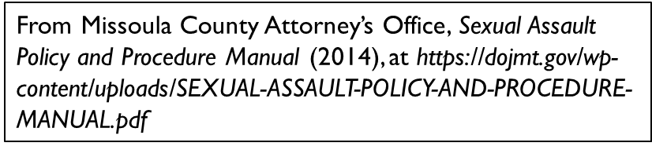
Analyzing Consent – General Factors
The following factors can aid in the determination:
  How drunk was the complainant? The more intoxicated the complainant was, the less likely it is that they were capable of consenting.
  Was the complainant conscious or unconscious? Did the complainant regain consciousness during the sexual assault? Did the complainant pass out? If so, what did the respondent do?
  Did the complainant black out or vomit?
  Could the complainant speak? Was the complainant slurring? Was the complainant able to communicate coherently?
  Was the complainant able to walk or did someone (in particular, the respondent) have to carry them? Did the complainant have to lean on someone?

Slide 37
Exercise – Jordan and Will
A student, Jordan, files a formal complaint alleging that a fellow student, Will, groped her at an off-campus party while both were drinking. Will claims that the touching was consensual and that both students were under the influence but fully aware of what was happening.
On the next two slides, you will see excerpts from Jordan’s and Will’s interview transcripts. Write down whether each statement is “Relevant” or “Not Relevant.” Be prepared to explain your reasoning.

Slide 38
Exercise – Jordan and Will
Excerpts from Jordan’s Interview
  “I told Will not to touch me, but he grabbed my waist anyway.”
  “I had at least three drinks and was starting to feel dizzy.”
  “I had just broken up with my boyfriend the day before.”
  “Other people were around but weren’t paying attention.”
  “Will is known for hooking up with a lot of people.”
  “He put his hands under my shirt after I told him to stop.”
  “After that night, I had trouble focusing in class.”
  “I used to think Will was kind of cute before this happened. I even gave him my number during freshman orientation.”

Slide 39
Exercise – Jordan and Will
Excerpts from Will’s Interview
  “We were both flirting earlier in the night, and Jordan didn’t seem uncomfortable.”
  “I didn’t hear her say no at any point.”
  “I had about four beers, but I wasn’t drunk—I knew what was happening.”
  “I saw Jordan arguing with one of her roommates before I came over.”
  “She was wearing this really tight shirt—I figured she was into me.”
  “We had danced together earlier and she put her hand on my shoulder.”
  “I didn’t think anything I did crossed a line.”
  “She’s always so dramatic about stuff like this.”

Slide 40
Exercise – Jordan and Will
Debrief Questions
  Did any of Jordan’s or Will’s statements reflect common myths or biases about consent?
  Looking at Will’s interview, how would you document statements like #5 (“She was wearing this really tight shirt—I figured she was into me.”) and #8 (“She’s always so dramatic about stuff like this.”), if at all?
  What is the difference between explaining behavior versus justifying it?
  What strategies can you use when summarizing statements that seem judgmental or problematic?

Slide 41

Drafting the Report

Slide 42
Anatomy of an Investigation Report
Background on Complaint
Summary of Allegations
Applicable Policies &
Definitions
Investigation Timeline
Supportive Measures
Summary of Other
Relevant Evidence
Party and Witness
Interview Summaries
Party Responses to Evidence

Slide 43
Anatomy of an Investigation Report
Background on Complaint
  Context for the complaint (institutional setting, relationship of parties)
  How the complaint was received
  Which policy/policies and procedure/procedures apply to the complaint

Slide 44
Anatomy of an Investigation Report
Background on Complaint
  On September 10, 2024, Complainant, a second-year student at the College, submitted a formal complaint to the Title IX Coordinator alleging that Respondent, a third-year student in the same academic program, engaged in unwelcome sexual conduct at a program-related gathering at a faculty member’s home on September 7, 2024. The complaint was reviewed and accepted by the Title IX Coordinator under the College’s Sex-Based Misconduct Grievance Process. The matter was referred to the undersigned investigator on September 12, 2024.

Slide 45
Anatomy of an Investigation Report
Summary of Allegations
  Clear and concise articulation of alleged conduct
  Accurately aligned with the allegations identified in the written notice, using clear and neutral language without materially changing their scope.
  Organized by discrete allegations if multiple incidents are included
  Should not include interview content or evidence

Slide 46
Anatomy of an Investigation Report
Summary of Allegations
  The allegations under investigation are as follows:
    That on or about September 7, 2024, Respondent engaged in nonconsensual sexual contact with Complainant while both were present at a program-related gathering at a faculty member’s home.
    That Respondent’s conduct included unwanted physical touching and verbal sexual advances.

Slide 47
Anatomy of an Investigation Report
Applicable Definitions
  Exact definitions from College policy
  Include only the definitions that are relevant to the allegations
  Include citations

Slide 48
Anatomy of an Investigation Report
Applicable Definitions
  The College’s Sex-Based Misconduct Policy prohibits Title IX Sexual Harassment, which is defined to include, in relevant part:
    Unwelcome conduct that a reasonable person would find so severe, pervasive, and objectively offensive that it denies a person equal educational access.

Slide 49
Quiz Time!
Which definitions from the Sex-Based Misconduct Policy would apply to the current fact pattern?
  Reminder: The allegations under investigation are as follows:
    That on or about September 7, 2024, Respondent engaged in nonconsensual sexual contact with Complainant while both were present at a program-related event at a faculty member’s home.
    That Respondent’s conduct included unwanted physical touching and verbal sexual advances.

Slide 50
Anatomy of an Investigation Report
Investigation Timeline
  Chronology of key investigation steps
  Dates of notice, interviews, report draft and review
  Should demonstrate compliance with procedural requirements
  Use simple, structured format (like bullet points or a table)

Slide 51
Anatomy of an Investigation Report
Investigation Timeline
  September 12, 2024 – Investigator assigned
  September 17, 2024 – Complainant interview
  September 22, 2024 – Respondent interview
  September 24–October 10, 2024 – Witness interviews and evidence review
  October 15, 2024 – Draft report shared with parties for review
  October 25, 2024 – Parties’ responses received
  October 30, 2024 – Final report issued

Slide 52
Anatomy of an Investigation Report
Party and Witness Interview Summaries
  Should not repeat/recite entire interview
  The summary should contain sufficient relevant information to accurately reflect the substance of the interview and permit meaningful review by the parties.
  Cite to the interview transcript, recording, or notes using the College’s established citation method.

Slide 53
Anatomy of an Investigation Report
Party and Witness Interview Summaries
  Complainant stated that Complainant arrived at the gathering at approximately 8:30 p.m. and spoke with Respondent several times during the evening. Complainant reported consuming approximately three alcoholic beverages. According to Complainant, at approximately 11:30 p.m., Respondent placed a hand on Complainant’s waist and then under Complainant’s shirt. Complainant stated that Complainant said “stop” and moved away. Complainant identified Witness A as being in the kitchen immediately before the alleged contact but was unsure whether Witness A observed the contact itself.

Slide 54
Anatomy of an Investigation Report
Summary of Other Relevant Evidence
  Brief, neutral summary of documentary or other physical evidence reviewed
  No need to provide explanation unless relevance is unclear or context is needed

Slide 55
Anatomy of an Investigation Report
Summary of Other Relevant Evidence
  The investigator reviewed the following documentary and physical evidence:
    Text messages exchanged between Complainant and Respondent from September 5–8, 2024, including a message from Respondent on September 8 stating, “Sorry if I was out of line last night.”
    A screenshot of an Instagram story posted by a third-party attendee at the party, time-stamped at 11:48 p.m. on September 7, showing Complainant and Respondent talking in the kitchen.
    Complainant’s class attendance records, reflecting fewer recorded class attendances after September 7 than during the preceding period.

Slide 56
Anatomy of an Investigation Report
Parties’ Responses to Evidence (Final Report Only)
  Summarize any responses submitted by parties during review-and-response period
  Identify whether corrections, clarifications, or rebuttals were offered
  Address material corrections or clarifications transparently. Preserve a record of the parties’ submissions and identify any resulting revisions to the report. Do not silently alter a party’s account or the evidentiary record.

Slide 57
Anatomy of an Investigation Report
Parties’ Responses to Evidence (Final Report Only)
  Complainant submitted a written response to the draft investigation report on October 20, 2024. In the response, Complainant expressed concern that the report did not emphasize that they told Respondent “no” more than once.
  Respondent did not submit a written response during the review period.

Slide 58
Elements of a High-Quality Report
Consistency
Clarity
Alignment
Rigor
Balance
Tone
Timeliness

Slide 59
Elements of a High-Quality Report
Allegation
Facts
Policy
Analysis
Conclusion
Sanction
Report
Written Determination

Slide 60
Drafting the Report – Final Reminders
Stay focused on relevant facts tied to the policy.
Use clear, neutral, and concise language.
Don’t include everything—filter for what matters.

Slide 61
Session #1 Takeaways
Distinguish a report from a formal complaint.
Determine which policy and process apply before beginning the investigation.
Preserve role separation, neutrality, and equitable treatment.
Build the investigation around the policy elements.
Ask open, relevant, and nonjudgmental questions.
Document investigative decisions and follow-up needs.

Slide 62

End of Session #1 & Next Steps
Grievance Process Exercise

Slide 63
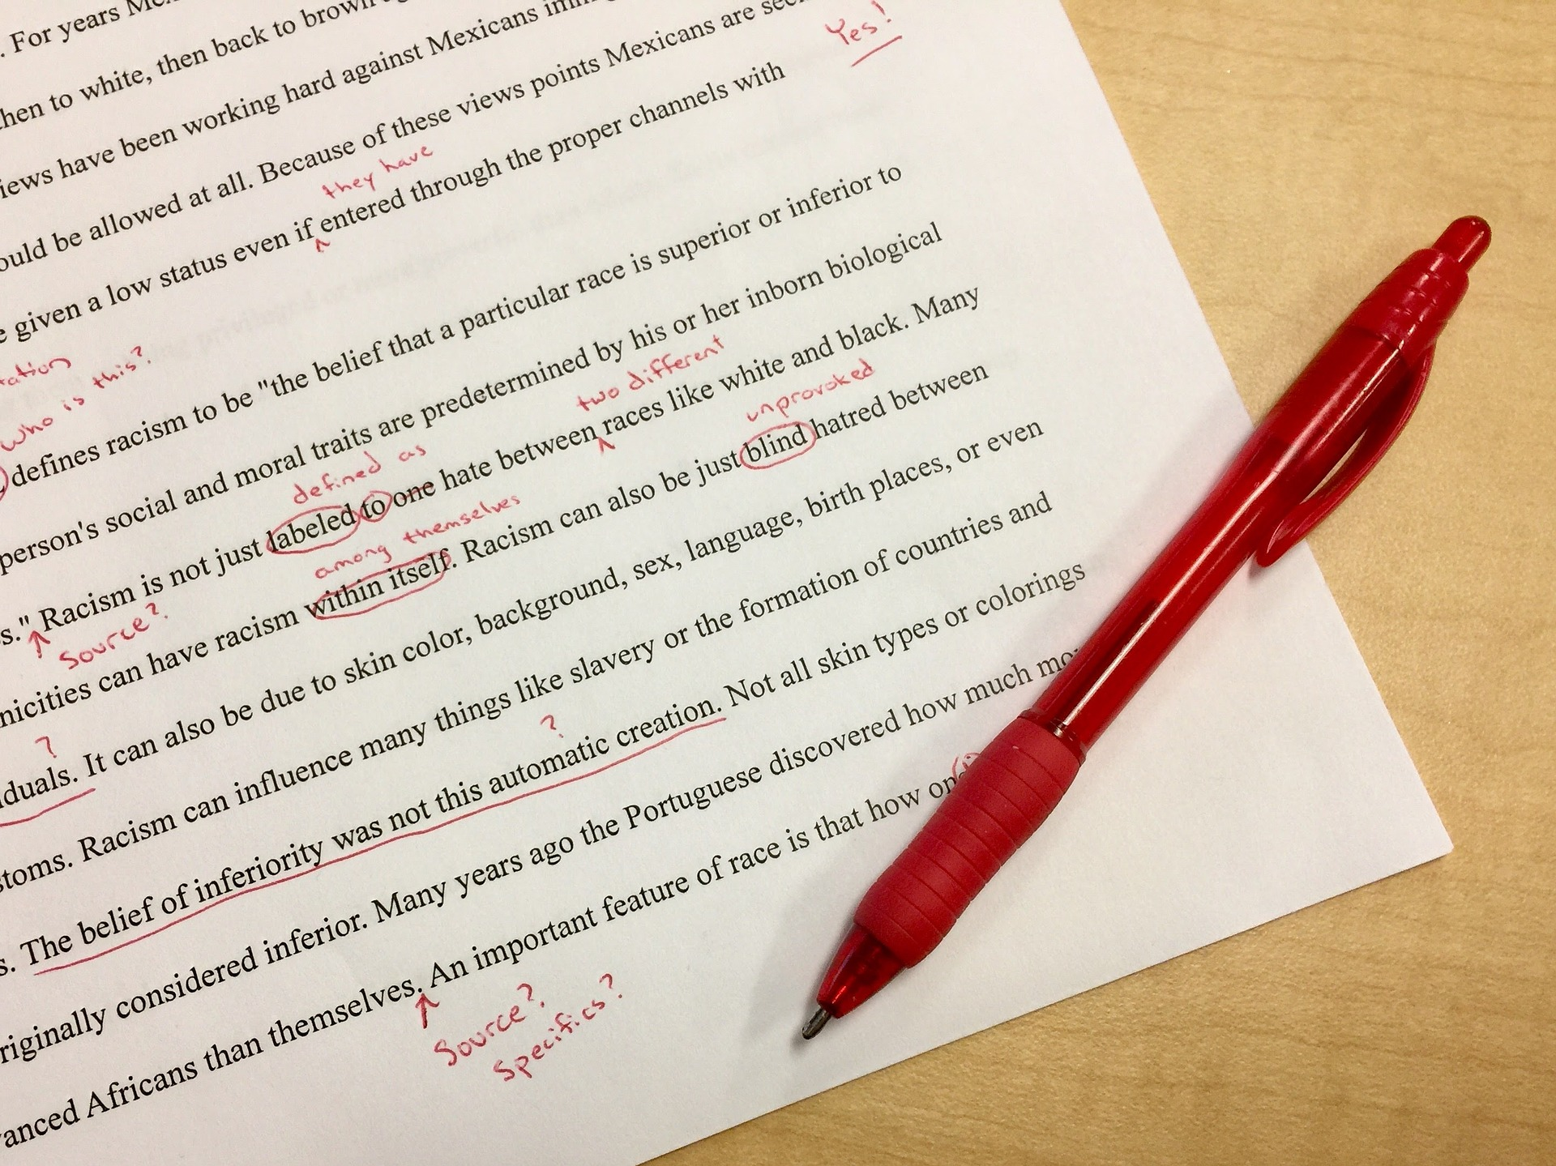
Start of Session #2
Grievance Process Exercise – Group Review
This Photo by Unknown Author is licensed under CC BY-NC

