Slide 1

Hearings and Written Determinations

Slide 2

Hearing
The Players:
  Hearing Officer – not the same person as Investigator, Title IX Coordinator, or Appeals Decisionmaker
  Parties
  Witnesses
  Title IX Coordinator (in administrative role)
  Investigator (as possible witness)

Slide 3

Obligation to Serve Impartially
Avoid prejudgment of the facts at issue
Presumption of non-responsibility
No bias or conflicts of interest
  For the individual Complainant
  For the individual Respondent
  For Complainants or Respondents generally
Apply the relevant facts to the appropriate policy

Slide 4
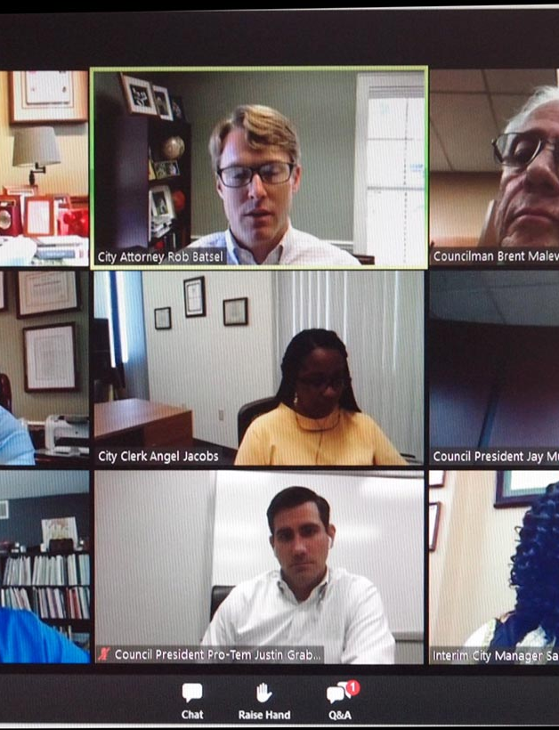
Location and Logistics
May be held in the same geographic location or virtually.
Specific location to be determined by the institution.
Technology must allow the parties, their advisors and the Hearing Officer to see and hear one another and any witnesses.

Slide 5
Orderly Hearings – Logistics to Think About
Information parties should have before the hearing
Any accommodations required by the parties
Physical space and use of remote technology—before, during and after hearing
Plan for order of hearing
Plan for recording hearing
Plan for handling/keeping evidence
Have contact information for Title IX Coordinator and legal counsel

Slide 6
Hearing Order
Hearing Officer opening remarks (including hearing ground rules)
Opening Statements
  Complainant
  Respondent
Cross-Examination
  Of Complainant by Respondent’s advisor
  Of Respondent by Complainant’s advisor
Witness testimony and cross-examination
Closing statements
Hearing Officer concluding remarks

Slide 7

Cross-Examination
Only relevant cross-examination may be asked of a party or witness.
The Hearing Officer must decide if a question is relevant before it is answered and explain any decision to exclude a question.
What is the impact of party or witness not submitting to cross-examination?

Slide 8
Cross-Examination – Advisors
If a party does not have an advisor present at the live hearing, the College must provide without fee or charge to that party, an advisor of the College’s choice, who may be, but is not required to be, an attorney, to conduct cross-examination on behalf of that party.
ADVISOR

Slide 9
Technology for Hearing
No specific technology required
Examples: Zoom; Microsoft Teams meetings
Must be in real time
Must enable hearing attendees to see and hear one another
Be sure the technology has the necessary security protections
Provide accommodations for individuals with disabilities
Train Hearing Officer(s) how to use the specific technology for the hearing

Slide 10

Access to Evidence
Parties must be allowed access to the evidence during the hearing.

Slide 11
Quiz Time!
For each scenario, pick the correct procedural call and explain your reasoning.
A party appears without an advisor. What do you do to proceed with cross‑examination?
An advisor asks about the complainant’s prior sexual history to attack credibility. What’s your ruling, and what must you explain?
Mid‑hearing, a party offers a video clip not shared during the investigation. Admit or exclude? What standard governs?

Slide 12
Quiz Time!
For each scenario, pick the correct procedural call and explain your reasoning.
A key witness declines to attend. May the decision‑maker rely on that person’s prior statement? If yes/no, under what authority?
An advisor begins shouting and badgering a witness. What immediate steps can/should the chair take to restore order?

Slide 13

Evaluating the Evidence
Preponderance of the Evidence Standard
  Which has the greater weight?
  “More likely than not”
  50% and a feather

Slide 14
Method for Evaluating Evidence - Chart
 |  | Incident? | Drinking? | Consent?
C | Statement
 | Testimony
 | Texts
 | Other Social Media
R | Statement
 | Testimony
 | Texts
 | Other Social Media
Witness A
Witness B
Physical Evidence?

Slide 15
Assessing Credibility
Consider all the information and ask:
  Is the account internally consistent on material points?
  Is the account consistent with reliable documentary or testimonial evidence?
  Did the individual have an adequate opportunity to perceive the event?
  Are any inconsistencies material or peripheral?
  Are there plausible and evidence-supported explanations for discrepancies?
  Has the account materially changed? If so, was an explanation provided?
  Does the individual have a demonstrated motive to misstate a material fact?
  What corroborating or contradicting evidence exists?
Avoid relying primarily on demeanor or whether an individual appears to be “telling the truth.”

Slide 16
Analysis – Common Mistakes
Letting sympathy or skepticism replace objective analysis
“Working backward” from your gut to justify a conclusion
Failing to tie facts directly to the policy language
Giving weight to irrelevant details or character traits
Over-relying on “common sense” instead of the defined standard

Slide 17
Applying the Legal/Policy Standard
For each allegation:
  Break down the policy definition into its elements.
  Identify facts that relate to each element.
  Ask:
    What weight should be assigned to the relevant evidence, and what corroborating or contradicting evidence exists?
    Does the evidence satisfy the element based on the standard?
  If an element is not met – no violation under the policy.

Slide 18
Exercise – The Boss
Instructions:
  Read the policy definition and the case summary.
  Break the policy into elements.
  Identify which facts support or do not support each element.
  Decide: Does the conduct meet the standard?

Slide 19
Exercise – The Boss
Policy Definition – Race-Based Harassment (Workplace Conduct Policy)
  “Unwelcome conduct based on an individual’s race or color that is so severe or pervasive that it creates a hostile, intimidating, or offensive work environment or interferes with the individual’s work performance.”

Slide 20
Exercise – The Boss
Complainant is a Black employee in the College facilities department. Complainant filed a complaint with Human Resources alleging that, over the course of five months, Complainant’s supervisor, a white employee, made multiple comments that Complainant perceived as racially biased or stereotypical, including:
  Frequently referring to Complainant as “articulate” and saying things like, “You don’t sound like most people from the South Side.”
  Expressing surprise when Complainant shared that they attended a competitive high school: “Wow, that’s impressive—good for you.”
  During meetings, assigning Complainant to more physically demanding tasks, while referring to others as “better fit for front-of-house work.”
  Referring to the department’s staff as “diverse” and occasionally commenting, “You’re one of the people who helps us show that we care about inclusion.”
Complainant stated that while none of the comments seemed openly hostile at the time, over time Complainant started to feel singled out and uncomfortable—like they were always being viewed differently than their coworkers. They reported dreading interactions with their supervisor and becoming more withdrawn from conversations and meetings.
The supervisor acknowledged the comments but stated, “I thought I was being supportive. I was trying to recognize what makes people unique.”

Slide 21
Exercise – The Boss
Debrief Questions:
  Did you determine that this conduct met the policy threshold? Why or why not?
  How does subtle, coded language complicate the analysis?
  Would your conclusion change if the supervisor had only made one or two of the comments?
  What other evidence would help clarify the impact or pervasiveness?

Slide 22
Written Determination
Must include:
  Allegations
  Procedural steps
  Findings of fact
  Conclusions regarding the application of the policy to the facts using the applicable standard of evidence
  A statement of, and rationale for, the result as to each allegation, including a determination regarding responsibility, any disciplinary sanctions the institution imposes on the Respondent, and whether remedies will be provided by the institution to the Complainant
  Appeal procedures available to both parties and the permissible bases for an appeal

Slide 23
Sanctions
Student disciplinary sanctions may range from a written warning or educational requirements to suspension or expulsion, as authorized by College policy.
Employee sanctions may include:
  Written reprimand
  Required training or corrective action
  Reassignment
  Suspension with or without pay
  Discharge or recommendation for discharge
Supportive measures and remedies are distinct from disciplinary sanctions.
The decisionmaker should apply the sanctioning authority and factors identified in College policy.

Slide 24
Elements of a High-Quality Determination
Allegation
Facts
Policy
Analysis
Conclusion
Sanction
Report
Written Determination

