Slide 1
HARPER COLLEGE 2026 NEW EMPLOYEE BENEFIT ORIENTATION

Slide 2
Human Resources/Employee Benefits contacts benefits@harpercollege.edu
Angela Bowling
Benefits and Compensation Manager
X6634
A311
abowling@harpercollege.edu
Jodie Olsen
Human Resources Benefits Assistant
X6217
A320a
jolsen@harpercollege.edu

Slide 3
Your Benefit Effective Date Is: Based on your Employment type Administrators: date of hire full time faculty: date of hire full time (30+ hours/week) staff: 30th day of employment
Please complete your benefit enrollment within 30 days

Slide 4
 | 2026 (24 DEDUCTIONS) INSURANCE RATES
 |  | SELF & | SELF & | SELF, SPOUSE
MEDICAL PLAN | SELF | SPOUSE | CHILDREN | & CHILDREN
PPO WELLNESS
Employee Cost | $119.94 | $238.25 | $252.96 | $357.36
HMO ILLINOIS
Employee Cost | $80.06 | $158.96 | $169.14 | $238.45
HMO BLUE ADVANTAGE
Employee Cost | $66.16 | $131.41 | $139.82 | $197.12
HDHP
Employee Cost | $107.95 | $214.43 | $227.66 | $321.66
DENTAL
Employee Cost | $0.00 | $15.00 | $25.00 | $31.25

Slide 5
 | 2026 (20 DEDUCTIONS) INSURANCE RATES
 |  | SELF & | SELF & | SELF, SPOUSE
MEDICAL PLAN | SELF | SPOUSE | CHILDREN | & CHILDREN
PPO WELLNESS
Employee Cost | $143.93 | $285.90 | $303.55 | $428.83
HMO ILLINOIS
Employee Cost | $96.07 | $190.75 | $202.97 | $286.13
HMO BLUE ADVANTAGE
Employee Cost | $79.39 | $157.69 | $167.78 | $236.54
HDHP
Employee Cost | $129.53 | $257.31 | $273.19 | $385.99
DENTAL
Employee Cost | $0.00 | $18.00 | $30.00 | $37.50

Slide 6
1.
Insurance Summaries
Medical / Dental / Flexible Spending / Harper Paid Benefits / Voluntary Plans / Retirement Savings Plans: SURS / 403b / Mandatory Notices

Slide 7


Medical Plans
PPO Wellness
Blue Edge HDHP/HSA
HMO of Illinois
Blue Advantage HMO

Slide 8
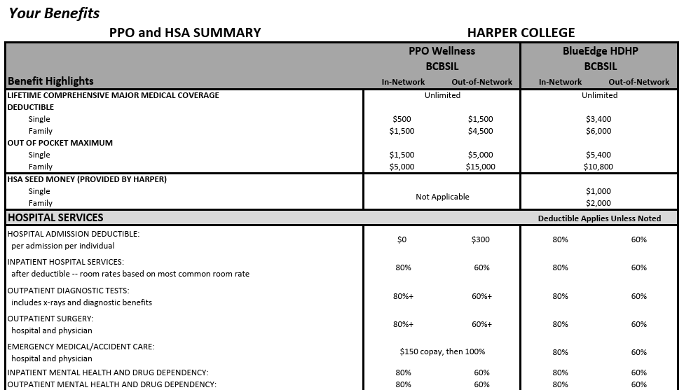

Slide 9

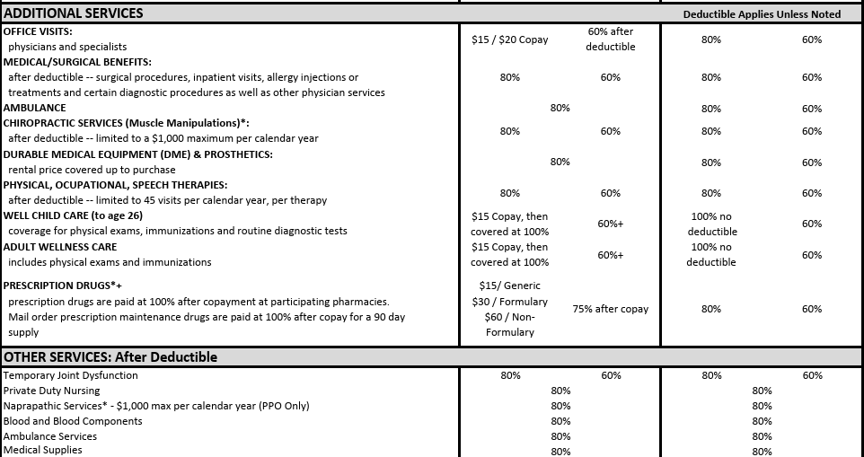

Slide 10
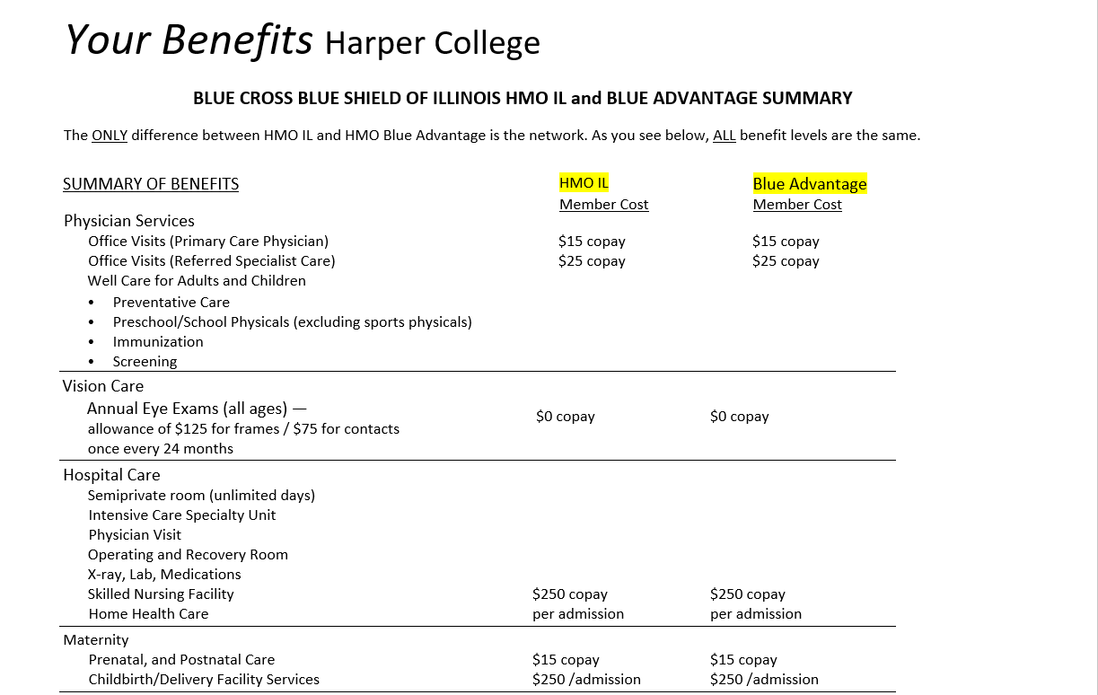

Slide 11

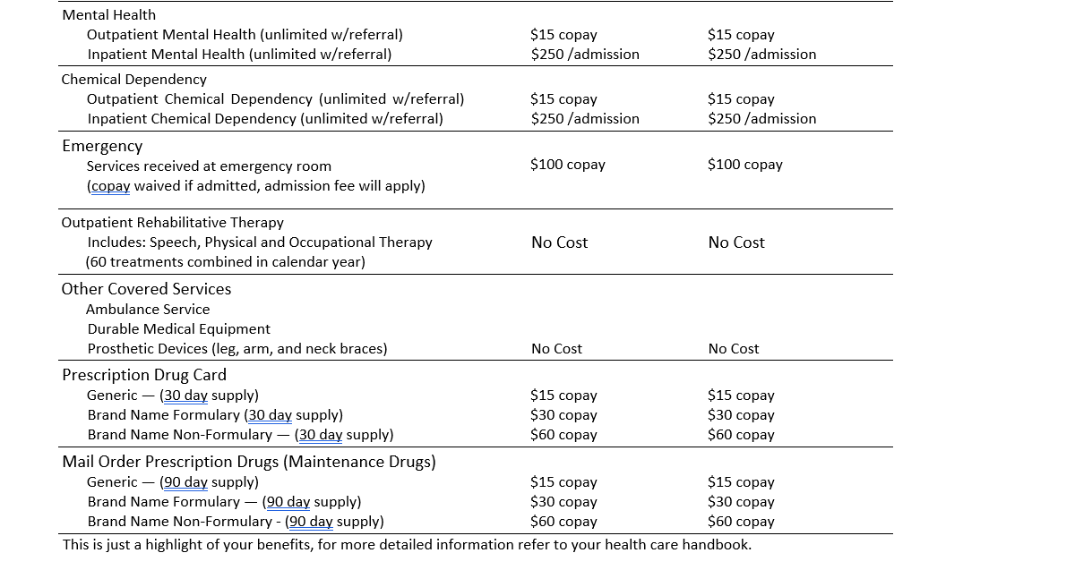

Slide 12


Dental Plan

Slide 13
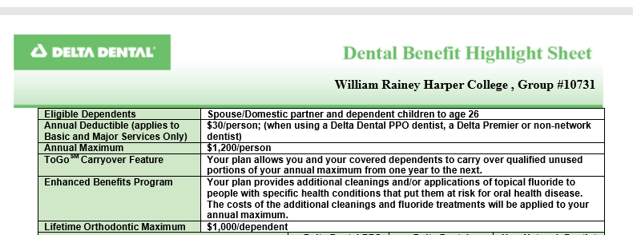

Slide 14
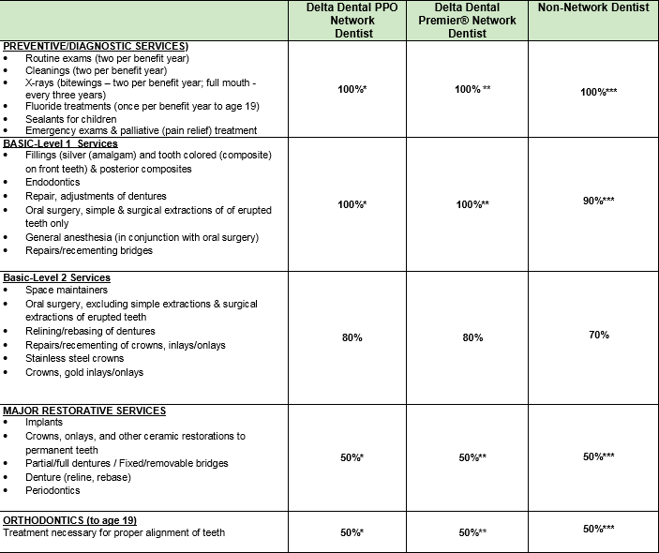

Slide 15

Flexible Spending Account
(FSA)

Slide 16
What is an FSA?
A HEALTHCARE flexible spending account (HCFSA) is an employer-sponsored benefit that allows you to set aside pre-tax dollars into an account to be used for ELIGIBLE HEALTHCARE expenses
Annual Maximum amount allowed for Health Care FSA $3300
A DEPENDENT CARE flexible spending account (DCFSA) is an employer-sponsored benefit that allows you to set aside pre-tax dollars into an account to be used for QUALIFIED DEPENDENT CARE expenses
Annual Maximum Amount Allowed For Dependent Care FSA $7500

Slide 17



Harper Paid Benefits
Harper College provides Eligible Employees:
Short Term Disability
Long Term Disability
Group Term Basic Life Insurance
Group Term Basic Accidental Death and Dismemberment
Additional concierge services provided through MetLife

Slide 18


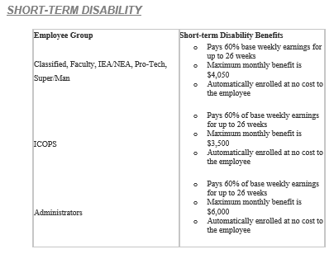
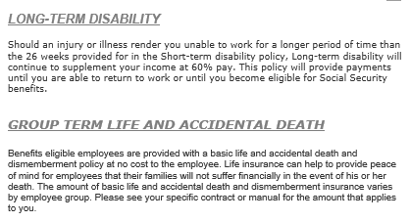
Disability, life and ad&d

Slide 19


Voluntary Plans
MetLife
Voluntary Term Life Insurance
Voluntary Personal Accident Insurance (AD&D)
Up to 5x’s your annual salary
Spouse eligible - up to $50,000
Children eligible - up to $10,000
(evidence of insurability may apply)
VSP
Voluntary Vision Insurance
Basic and Premier plans available
Norton LifeLock
Voluntary Identity Protection

Slide 20

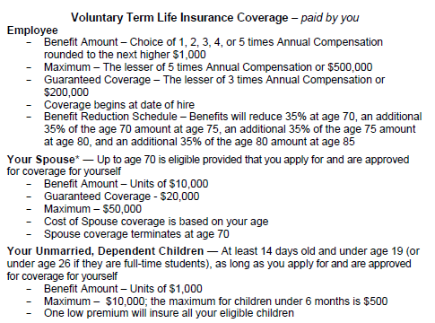
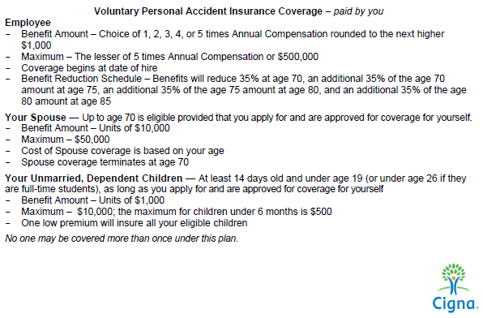

Slide 21
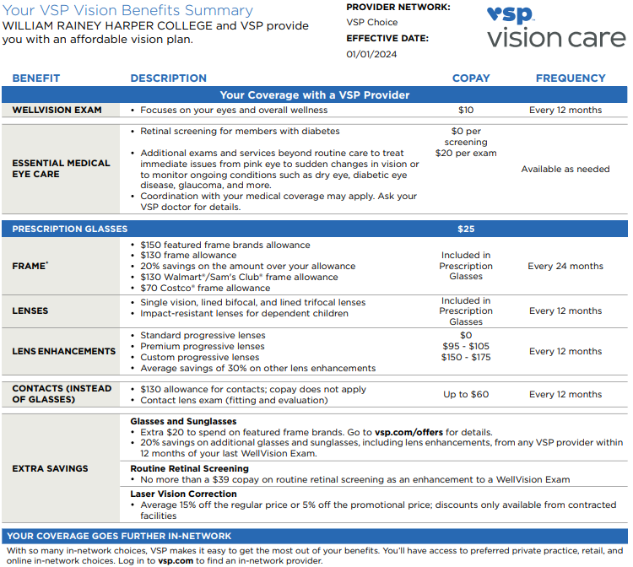

BASIC Voluntary VSP 24 Premium Deductions
Employee $3.20 Employee + Spouse $5.12 Employee + Child(ren) $5.23 Employee + Family $8.43

Slide 22


PREMIER Voluntary VSP 24 Premium Deductions
Employee $6.35 Employee + Spouse $10.16 Employee + Child(ren) $10.37 Employee + Family $16.72

Slide 23



Slide 24


Let’s Discuss
State University Retirement System
While working at Harper College, most employees are required to contribute to the pension system which is known as SURS. You can get more information by going to SURS.ORG
Community College Health Insurance
Full time active community college employees pay 0.95 percent of gross earnings to help fund a health plan for retirees of community colleges, the College Insurance Program (CIP)
403(b)
Harper also provides a voluntary 403(b) and 457 plan that can help supplement the SURS pension in retirement
Visit the HIP > Career & Benefits > Retirement for more details

Slide 25





Mandatory Notices can be found on the HIP > Career & Benefits > Benefits Scroll to the bottom of the benefits page to find the required notifications

Slide 26
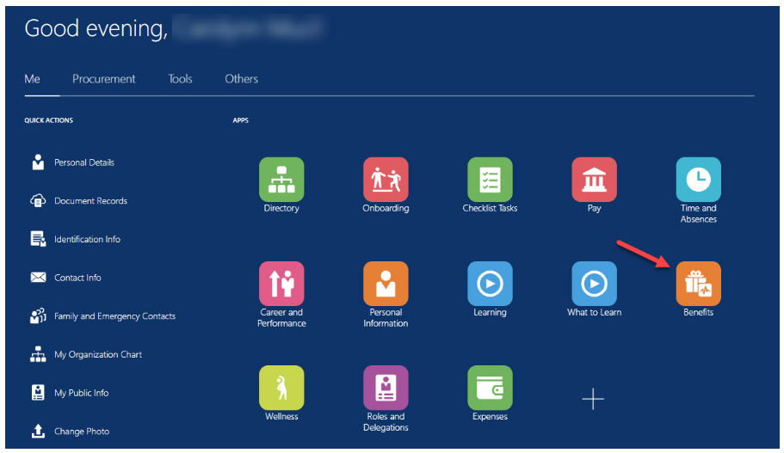
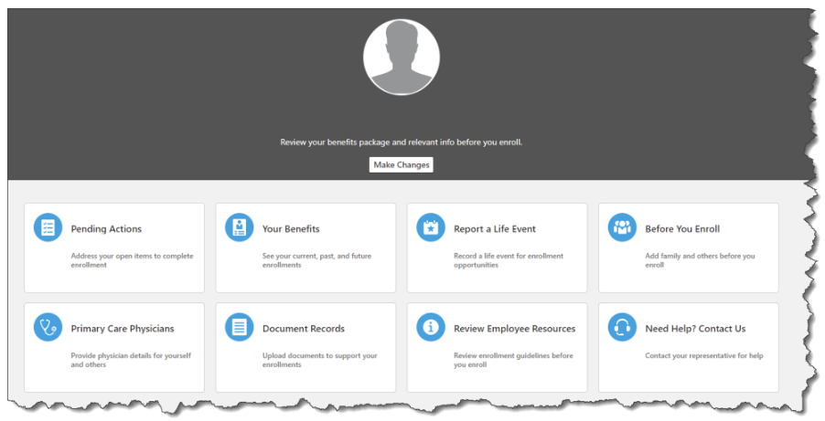
HOW DO I ELECT MY BENEFITS?
2.
You will make your Benefit Elections in Oracle Fusion
.

Slide 27

Frequently Asked Questions……..
When are My Benefits Effective?
Your Benefits effective date is based on your employment type
Administrator & faculty = date of hire
Full time staff employee = 30 days
When do I have to complete my benefit elections?
Within 30 days from your hire date
The sooner the better for your coverage to be active
How do I enroll?
Through Oracle Fusion
Use this handy guide for assistance
Who do I contact if I have questions?
Email: benefits@harpercollege.edu
Where can I find Harper Benefit plan documents?
HIP Harper Internal Portal BENEFITS

Slide 28
thanks!
Any questions?
Please Ask!
Angela and Jodie look forward to hearing from you
benefits@harpercollege.edu

Slide 29

Place your screenshot here
Welcome to Harper!
We are glad you are here!

