Slide 1
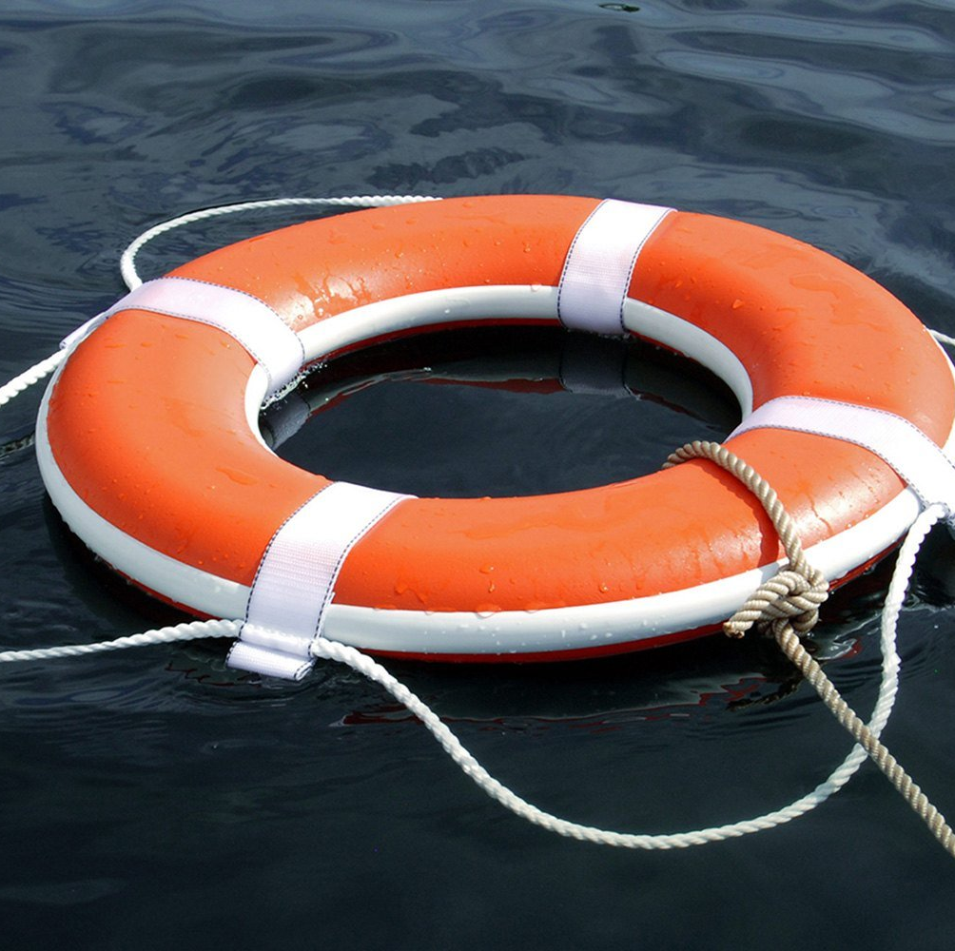
Harper College
Life Ring Locations and Use

Slide 2
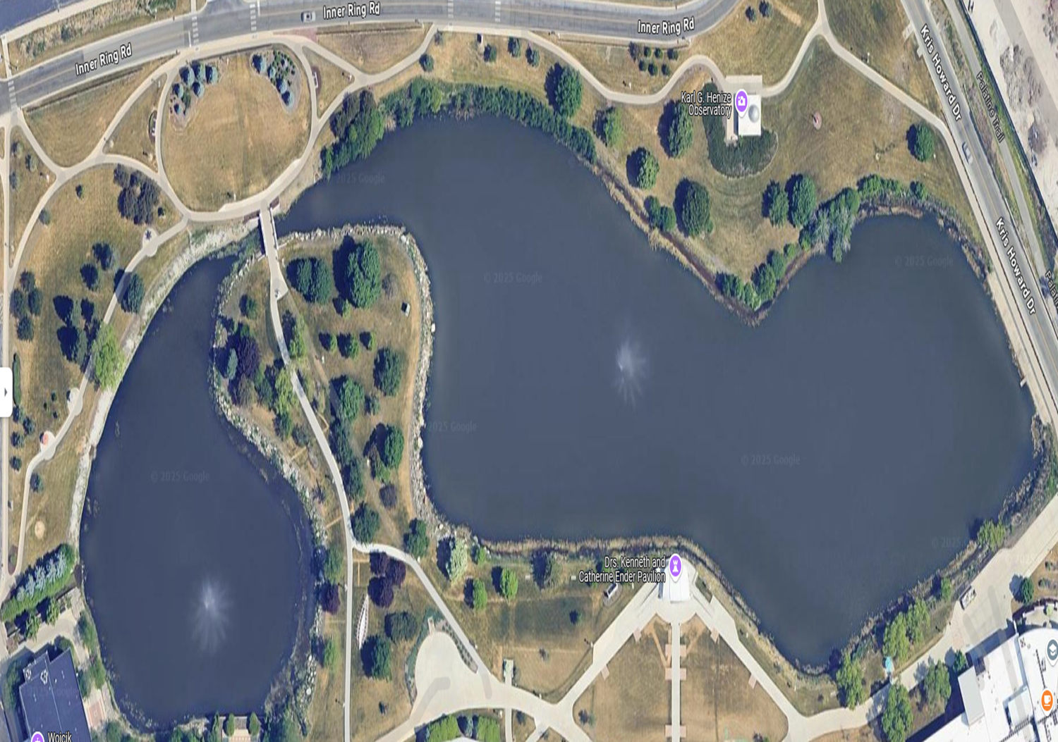




Slide 3
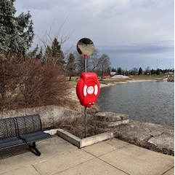
#1 W Building Northeast Corner

Slide 4
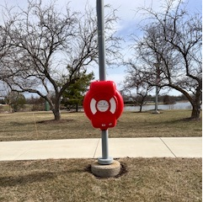
#2 Between The Two Ponds

Slide 5
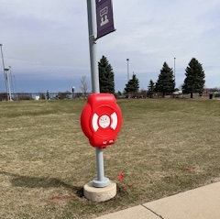
#3 North Side by The Bridge

Slide 6
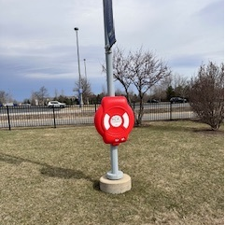
#4 Observatory

Slide 7
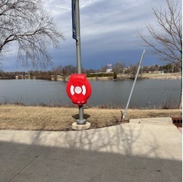
#5 D Building by Starbucks

Slide 8
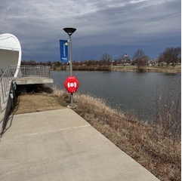
#6 Ender Pavillion

Slide 9
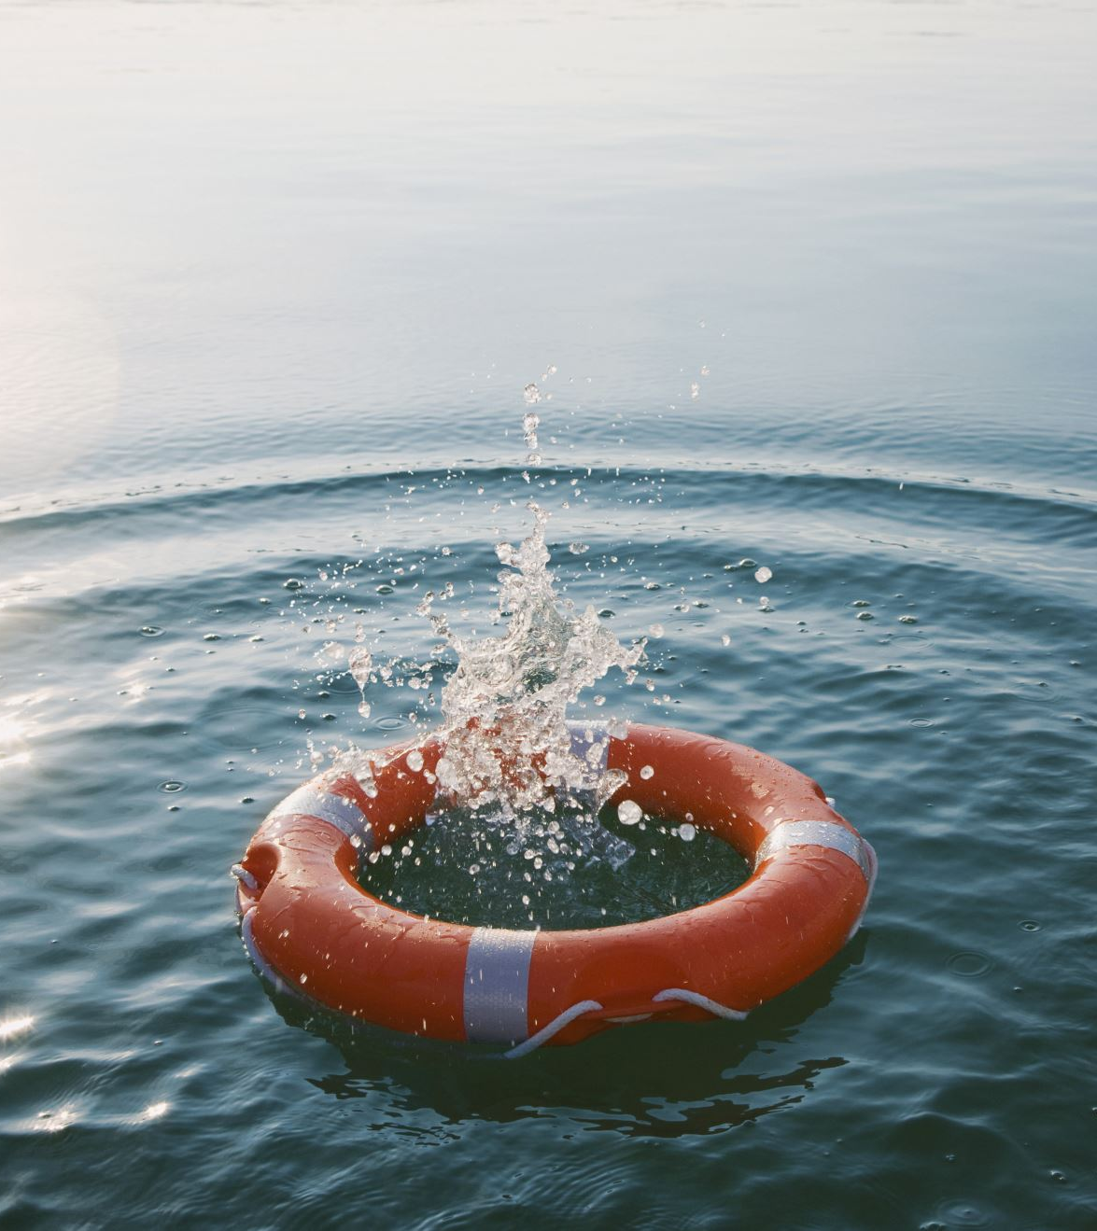
Life Ring Instructions
Watch this video to learn how to deploy a life ring.
Proper Way to Throw a Life Ring

