Slide 1
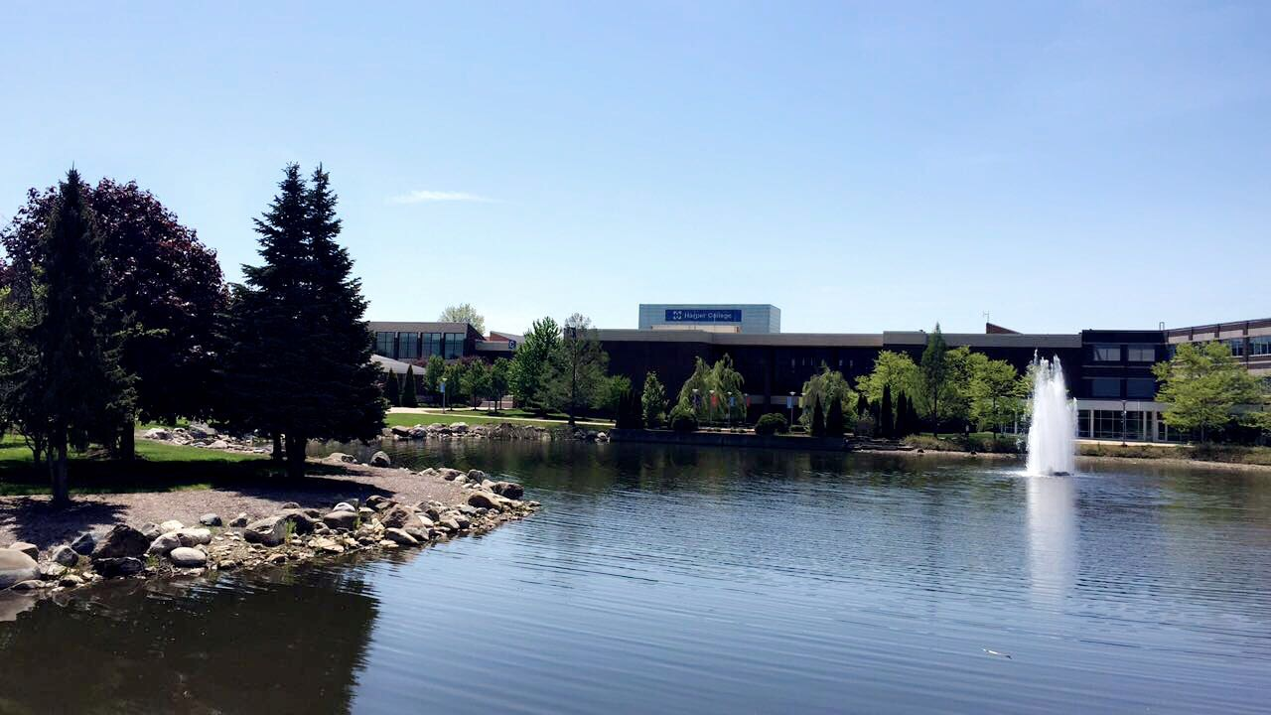
Harper College
International Student
Pre-Departure Orientation

Slide 2
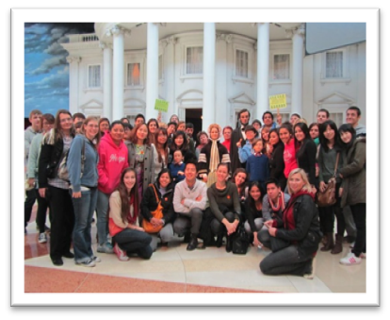
Welcome!
Harper College is pleased to welcome students from around the world!
Here at Harper we are excited to welcome you and support you on your educational journey in the United States.
We offer many programs and resources to help make your time here a success. We hope that Harper College serves as an educational platform for your continued personal, professional, and educational growth.

Slide 3

What is Harper College?
Community
College
Associate degrees (first two years of college)
Applied Science degrees
ESL Intensive English Program
Certificates
2-year Associate degrees
4-year Bachelor’s degrees
Master’s degrees
Doctorate degrees
University

Slide 4
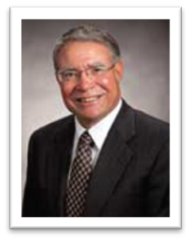
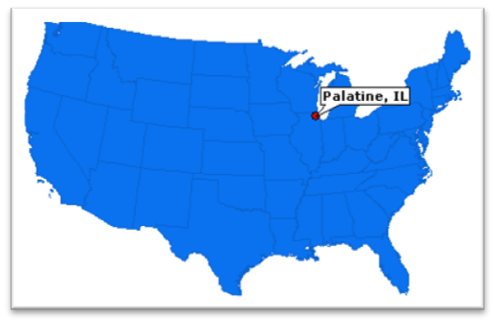
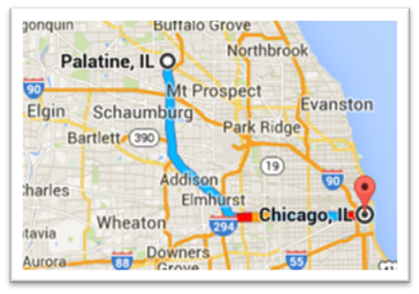
About Harper College
College President: Kenneth L. Ender
State: Illinois
City: Palatine (Northwest suburb of Chicago)

Slide 5
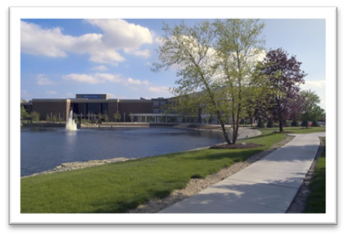
Harper Highlights
Accredited two-year college (Higher Learning Commission)
Beautiful 200 acre campus located 30 miles outside of downtown Chicago
Over 230 full-time faculty (professors) who care about teaching
Associate/transfer degrees and applied science career degrees

Slide 6
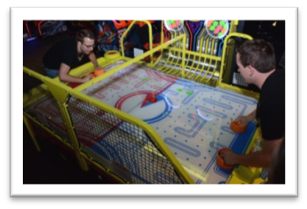
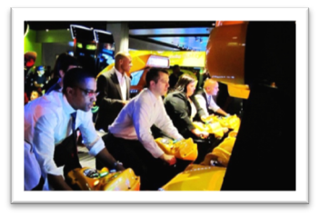
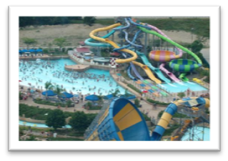
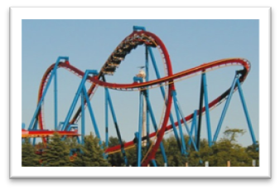
Things to do – Near Palatine
Game Works http://www.gameworks.com/
Woodfield Mall http://www.simon.com/mall/woodfield-mall
Six Flags Great America Amusement Park https://www.sixflags.com/greatamerica

Slide 7
Things to do - Restaurants
  Mitsuwa Marketplace http://www.mitsuwa.com/
  Level 257 http://www.level257.com/
  Chicago won ‘Restaurant City of the Year’ 2017
  You can find almost any type of restaurant you would like in the Chicago area!

Slide 8
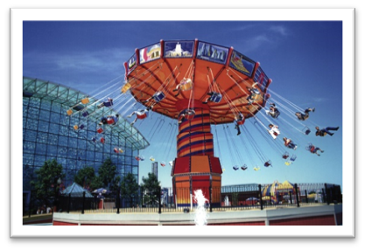
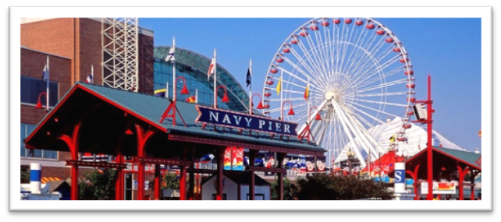
Things to do - Chicago
Chicago
  Navy Pier (https://navypier.com/ )
  Museums
    Museum of Science and Industry
    Field Museum of Natural History
    Museum of Contemporary Art
    Art Institute of Chicago
    Shedd Aquarium
    Adler Planetarium
  Places to Visit
    Willis Tower Skydeck
    John Hancock 360° Observatory

Slide 9
Academic Information
Academic Year
  Fall Semester: Late August – Mid December
  Spring Semester: Mid January – Mid May
  Summer Session: Late May – August
Areas of Study
Architecture/Construction | Human Services/Social Sciences
Arts/Media | Information Technology
Business | Manufacturing
Education | Paralegal/Law
ESL | Enforcement/Public Safety
Health Sciences | Science, Math, Engineering
Hospitality

Slide 10
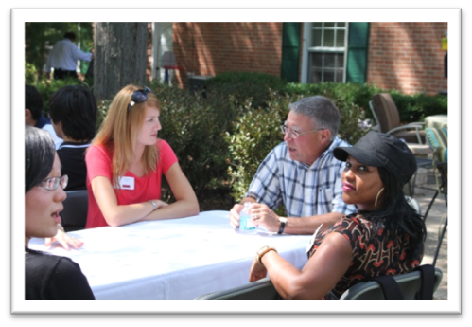
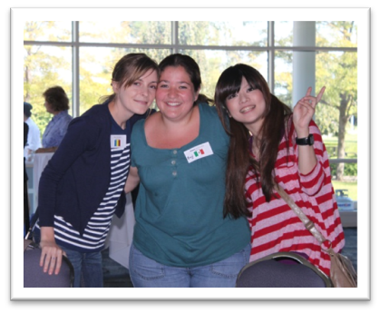
Beyond the classroom
Here at Harper College, there are many ways to stay involved to help you become a part of the community!
Harper’s Office of Student Involvement offers over 50 clubs!
Like sports? Harper offers a variety of sports – both intercollegiate and intermural!

Slide 11
Student Support
Throughout your time at Harper College, you have many support services that are available to you to be successful.
Career Development Center
Center for New Students
Computer Labs
Harper College Library
Academic Advising and Counseling Services
Tutoring Services
Writing Center
Success Services for Students

Slide 12
Other Student Services
Health Services
  First Aid
  Health Education
  Medicine
  Vaccinations
  Physical Exams
Psychological Services
Access and Disability Services

Slide 13
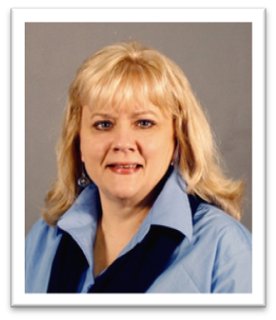
Office of International Students
Jill Izumikawa
Coordinator, International Student Services
Assists with:
New International Student Information
Cross-Cultural Adjustment
Legal Requirements
Health Insurance

Slide 14
International Student Tuition/Fees
 | Fall Semester | Spring Semester
Credit Hours Required | 12 | 12
Tuition (Cost per Credit: $457.50) | $5,490.00 | $5,490.00
College Fees | $249.00 | $249.00
Health Insurance | $527.18 | $765.79*
TOTAL | $6,266.18 | $6,504.79
*Includes health insurance coverage for spring and summer months

Slide 15
Academic Integrity
Academic integrity is a very important part of your time here at Harper College.
It is important that you are familiar with our policy and have a good understanding of what academic integrity is.
What is “Academic Integrity”?
  Honesty and responsibility in education
  Adhering to moral and ethical principles
What you need to avoid
  Cheating
  Academic dishonesty
  Plagiarism = The practice of taking someone else’s work or ideas and passing them off as your own (International Center for Academic Integrity)
Why is “Academic Integrity” so important?
  https://www.youtube.com/watch?v=3BeyUy_QyO8

Slide 16
What to expect - WEATHER
Average Chicago Climate
  Summer (June – August)
    75° - 84°F (23° - 28°C)
  Fall (September – October)
    75° - 50°F (23° - 10°C)
  Winter (November – February)
    35° - 15° F (1° - -9°C)
  Spring (March – May)
    40° - 60° F (4° - 15° C)
  Average snowfall: 38 inches (96.52 cm)
    What to pack
      Winter: gloves, hat, scarf, heavy coat/jacket, warm boots
      Summer: shorts, t-shirt, sandals

Slide 17
What to expect - TRANSPORTATION
Transportation within the suburbs can be limited if you do not have a car, but the following options are great ways to get to and from the city:
Taxi / Uber / Lyft
Bus
  CTA Bus (Chicago)
  PACE (Suburbs)
    Route 696 stops at Harper College
Metra Train
CTA Train
  There is a great app called Transit Stop: CTA Tracker

Slide 18
What to expect - CUSTOMS
Legal drinking age is 21 years old
People you don’t know may say “hello” and smile
You will be asked “how are you?” often…it is a form of “hello”
  Customary response: “I’m well, and you?”
We like queues: Do not jump in line in front of others!
Participation in the classroom is expected
Hold the door for others

Slide 19
What to bring with you
When entering the United States, it is important to have all the following documents and items readily available to hand to the immigration specialist when you arrive.
Passport
Form I-20
  Keep document available to provide to the airline and immigration
Visa
Admission letter to Harper College
SEVIS fee payment receipt
Money
  Make sure your bank knows you are traveling
  Have access to sufficient funds for your first semester
    Be careful in bringing large amounts of cash. If it is lost or stolen, there is no compensation.
    U.S. Customs and Border Protection does not allow anyone to bring more than $10,000 in cash

Slide 20
Immigration Expectations
Before you arrive, it is important to understand your legal immigration requirements.
Below is key information to keep in mind before arriving.
U.S. Government Information for International Students
Maintaining your LEGAL STATUS
  Maximum of 3 credits online per semester
  Must enroll in and complete a minimum of 12 credits for Fall and Spring semesters for degree-seeking students (minimum of 15 credits for ESL students)
  No unauthorized employment is permitted
Customs and Border Protection
  Do not bring fresh fruit or vegetables, meat, prepared food, spices, or plants

Slide 21
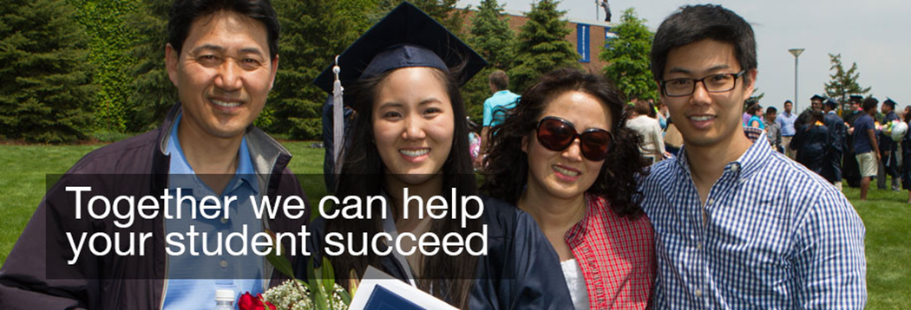
Parent and Family Information
Having a student transition to a university setting can be challenging for all families. We recognize the importance of making your student feel comfortable in the college environment. The following website connects parents and families to information that will be beneficial during this transition:
http://goforward.harpercollege.edu/start/parent/index.php

Slide 22
We look forward to meeting you!
Thank you for participating in this orientation!
We hope we have provided you with information to help you feel comfortable and excited about coming to Harper College.
If you have any questions or concerns, please contact:
Jill Izumikawa
jizumika@harpercollege.edu
phone: +1(847)925-6756
www.harpercollege.edu

