Slide 1
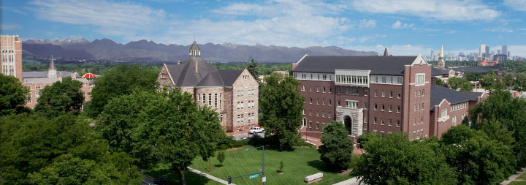
Unsettling Times:
Higher Education in an Era of Change
Dr. Jim Griesemer, Professor and Dean Emeritus
Chair, DU Strategic Issues Panel on Higher Education

Slide 2






University of Denver
Strategic Issues Program

Slide 3


University of Denver
Strategic Issues Process

Slide 4




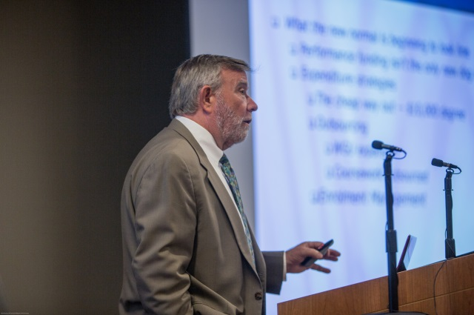


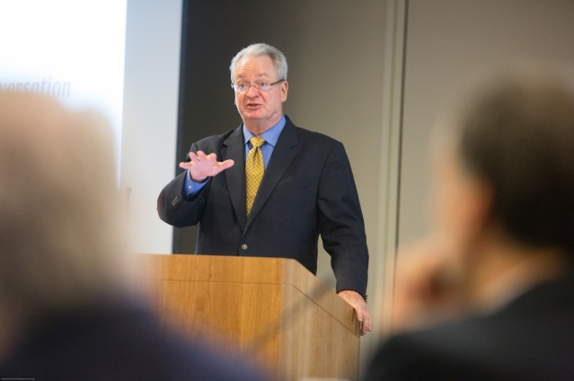

Presentations, Reading, Research

Slide 5
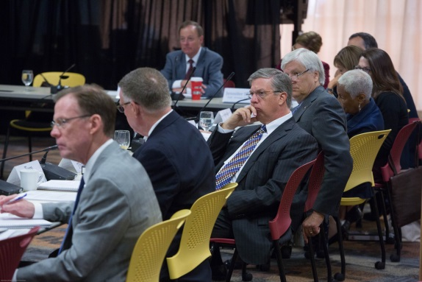


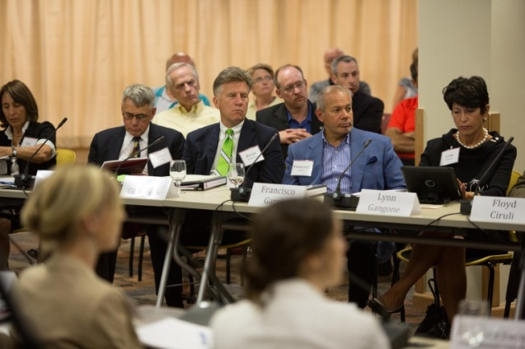




Listening, Learning, Notes

Slide 6
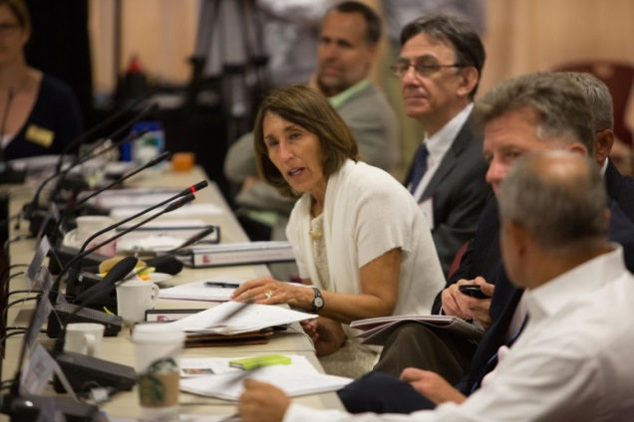


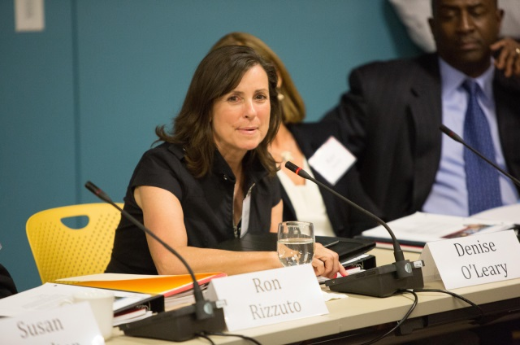


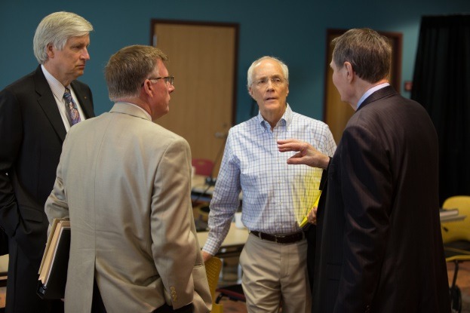

Then…Discussion

Slide 7
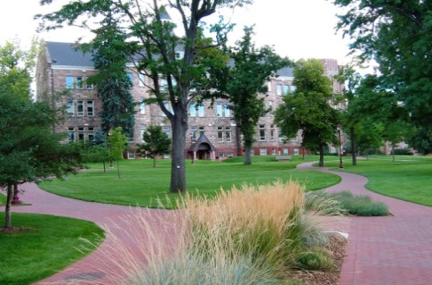
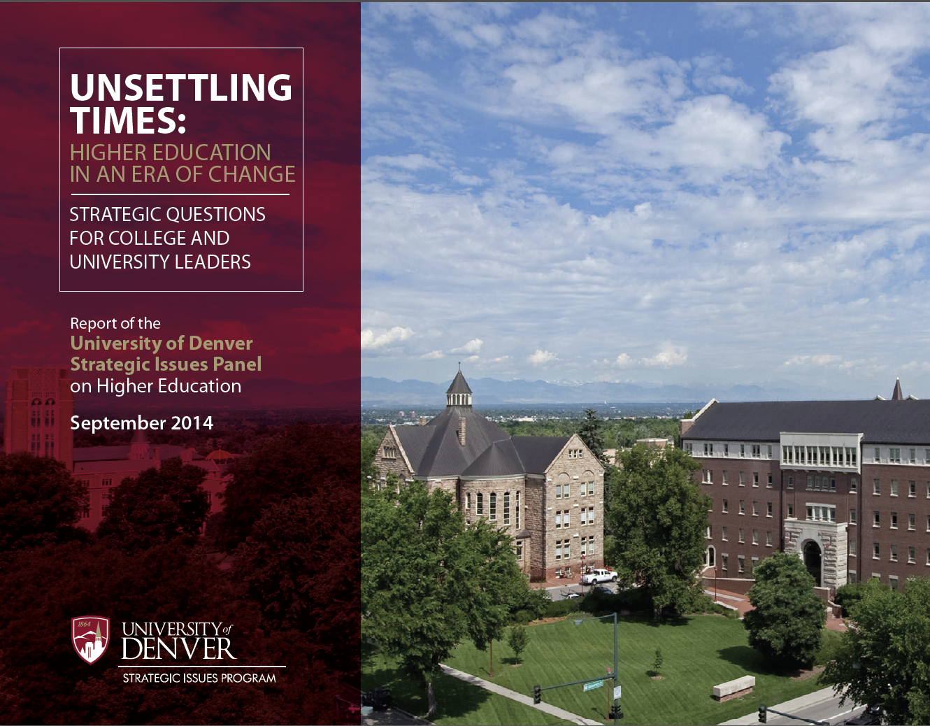
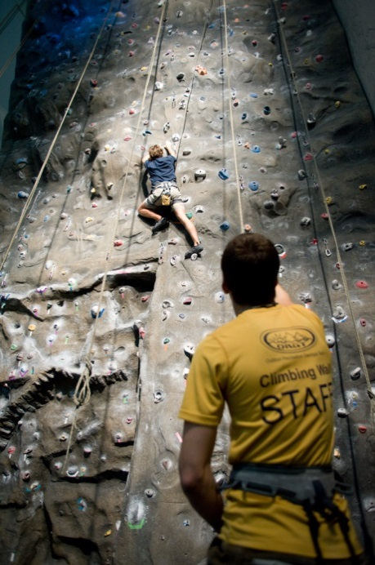
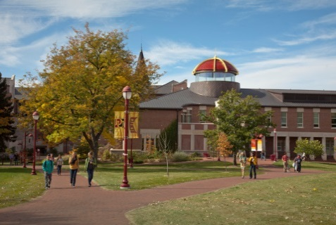
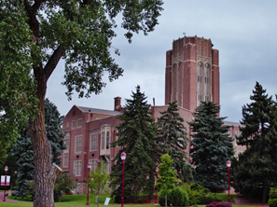
A Perception of Permanence...
A Growing Sense of Unease…
Unsettling Times…
7

Slide 8
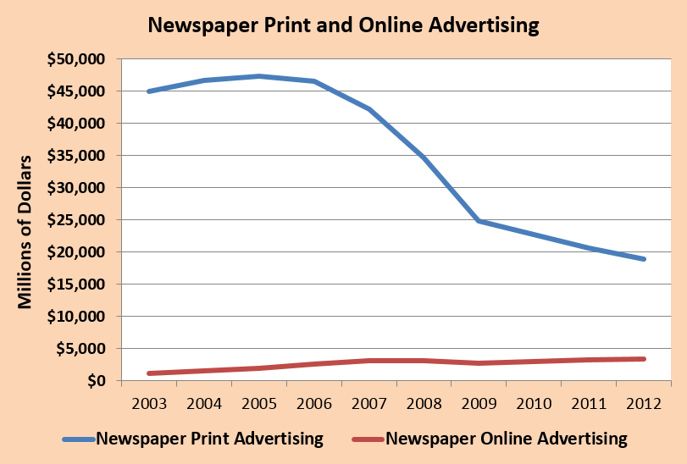
The Print Media
Printing press invented about 1450, first newspapers appeared 400 years ago, in widespread use by 1750
Then came the internet
Shattering Change
Closures, layoffs
  Rocky Mt. News
  closed after 150
  Cincinnati Post
  Tucson Citizen
Transformations
  Seattle Post-Intelligencer
Sales
  Wall St Journal
  Washington Post

Slide 9
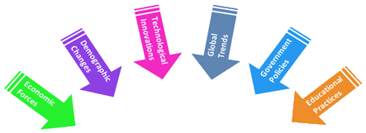


The Environment of Higher Education
Knowledge
Society
Financial
Stress
Increasing
Costs
Increased
Expenses
Demographic
Shifts
COLLEGE
UNIVERSITY
INDEPENDENT
Environmental Conditions
Enrollment
Pressures
Declining
Affordability
Increased
Competition
Information
Availability
Disruptive
Innovation

Slide 10



Knowledge Society

Slide 11

Rising Costs...
Declining Affordability
  Higher ed. costs have grown 30% faster than health care (WSJ, 2014)
  What does that mean for the higher education marketplace?

Slide 12
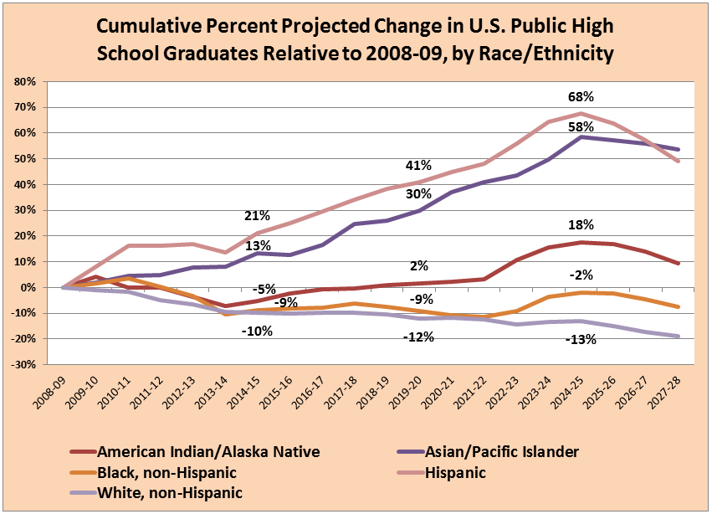
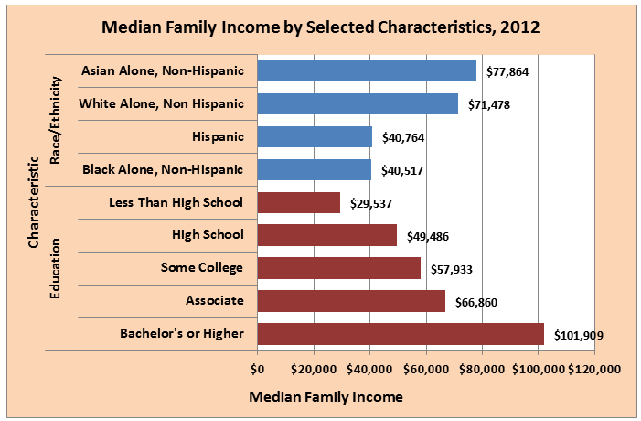
Demographics, Income and Markets
Implications for markets: Declining traditional cohorts…
while growing market segments struggle with rising prices…
even as knowledge society rewards postsecondary education
So how have American families dealt with rising costs?

Slide 13
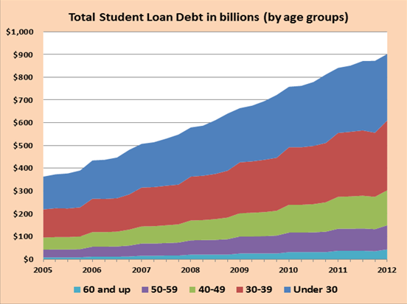
Student Debt
  Student debt now exceeds all other forms except mortgages…
  Not surprising…reflects economics a scarce, valuable resource
  But what if supply of knowledge increased? And became cheap?

Slide 14
Information Availability
Commodification of information
Information is now a global commodity
“Big Data” – pure information product
From cyberspace to the real world
Detailed information on academic topics
Information no longer a private treasure
So…what do you do when:
The limited and valuable knowledge…
for which you’ve been charging high prices…
is taking on the characteristics of a commodity…
that is now widely available…at little or no cost?

Slide 15
Drivers of Disruptive Innovation
Innovative technology
  Power of computing + reach of the internet
  + mobile devices + capabilities of advanced software
  = potential for severe disruption
  Online courses, online degrees
    Georgia Tech Master’s in Computer Science $7,000
How do we respond to inexpensive online courses and degrees offered by top universities?
What’s the strategy in a world where every student can hear lectures from outstanding professors at little or no cost?
Innovative practices
  Competency-based education
    Disruptive capability equal to technology

Slide 16
The Changing Environment
Challenges of a
changing environment
  Knowledge society
  Increasing costs
  Shifting demographics
  Declining affordability
  Information ubiquity
  Academic practices
  Disruptive innovation
  Increased competition
  Enrollment challenges
  Financial pressures

Slide 17
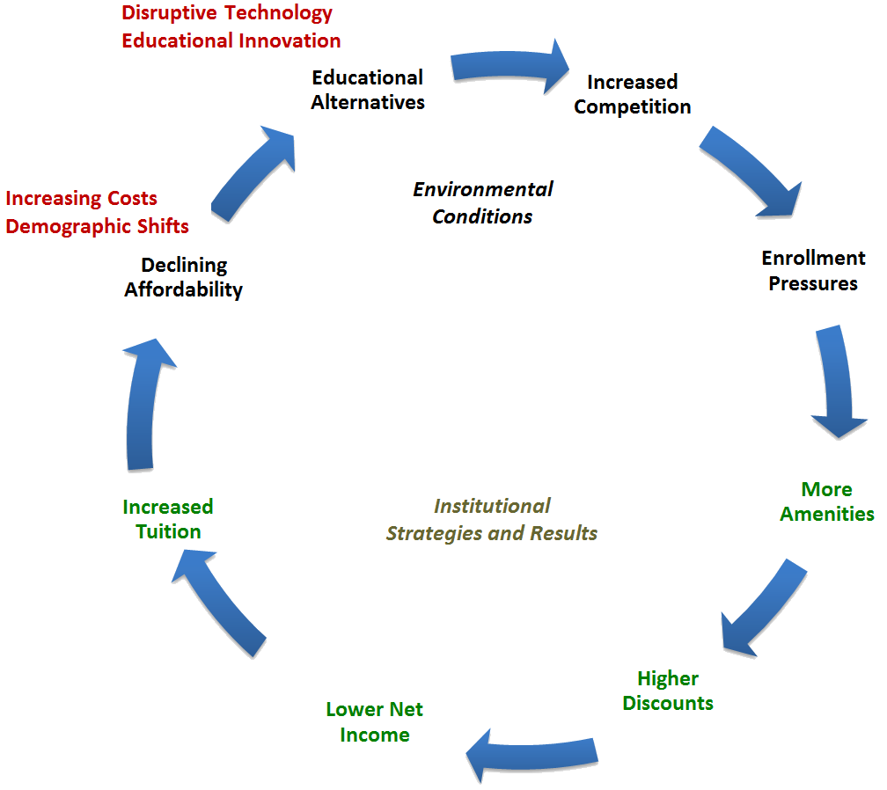
The Changing Environment
Financially-based Strategy
Growing
Markets
Challenges of a
changing environment
  Knowledge society
  Increasing costs
  Shifting demographics
  Declining affordability
  Information ubiquity
  Academic practices
  Disruptive innovation
  Increased competition
  Enrollment challenges
  Financial pressures
Is this strategy
sustainable?

Slide 18
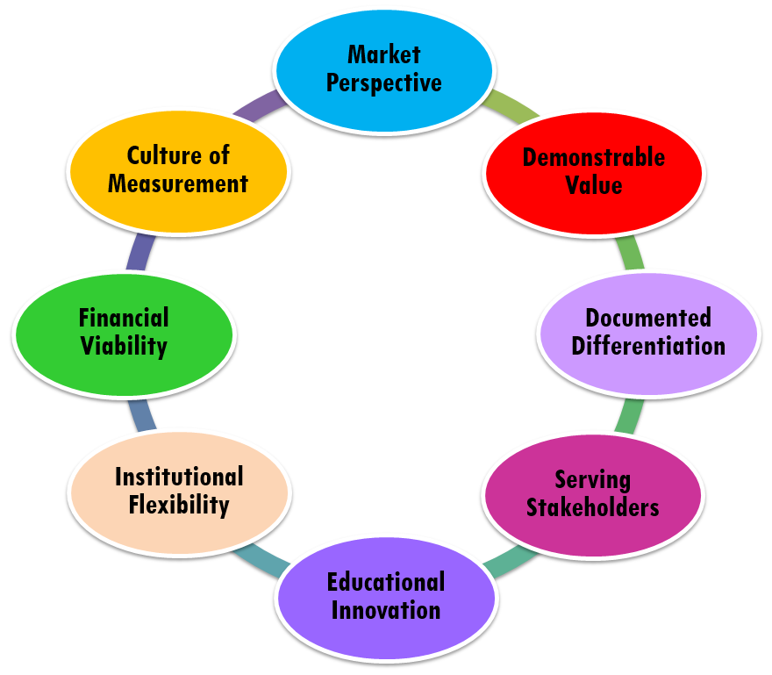
The Changing Environment
Value-based Strategy
Direction
of Strategy
Challenges of a
changing environment
  Knowledge society
  Increasing costs
  Shifting demographics
  Declining affordability
  Information ubiquity
  Academic practices
  Disruptive innovation
  Increased competition
  Enrollment challenges
  Financial pressures
Implementation
of Strategy
Focus on
those served/
customers
Focus on
capability/
culture, etc.

Slide 19
Elements of a
Value-based Strategy
STRATEGY

Slide 20
Questions related to
Internal Strategic Elements
Implementation of strategy
  Organizational Capability/Culture/Resources
Measurement
  Do we have a culture of measurement?
  Are our measures strategic?
  Do we share progress with colleagues in the community?
  Can we fund opportunities?
  Is financial strength an organizational priority?
  Will be share financial information across the community?
Financial
Flexibility
  Can we respond to opportunities?
  Do we have the capability to grasp a particular opportunity?
  Are our structure, rules and procedures supple?
  Can we create to opportunities?
  Do we encourage a climate of innovation?
  Do we have a process for assessing risk?
Innovation

Slide 21
Questions related to Markets
External Strategic Elements
Direction of strategy
  Those to be served: customers/stakeholders
Markets
  Where shall we be active?
  What do our target markets need that we have the
  capability to provide?
  Within each selected market, whom shall we serve?
  What vehicles shall we use to provide service?
  _______________________________________________________________________________________________
  What is the staging of market entry?
  Have we identified markets in which we choose not to compete?
  Do our institution’s administrators, faculty and staff share a market orientation?

Slide 22
Questions related to Value:
External Strategic Elements
Direction of strategy
  Those to be served: customers/stakeholders
Value
  Does our institution and each of its units
  treat value creation as a matter of the highest priority?
  Where is our locus of value in each market?
  How do we demonstrate the value our programs create?
  _______________________________________________________________________________________________
  Has our institution and each academic unit established clear and demonstrable value propositions on which to compete?
  Does our institution consistently verify the value created by every academic program?
  Do we implement a policy of revitalizing or terminating programs failing to demonstrate high levels of value over time?

Slide 23
Questions related to Differentiation:
External Strategic Elements
Direction of strategy
  Those to be served: customers/stakeholders
Differentiation
  How are we distinctive?
  How is our differentiation validated to stakeholders?
  Does the institution and each of its units treat differentiation, along with value creation, as matters of high priority?
  _______________________________________________________________________________________________
  Does our institution have a thematic constant in terms of differentiation that is reflected or interpreted through units?
  How do we achieve strategic vertical and horizontal alignment throughout the organization?

Slide 24
Questions related to Stakeholders:
External Strategic Elements
Direction of strategy
  Those to be served: customers/stakeholders
Stakeholders
  Has the institution and each of its units
  identified its external and internal stakeholders?
  Are our internal conversations focused on creating benefit for external stakeholders?
  Have we prioritized our stakeholders?
  Are we clear on the stakeholders for whom is value first maximized?

Slide 25

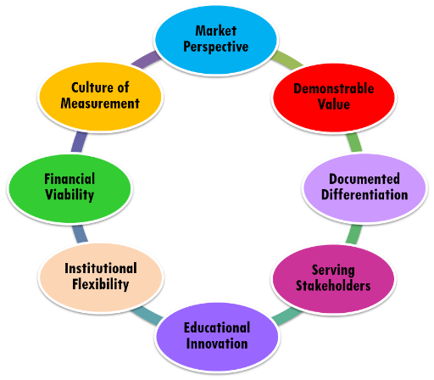
Knowledge
Society
Financial
Stress
Increasing
Costs
Increased
Expenses
Demographic
Shifts
Enrollment
Pressures
Declining
Affordability
Increased
Competition
Information
Availability
Disruptive
Innovation

