Slide 1
Harper College Strategic Planning Conference
Aligning Workforce
and
Community Needs
Presented by
Karin M. Norington-Reaves, CEO

Slide 2
About The Partnership
The successor agency to the Chicago Workforce Investment Council (CWIC) – the City’s workforce policy and strategy-making organization.
Replaces the three administrative agencies that oversaw federal workforce development funds and programs throughout Cook County and the City of Chicago.
Chicago Department of Family & Support Services (DFSS)
Cook County Works (CCW)
Workforce Board of Northern Cook County
2nd largest LWIA in the nation.
Serves 140,000 annually through 10 workforce centers, 8 satellites, 4 sector centers and a business intermediary

Slide 3
Vision & Mission
Vision
Every person has the opportunity to build a career; every business has the talent to grow and compete in a global economy.
Mission
To create, promote, and effectively manage a network of workforce development organizations that:
Designs innovative solutions to address business needs, and,
Prepares individuals for, and connects them to, career opportunities

Slide 4
People are laid-off every month (Source: Shierholz)
1MILLION+

Slide 5
Americans employed in temporary jobs in 2013- an increase of 28% since 2010 (Source: EMSI)
3MILLION

Slide 6
Who do we serve?

Slide 7
ADULTS
Disabled
Long-Term
Unemployed
Dislocated Workers
Ex-offenders
Opportunity
Youth
Veterans

Slide 8
American families have someone working but earning wages below the poverty line:
$11,702 a year for an individual or $23,021 for a family of four.
46.2 MILLION

Slide 9
Young Adults

Slide 10
Number of U.S. young adults 15-24 neither working nor in school (Source: OECD, The Economist)
6.1MILLION

Slide 11
Unemployment rate for youth 16-24 Nearly double the national average (Source: Young Invincibles)
15%

Slide 12
200,000
Number of
Opportunity Youth
In Chicagoland

Slide 13
Earnings loss among Americans aged 20-24 over the next ten years (Source: Young Invincibles)
$21.4BILLION

Slide 14
Amount of time millennials have experienced double digit unemployment (Source: Young Invincibles)
7years

Slide 15
2 years
Average length of tenure for a Millenial

Slide 16
Long-Term Unemployed

Slide 17
of those categorized as long-term unemployed were employed 15 months later (Source: Krueger/Cramer/Cho)
34%

Slide 18
of long-term unemployed in any given month returned to full-time/steady work a year later (Source: Krueger/Cramer/Cho)
11%

Slide 19
What do employers want?

Slide 20
of employers report that college graduates are NOT adequately prepared for work (Source: Innovate + Educate)
58%

Slide 21
Judgment/decision-making
Most In-Demand Competencies by 2020
4
Communication
Analysis
Administration
(Source: McKinsey Global)

Slide 23
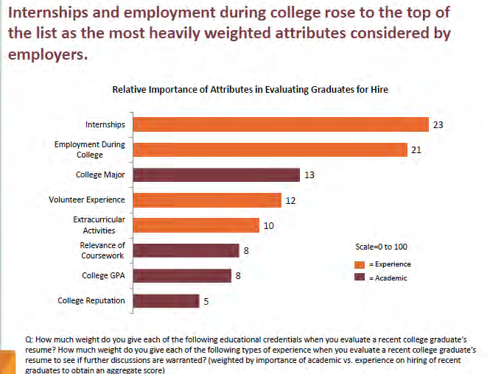

Slide 24
Americans who gained skills through employer-sponsored job training in the past 5 years. (Source: Accenture)
21.4%
↓

Slide 25
% of college grads who are unemployed or underemployed (Source: Innovate + Educate)
53%

Slide 26
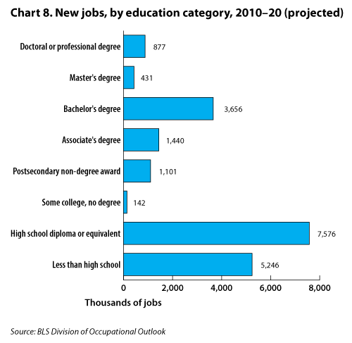

Slide 27
7 Target Industries*
Business and Professional Services
(6 occupations)
Healthcare
(14 occupations)
Hospitality, Culinary, and Retail
(4 occupations)
Information Technology
(5 occupations)
Manufacturing
(5 occupations)
Transportation, Distribution, and Logistics
(7 occupations)
* The Partnership has 7 target industries, but for discussions purposes, we have combined hospitality/culinary and retail in order to group similar occupations together.

Slide 28
Labor Market Information
Career Pathways
Target Occupational Profiles
Where Are the Jobs? reports

Slide 29
What will it take to prepare the future workforce?

Slide 30
Career Coaching
Assess strengths & needs
Develop employment plan
Determine eligibility for multiple programs
Explore career pathways

Slide 31
Employer Services
Manage employer leads & contacts
Identify & refer qualified candidates
Support both employer and participant
Identify and manage paid work experience opportunities

Slide 32
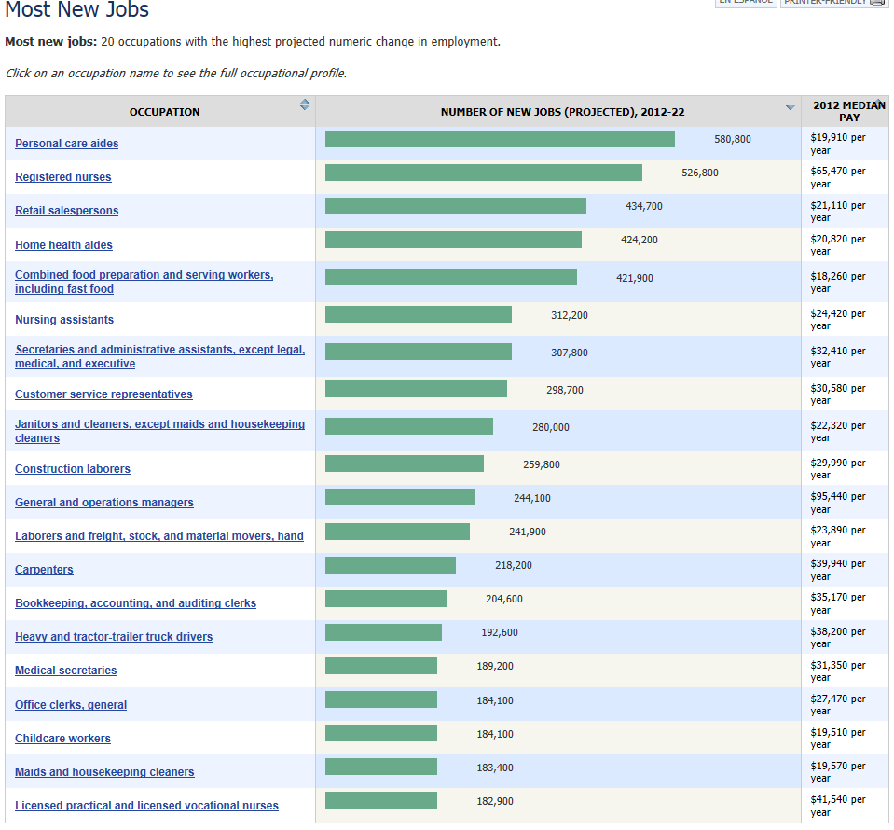

Slide 33
Jobs requiring postsecondary education or training beyond high school by 2020 (Source: Georgetown University Center on Educations & the Workforce)
65%

Slide 34
Hope?

Slide 35
# of today’s grade-school children who will work at jobs that haven’t been invented yet (Source: Fast Company)
65%

Slide 36
Number of job openings in the economy through 2020 (Source: Georgetown University Center on Education & the Workforce)
55MILLION

