Slide 1

A CELEBRATION OF HARPER ATHLETICS

Slide 2
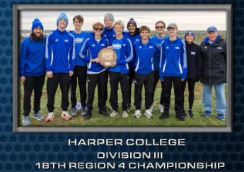
Men’s Cross Country
Record-Setting Season

Slide 3
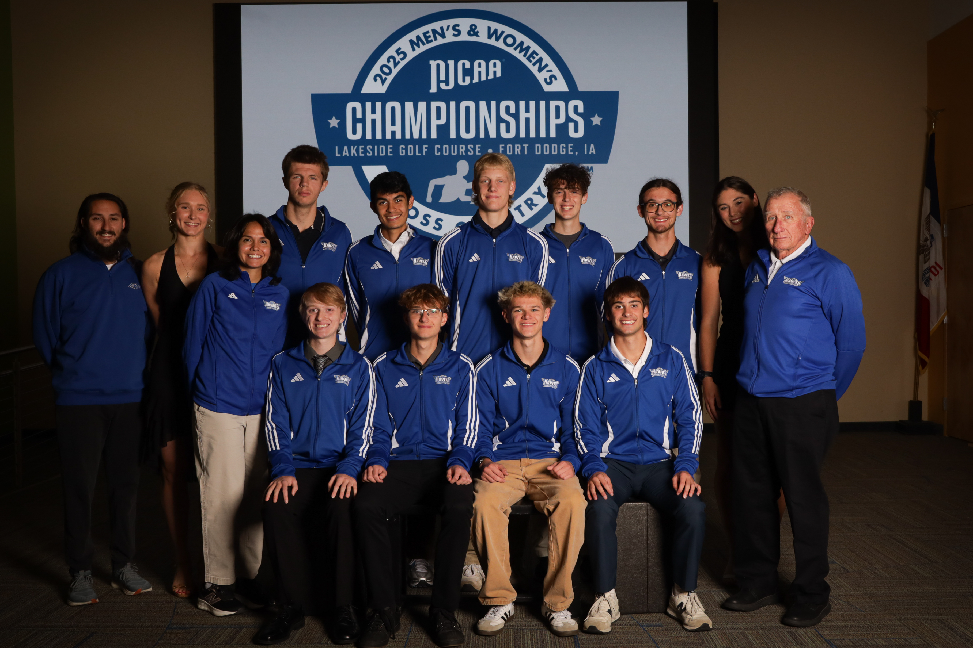
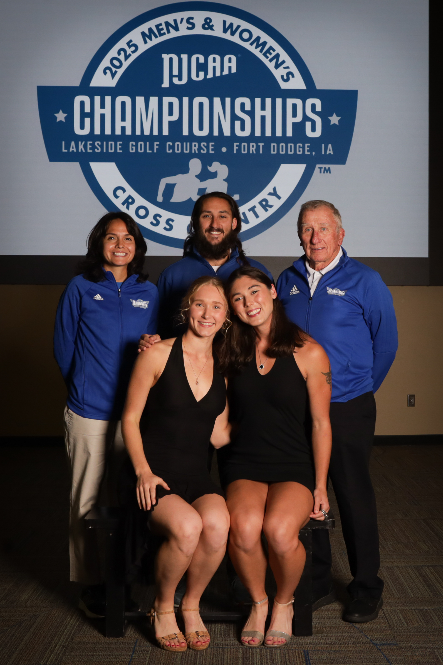
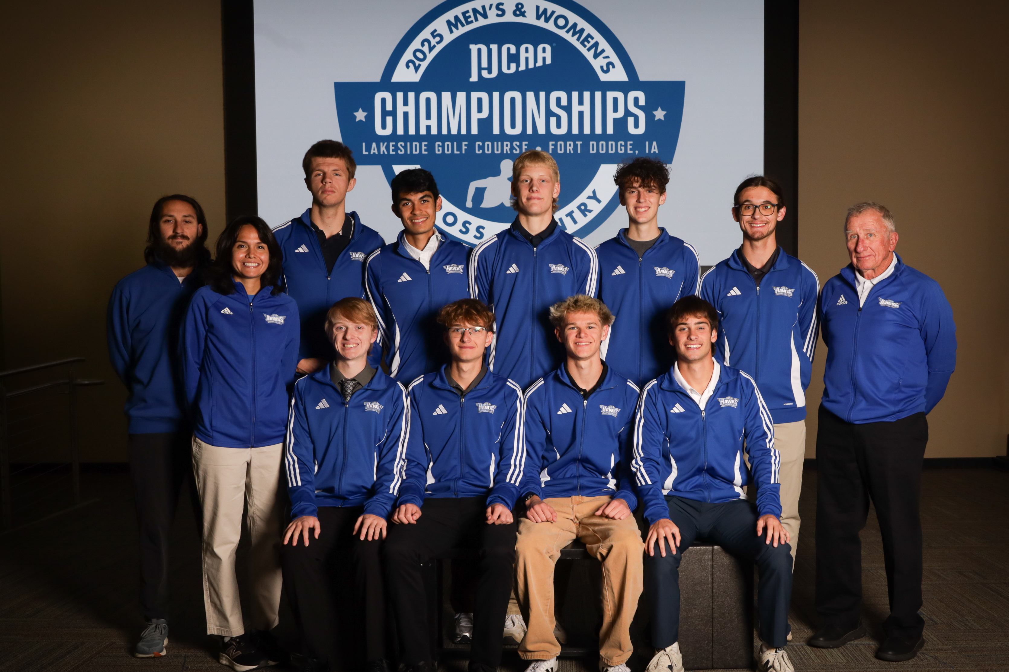
2025 Men’s & Women’s Cross Country NJCAA Championships
HARPER HAWKS
NATIONAL CHAMPS
ALL - AMERICANS

Slide 4
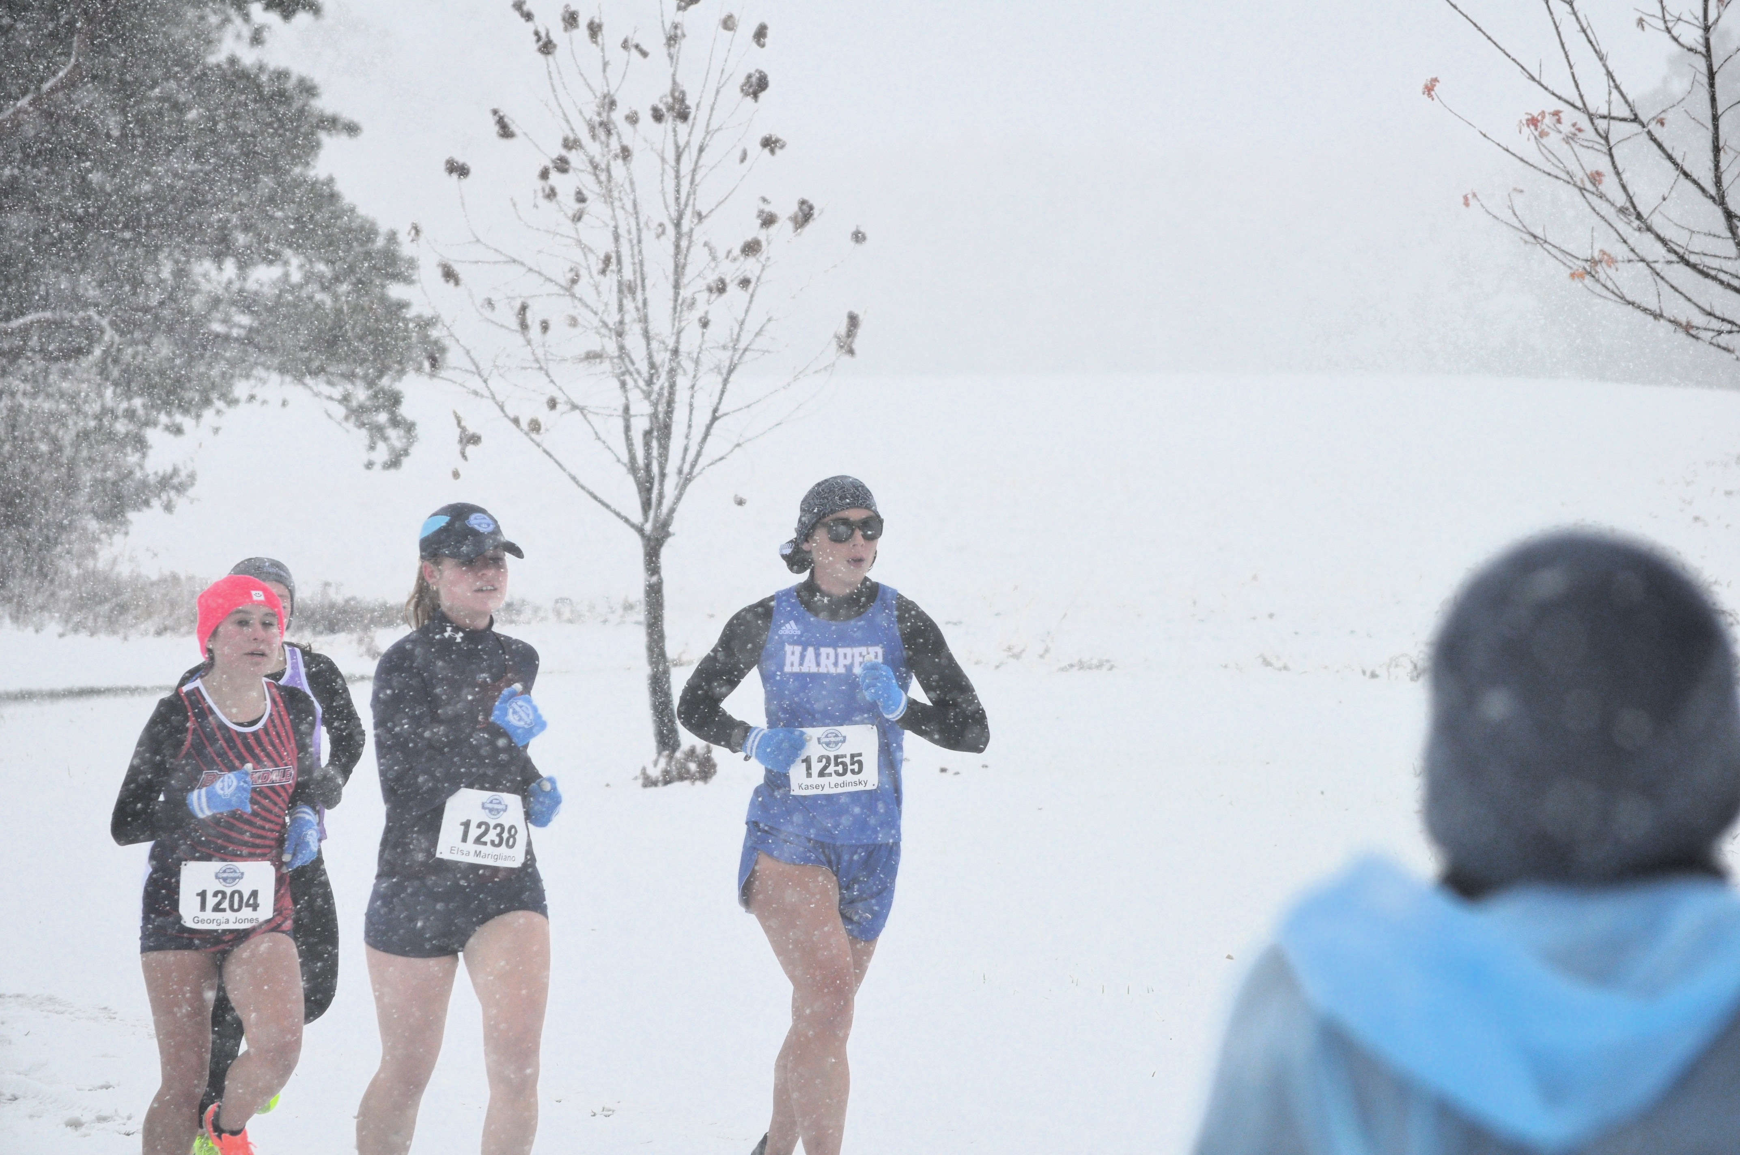
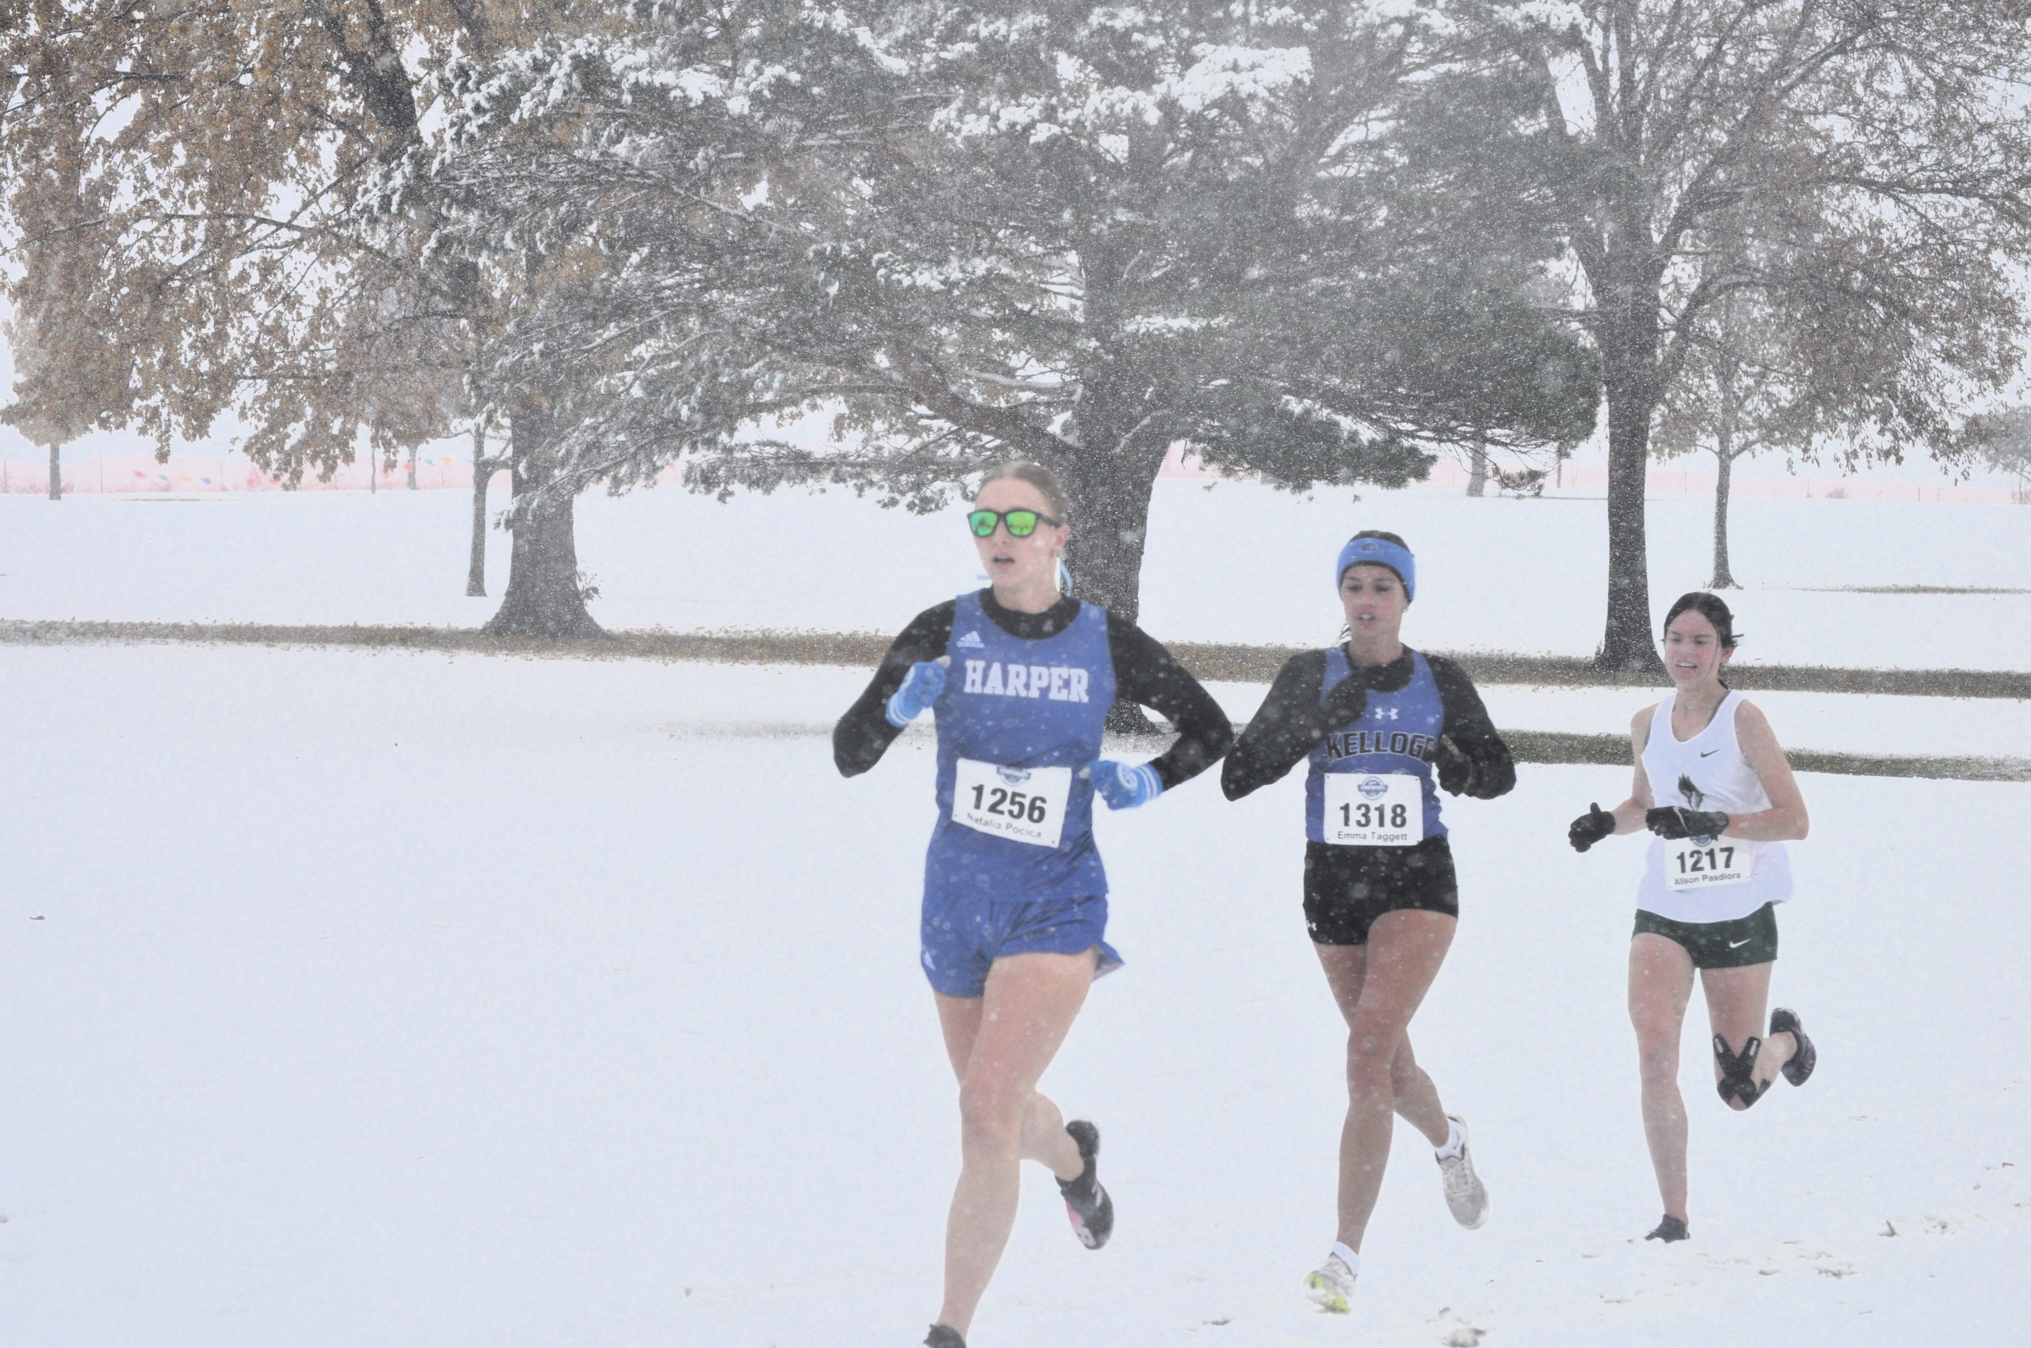
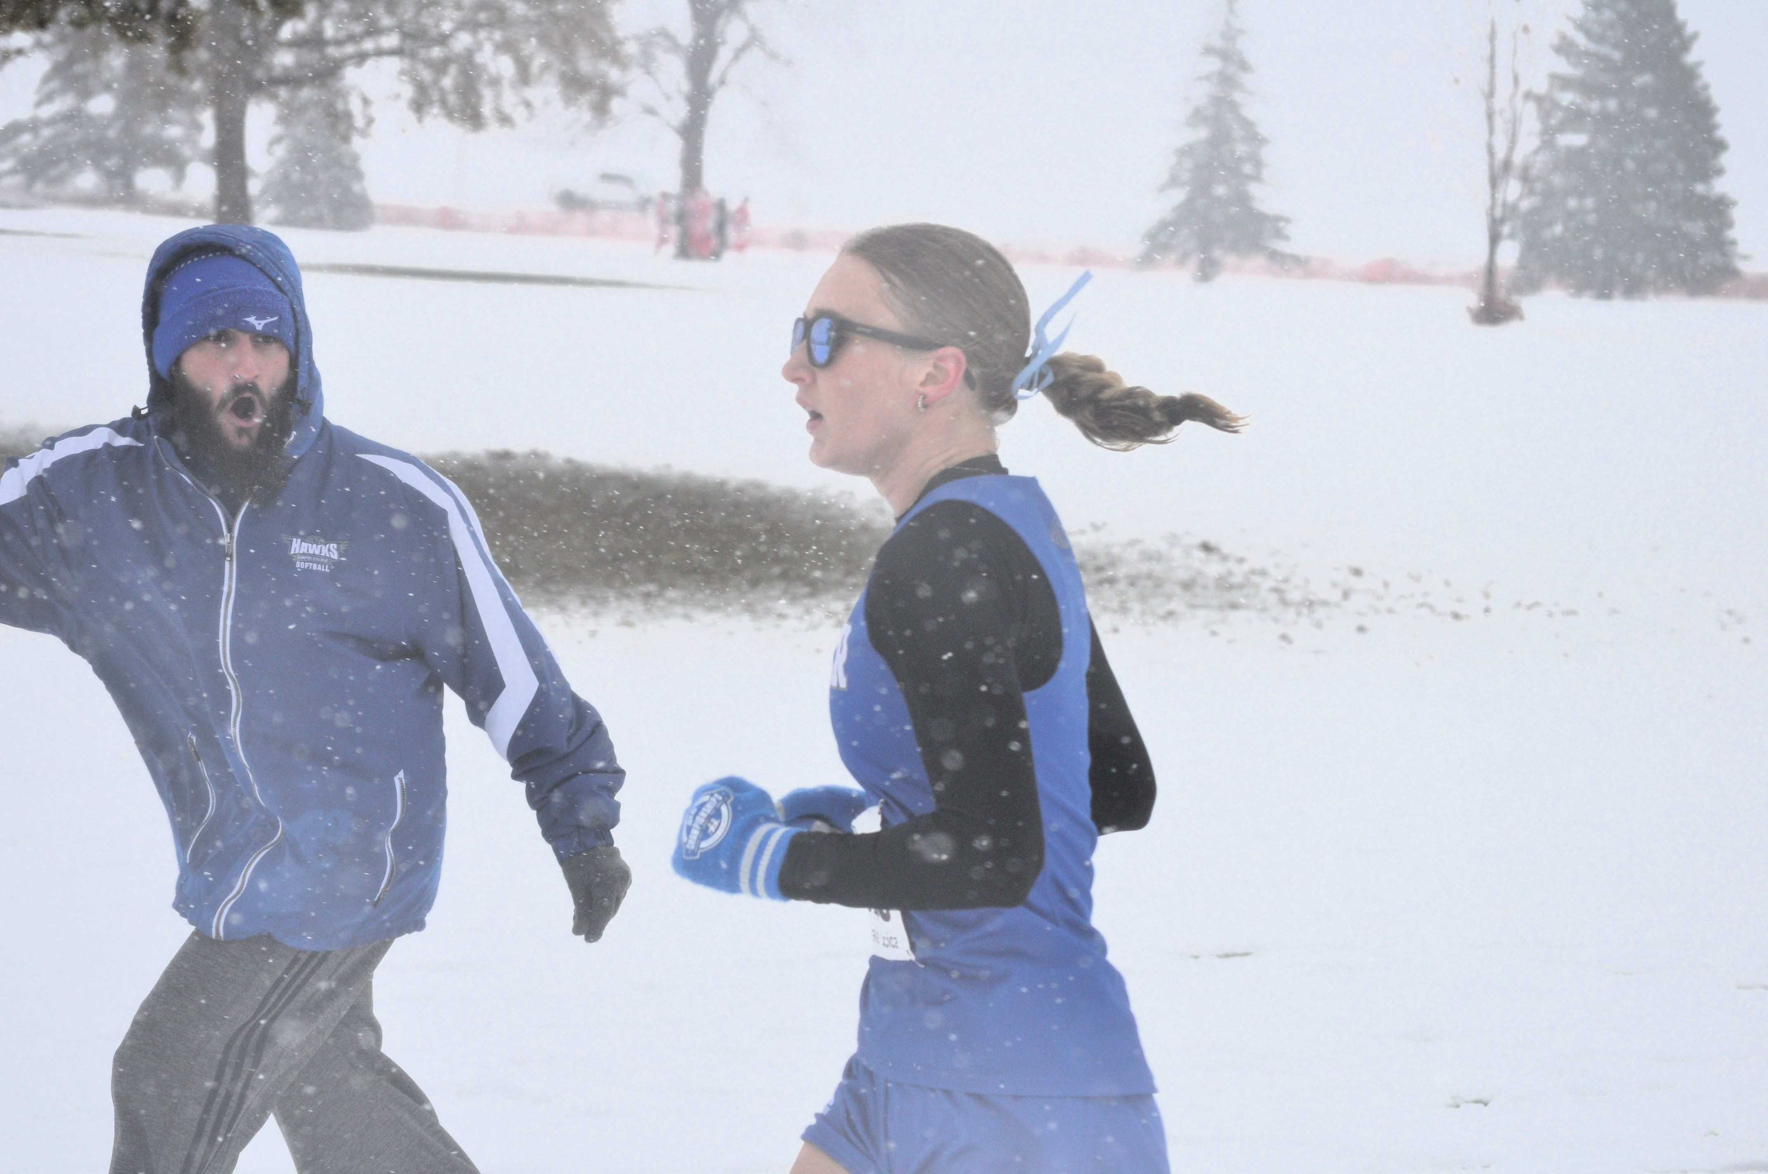
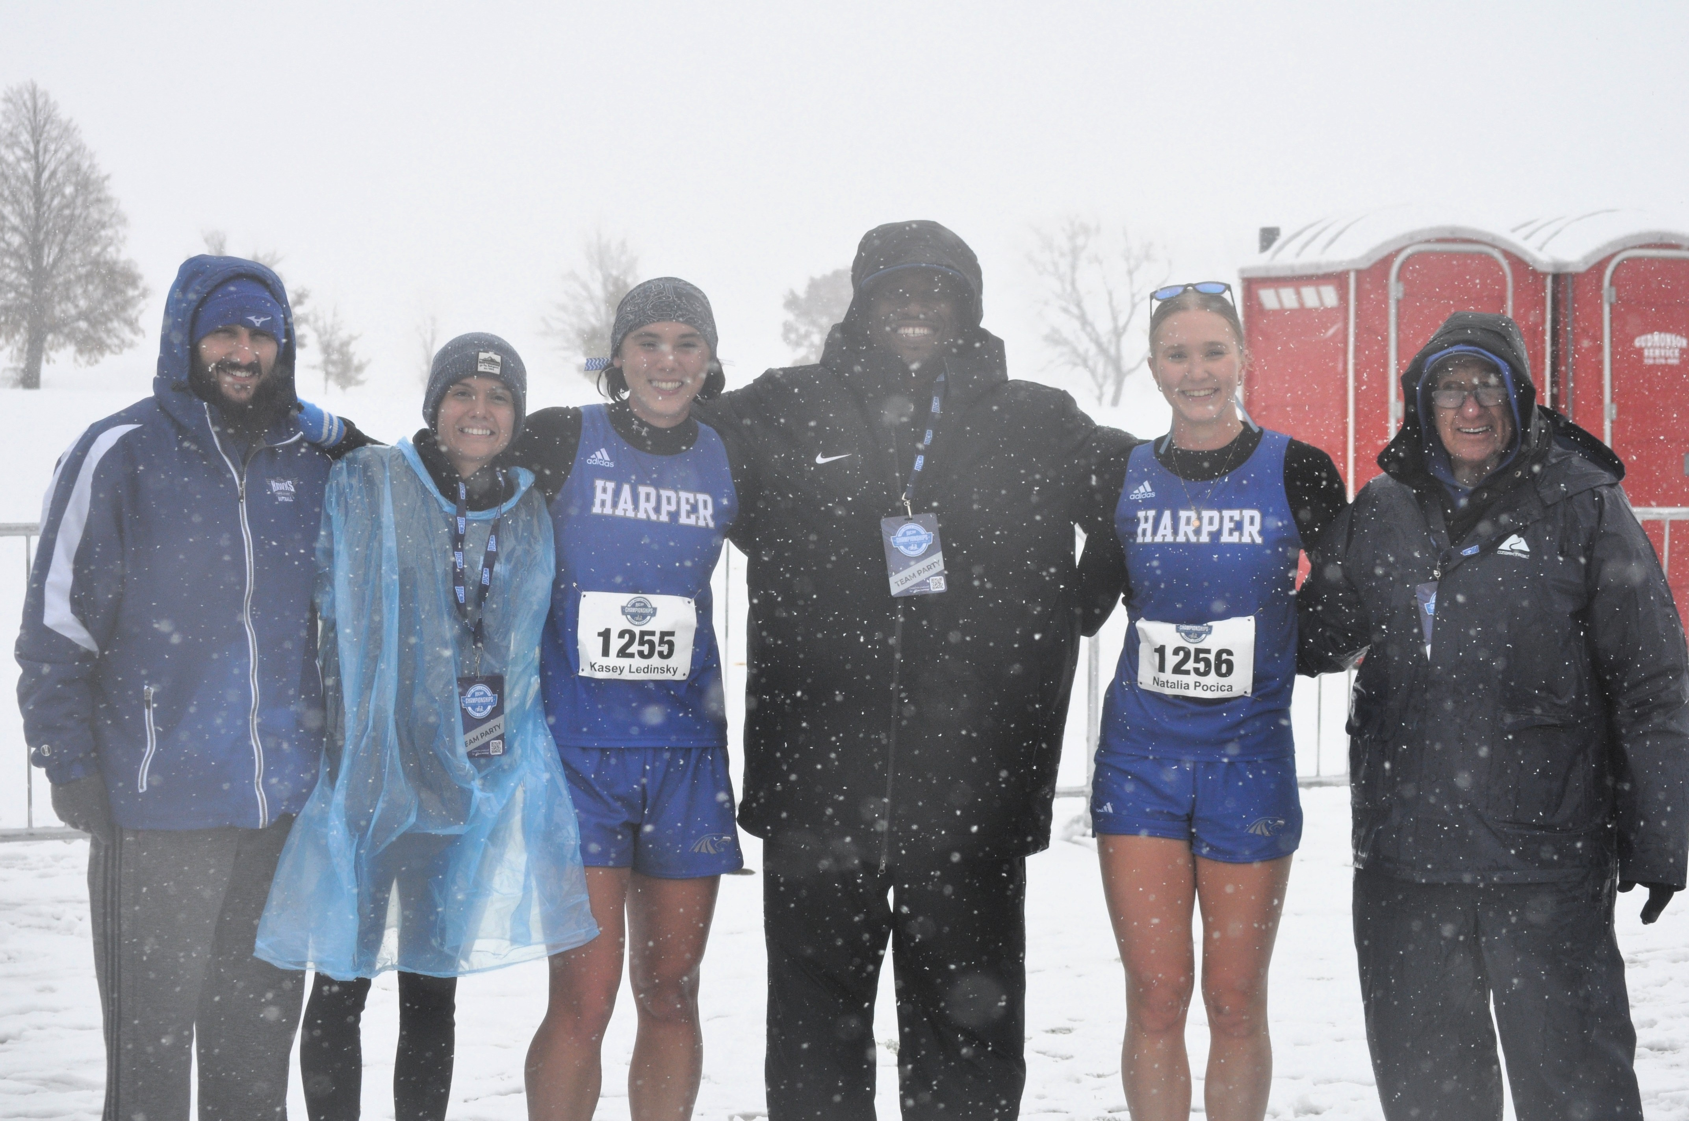
Harper College Women XC SOAR!
Kasey Ledinsky
Natalia Pocica
NJCAA All-Americans
2025
Fort Dodge, IA | November 8, 2025

Slide 5
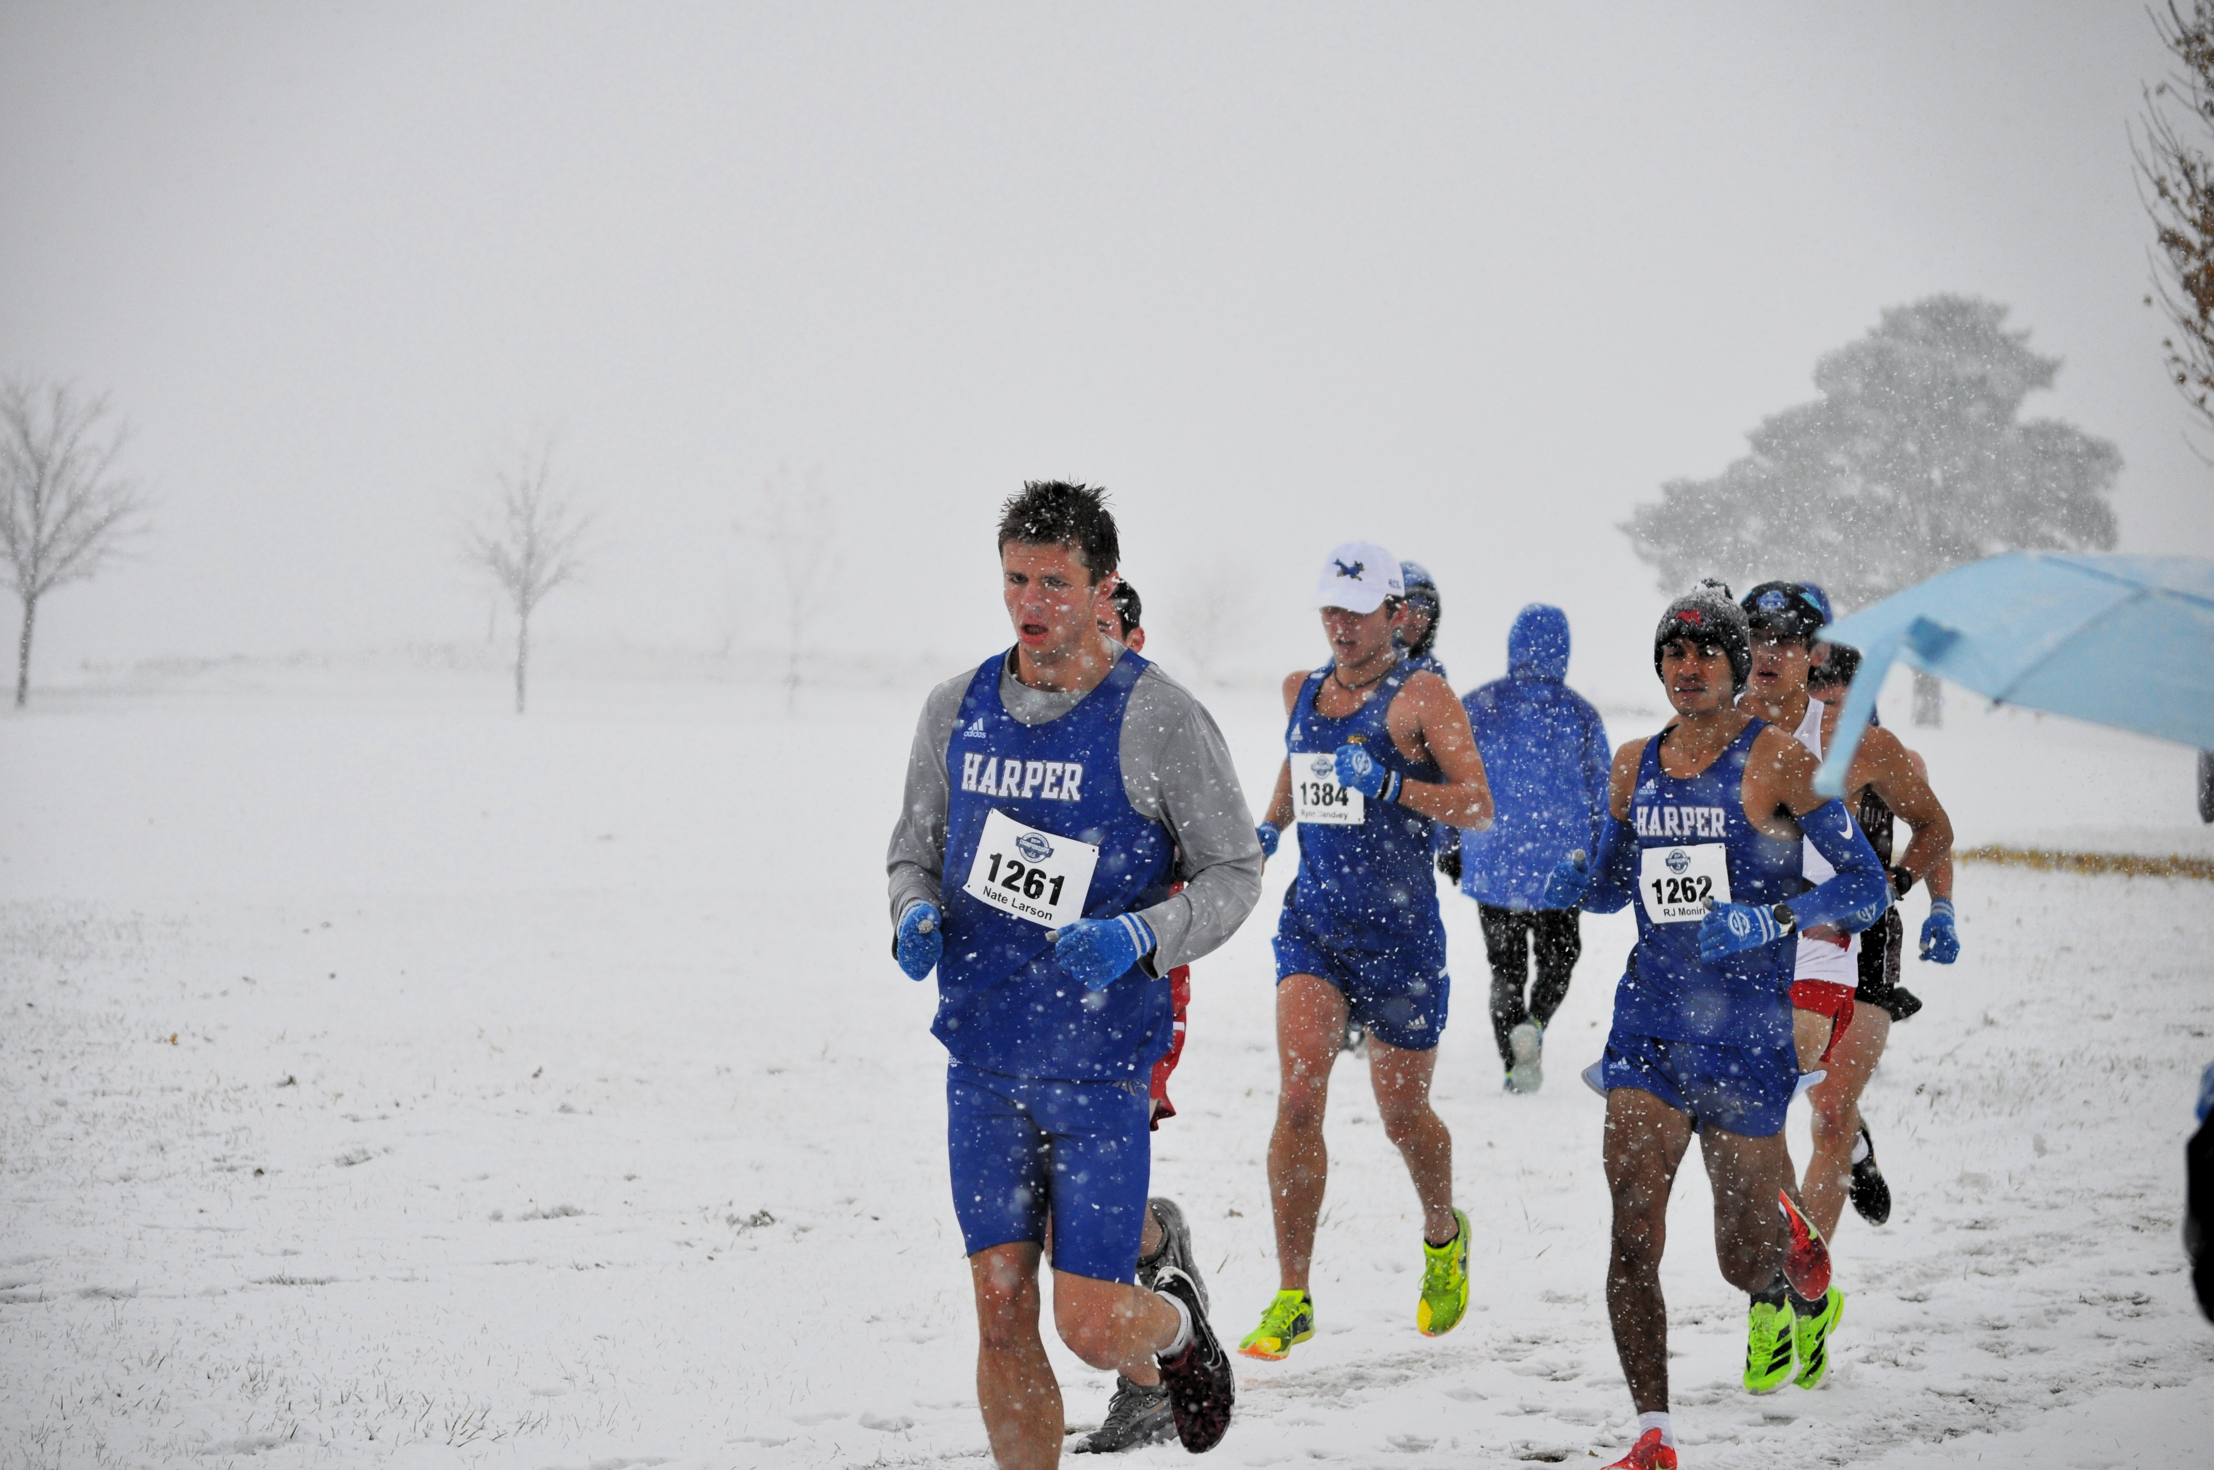
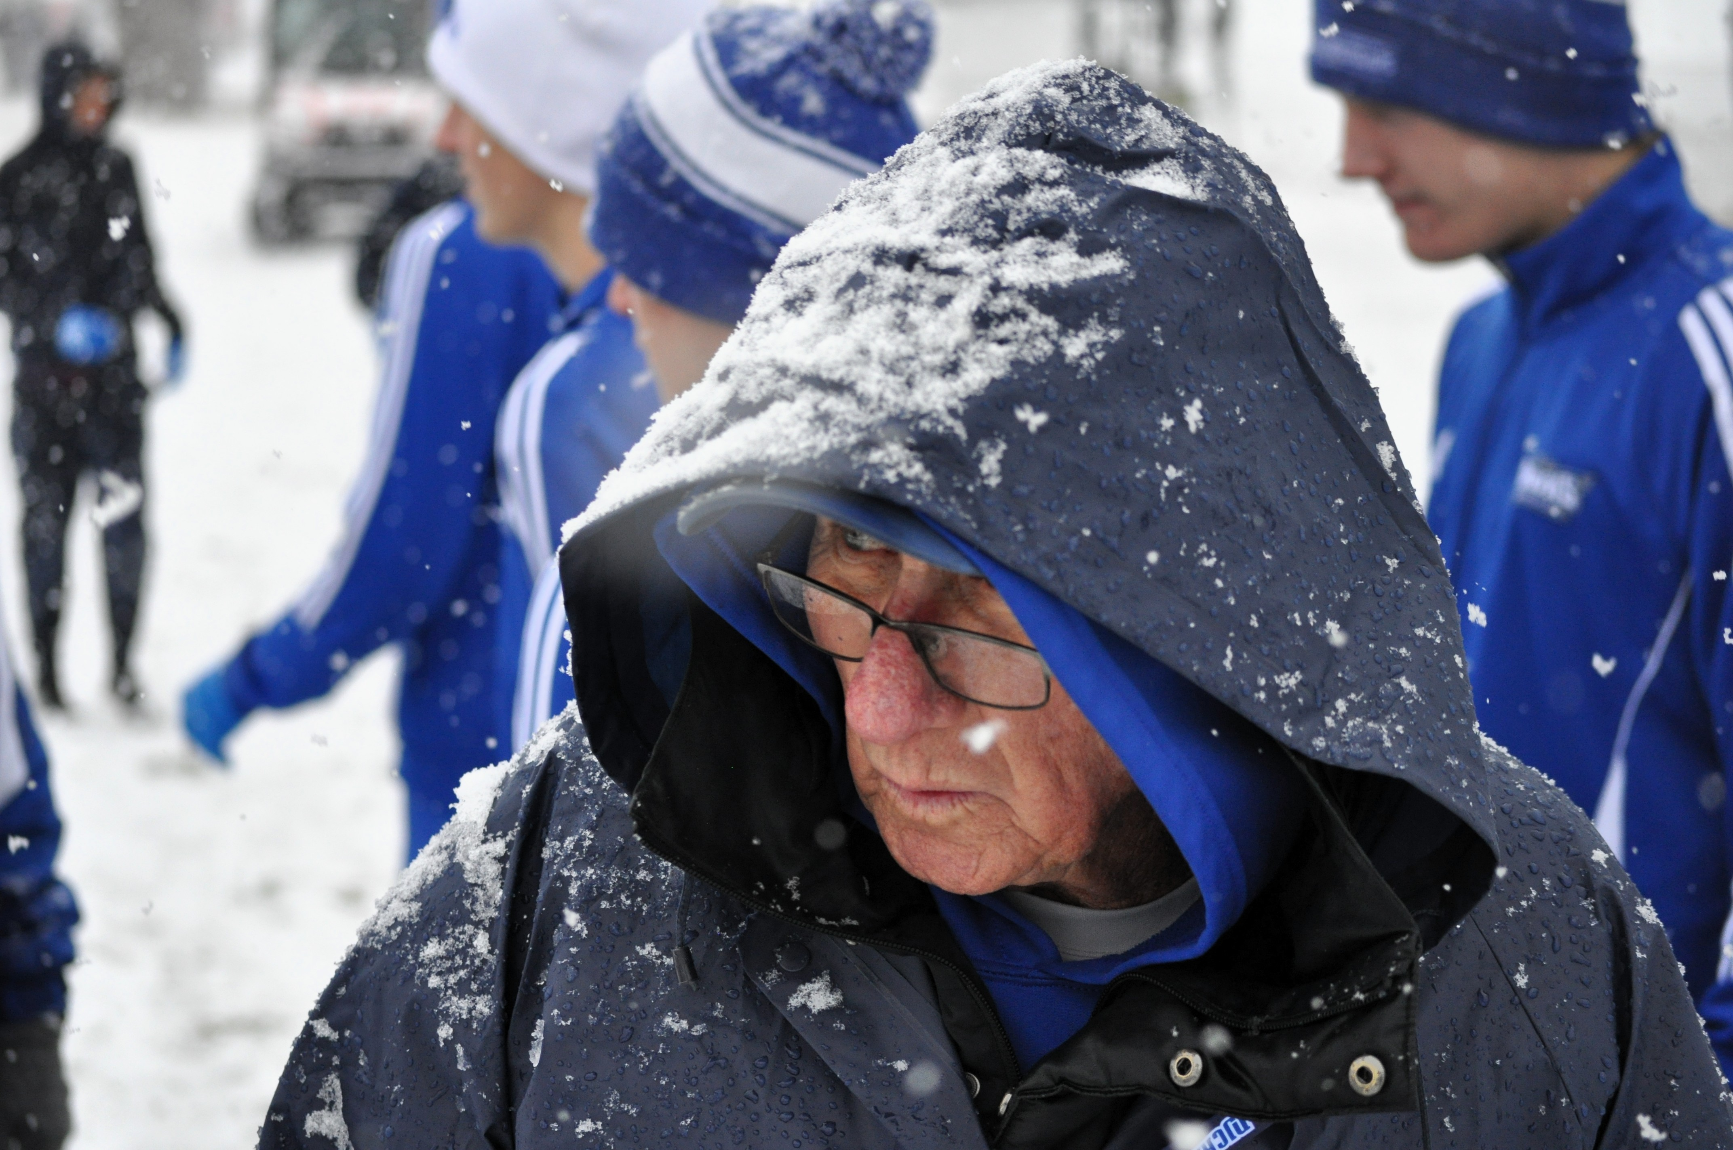
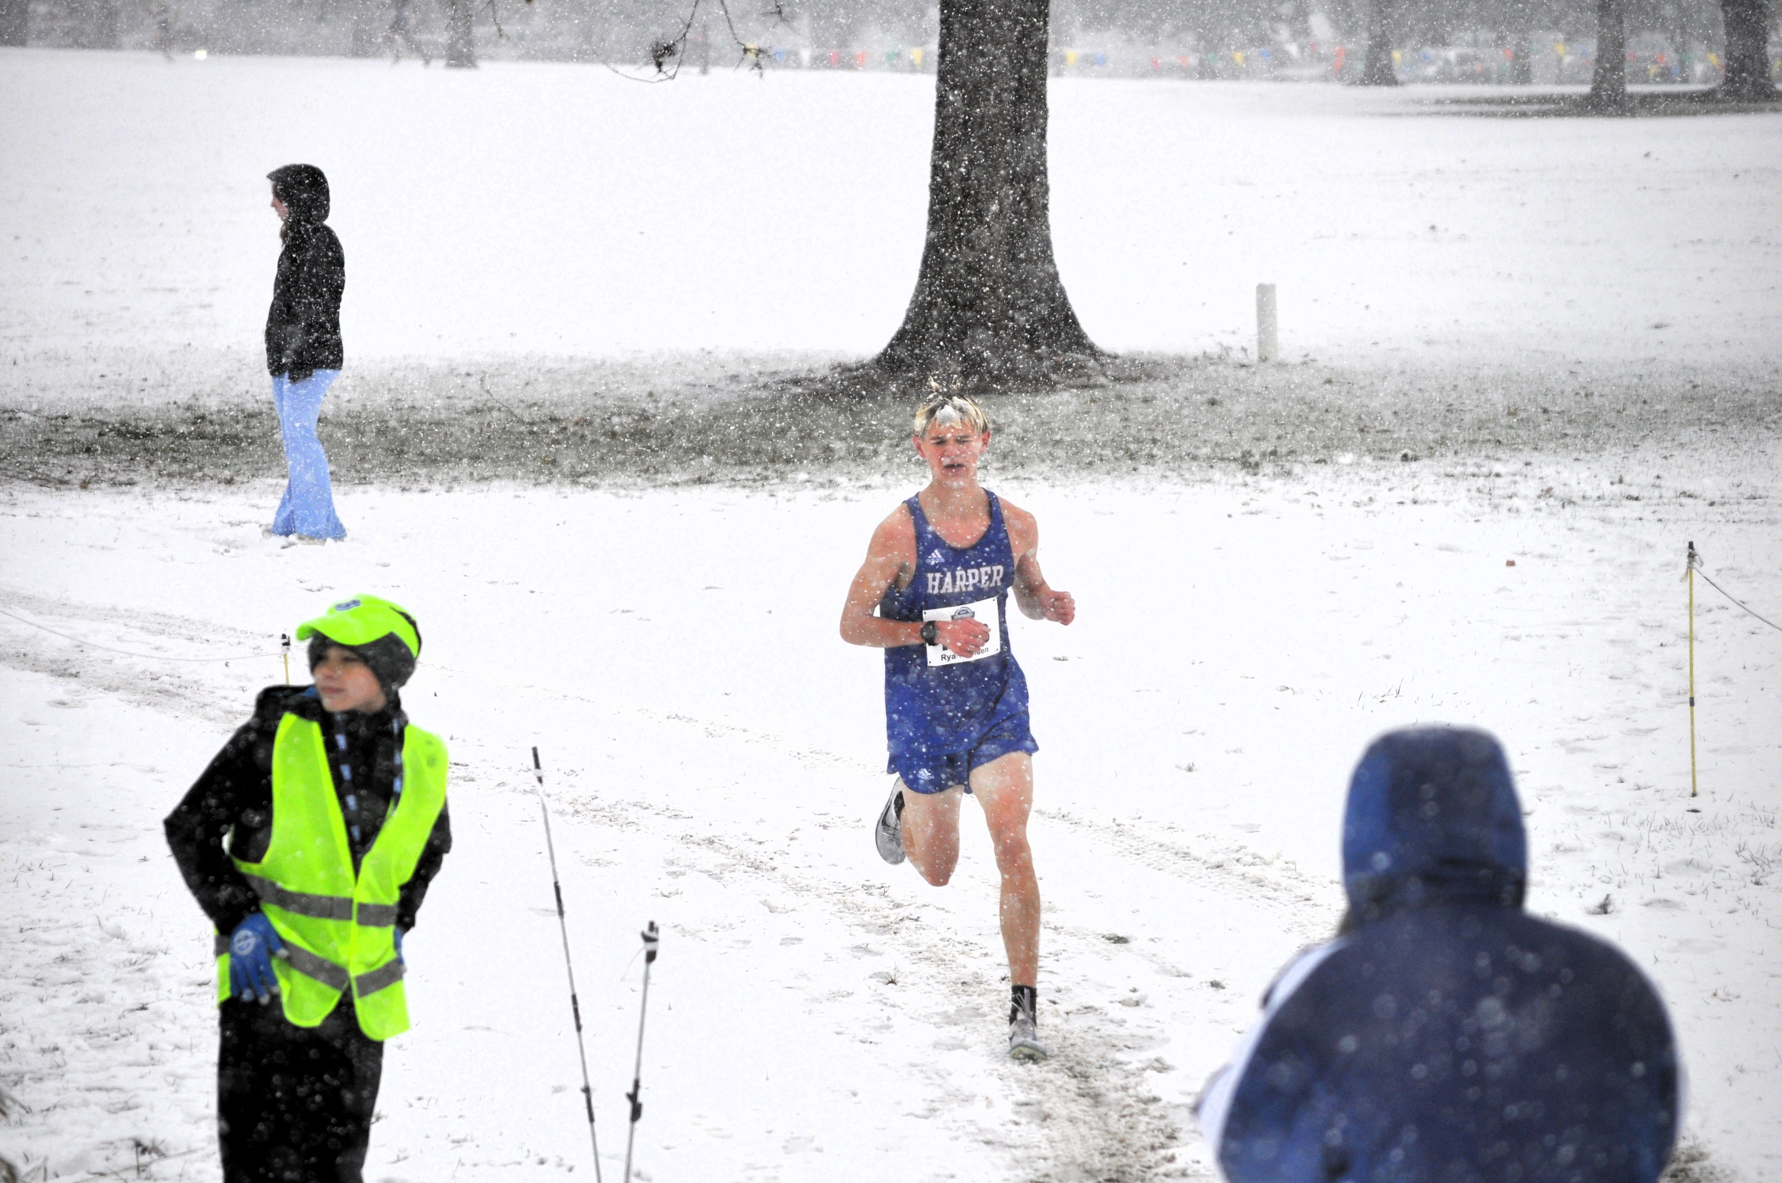
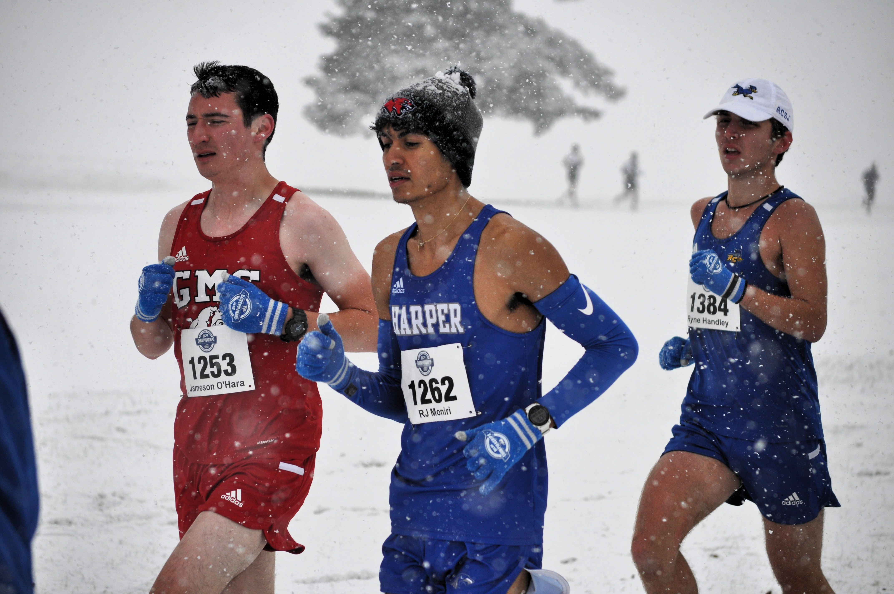
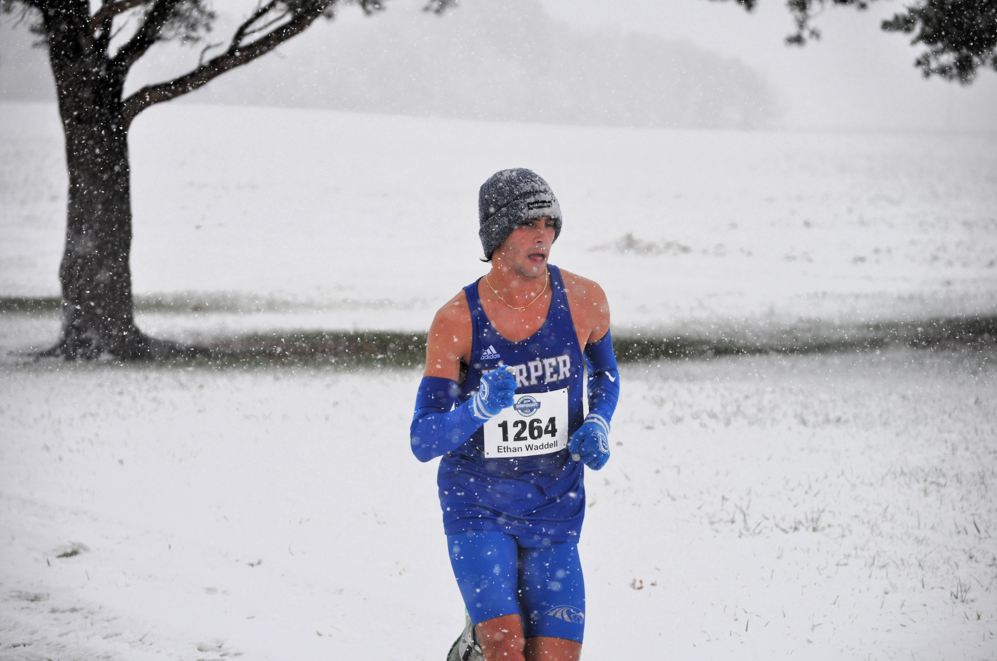
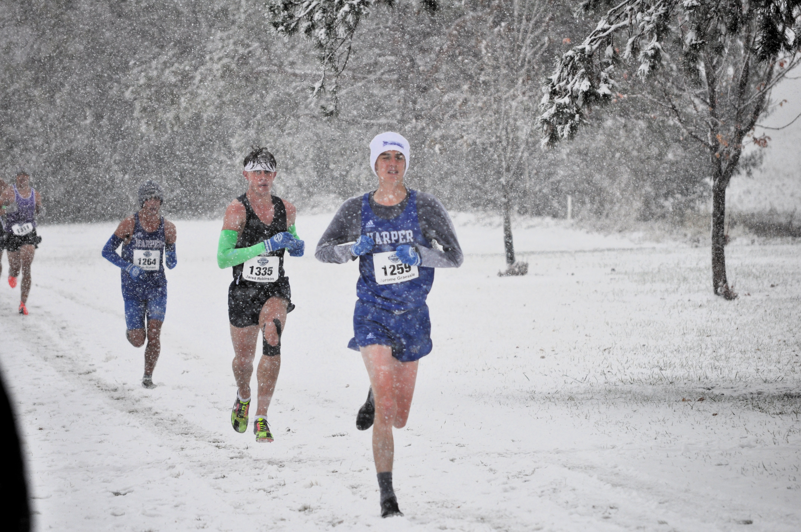
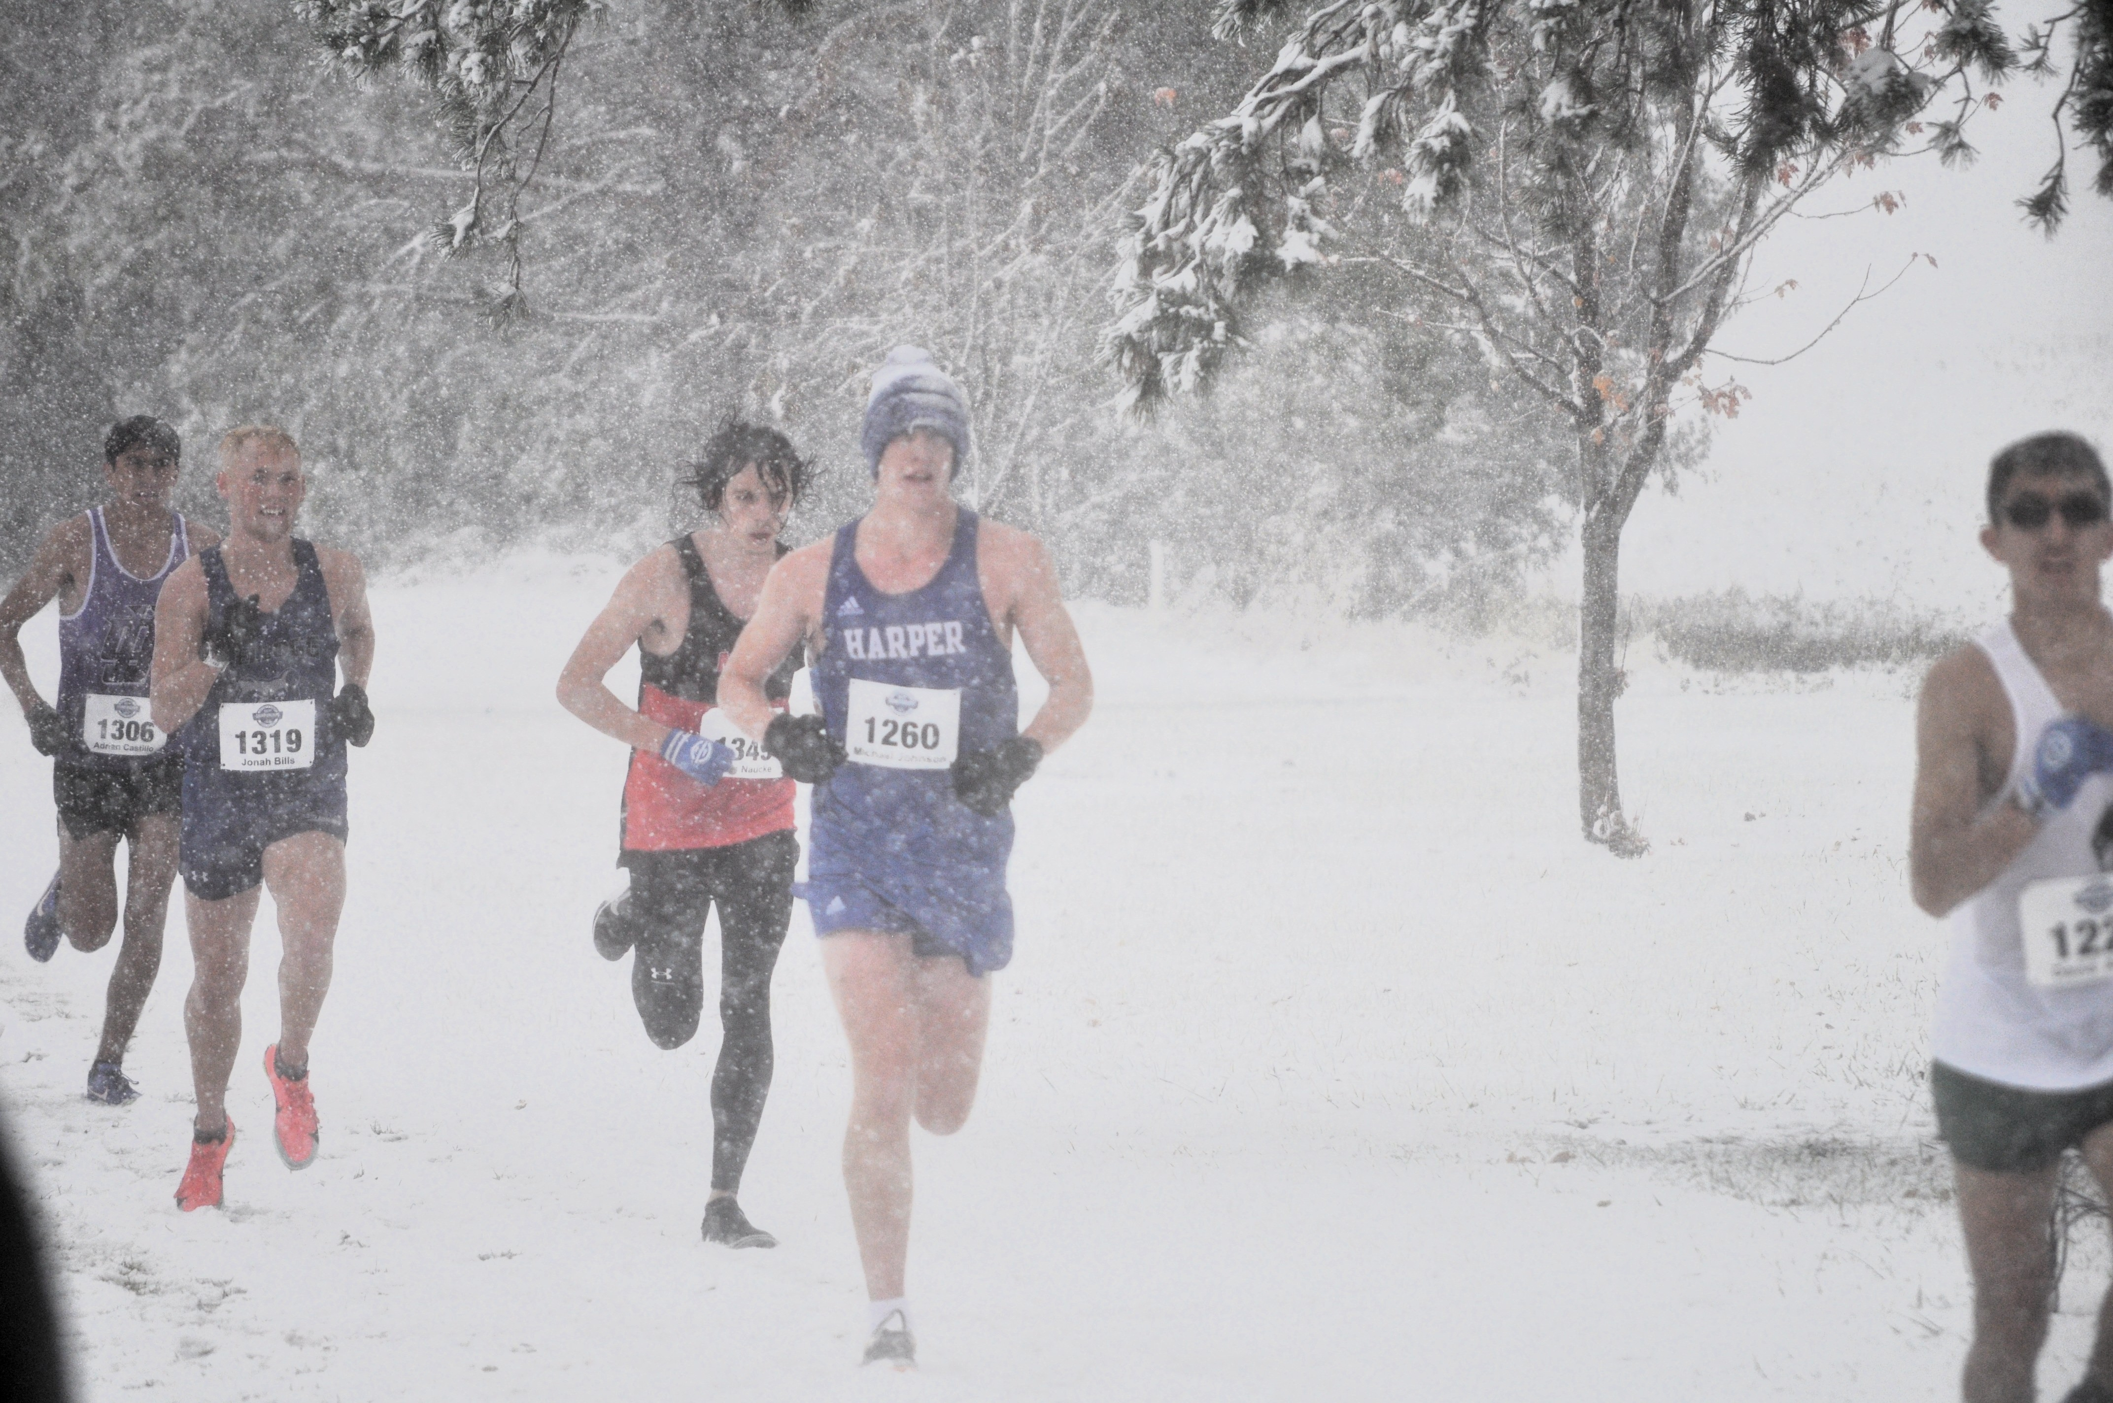
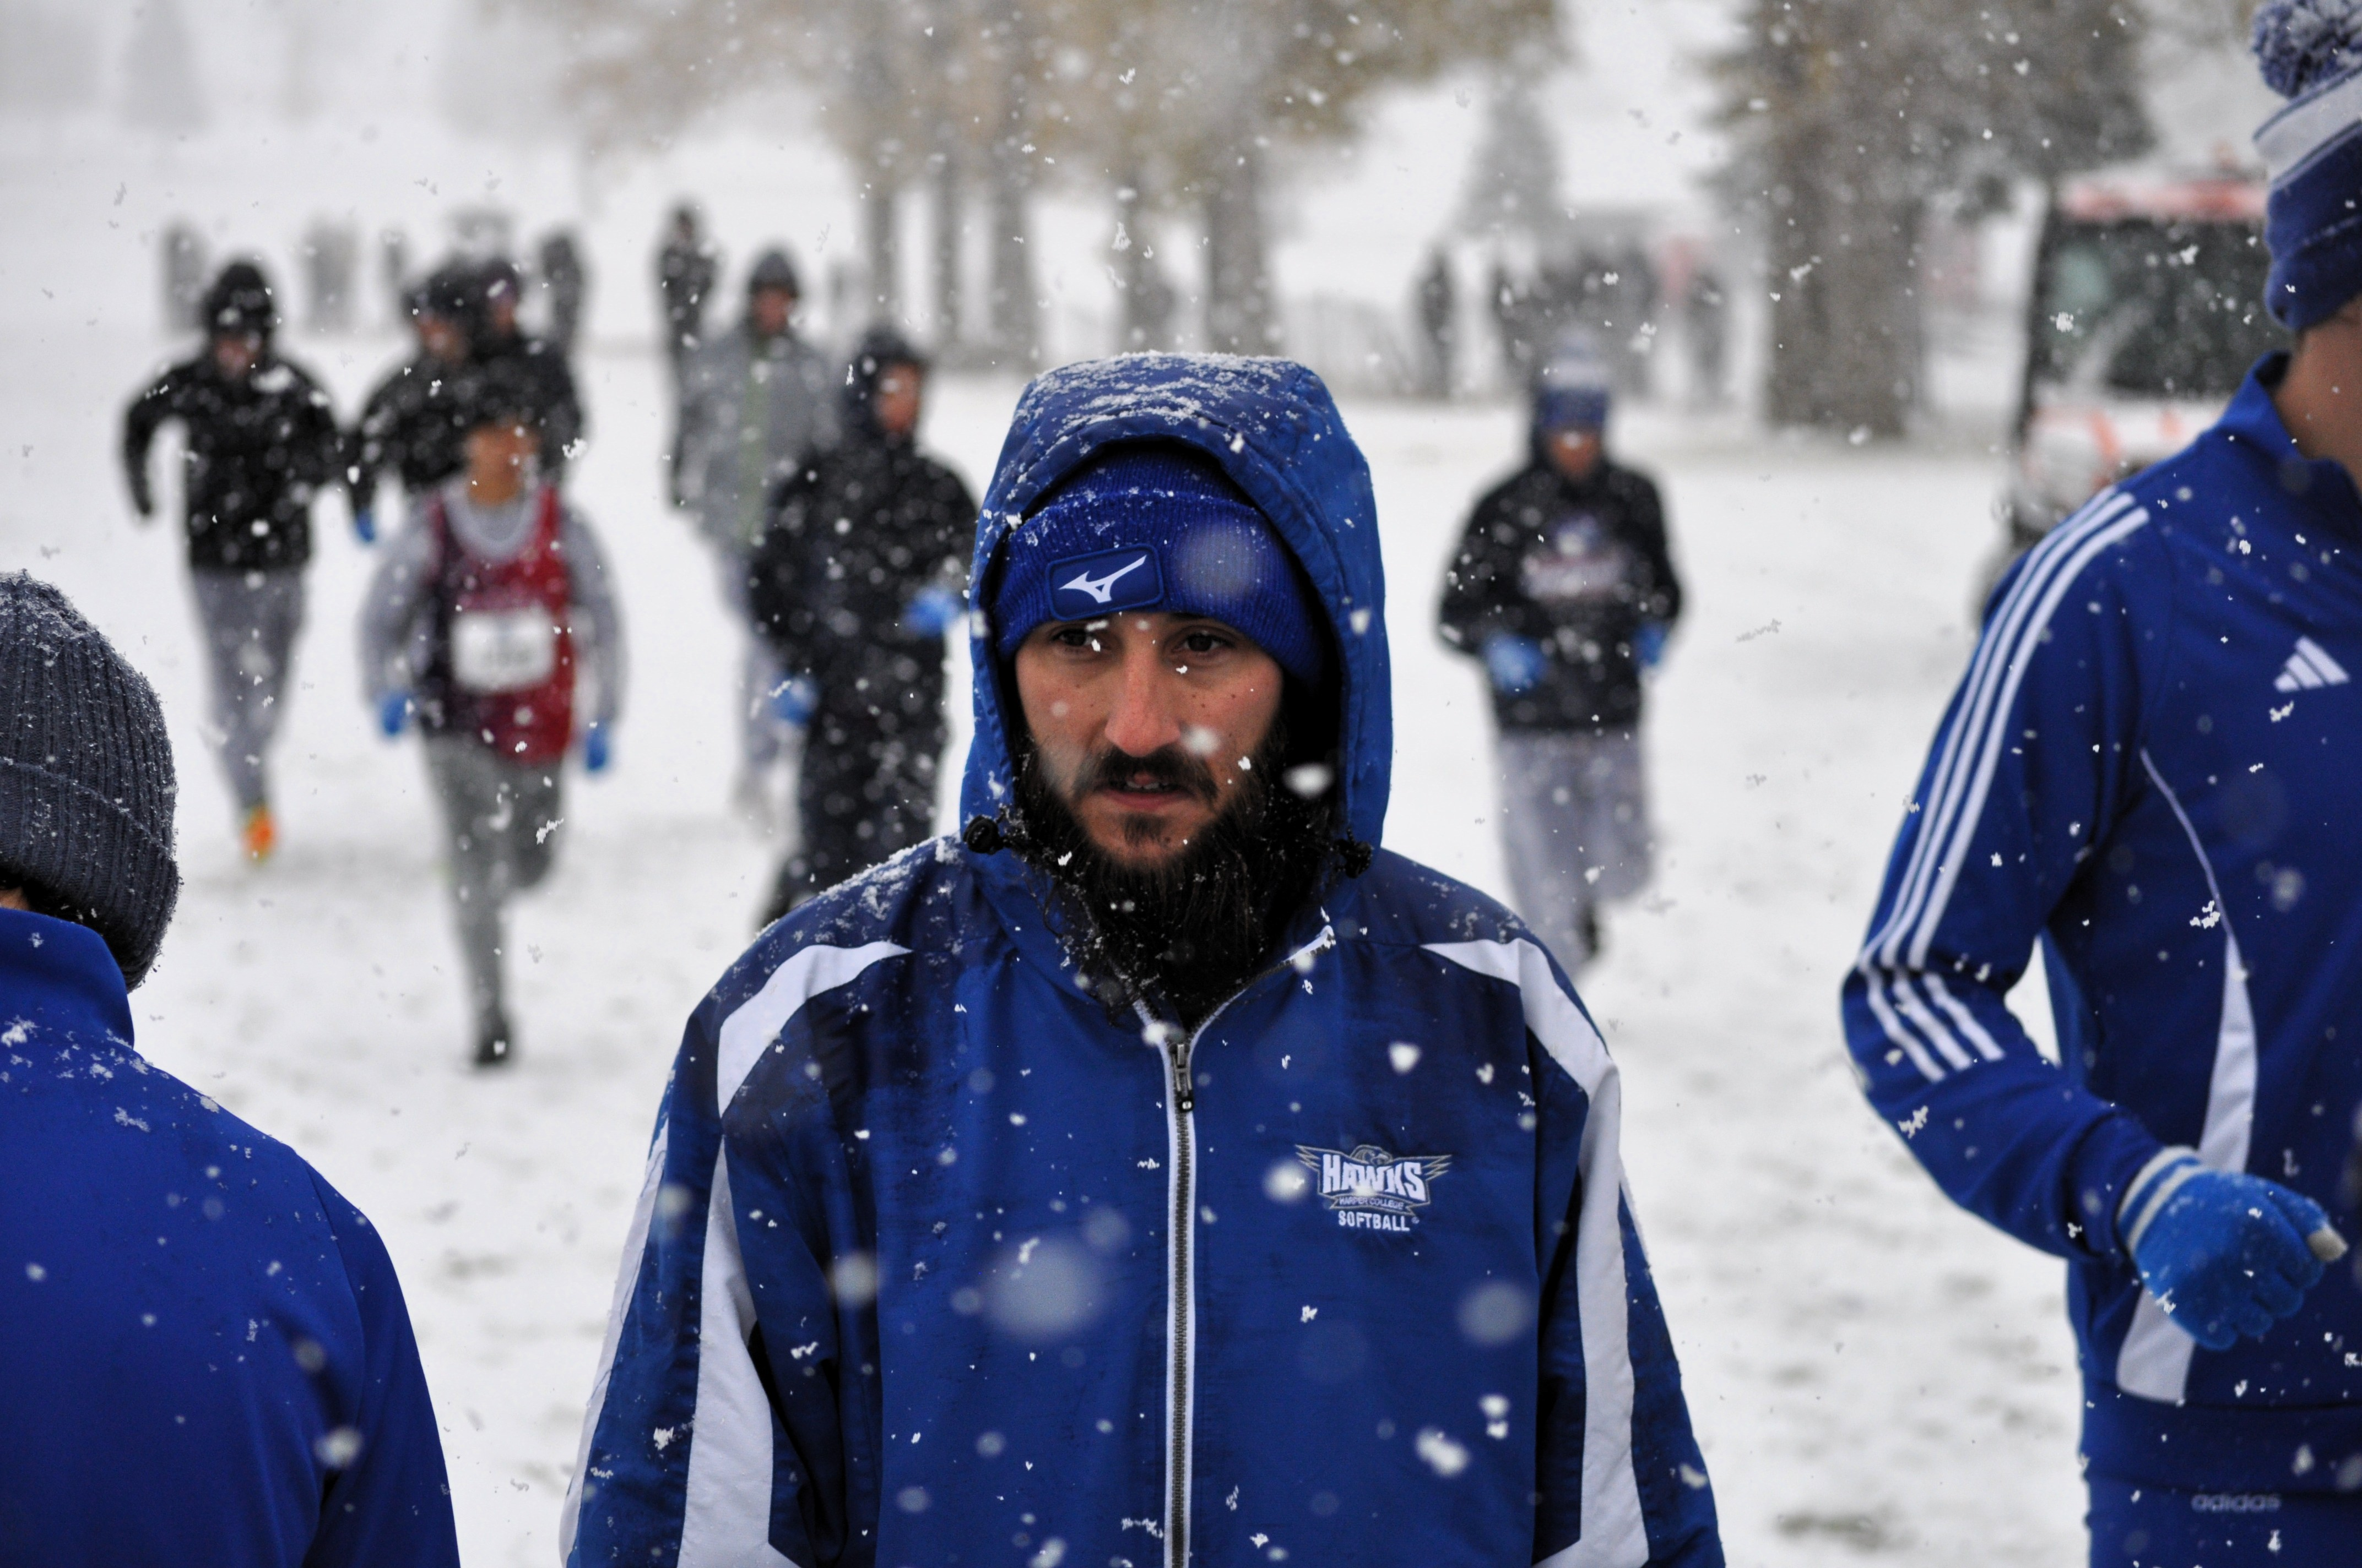
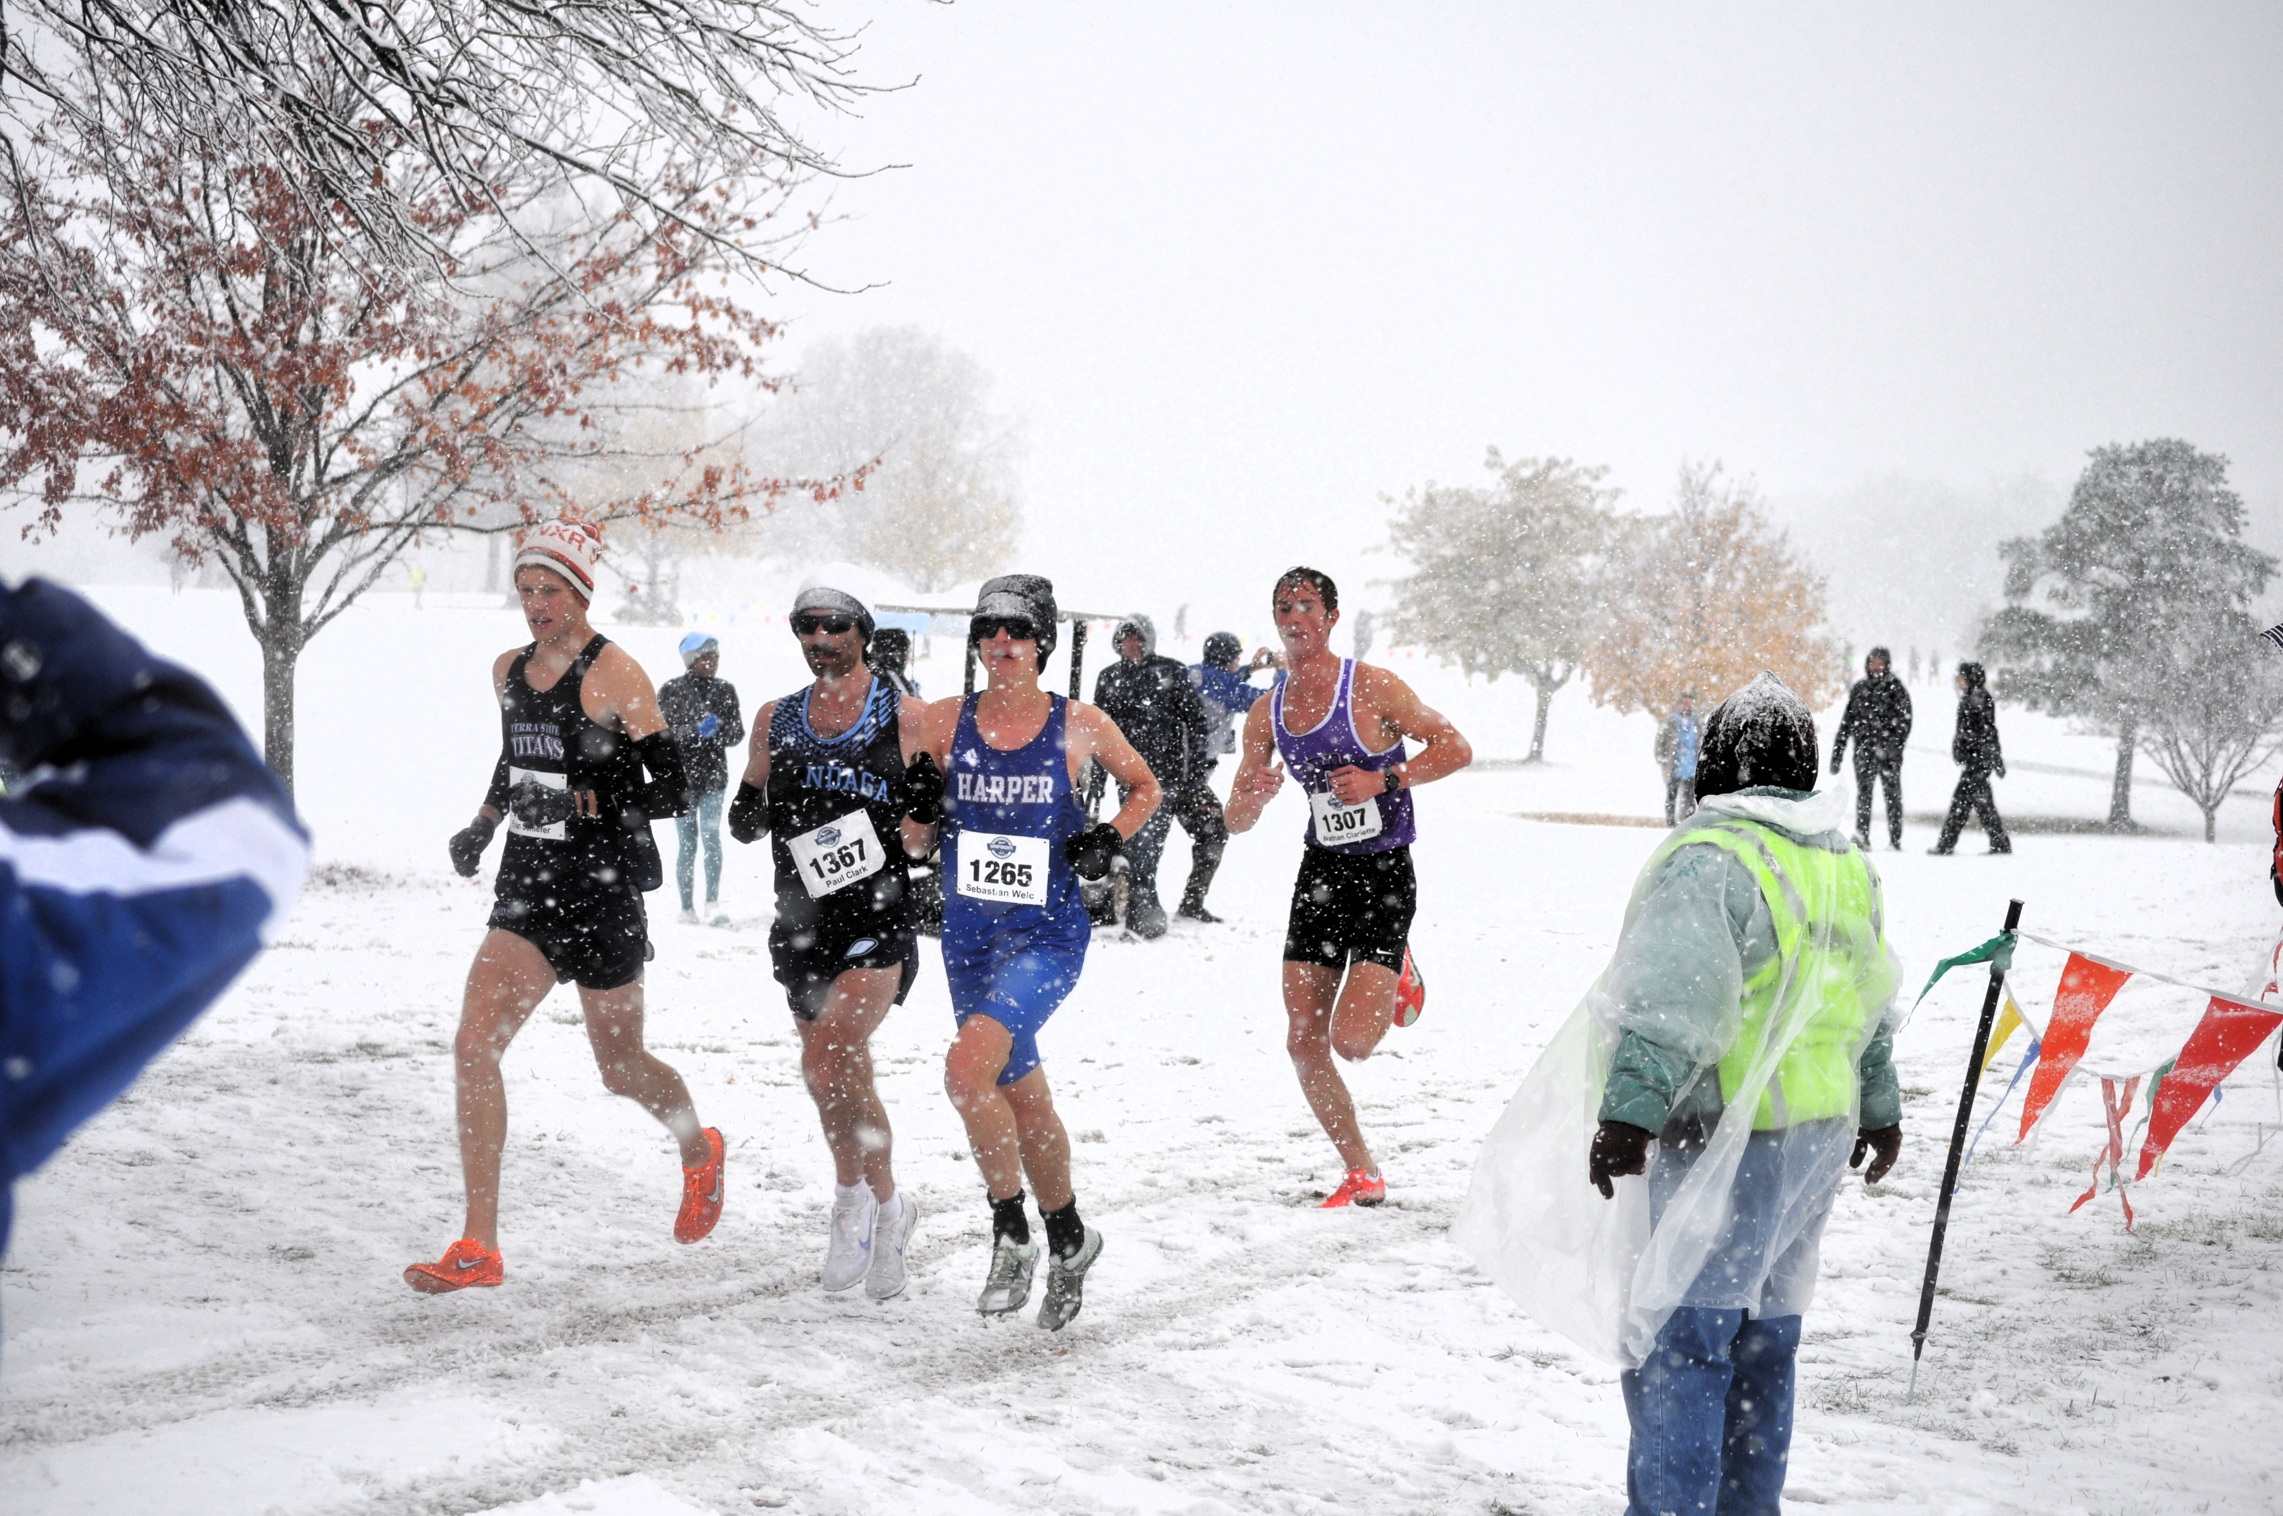
Harper College Men XC RISE TO THE CHALLENGE
2025 NJCAA DIII National Champions

Slide 6
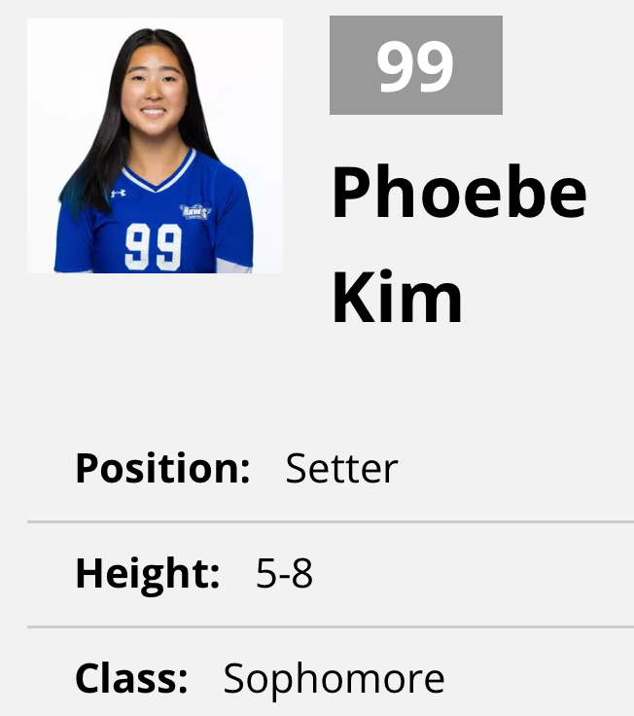
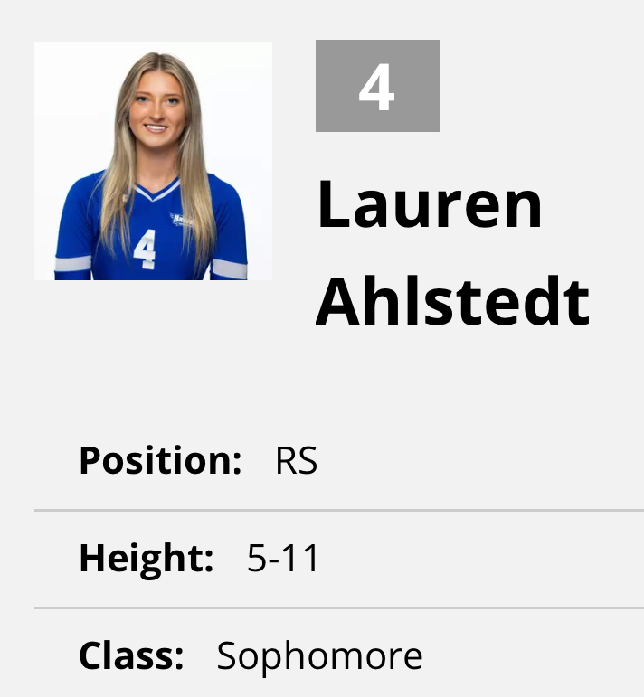
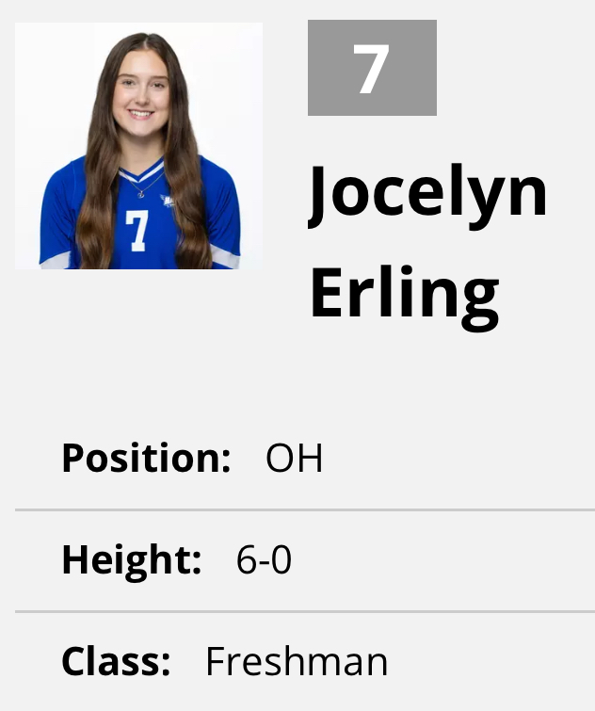
NJCAA DII Region 4 District A Runner-Up (33-win season)
All-American Nomination
Phoebe Kim
Region 4 All-Region
Phoebe Kim | Setter, First Team
Jocelyn Erling | Outside Hitter, First Team
Lauren Ahlstedt | Right Side Hitter, Honorable Mention

Slide 7
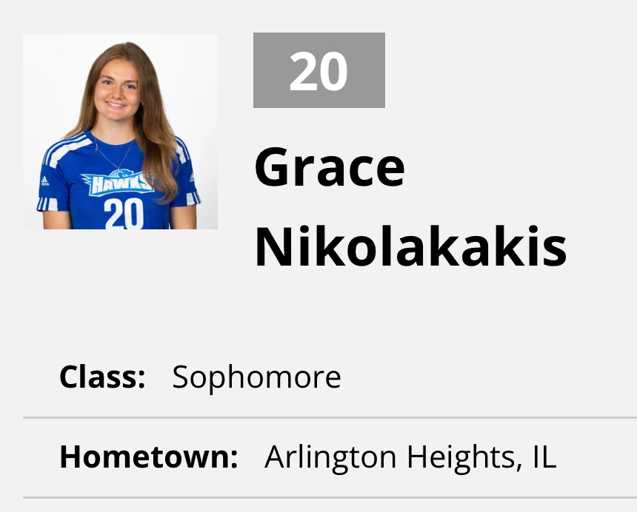
2025 HARPER HAWKS WOMEN’S SOCCER
NJCAA ALL-REGION HONORS
Grace Nikolakakis, Defense, First Team
Region 4 All-Region

Slide 8
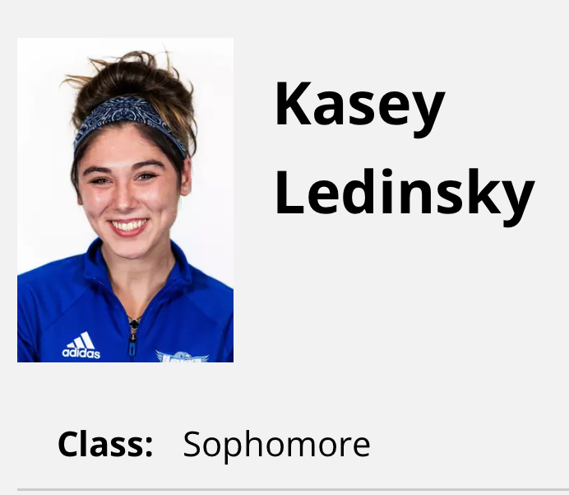
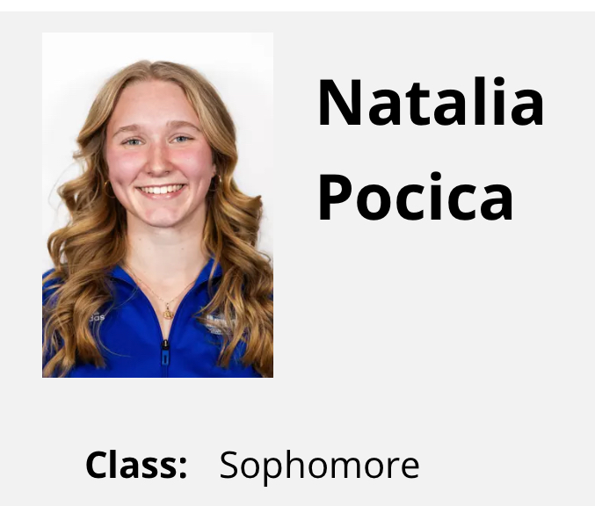
2025 WOMEN’S CROSS COUNTRY HONORS
NJCAA All-Americans
Kasey Ledinsky, 13th Place, Honorable Mention Team
Natalia Pocica, 14th Place, Honorable Mention Team
USTFCCCA All-Americans
Kasey Ledinsky, 13th Place
Natalia Pocica, 14th Place
Region 4 All-Region
Kasey Ledinsky, 5th Place

Slide 9
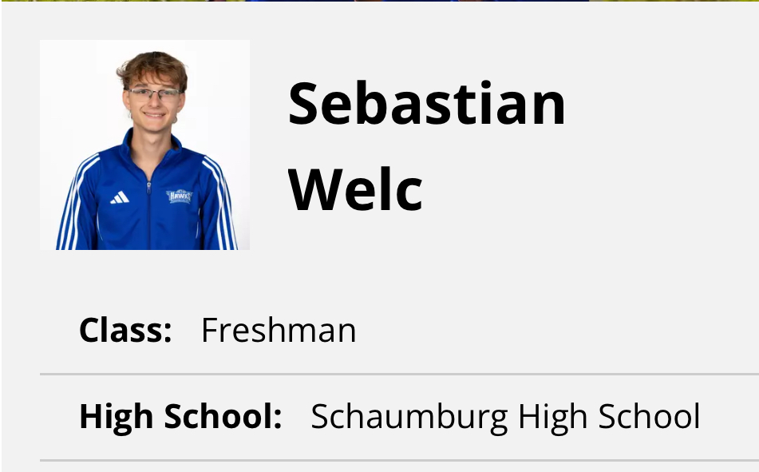
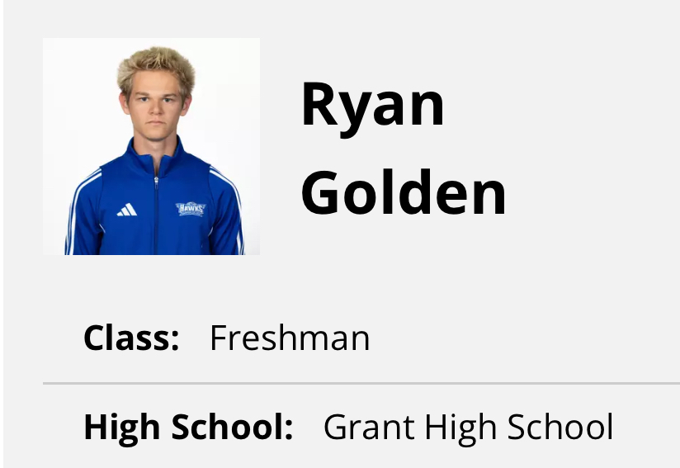
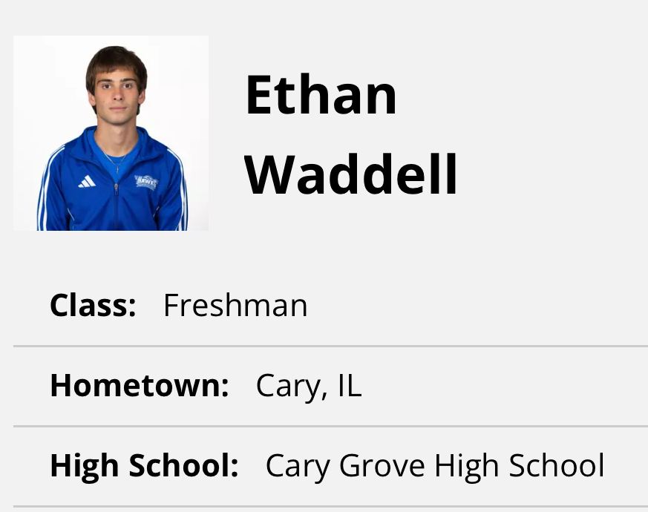
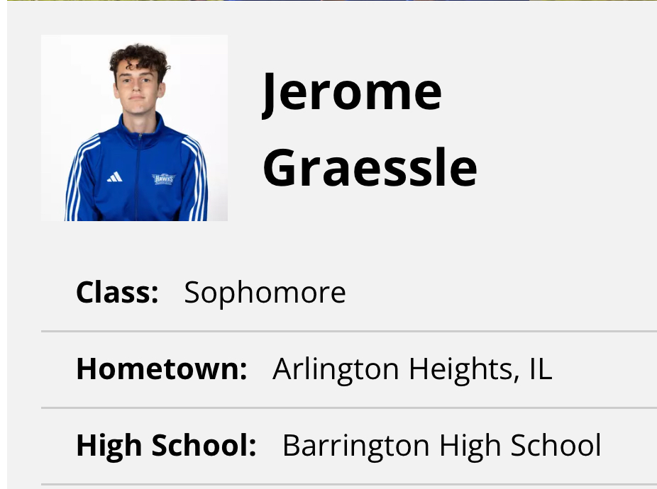
2025 MEN’S CROSS COUNTRY HONORS
Won 10th National Championship
Won 18th Region 4 Championship
NJCAA All-Americans
Sebastian Welc, 4th Place, First Team
Ryan Golden, 5th Place, First Team
Ethan Waddell, 14th Place, Honorable Mention Team
USTFCCCA All-Americans
Sebastian Welc, 4th Place
Ryan Golden, 5th Place
Ethan Waddell, 14th Place
Jerome Graessle, 16th Place
Region 4 All-Region
Ryan Golden, 2nd Place
Sebastian Welc, 3rd Place
Ryan Golden and Sebastian Welc ran times that were fast enough to make the Harper all-time top 10 for 8k.

Slide 10
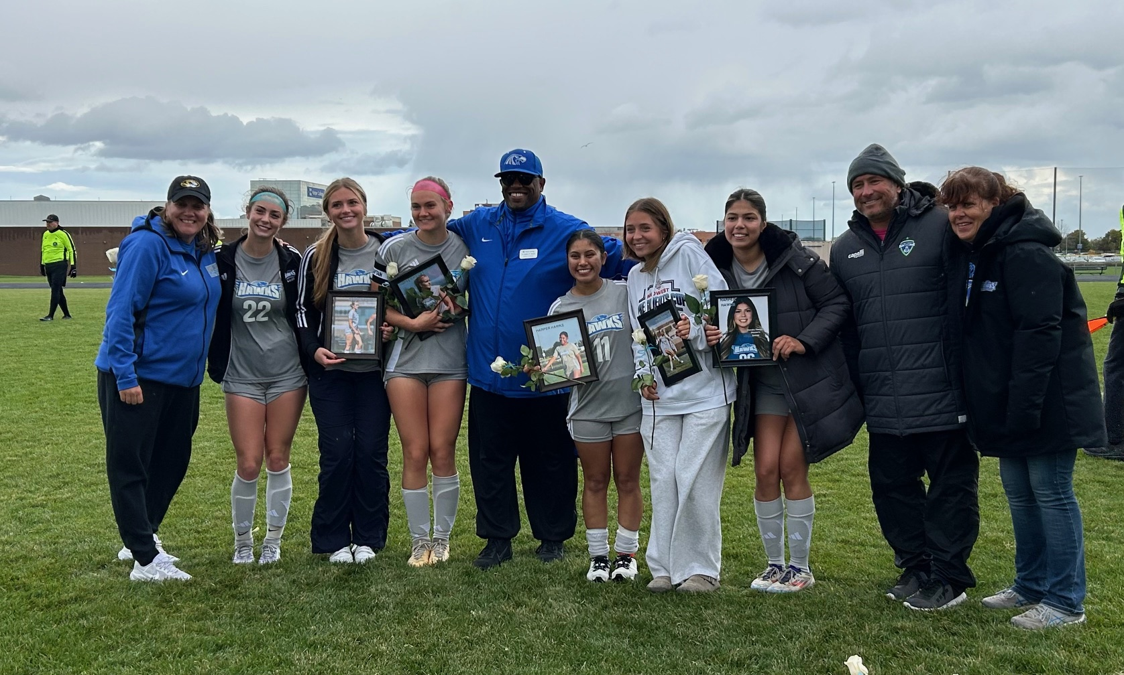
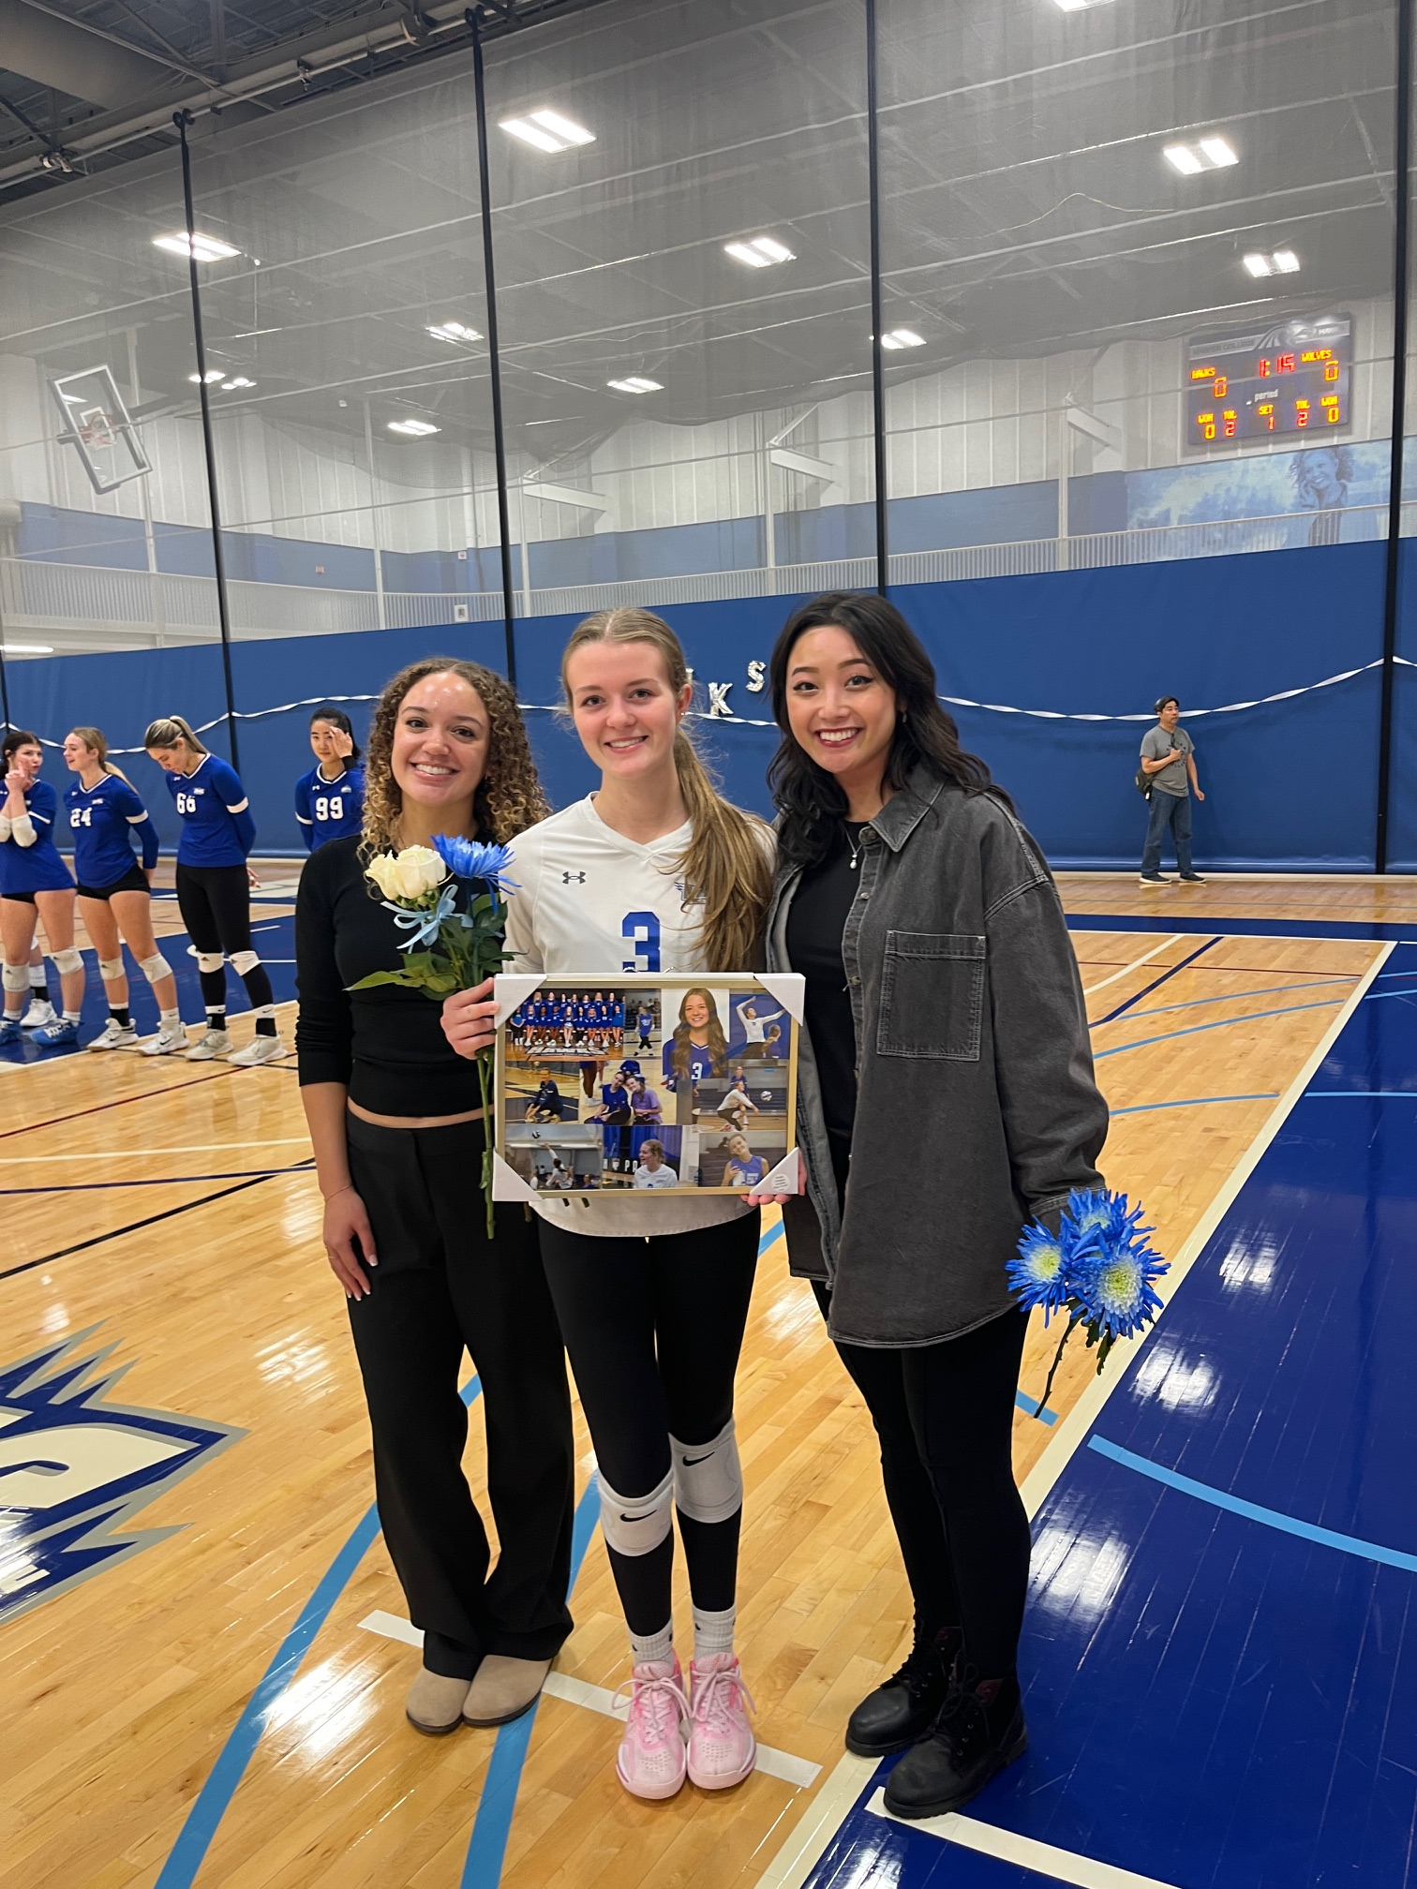
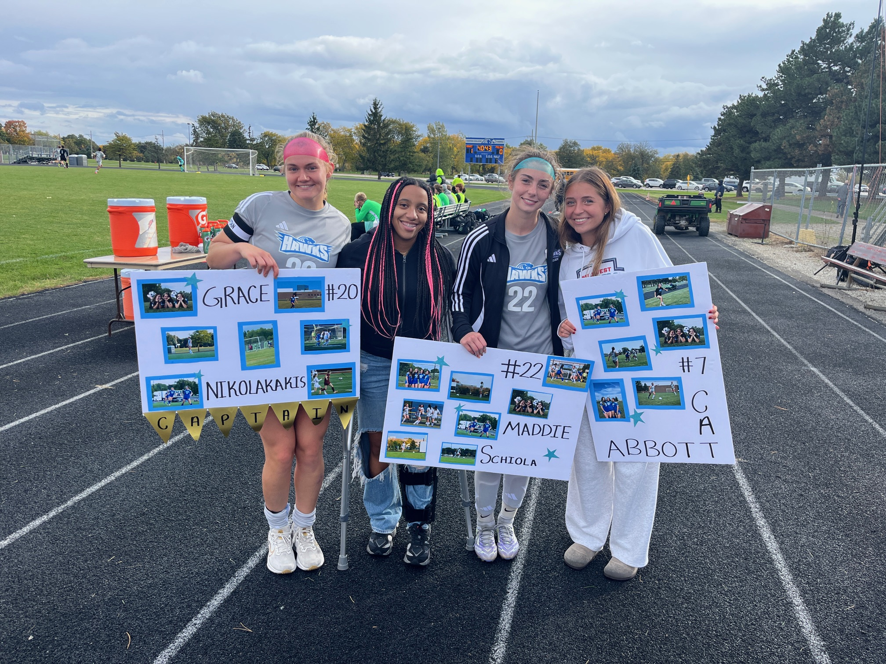
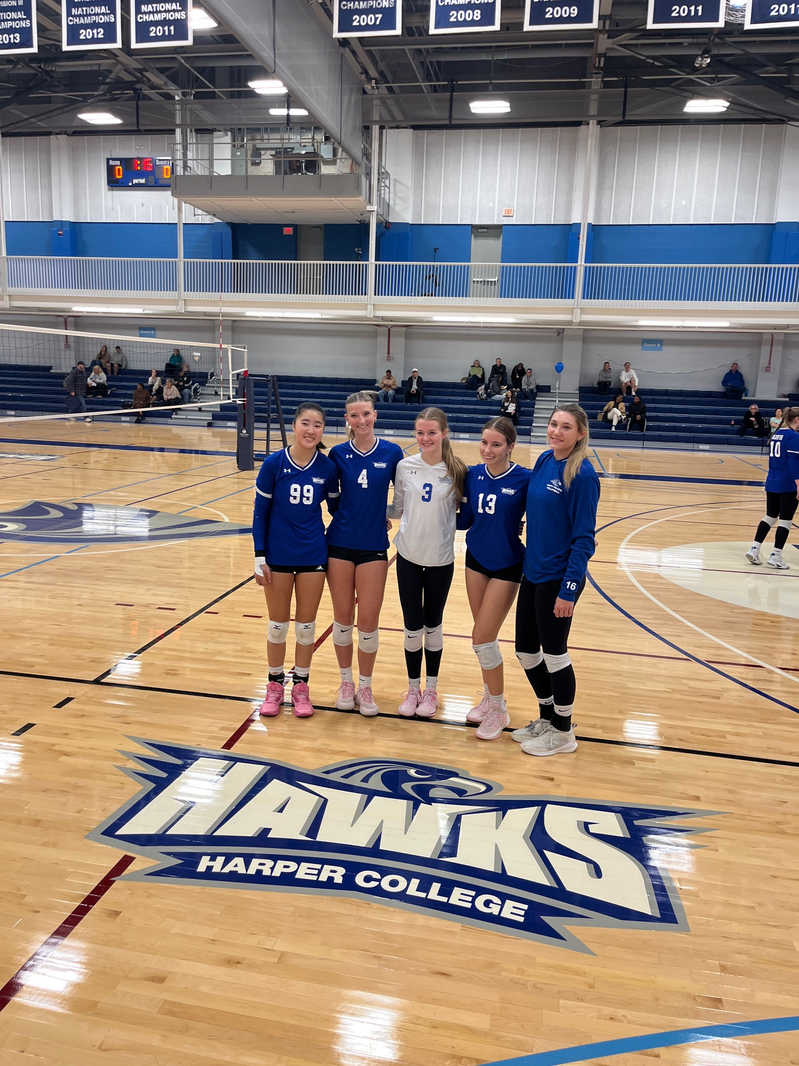
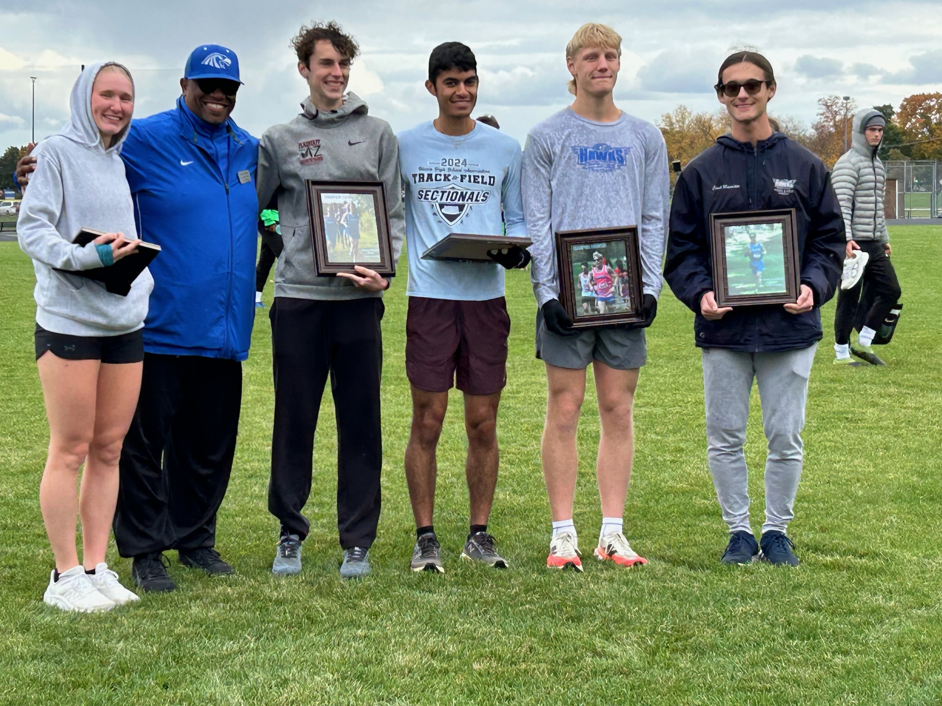
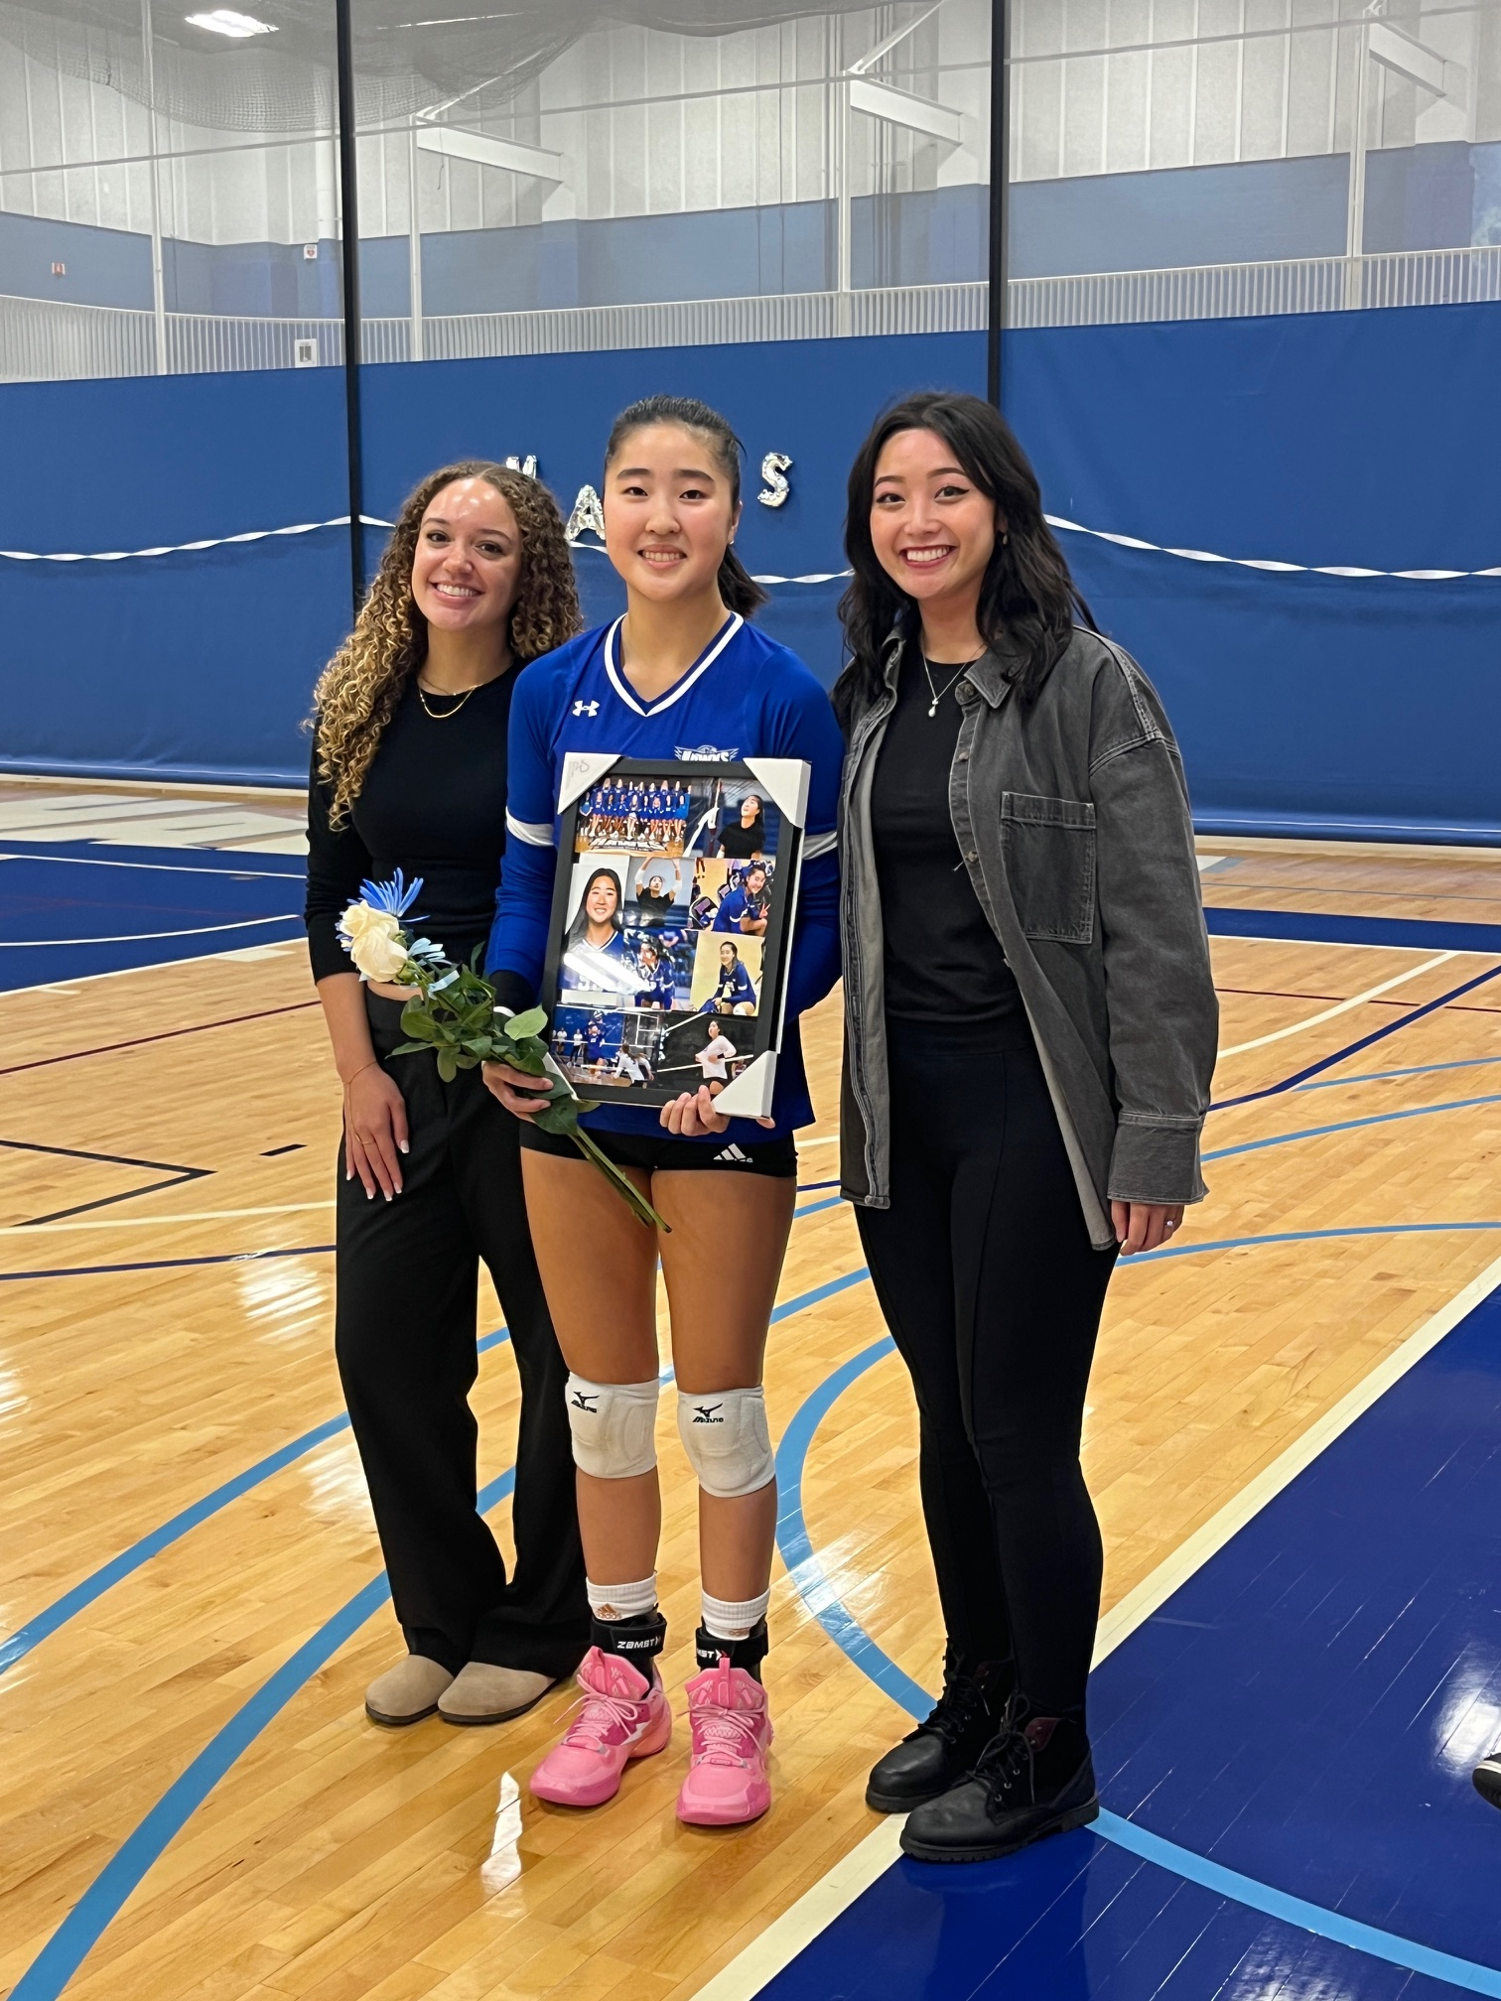
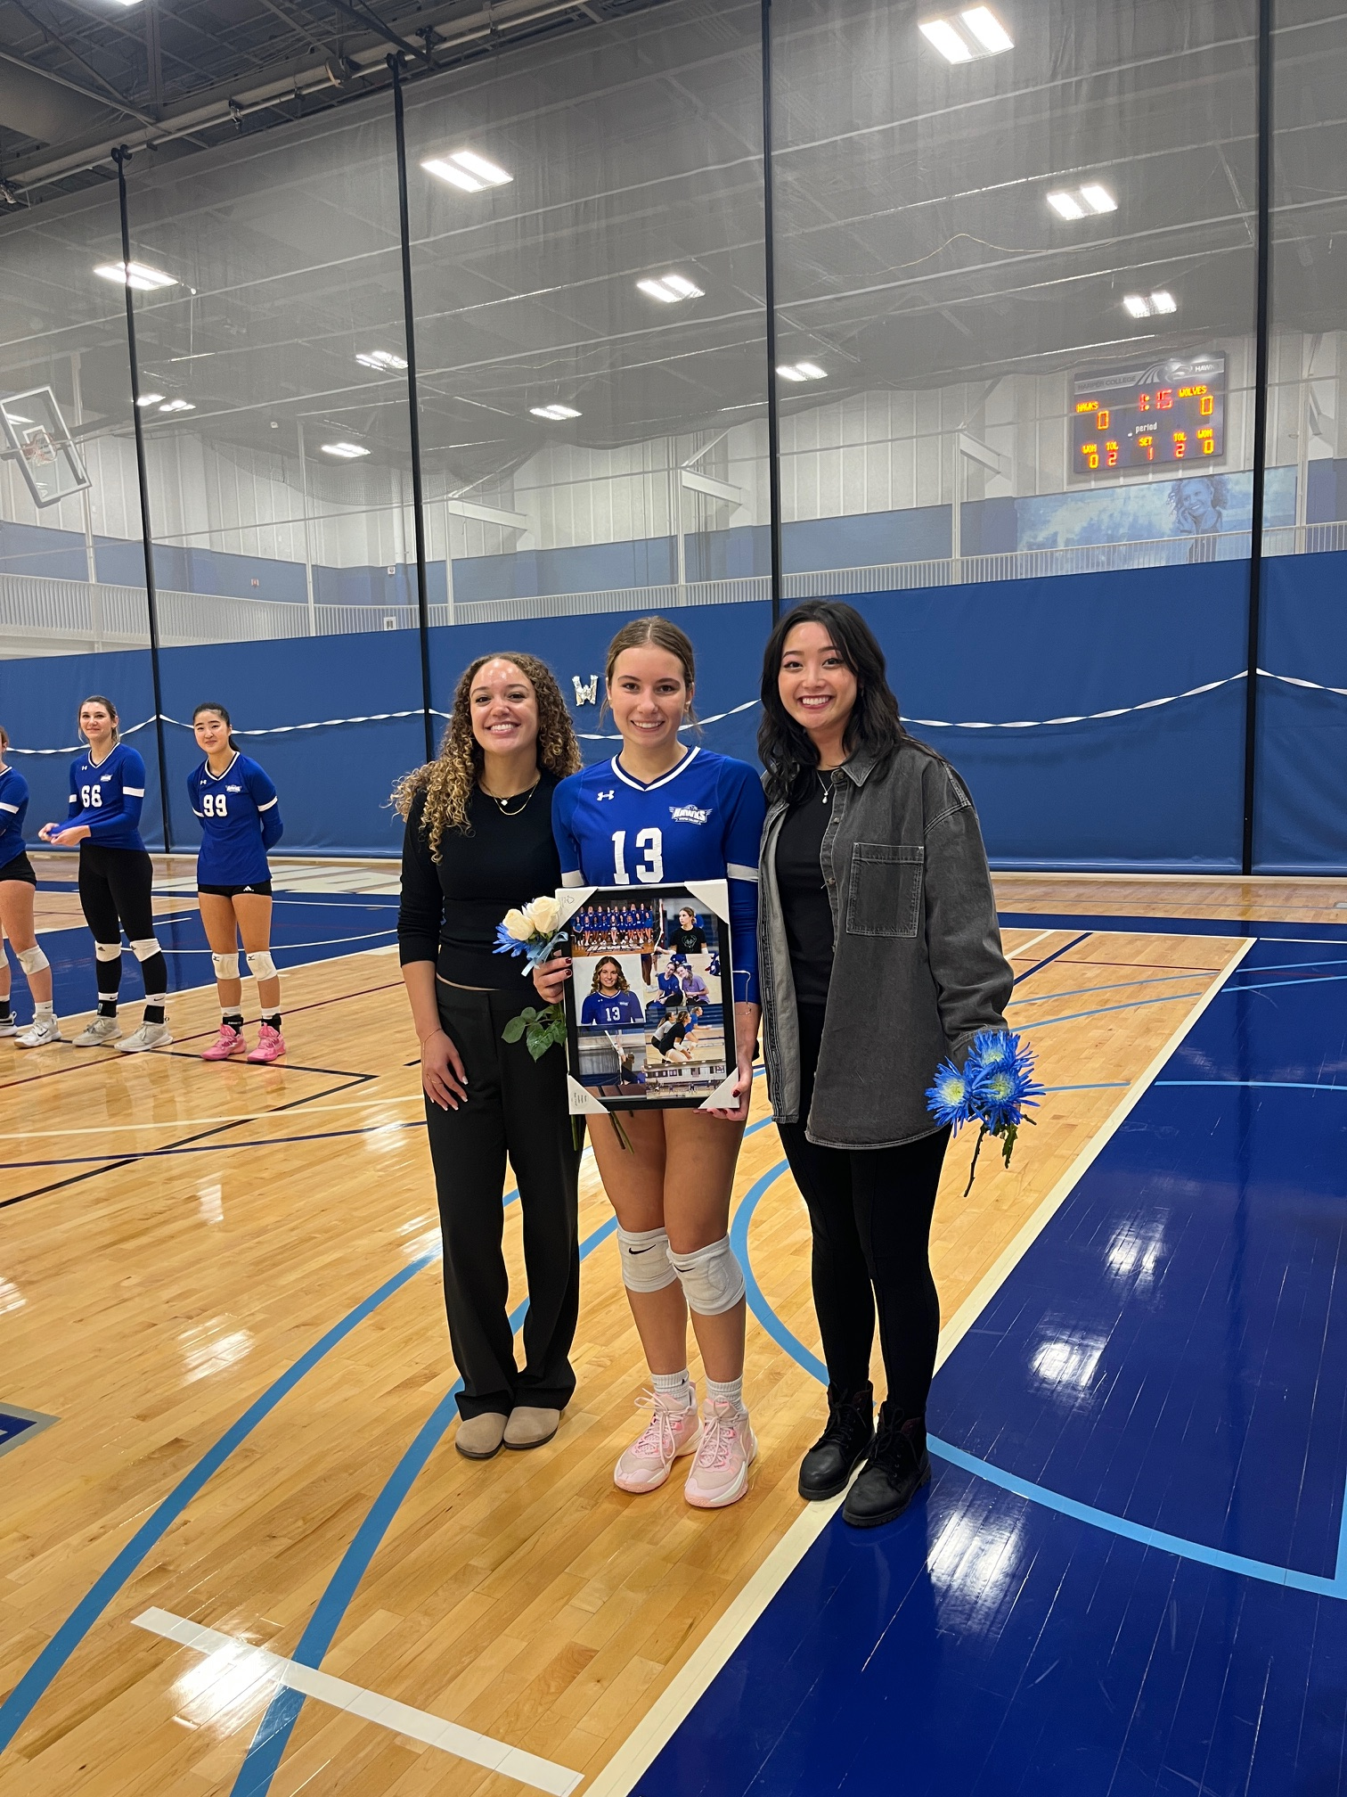
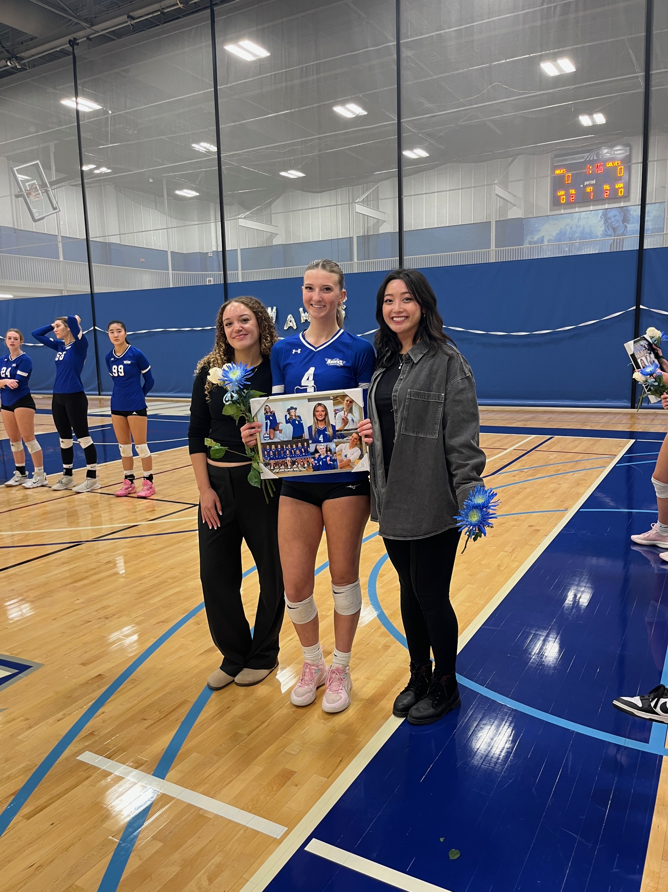
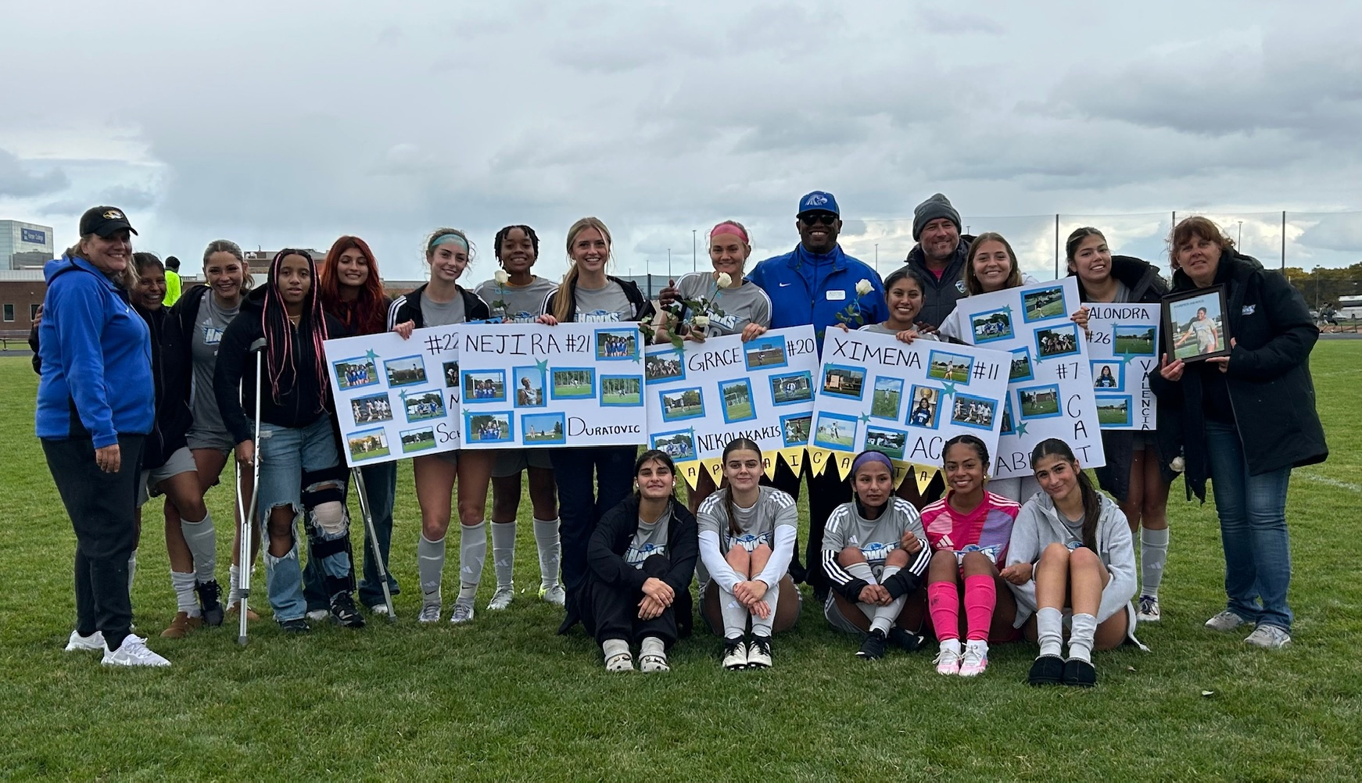
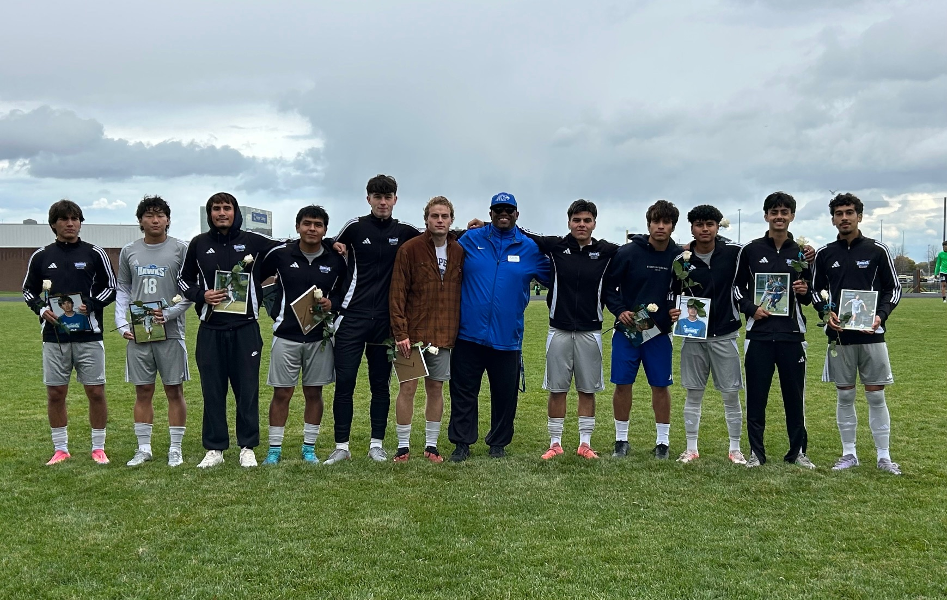
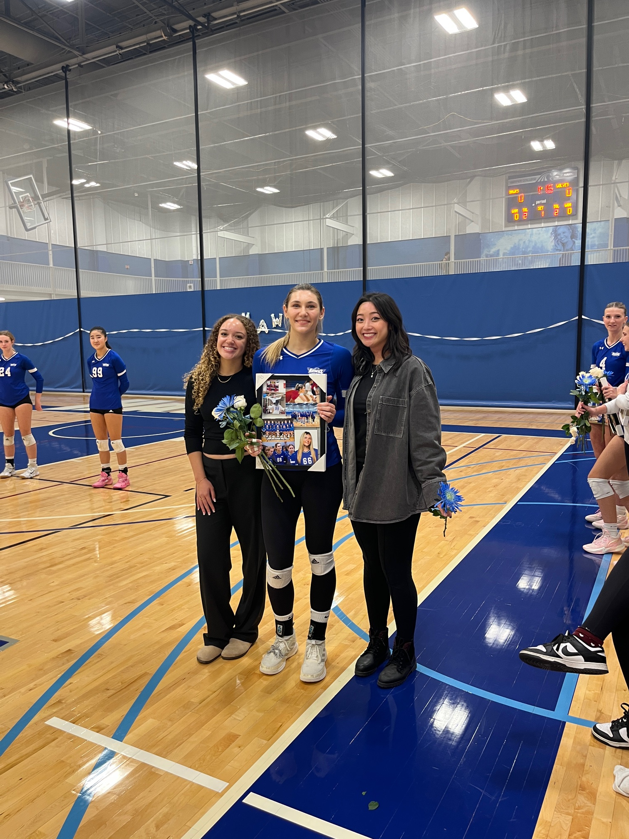
CELEBRATING SOPHOMORES

