Slide 1
Grants Strategy for Institutional Impact
Harper College Board of Trustees Presentation
December 2025

Slide 2



Funder: National Science Foundation
Project: Enhancing Uncrewed Aerial Systems Career Readiness
Total award: $345,647
Support for: Curriculum development, equipment, faculty development
stipends, recruitment, student field experiences
Funder: Illinois Community College Board
Project: Pipeline for the Advancement of the Healthcare Workforce
Total award: $856,640
Support for: scholarships, exam fees, project coordinator, nursing lab assistants, tutors,
specialists, student supplies, equipment, conference travel
Funder: Rivers Casino-Rivers Gives Foundation
Project: Veteran and Military Connected Students Scholarship
Total award: $50,000
Support for: Tuition, books, supplies, and fees for veteran and military-
connected students enrolled on a full- or part-time basis.

Slide 3




Objectives for Grant Funding

Slide 4
Objectives for Grant Funding

Slide 5
Objectives for Grant Funding

Slide 6
Objectives for Grant Funding

Slide 7
Objectives for Grant Funding

Slide 8
The Importance of Grant Funding
Grants enable the college to:
      Scale existing programs
      Remove barriers for students
      Establish new initiatives
      Upgrade technology and infrastructure
      Be progressive in teaching skills and training for the future

Slide 9
Effective Grant Strategy
Centralization

Slide 10

Funder
Funder
Funder

Slide 11


Slide 12
Facilities
Continuing Education
Faculty
Administration
Financial Aid
Grant Accountants
Community
Grant Office
Board
Staff
Finance

Slide 14
Scholarships
New Technology/Equipment
Outreach/
Marketing
Personnel
External Contractors & Consultants
Books,
Fees
Wrap Around
Supports
Professional
Development
Facility
Improvements

Slide 15
Growth and Success
Student Achievement
Program Expansion
Community Impact
Coordination of efforts
Grants Office/Grant Accounting
Strong Root System
Finance * Financial Aid * Faculty * Staff * Facilities * Continuing Ed * Administration * Workforce Solutions * Grant Accountants * Grants Office

Slide 16
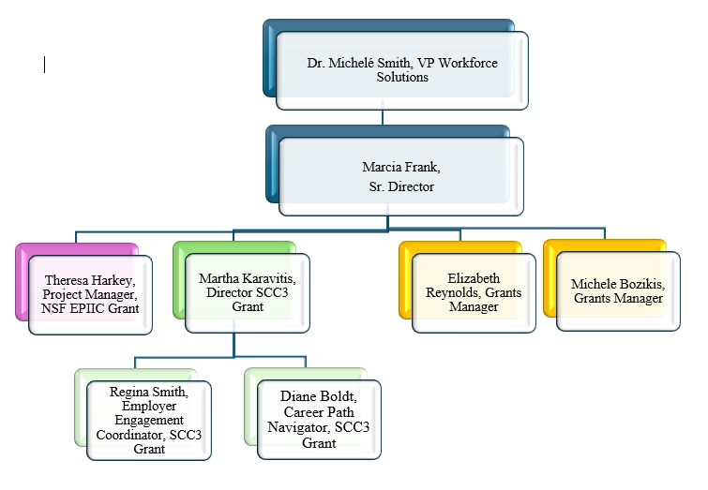
It’s A Team: Innovation & Development

Slide 17

It’s A Team: Finance & Foundation
Grant Accounting Finance
Anne Mauer Craig Duetsch
Maria Tambellini Bob Grapenthien
Bob Hayley
Foundation
Heather Zoldak
Kristyn Meyer
Suzette Tolentino
Brenda Escutia

Slide 18
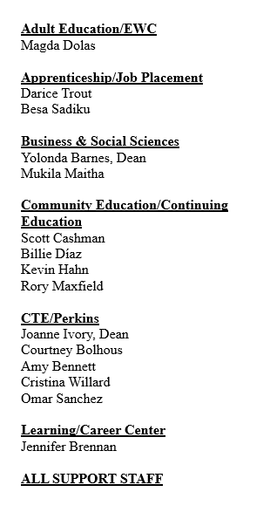
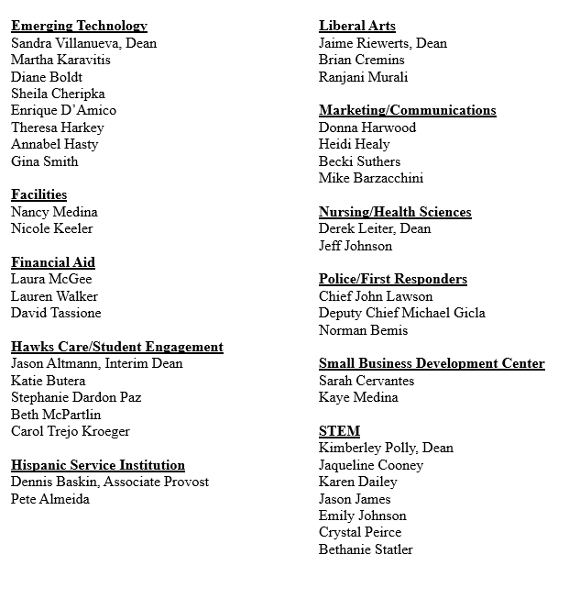
It’s A Team: Harper Grant Leaders

Slide 19

The Horizon

Slide 20
Questions?

