Slide 1
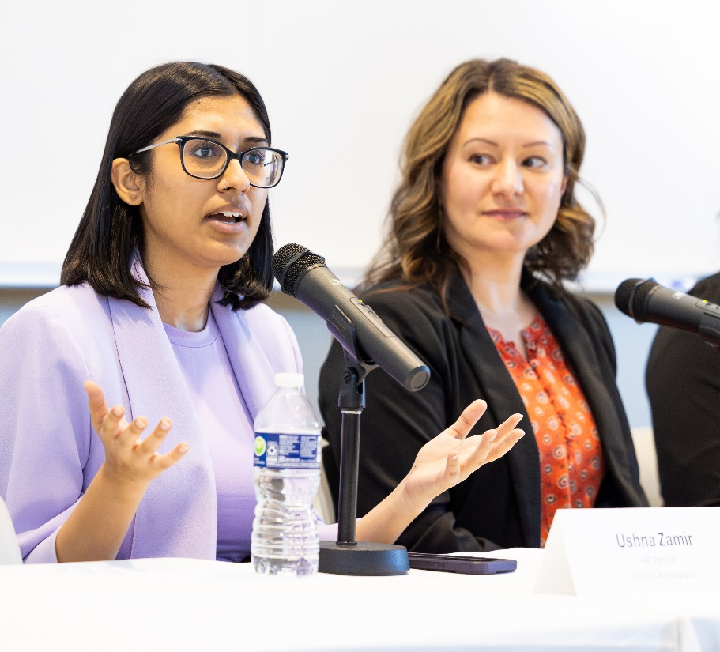
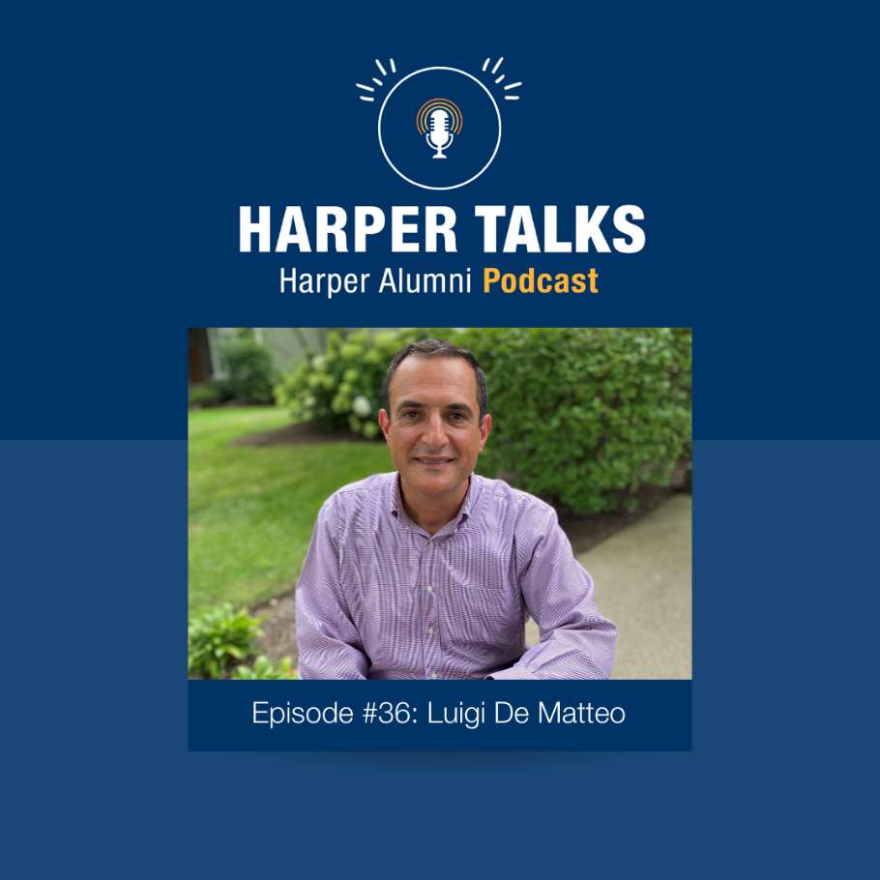
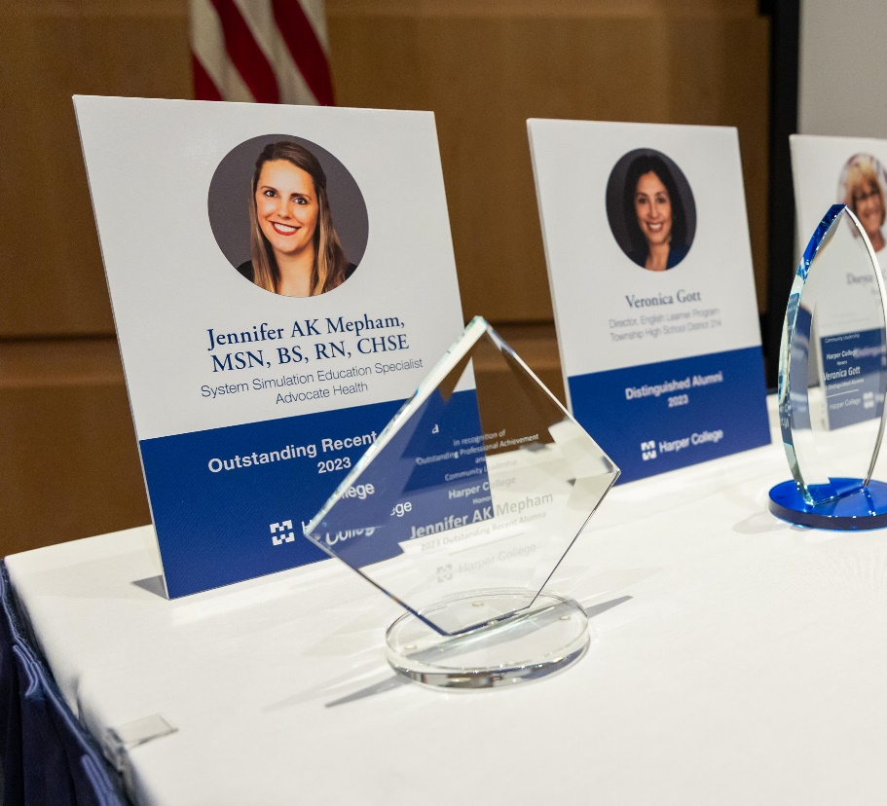
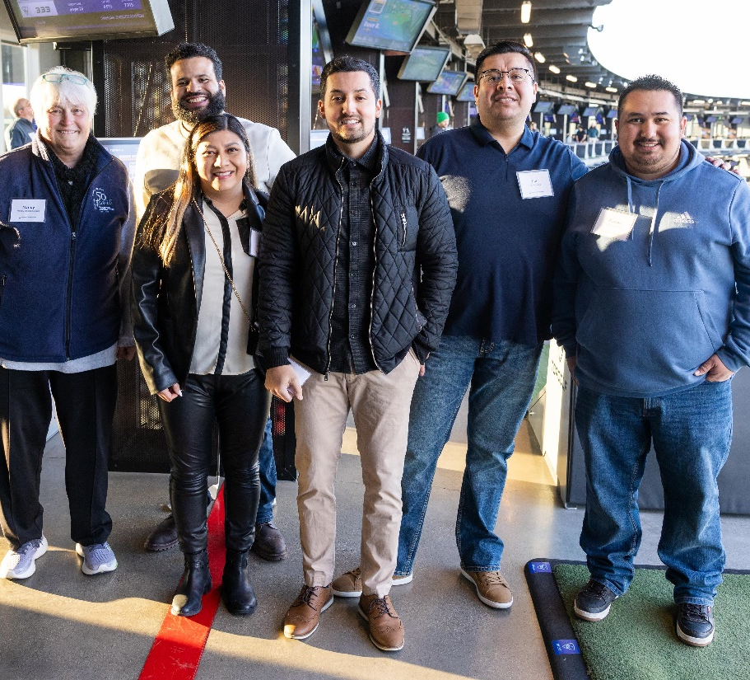
Alumni Relations at Harper College
Shannon Hynes
Director of Alumni Relations
and Affinity Groups

Slide 2
Alumni Relations
Mission
Engagement programming & Outcomes
What’s in store?
Notes:
How are we engaging our alumni?
Today, I am going to share an overview of alumni relations at Harper College including the background and mission, our goals and programming, and what’s in store for alumni in FY26 and beyond.

Slide 3
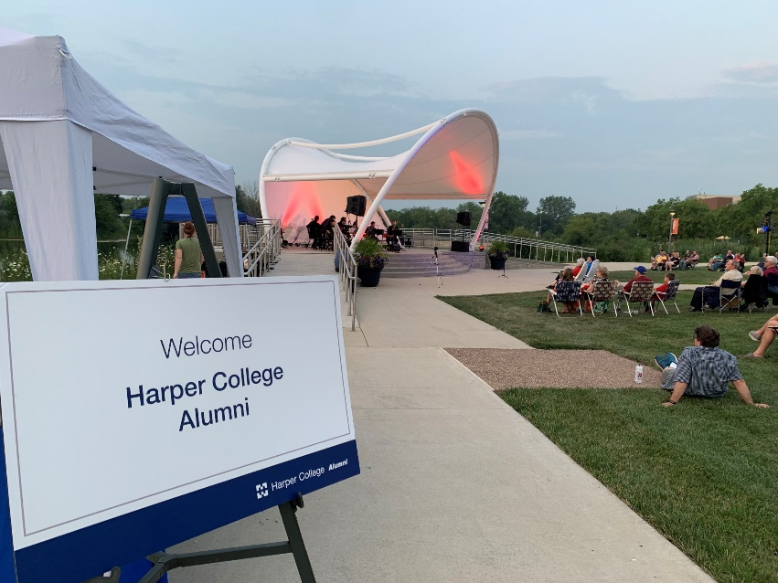
Alumni Relations
Mission
The mission of the Harper College Alumni Relations Program is to foster lifelong connections between alumni and the College and create and facilitate meaningful opportunities for alumni to engage with and support the College through their time, talents and resources.
Who are alumni?
Individuals who have taken one or more classes at Harper College
Notes:
Our mission is to foster that lifelong connection between our alumni and the college and work to create meaningful opportunities for our alumni to engage with us and support the college through their time, talents and resources.
Who are alumni? We define alumni as anyone who has taken one or more credit classes at Harper.
Alumni are among an institution’s greatest assets.
Alumni Relations helps strengthen the bond between the college and our alumni.
Alumni can help enhance the institution’s reputation in the community.
We know that alumni can be a source of philanthropic support. It has also been shown that increased alumni engagement will result in an increase in alumni giving.
Alumni can serve as advocates, spokespersons and goodwill ambassadors.
Our alumni can inspire current students. And those interactions with alumni can help set the stage for those students to become active and engaged alumni themselves

Slide 4
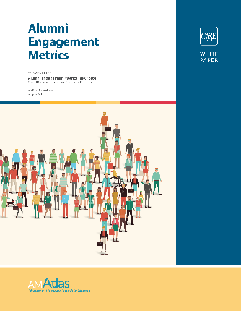
Goals and Programming
CASE: Council for Advancement
and Support of Education
Experiential
Meaningful experiences that inspire, promote mission, celebrate achievements
Volunteer
Formal and rewarding ways to give back through time
Communication
Interactive, meaningful, informative communication supporting mission and strategic goals
Philanthropic
Diverse, mission-driven opportunities for alumni to give back as donors
Notes:
In 2018, the Council for Advancement and Support of Education established an industry wide framework or parameters for alumni engagement and metrics for measuring success. The metric areas engagement through experiences, volunteerism, communication, and philanthropy.
We have used these metrics to produce an alumni engagement plan here at Harper that connects with alumni through these means. It give alumni a variety of opportunity to connect in a way they would like to connect back with the institution. And on the following slides I am going to share some highlights of programming in each area.

Slide 5
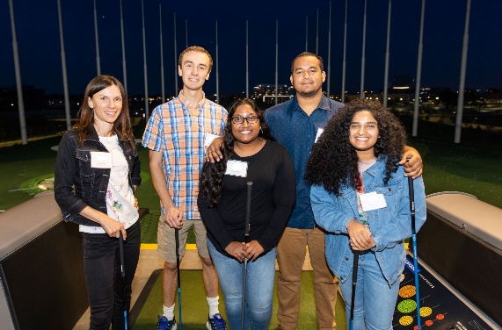
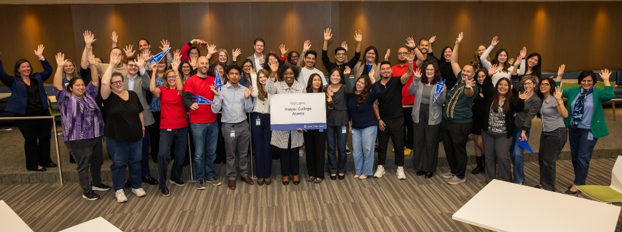
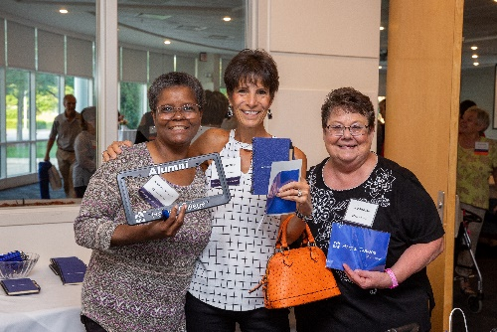
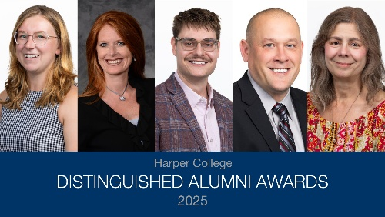
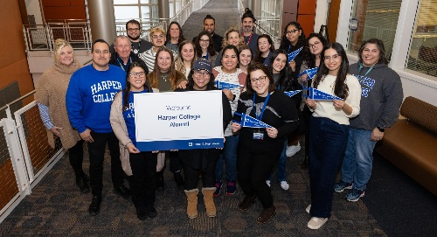
Experiential
Meaningful experiences that inspire, promote mission, celebrate achievements
Creating value-based events
Distinguished Alumni Awards Program
Engagement Events (Social/Networking)
Alumni Reunions
Career-Based Events (Harper @ Work, Webinars)
New Alumni Events (Destination Graduation)
Notes:
For our experiential engagement, we have created opportunities for alumni to connect with us through events that promote our mission, engage socially, and celebrate alumni and their achievements.

Slide 6
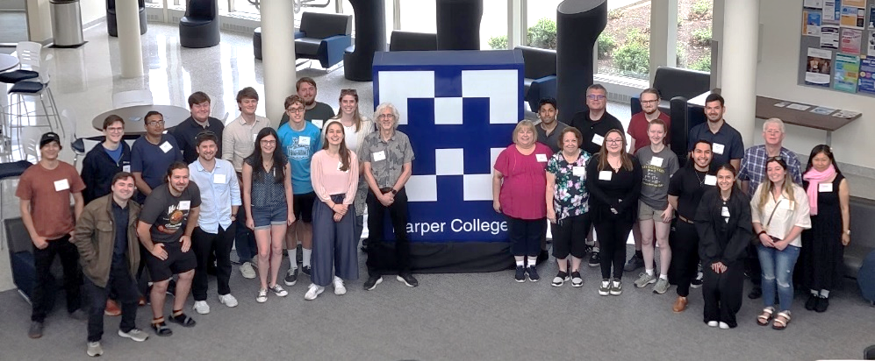
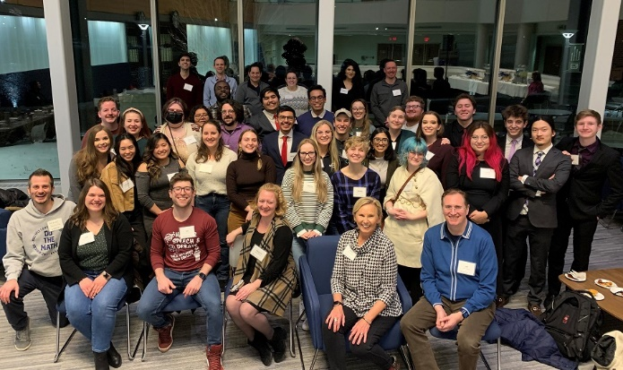
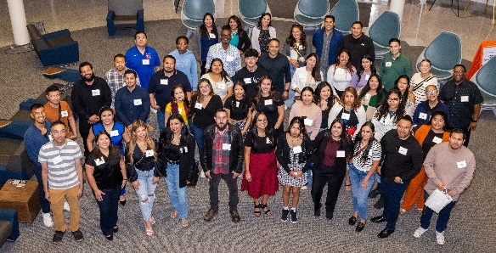
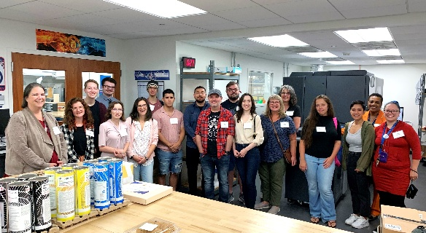
Experiential
Meaningful experiences that inspire, promote mission, celebrate achievements
Alumni Affinity Groups
Engaged students become engaged alumni
Student Organizations
Major/Program Connection
Campus partnerships = Successful Engagement!
Notes:
Affinity Groups programming works to engage alumni in the way that they connected with an institution. We know that engaged students are more likely to connect back as alumni so focusing our efforts on alumni who were a part of a student organization or had a close connection to a major or program is a targeted focus. We look forward to continuing engaging through affinity groups. The campus partnerships with Deans, faculty, and staff have helped to make this programming very successful.

Slide 7
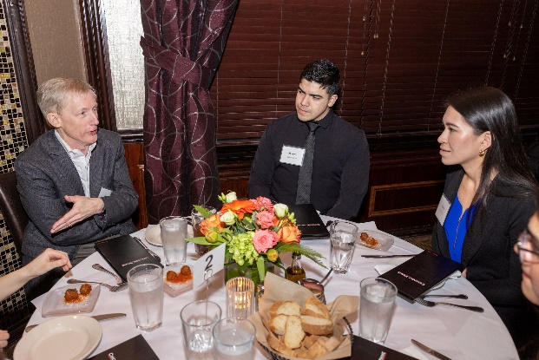
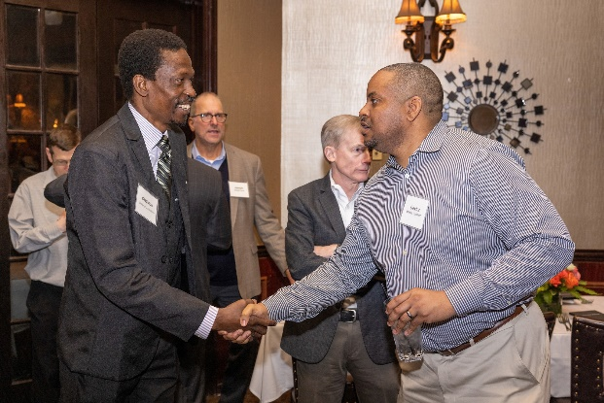
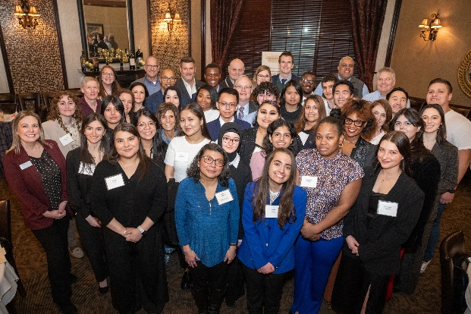

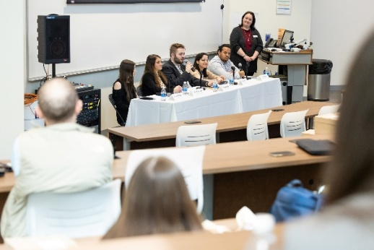
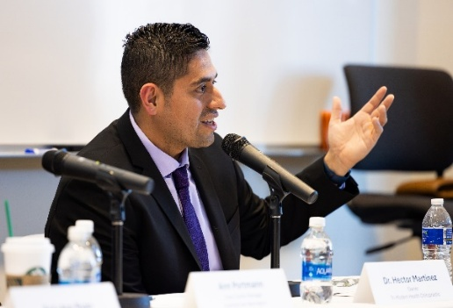
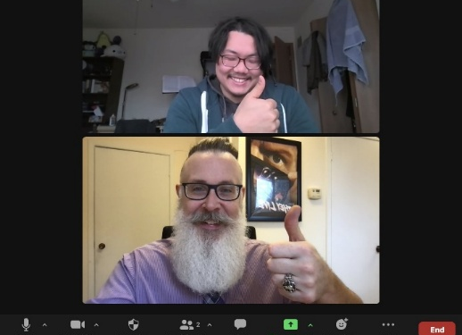
Volunteer
Formal and rewarding ways to give back through time
Creating opportunities to give back
Programs: Career Conversations with Harper Alumni
Speaking opportunities
Distinguished Alumni Virtual Mentoring
Committee Volunteers
Notes:
We work to create volunteer programming for alumni to give back through their time and support students.
This helps:
Creates engaged alumni
Give back time vs. $.
Volunteer programming helps us identify alumni leaders

Slide 8
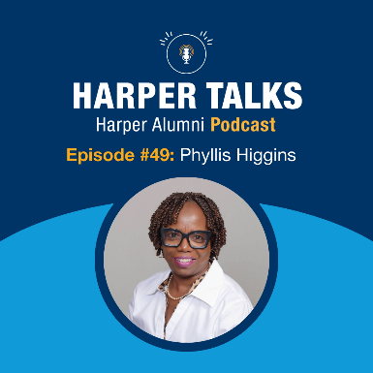

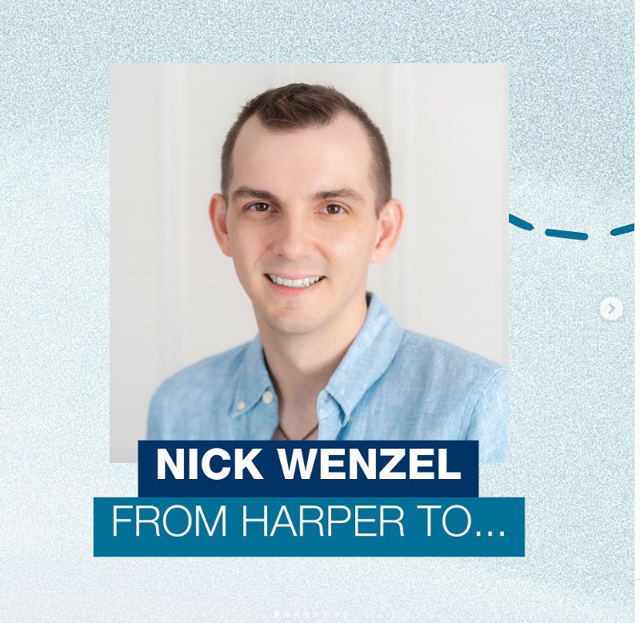
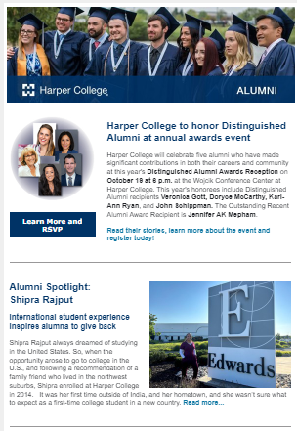
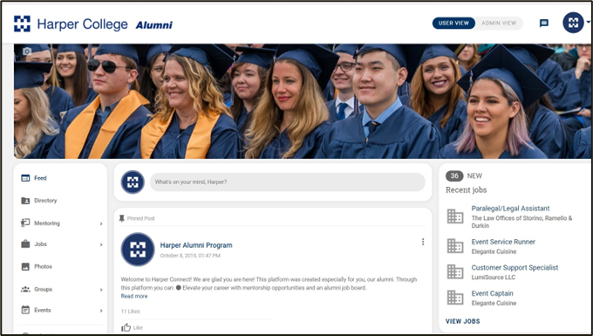
Communication
Interactive, meaningful, informative communication supporting mission and strategic goals
Connecting with alumni
95,000 records; ~30,000 emails
Harper Alumni eNewsletter – 7x per year
  Affinity eNewsletters: Health Careers and Business/Social Science
Alumni Storytelling: Spotlight Features
New Graduate Communication
Social Media: “From Harper to…”
Harper Talks Alumni Podcast
Harper Connect Alumni Network
Notes:
Communication Engagement: We can communicate with our alumni.
We have 95K alumni in the database and of those about 30k with good personal email addresses.
We communicate through our vehicles such as the enewsletter (including two new affinity newsletters), podcast, spotlight features. We work to tell the stories of our alumni.
We also offer alumni to engage through our Harper Connect Alumni networking platform. This allows them to connect with us and each other.

Slide 9
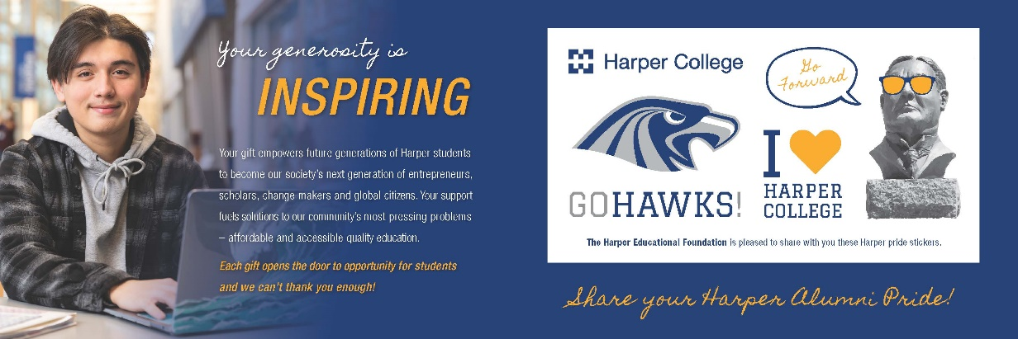
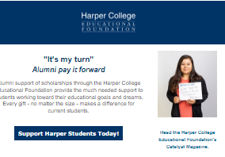

Philanthropic
Diverse, mission driven opportunities for alumni to give back as donors
Alumni philanthropic programming
Scholarships started by alumni
  INSPIRE Campaign
  Distinguished Alumni Endowed Scholarship
Crowdfunding: WHCM Alumni & Friends, Speech Team Alumni, Other Student Clubs
Annual Giving appeals
First-time alumni donor stewardship
Notes:
We provide opportunity for alumni to support the college philanthropically through scholarship creation, supporting the areas they care about the most. We host crowdfunding with student orgs that target alumni as well as through annual giving appeals. We also work to steward our alumni donors and first time alumni donors.

Slide 10
Alumni Relations: Experiential Outcomes
294 alumni attended events in FY25

Slide 11
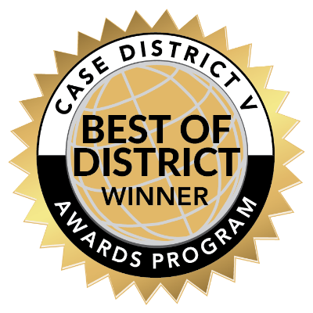
Alumni Relations: Volunteer Outcomes
59 Alumni in volunteer roles in FY25
Career Conversations
with Harper Alumni
Volunteer Engagement

Slide 12
Alumni Relations: Communication Outcomes
7 issues of Harper Alumni eNews annually; 21% avg open rate
48 episodes of Harper Talks
Alumni Podcast
198% increase
in Harper Connect
Membership
since launch

Slide 13

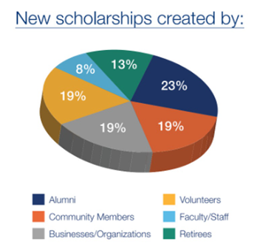
Alumni Relations: Philanthropic Outcomes
138% to goal in alumni giving in FY25

Slide 14
Alumni Relations in FY26 and beyond
Lightcast
Alumni module for career outcomes tracking
SOAR+
Alumni mentorship in the new SOAR+ Student Success Model
Launch of Foundation’s New Strategic Plan
Focus on increasing alumni engagement
Affinity Partnerships
Continued focus on alumni engagement through affinity connections

Slide 15
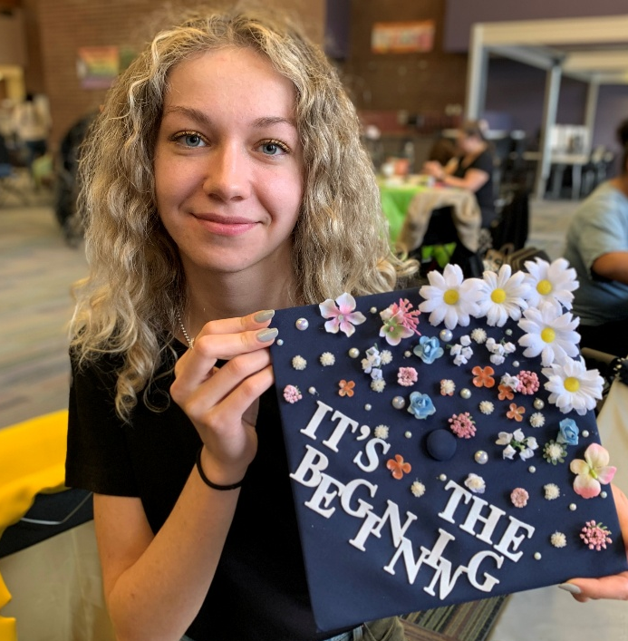

Questions?
Thank you!
Shannon Hynes
shynes@harpercollege.edu
Harpercollege.edu/alumni

