Slide 1
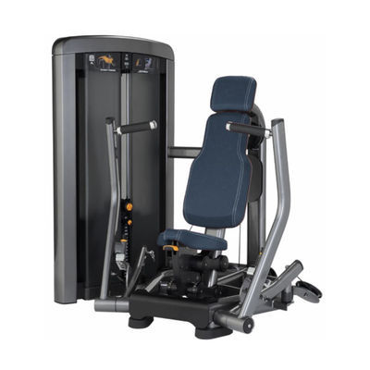
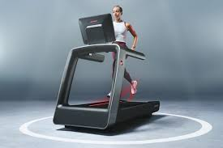
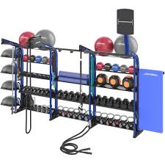


Partnership Update
JULIE BEARDEN
Harper College
Director, Campus Recreation and
Health and Rec Center
JULIE DALY
Life Fitness / Hammer Strength
Director, Biomechanics & Advanced Engineering

Slide 2
Partnership Overview
Core | Auxiliary
5-year agreement | Beta testing equipment
Harper - new fitness equipment | Research studies (IRB)
Life Fitness - exclusive use of M2510 (PIL) | Educational opportunities - Harper students
Notes:
5-year agreement approved by the board in fall 2025
Each partner has core benefit - Harper received new fitness equipment for the rec center & LF received exclusive use of classroom M2510 for their performance insight labs
Additionally beta testing will take place on the fitness floor; research studies will be conducted on the fitness floor and PIL; and other educational opportunities will be available for harper students

Slide 3
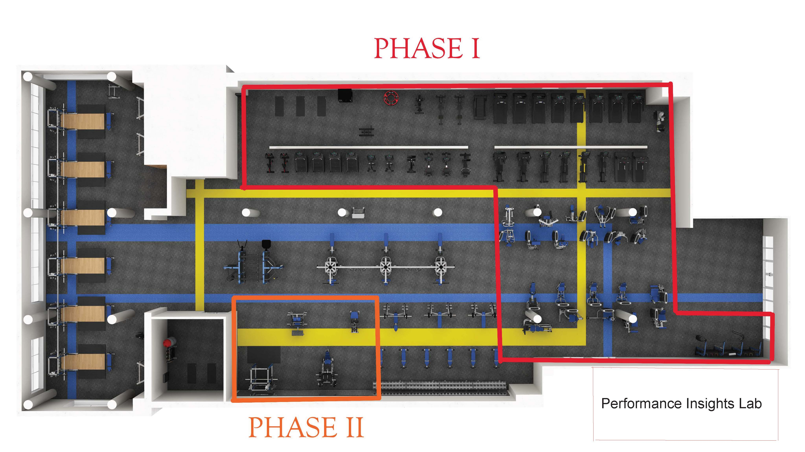
New Fitness Equipment
Notes:
Phase 1 – Oct 2025 / 50 pieces of equipment / 30+ cardio equipment / 21 pieces selectorized / Synrgy180 functional training center / value over $600k
Phase 2 – March 2026 / 6 plate loaded strength machines / over 4 tons of plates and dumbbells / value over $100k
Plus 5 years of preventative maintenance / value over $40k
Anticipate additional equipment upgrades over the course of the agreement
Note performance insights lab location

Slide 4
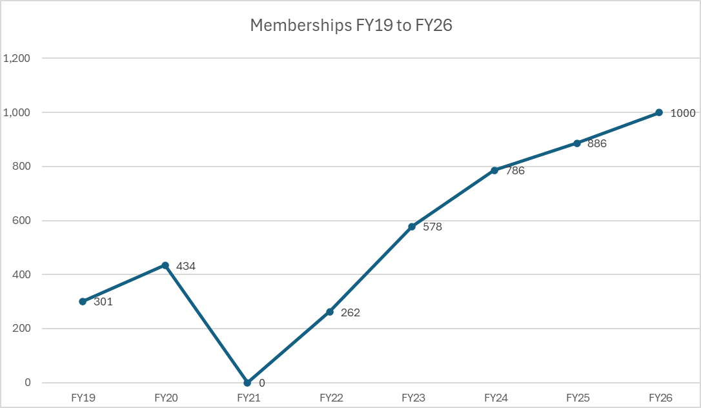
Rec Center Memberships
Source: Bldg. M Rec Automation Membership Software, 2026.
Notes:
Memberships trending up since covid reopening
Saw exponential growth 3-month period after new equipment
Currently at our highest active memberships since renovation

Slide 5
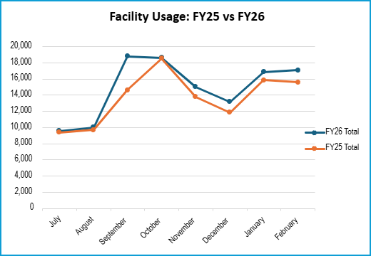
Rec Center Facility Visits
Source: Bldg. M Rec Automation Membership Software, 2026.
Notes:
Total facility visits trending up in FY26 when compared to last year
October was flat because of 5 day closure to install new equipment, but otherwise busier than last year
On target for FY26 to be highest number of visit (exceed fy25 by 20,000)
FY25 – 158,322
FY26 – on target for 170,000

Slide 6
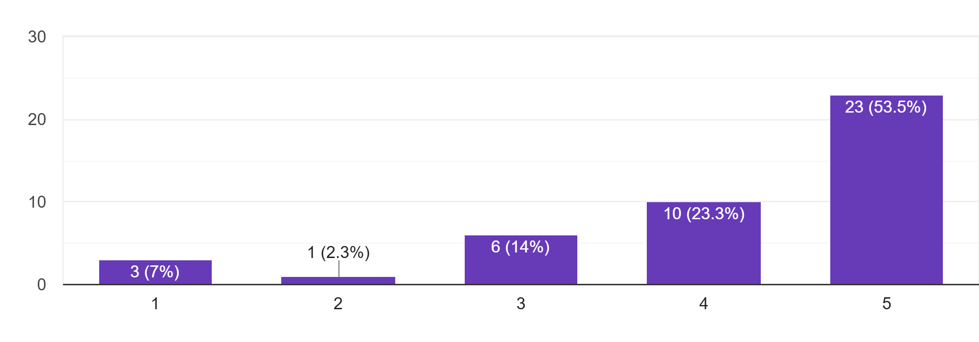
Equipment Pulse Survey Results
91% of responses are satisfied with the new Life Fitness equipment when compared to the previous Matrix Fitness equipment?
Source: Bldg. M Google Forms Survey, March 2026.
Notes:
Conducted March 2026
45 responses – 50% from students
JB intro JD
Julie Daly
Director of Biomechanics and Advanced Engineering
LF

Slide 7
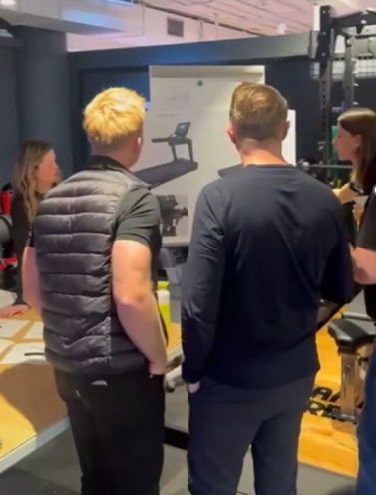
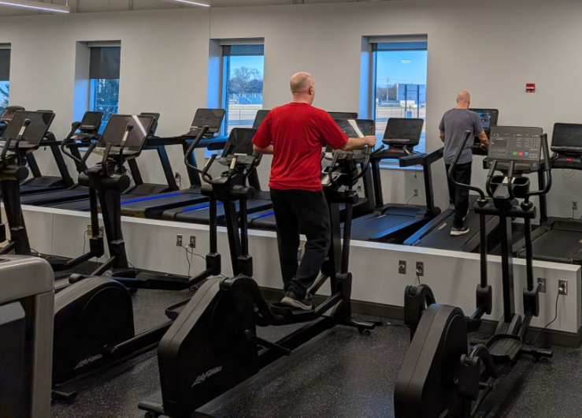
Performance Insights Lab | M2510
Students and staff have the opportunity to participate in product development studies
Customer Research
Discuss exercise trends
Convey exerciser wants/needs
Highlight facility management needs
Relay facility management pain points
Product Beta Testing
Experience new products prior to production
Provide feedback to shape improvements
Product Management
Gathering Customer Insights

Slide 8
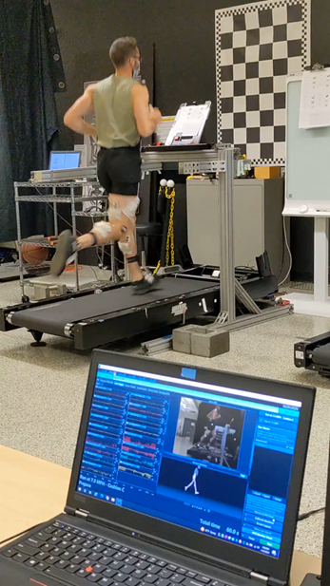
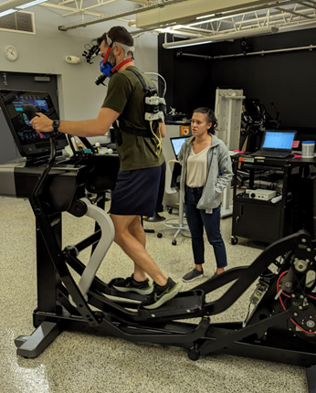
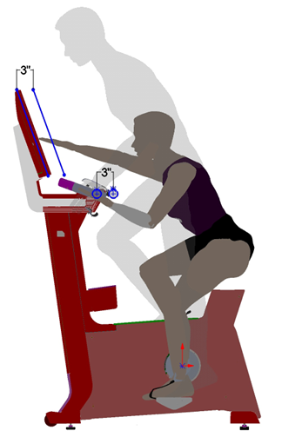
Performance Insights Lab | M2510
Students and staff have the opportunity to participate in product development studies
Biomechanics Lab Testing
Follow study protocol
Observe test setup (sensors, calibration)
Contribute to data acquisition
Understand data analysis
Learn About Product Development
Distilling data into actionable results
Translating results into product specifications
Biomechanics Engineering
Analyzing Exerciser Data

Slide 9
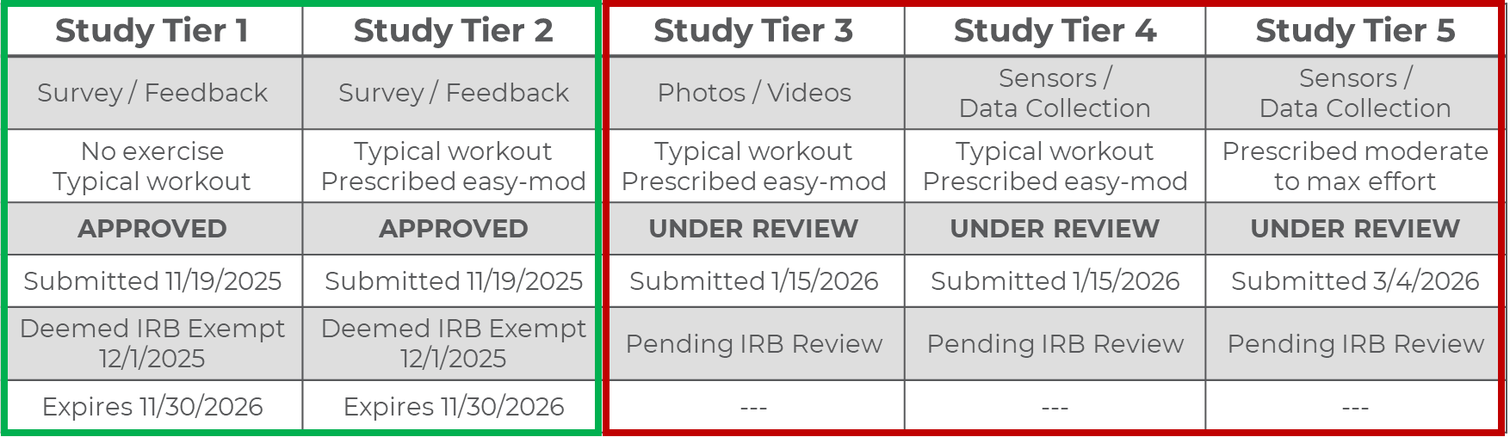
Institutional Review Board (IRB)
Working with Harper College Office of Institutional Research

Slide 10
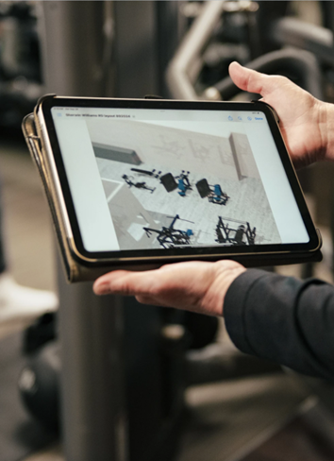
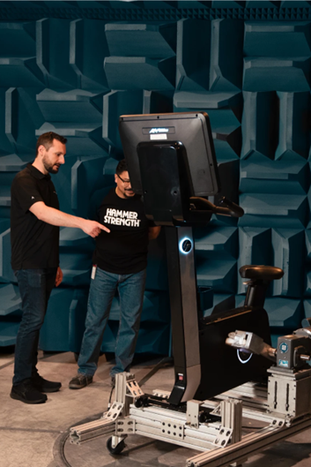
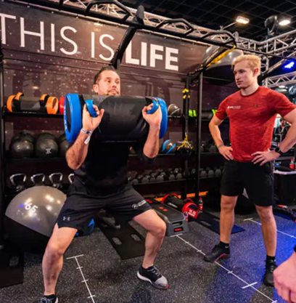
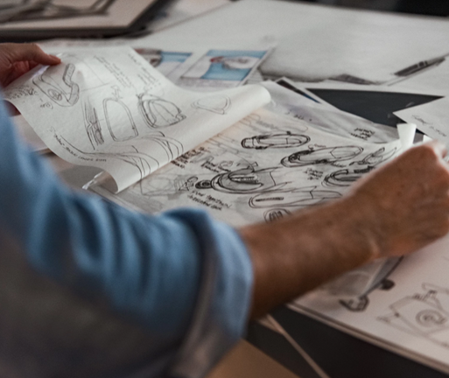
Additional Student Interactions
Potential opportunities for job shadowing / interfacing with teams such as:
Life Fitness Academy
Industrial Design
Marketing
Engineering

Slide 11
Key Takeaways
Partnership is exceeding expectations for both parties
Rec Center memberships and facility visits continue to trend upwards
IRB process is partially approved and moving forward
Product beta testing has started (3 trials to date)
Educational opportunities are underway to benefit Harper students
Notes:
Beta testing – Atmos (specialized cardio line purpose-built for select hotels and residential / i.e. light commercial) was testing at Harper's Rec Center December through March. Line is now launching national
Education opportunties – October Rec Center Fitness Floor monitors attended on-site Life Fitness academy training to learn about the new equipment so they could be prepared to assist members
In February held first meeting between LF and Harper College deans to discuss opportunities for students to work with LF on sound, photo and video shots planned for summer 2026

