Slide 1

Harper College
Employer Engagement
Daniel Brito, Associate Human Resources Business Partner, S&C Electric
Luis Manzo, CNC Apprentice, S&C Electric
Paul Rimington, Community Relations, Weiss-AUG Diemasters
Darice Trout, Sr. Director, Workforce Solutions & Job Placement, Harper College
Harper College Board of Trustee Meeting: May 20, 2026

Slide 2
Engaging with Employers
Advisory Committees
Apprenticeships
Conference & Facility Rentals
Harper Business Solutions
Job Placement Resource Center
Small Business Development Center
Notes:
Apprenticeships: Academic programs designed in partnership
Job Placement Resource Center: Support for employers hiring Harper students and alumni
Small Business Development Center: Supporting employers in in developing and growing their business
Harper Business Solutions: Customized, employer-driven training aligned to business operations
Advisory Committees: Understanding industry needs through Advisory Committees and Business and Industry Leadership Teams
Conference & Facility Rentals

Slide 3
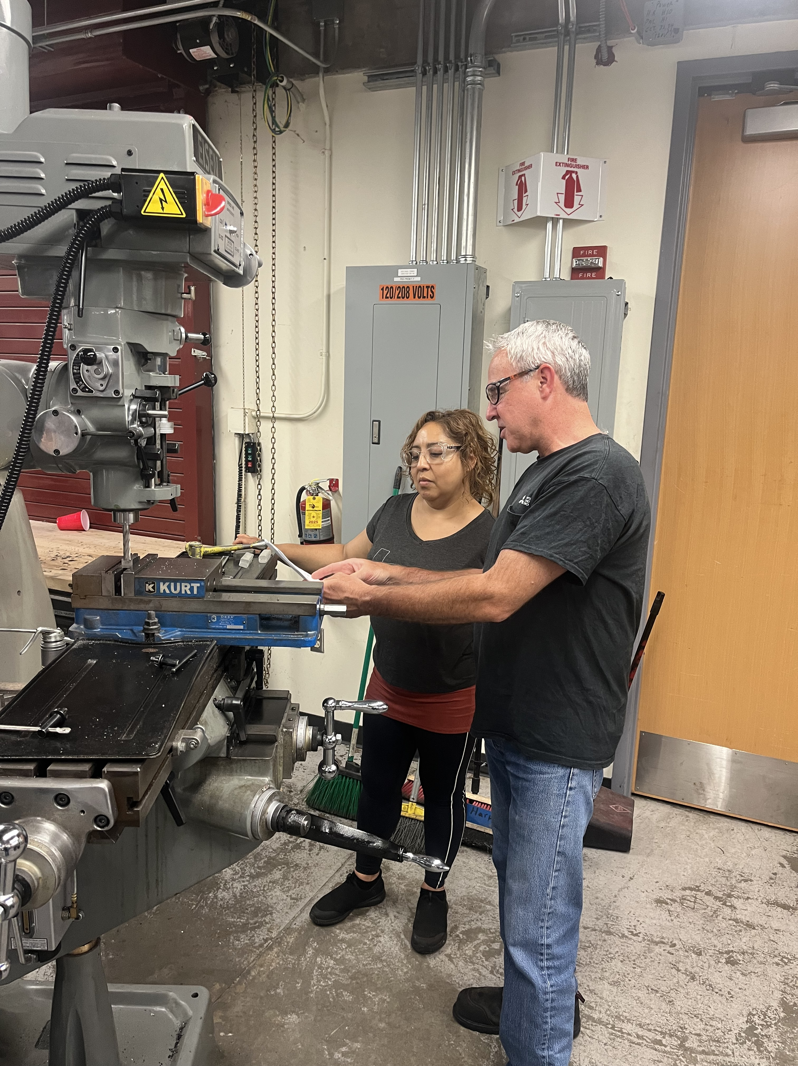
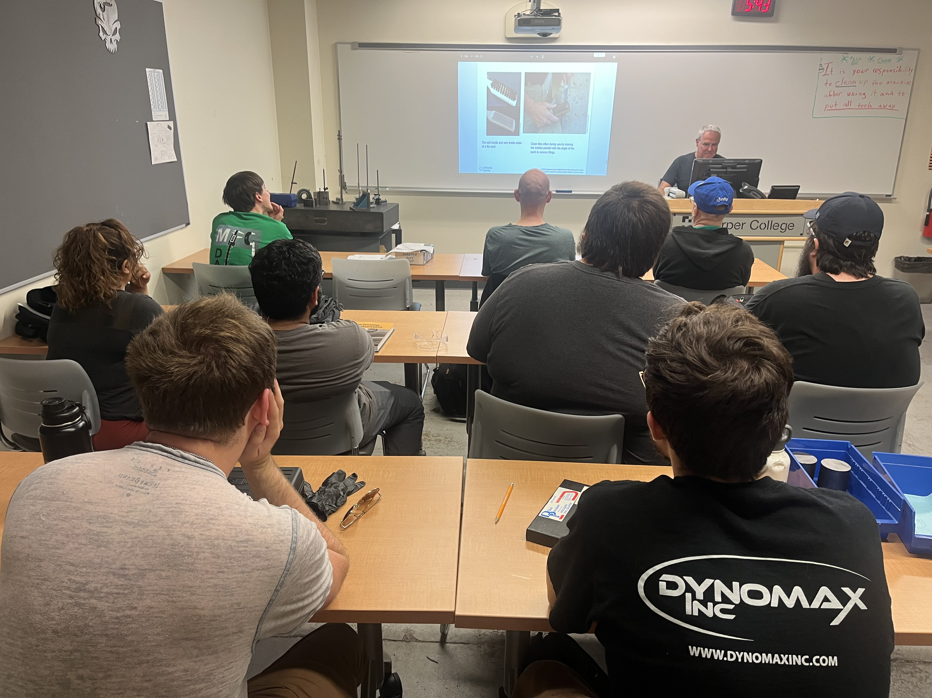
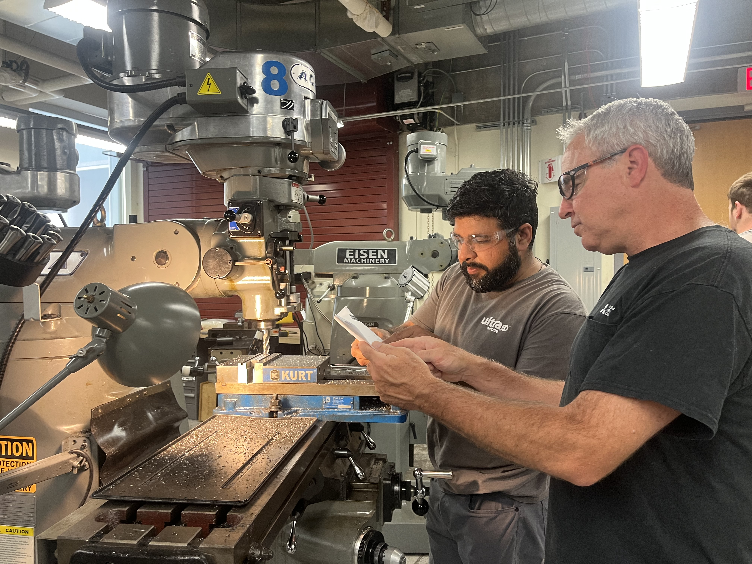
S&C Electric
The Value of Apprenticeships, Employer and Apprentice Perspective

Slide 4
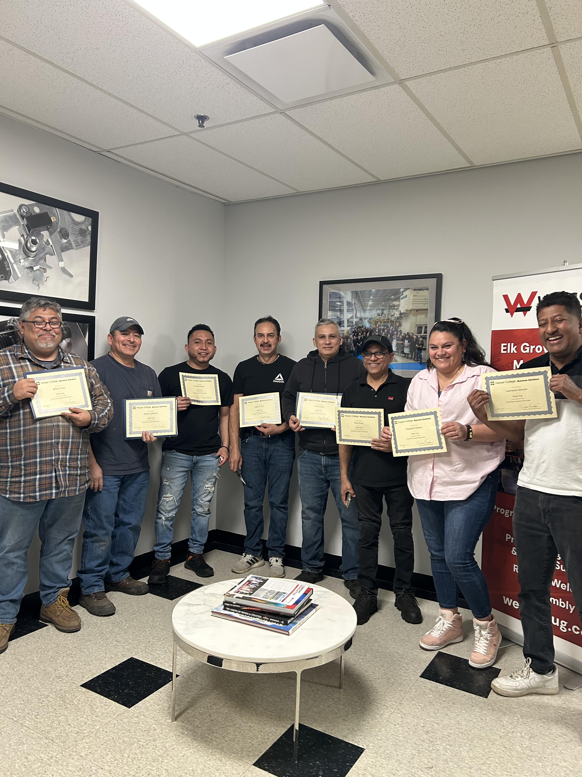
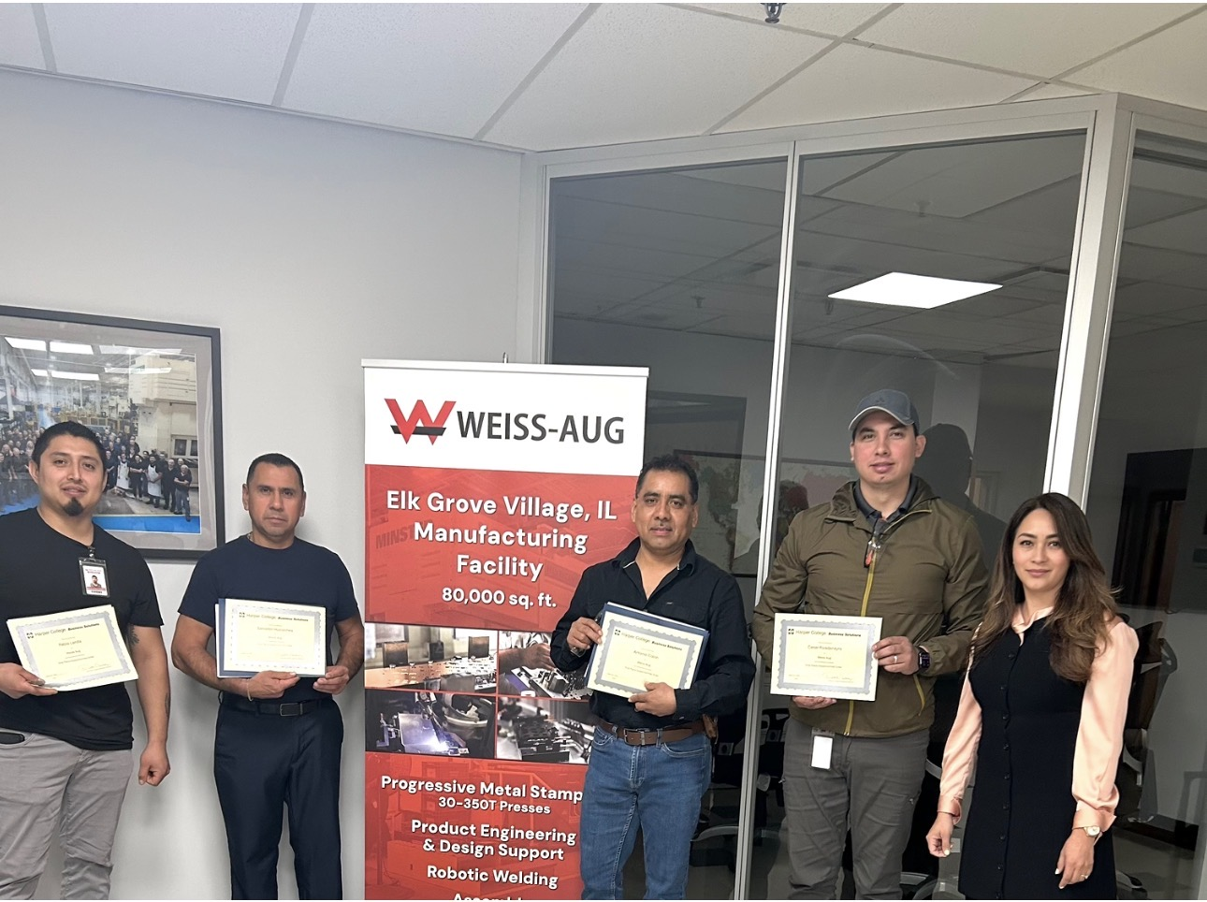
Weiss-AUG Diemasters
Advisory Committee Engagement
Harper Business Solutions; Workplace ESL Courses

Slide 5
Thank you!
Workforce Solutions
Building Talent Pipelines.
Strengthening Businesses.
Advancing the Regional Economy.

