Slide 1

Spring 2026 Student Achievements

Slide 2
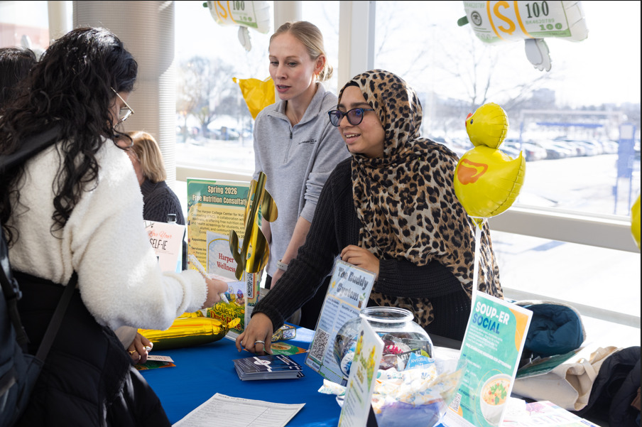
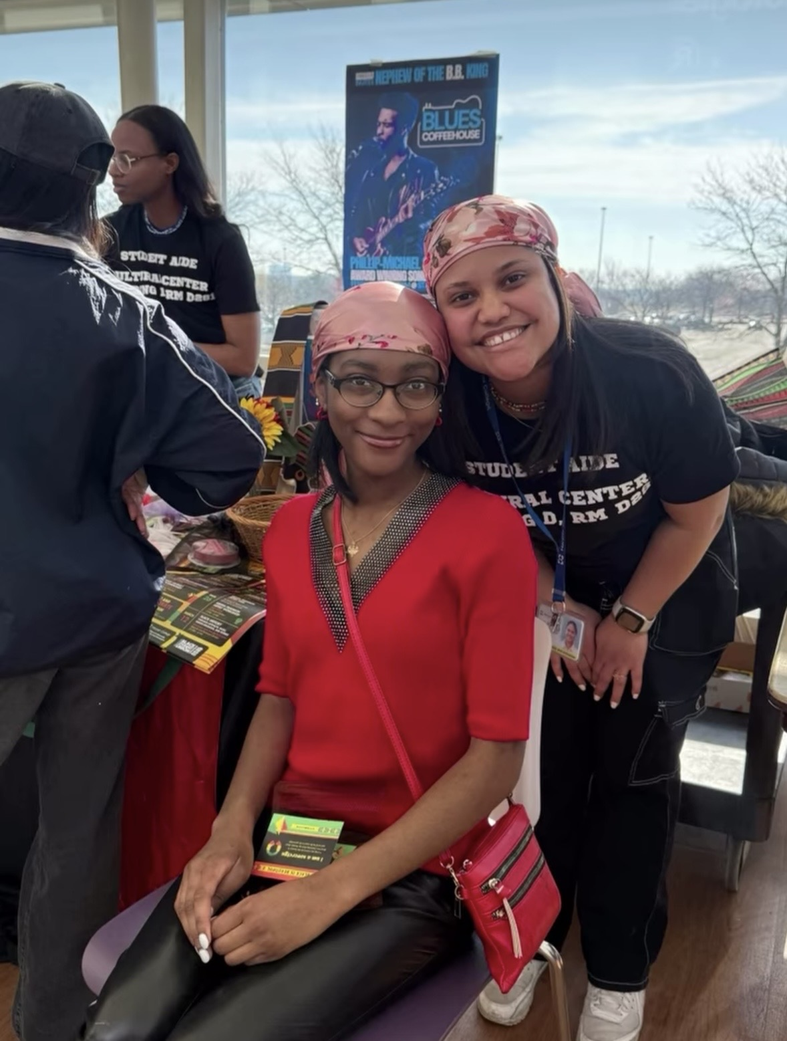
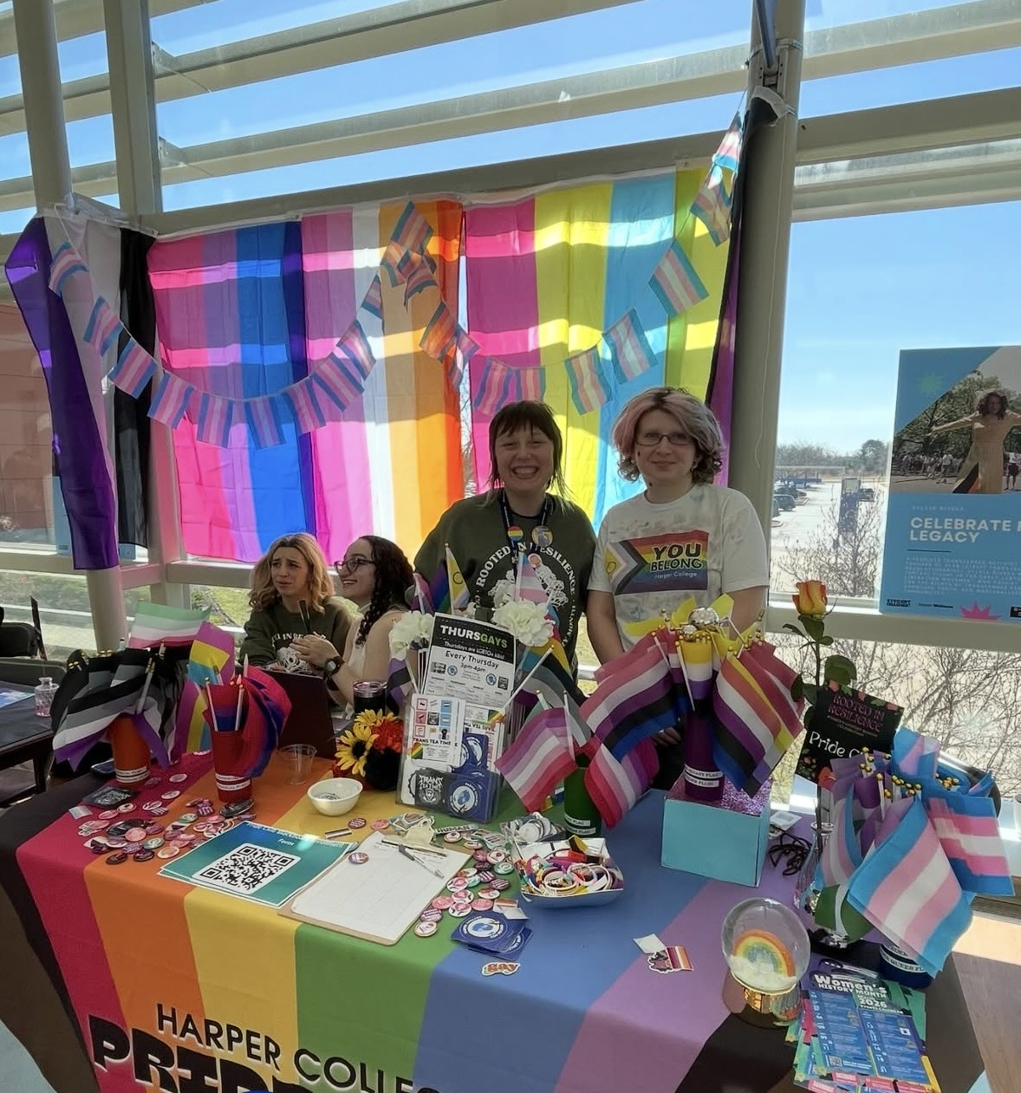
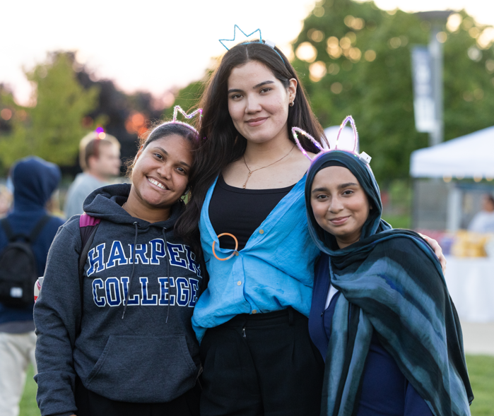
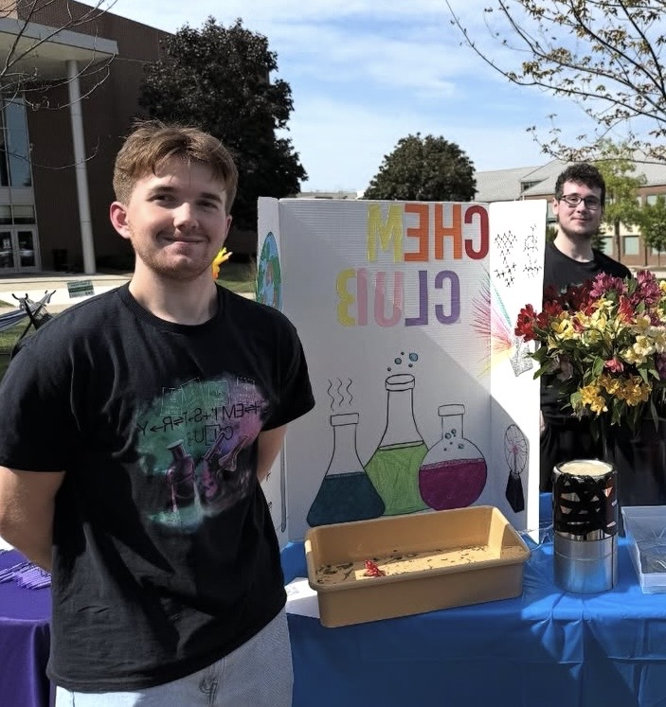
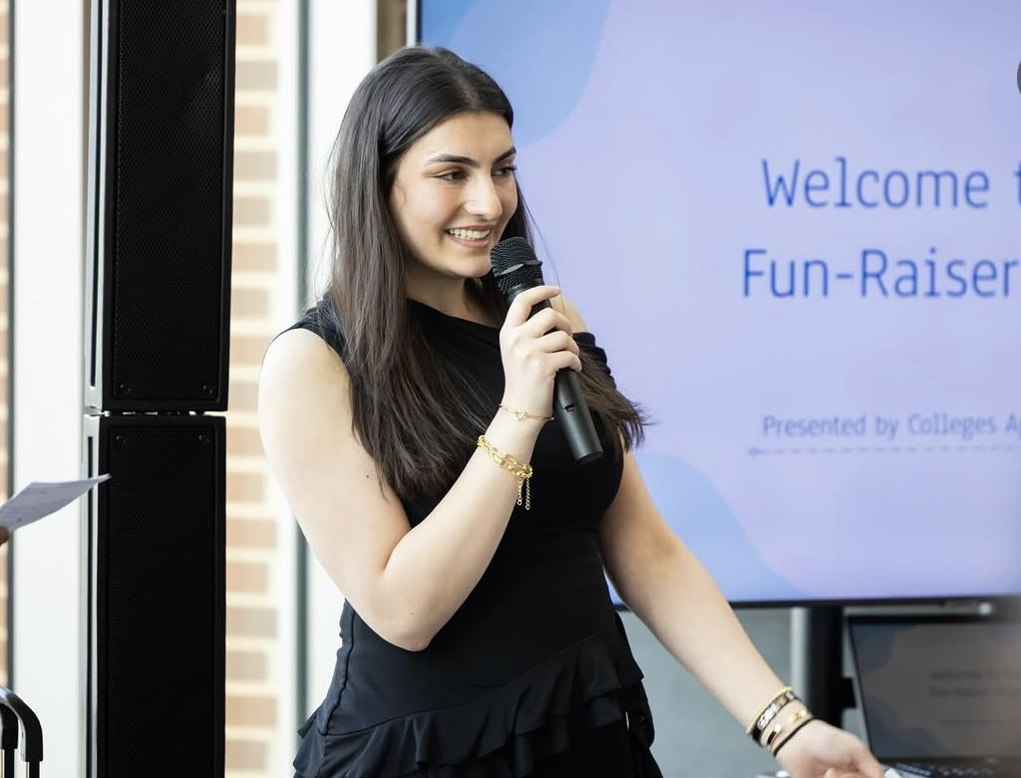
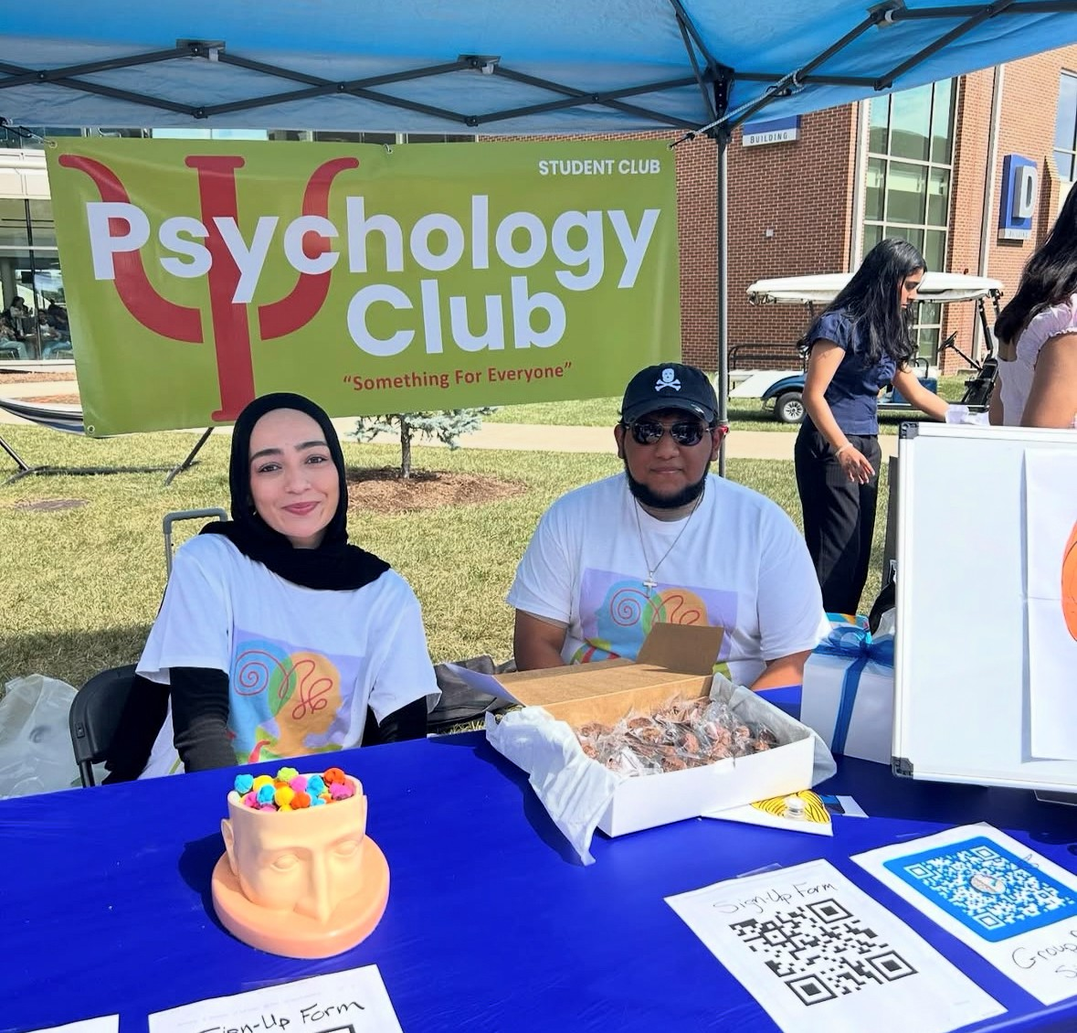
Student Service Awards
Ruveyda Aydin
Ryan Bustos
JP Federkins
Himeka Hoshino
Michael Johnson
Nineveh Khabeer
Manaal Khan
Tugba Odabas
Jacqueline Ramos
Annelys Suarez
Notes:
Student Service Awards are recommended in lieu of salaries, tuition waiver grants, or other
means of payment for particular student positions. They are recommended based on
consideration of a nominator’s assessment of a student’s leadership performance, position(s)
held in clubs or organizations, length of service, academic credit-hour completion, and the
grade-point average achieved during the specified semester. A student’s eligibility for an award
is based on an evaluation of each of these criteria.
Monetary student awards are presented in recognition of specific campus responsibilities by
Student Engagement as a means of compensating student leaders for significant contributions
to campus life. The Board of Trustees is asked to approve Student Service Awards after each
semester. Education funds are allotted each year for these awards.
Awards require students to maintain a GPA of 2.0 and higher and be cleared through the Dean
of Students for any student misconduct violations.

Slide 3
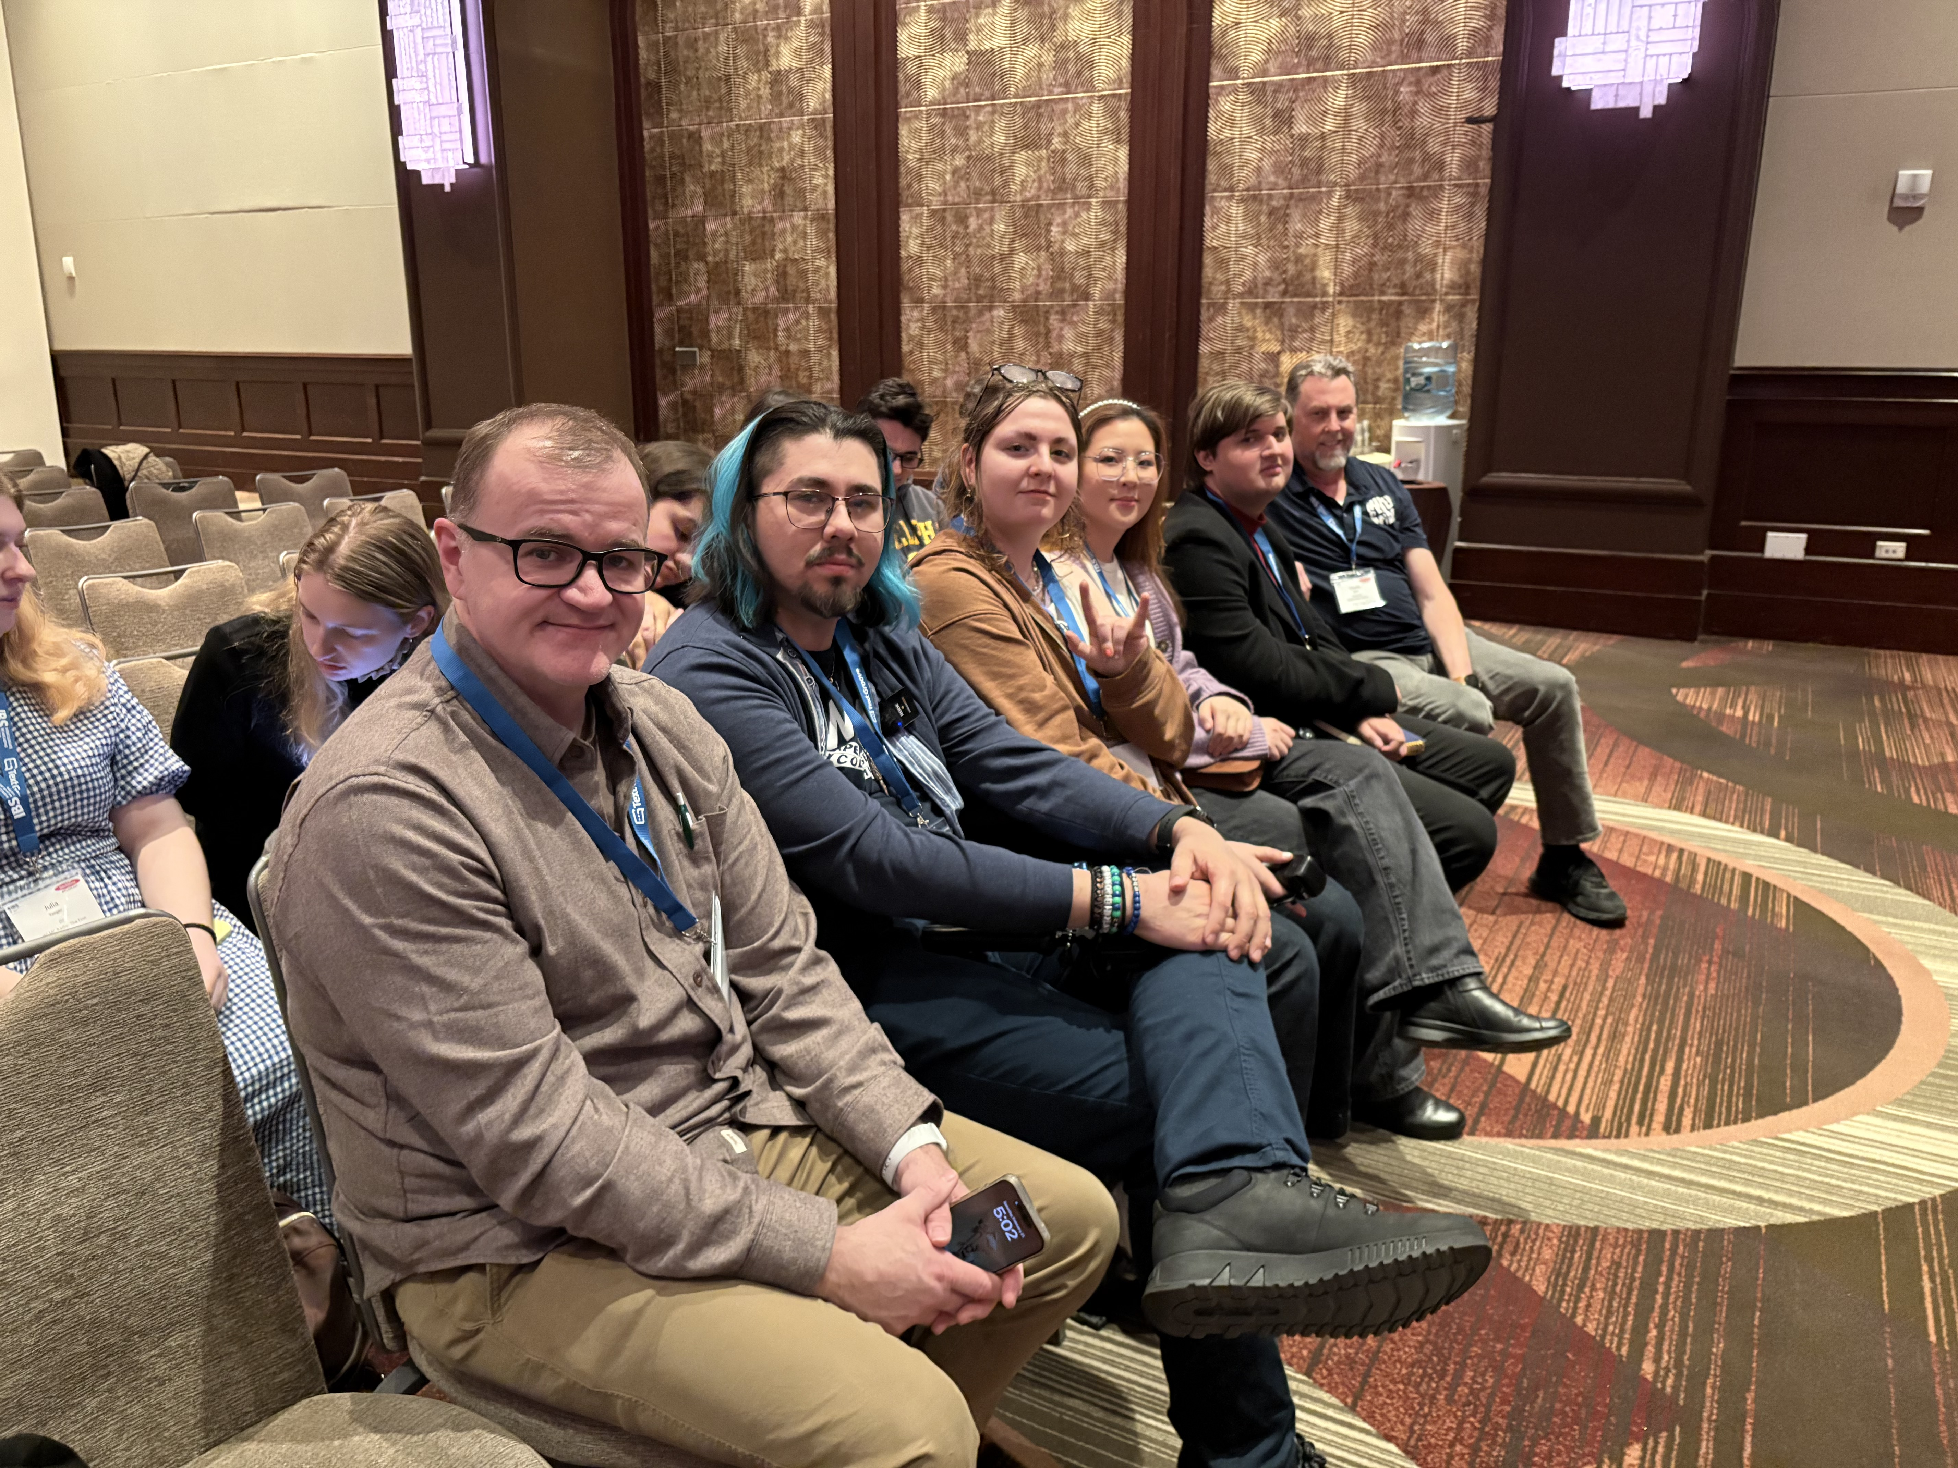

2026 Intercollegiate Broadcasting Awards
Finalist: Best Community College Radio Station
Finalist: Best Foreign Language Program:
Yare Lopez
Winner, Best Community Volunteer Program: Erik Hanson

Slide 4

Best of Festival Winner:
Zoe Meshenberg
Audio Documentary 25 years
of Harper Radio
_____________________________
1st Place Winner:
Abeer AbuGhalyoun
Harper Talks Video Production

Slide 5
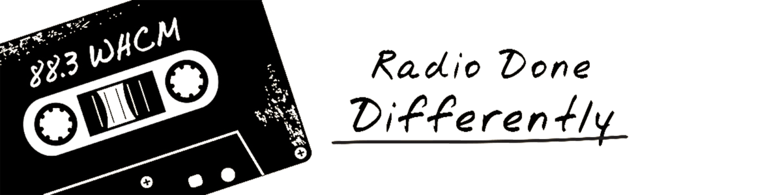
Andy Hood
Zoe Meshenberg
Abraham Salazar
Alexander Para
Erin Sage Gillies
Norbert Grzymkowski
Robbin Llamas
Mike Sulka
Chris Causer
Kira Orgil
Jason Mayschak
Kathleen Miljevich
Devinity Rodriguez
Yare Lopez
Larry Moy
Vic Krol
Samuel Garcia
Abeer Abu Ghalyoun
Emmanuel Dona
Lily Nicoll
Jobani Gonzalez
Tyler Goodman
Morgan Smith
Walter Moist
Erik Hanson
Kris Piepenburg
Gerardo Cruz
Cristina López
Esmeralda Guerrero Lopez
Jorge Perez
Keith Maurice Harris
Chris Smith
Charlie Ayers
Jon Decatorsmith
Erica Berger
Brian Diaz
Nina Stoner
Matthew Byrne
Ricardo Garcia
Mike Prendergast
Coby Pozo
Ben Dojutrek
Angel Lopez
Josilyn “Blue” Bailey
Costa Petropoulos
Meghan Gilles
Leslie Jordan Bernal
Harper College Radio Staff 25-26
General Manager: Blue Bailey
Program Director: Coby Pozo

Slide 6

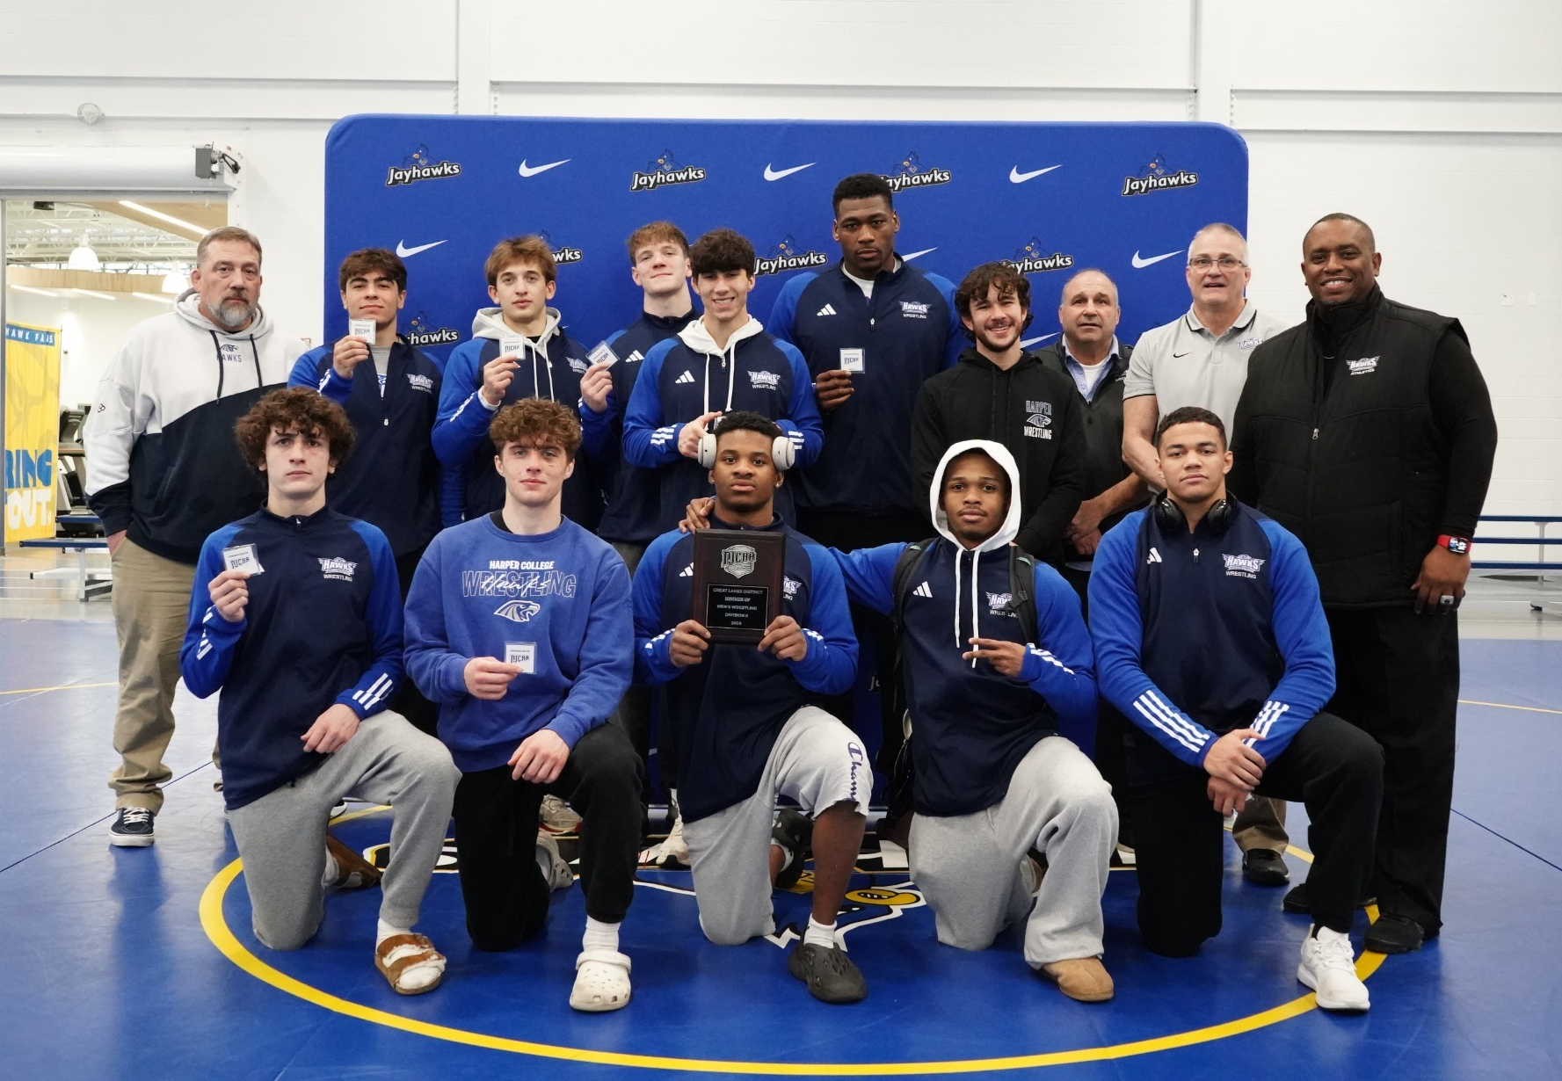
Harper Hawks
Spring 2026 Achievements
Noah Brockie
Aiden Cohen, All-American
Michael Galloway
Maguire Hoeksema
Joshua King
Michael Merevick
Tyson Poyer
Samuel Sikorsky
Lennon Steinkuehler
Truth Vesey, All American
NJCAA DIII National Runners-Up
Men's Wrestling

Slide 7
Harper Hawks
Spring 2026 Achievements
Men's Track & Field
19 National Qualifiers
3rd Place Nationals
Joaquin Aguilar, Shot Put, Discus, Hammer
Sean Burke, 10K
Ryan Cipra, 4 x 100m relay, 4 x 400m relay, 100m
Jake Cody, National Champion in Hammer, Shot Put
Dominic Giuseffi. 4 X 100 m relay, 100m, 200m
Nico Navarrete, 4 x 400m relay, 400m
Stefano Nomikoudis, Pole Vault
Anthony Pupillo, 200m
Ian Shahwaiz, Triple Jump
Fernando Velasquez, 4 x 400m relay, 400m
Sebastian Welc, 1500 m
All American Athletes
Jaylen Calhoun, High Jump, 4 X 100m relay, 200m
Ryan Golden, 4 x 800 m relay, 4 x 400m relay, 1500 m, 5K
Jerome Graessle, 10K and 5K
Stephen Osei , Pole Vault, 4 X 100 m relay
Michael Johnson, 3000m Steeplechase, 4 X 800 m relay, 5K
Nate Larson 4 X 800m relay, 1500 m, 800m
Vladyslav Nakhim, Hammer, Shot Put, Discus, Javelin
Carter Swearingen , 4 X 800m relay

Slide 8
Harper Hawks
Spring 2026 Achievements
Women's Track & Field
4 National Qualifiers
9th Place Nationals
Daisy Flores, 400m, Long Jump, Triple Jump
Kasey Ledinsky, National Champion 3000m Steeplechase, All American, 800m, 1500 m
Lucy Reyna, Pole Vault, 200m, 400m
Hannah Schulz, All American, Discus, Hammer, Shot Put, Javelin

Slide 9


Vanessa Carrasco
Glamour Egbe
Notes:
Two of our fashion studies students, Glamour Egbe and Vanessa Carrasco won the 2026 Community College Scholarship Competition conducted by Fashion Scholarship Fund in New York city. Each of these students will receive the following :
The $5,000 Scholarship award payment
Mentoring opportunities
The FSF Virtual Summer Scholar Series
The July Fashion Industry Immersive Experience in California and New York City

Slide 10
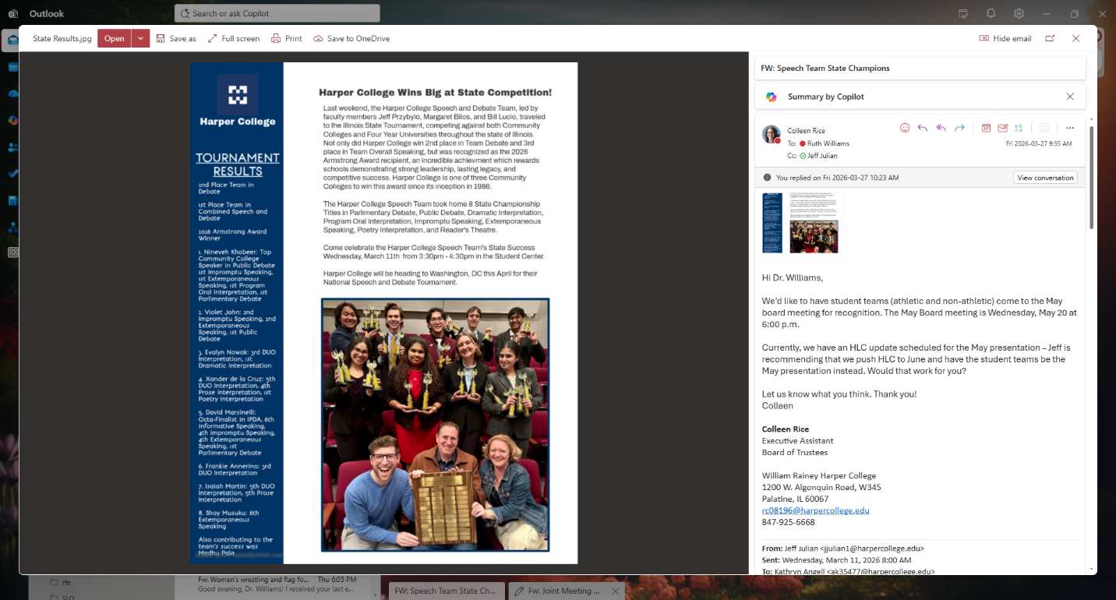
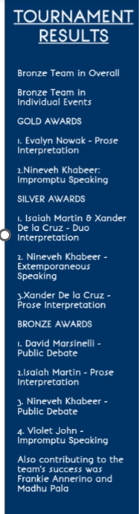
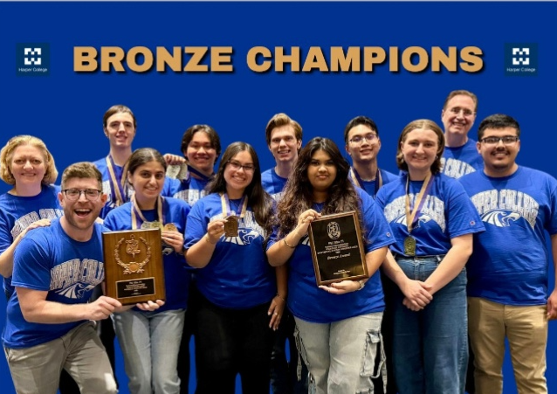
Speech and Debate Team
Illinois State Tournament
2nd Place, Team Debate
3rd Place, Team Overall Speaking
Armstrong Award
Phi Rho Pi National Forensics Tournament
5th Place (Bronze)
Xander de la Cruz, Frankie Amenno, Violet John, Nineveh Khabeer, David Marsinelli, Isiah Martin, Shay Mosuku, Evelyn Nowak, Madhu Pala
Notes:
At the Illinois State Speech Tournament, Harper College won the Armstrong Award, an honor given to the program that has accumulated the most points at the state tournament over time.
The Speech and Debate Team returned from the Phi Rho Pi National Tournament as BRONZE CHAMPIONS! Our students worked so hard this year and brought home another championship title for Harper College. Not only were we the 5th place school in the entire country, but we beat out all the other Illinois colleges in attendance, making us the highest ranked and awarded school in the state of Illinois! Also, our amazing colleague Jeff Przybylo was recognized by tournament leadership with an award named after him, cementing his legacy not just for Harper College, but for all of his service regarding Speech, Debate, and Forensics in general!

