Slide 1


Advancing Harper’s 2028 Reaffirmation Efforts
Building institutional readiness through engagement, planning & continuous improvement
Veronica Mormino, Professor of Geography
Dr. Kathleen Gorski, Associate Provost of Curriculum & Instruction
Notes:
Today we want to share how Harper is advancing our 2028 HLC reaffirmation through engagement, planning, and continuous improvement. Reaffirmation isn’t something that starts the year before a visit—it’s the result of sustained, institution-wide work. This presentation highlights what we’ve accomplished this year and how that work positions us well for April 2028.

Slide 2
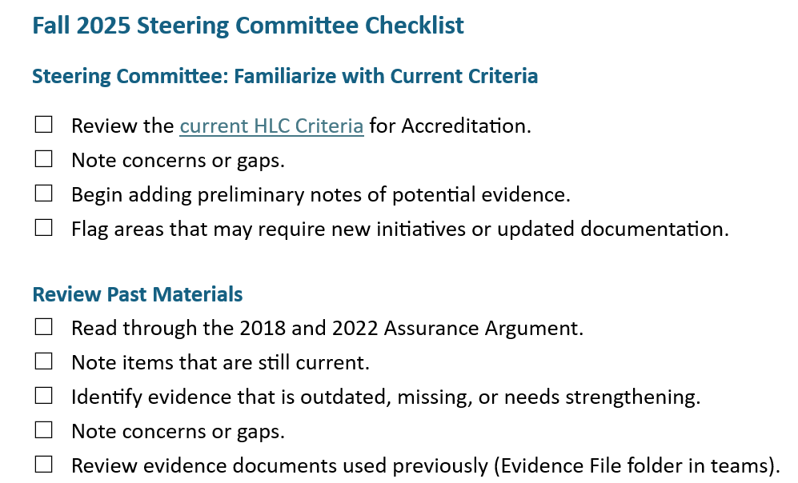
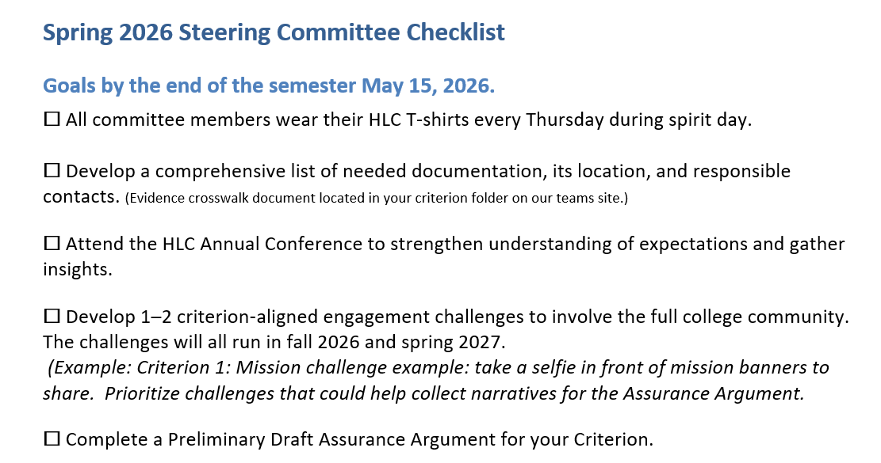

Advancing Harper’s 2028 Reaffirmation – A Year in Review
Outcome: By the end of Spring 2026, evidence summaries will be
compiled from all 4 criterion and preliminary draft of arguments will be created.
Notes:
We want to begin by thanking our HLC Steering Committee and criterion teams. Over the past year, more than 100 Harper employees—faculty, staff, and administrators—have been actively engaged in reaffirmation work. Teams have been reviewing HLC criteria, identifying gaps, and beginning to prepare well ahead of the 2028 visit. This spring, the focus shifted to reviewing past assurance arguments and collecting and organizing evidence, so this work is thoughtful and intentional—not rushed.

Slide 3
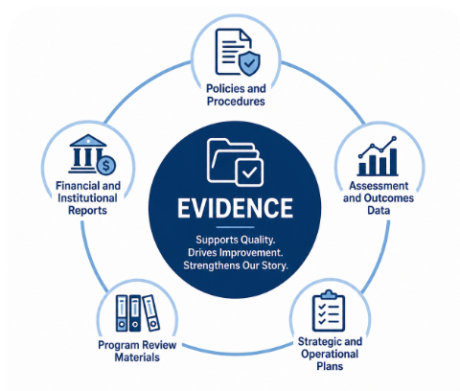
Preparing the Assurance Argument: Understanding HLC Evidence
Evidence Demonstrates:
Institutional quality and effectiveness
Student success and continuous improvement
Alignment with HLC accreditation criteria
Examples of Evidence:
Policies and procedures
Assessment and outcomes data
Strategic and operational plans
Program review materials
Financial and institutional reports
Evidence is more than a collection of documents. It supports Harper’s Assurance Argument and tells the story of how the college fulfills its mission.
Notes:
This slide is an overview of the quality work our teams are doing collecting evidence. It is also a good reminder that evidence is more than a collection of documents. Evidence is what supports Harper’s assurance argument and tells the story of how we fulfill HLC’s criteria. Strong evidence demonstrates: Institutional quality and effectiveness
Student success and continuous improvement
Clear alignment with HLC expectations
You’ll see familiar examples here—policies, assessment data, program review materials, strategic plans, and financial reports—but what matters most is how they work together to tell a coherent story. Good evidence doesn’t just document what we do; it shows how we learn, improve, and evolve.

Slide 4
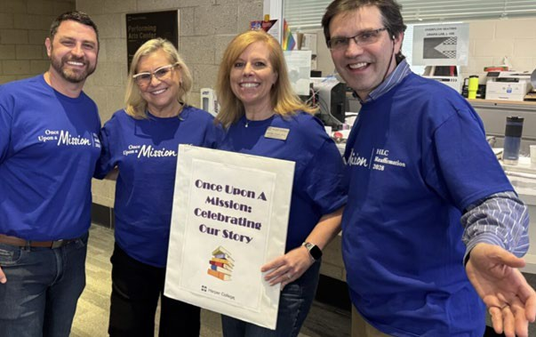
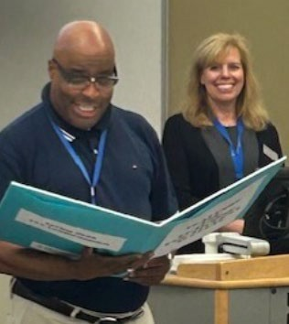
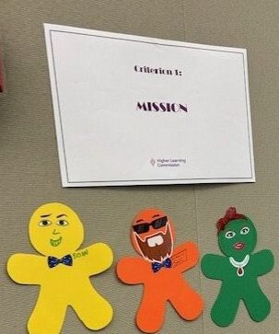
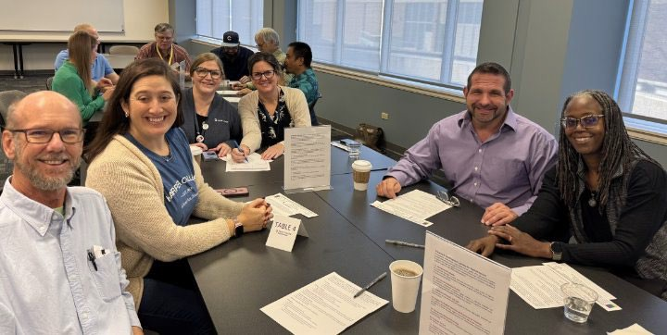
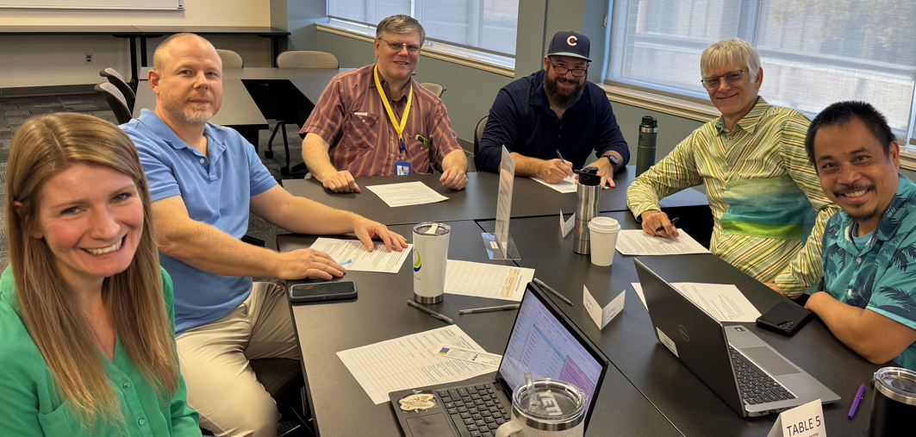
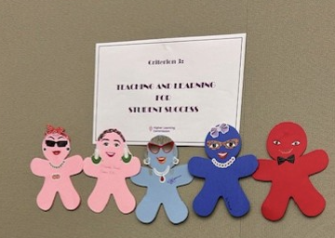
HLC Campus Engagement
Established a Steering Committee
Recruited criterion-based committees
Launching the Work Together
          Summer Retreat
          Board Meeting
          Opening Week
          Hullabaloo
          Operations Council
          Provost Meeting
          President’s Address
Notes:
From the beginning, we have been intentional about broad campus engagement. We established a steering committee and recruited criterion-based committees to ensure shared ownership. Reaffirmation work is being woven into existing campus events: Summer Retreat
Board meetings
Opening Week
Operations Council, Provost meetings, and the President’s Address
This approach reinforces that accreditation is not separate from our work—it reflects our work.

Slide 5

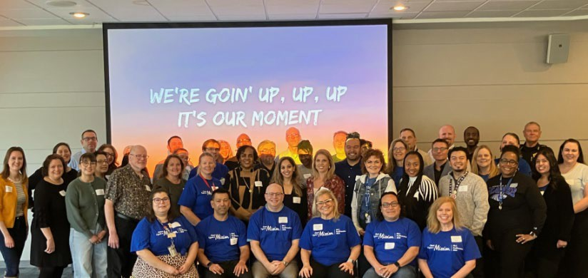
Reaffirmation in Motion
Launched Criterion-Based Committees
Built a Shared Digital Workspace
Initiated Structured Review Across Committees
Embedded Evidence Collection Into Ongoing Work
Notes:
We launched criterion-based committees. This slide highlights the HLC criterion kick-off meeting on January 9th during opening week. After kick off, we created a shared digital workspace to support transparency and collaboration. Through structured review, teams are identifying how our current practices and processes align with HLC expectations. This helps ensure our assurance argument reflects the real work of the institution.

Slide 6
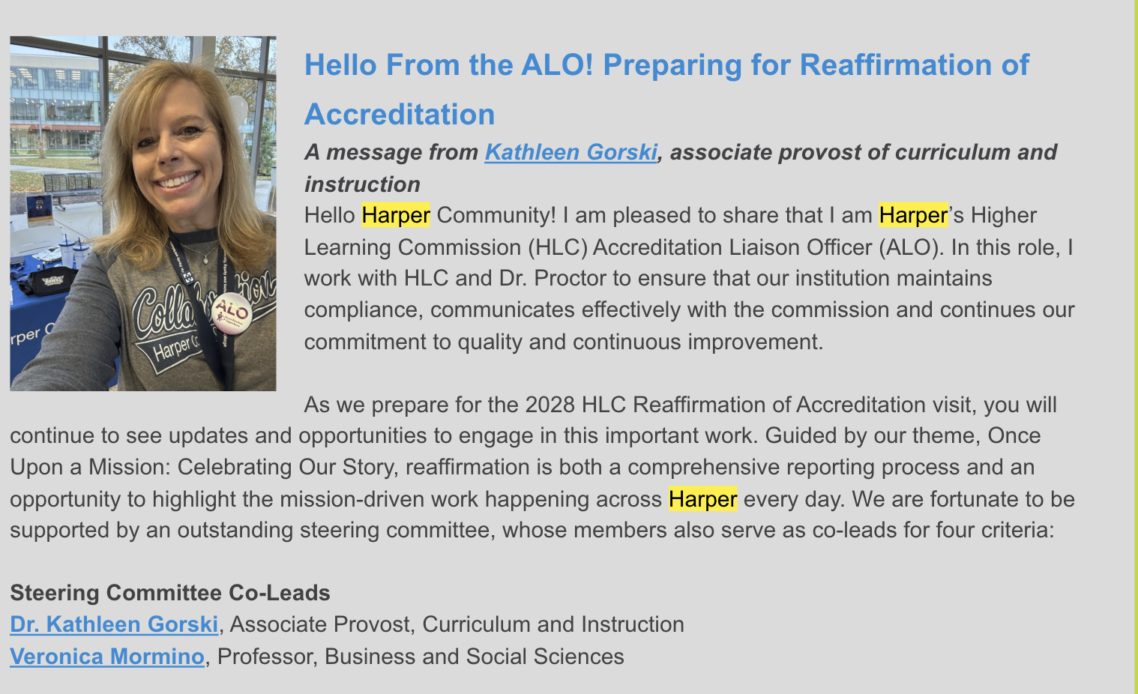
Accreditation Awareness and Preparation
“Hello From the ALO!” launched in Inside Harper to support campus awareness and engagement around reaffirmation.
Harper’s Steering Committee attended the 2026 HLC Annual Conference to advance preparation for the April 2028 visit.
Conference learning focused on accreditation expectations, institutional quality and continuous improvement.
Supporting a culture of continuous improvement and shared responsibility for Accreditation.
Notes:
We also focused on campus awareness and professional learning.
We launched the “Hello from the ALO!” feature in Inside Harper to keep accreditation visible and accessible across campus.

Slide 7
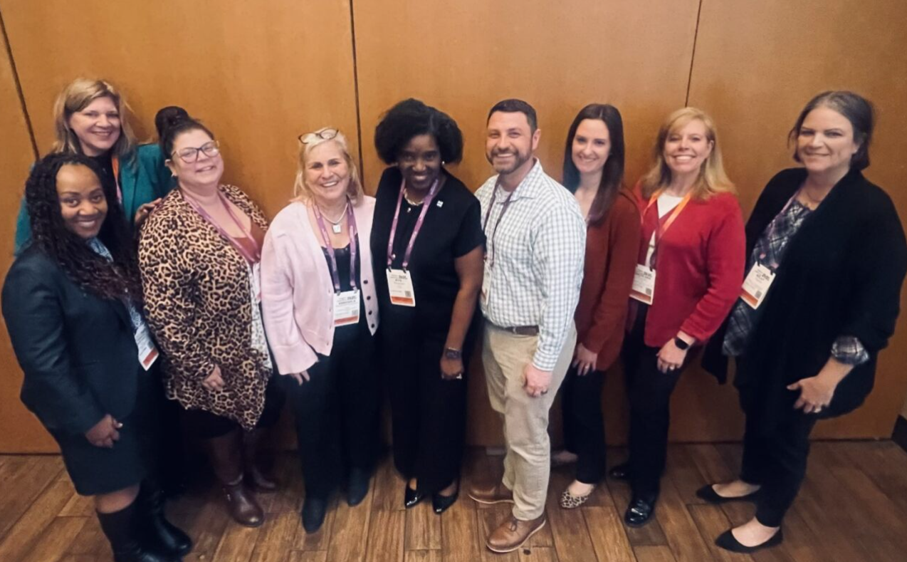
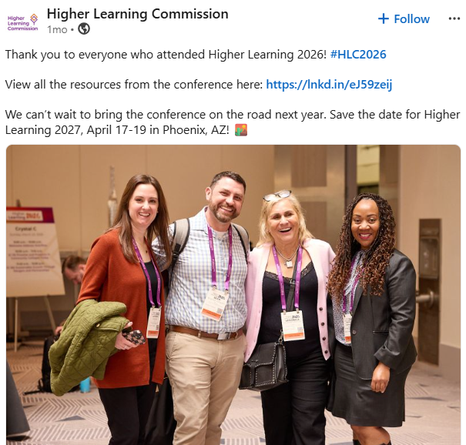
Accreditation Awareness and Preparation
Notes:
Members of the Steering Committee attended the 2026 HLC Annual Conference, deepening our understanding of expectations, institutional quality, and continuous improvement.
A highlight for us was that four Harper attendees were featured on HLC’s LinkedIn page, recognizing Harper’s engagement at the national level.
All of this supports a culture of shared responsibility for accreditation.

Slide 8
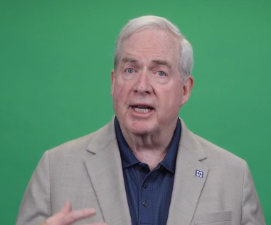
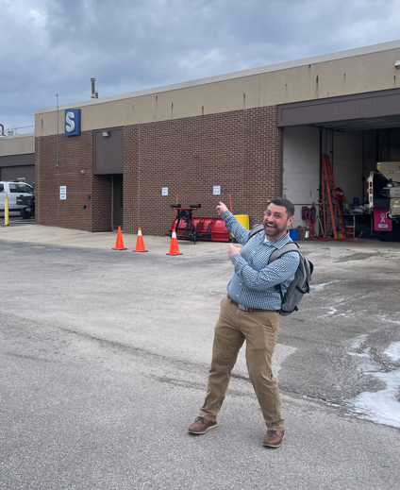
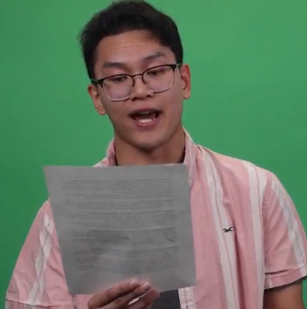
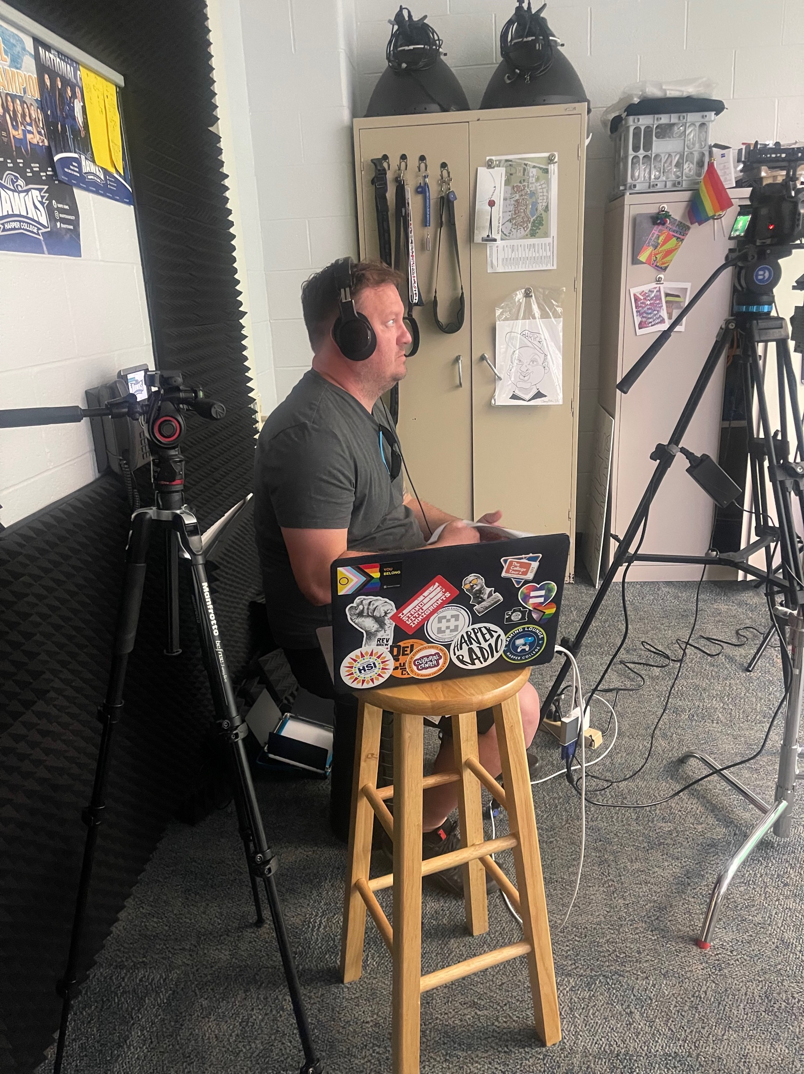
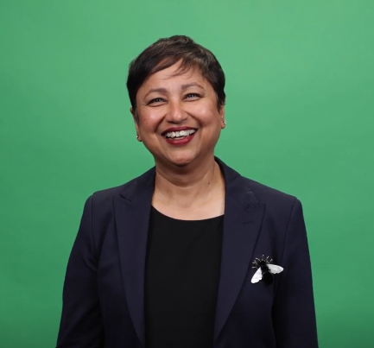
Preparing for the Fall 2026 – VIDEO DAY!
Criterion teams developed video scripts reflecting on the meaning and impact of each HLC criterion across the institution.
The project highlights student voice, faculty and staff perspectives, and mission driven work across the college.
The videos are designed to engage the entire Harper community in preparation for the April 2028 reaffirmation visit.
Focus areas include mission, integrity, teaching and learning, institutional effectiveness, planning and continuous improvement.
Notes:
One of our initiatives to prepare for the fall was Video Day.
Criterion teams developed short video scripts reflecting the meaning and impact of each HLC criterion across the institution.
These videos intentionally include faculty, staff, and student voices, reinforcing that accreditation reflects the full Harper experience. We were excited to have Chair Kelly participate. We want to thank Marketing for their support and especially Michael Hubatch or his patience as we all had multiple TAKES. A fun behind-the-scenes moment captured here is Sean helping the team locate where the recording student needed to stand in the S Building—no small task given ongoing construction.

Slide 9
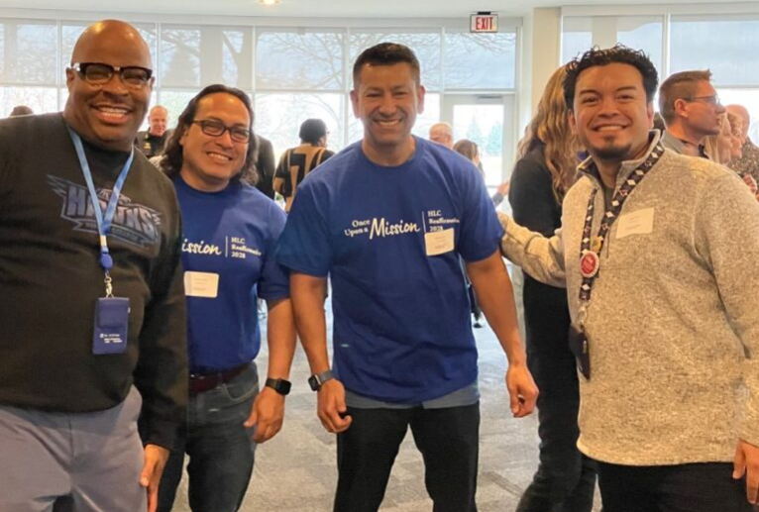
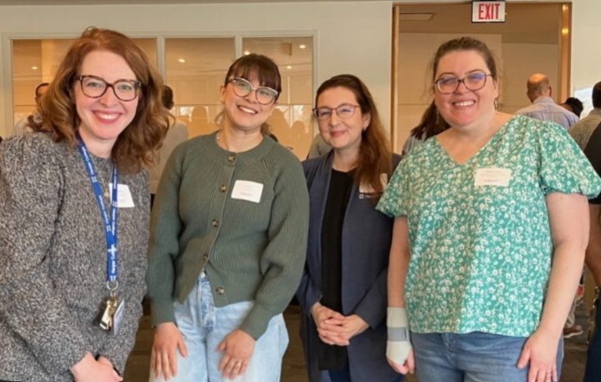
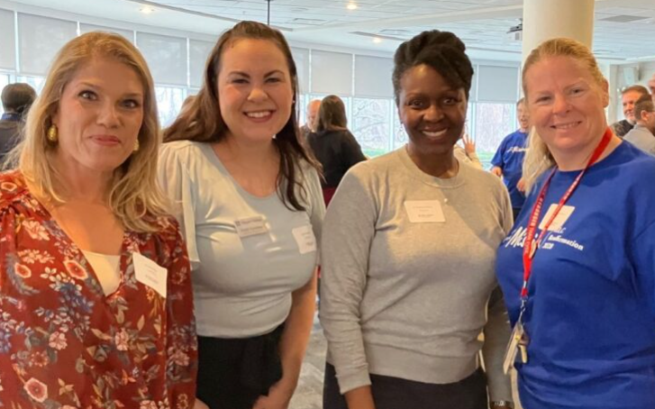
Fall 2026
Opening Week Engagement and
Campuswide HLC Updates
Continued Evidence Collection
Draft Reviews with Stakeholders
Initial Mock Review and Feedback Sessions
Next Steps: Preparing for Continued Engagement
Summer 2026
Attend HLC Workshop: Collaborating on Quality: Preparation for the Comprehensive Evaluation
Steering Committee Retreat and
First Review of the Assurance Argument
Preparation for Expanded Campus
Engagement and Communication
Focusing on collaboration, engagement, and institutional readiness for Harper’s April 2028 Reaffirmation Visit.
Notes:
As we look ahead to fall, our focus is on expanding campus-wide engagement.
This includes:
Opening Week reaffirmation activities and updates
Continued evidence collection and draft reviews with stakeholders
Initial mock reviews and feedback sessions
We’re also planning fun, team-based campus challenges tied to the HLC criteria to keep momentum high and involvement meaningful.
The goal is to build understanding, enthusiasm, and readiness well before the visit.

Slide 10

Notes:
We appreciate the collective effort that has gone into this work and welcome any questions, ideas, or feedback. Reaffirmation is a shared journey, and we’re grateful for everyone who continues to contribute.

