Slide 1

August 18, 2026
Dr. Sean Warren-Crouch, Director of College Transitions
Lisa Haegele, Assistant Director Dual Credit

Slide 2
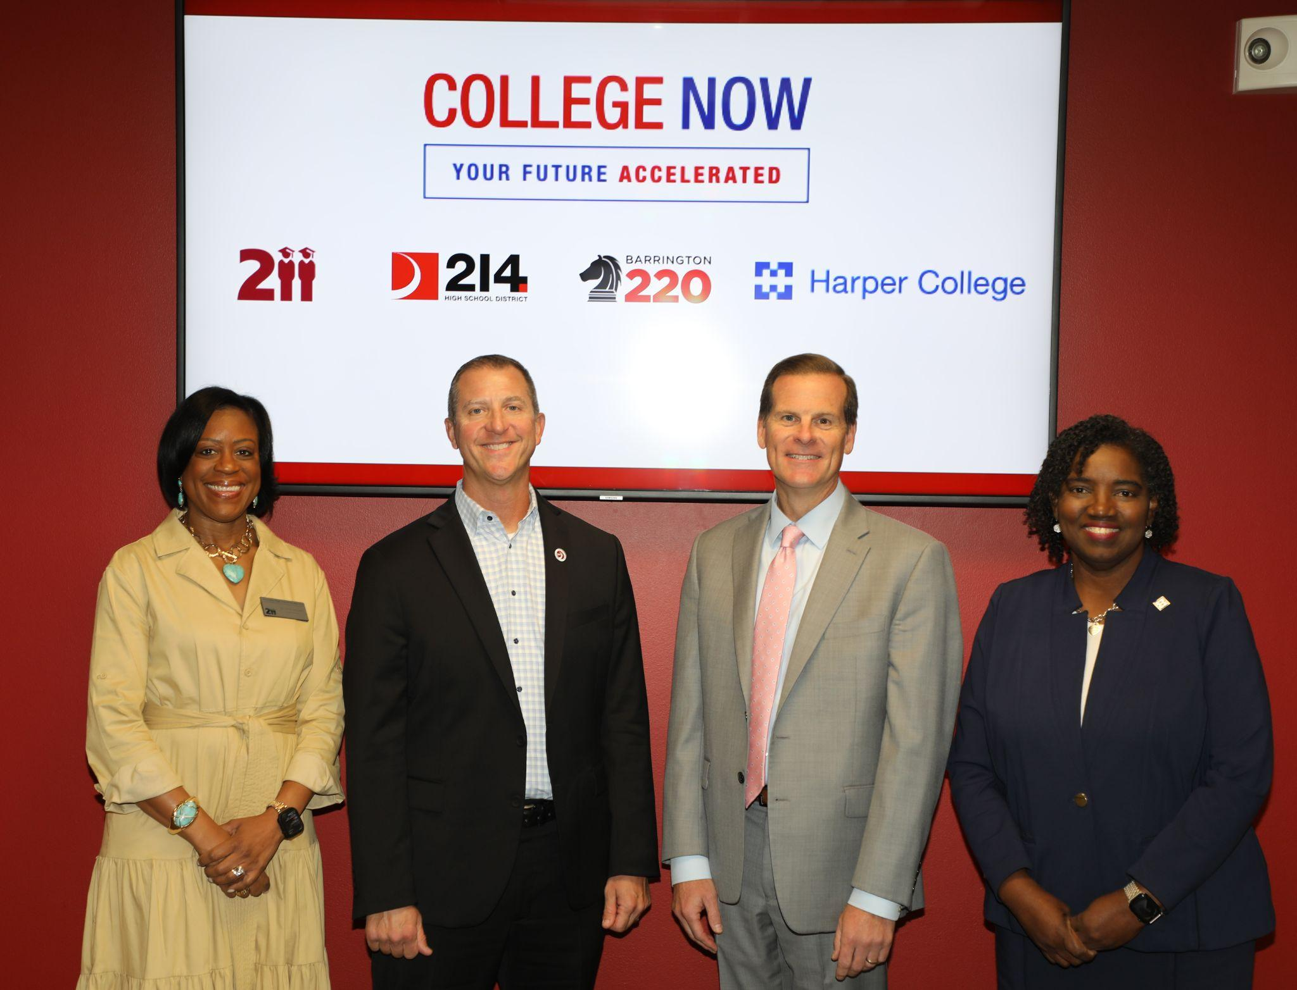
College Now Program
Partnership between Harper College, and high school districts 211, 214, and 220
High School Diploma and AA degree simultaneously
First cohort starting this fall!

Slide 3
Recruitment of Inaugural Cohort
Program Launch – September, 2025
Over 400 Inquiries
Applications Received – October, 2025
312 Applied

Slide 4
Recruitment of Inaugural Cohort
Program Launch – September, 2025
Over 400 Inquiries
Applications Received – October, 2025
312 Applied
Initial Acceptance – Late October, 2025
89 Accepted

Slide 5
Recruitment of Inaugural Cohort
Program Launch – September, 2025
Over 400 Inquiries
Applications Received – October, 2025
312 Applied
Initial Acceptance – Late October, 2025
89 Accepted
Met High School Semester 1 Requirements– January, 2026 - 88 Accepted

Slide 6
Recruitment of Inaugural Cohort
Program Launch – September, 2025
Over 400 Inquiries
Applications Received – October, 2025
312 Applied
Initial Acceptance – Late October, 2025
89 Accepted
Met High School Semester 1 Requirements– January, 2026 - 88 Accepted
Met Testing Requirement– March, 2026
48 Met Testing Requirements

Slide 7
Recruitment of Inaugural Cohort
Program Launch – September, 2025
Over 400 Inquiries
Applications Received – October, 2025
312 Applied
Initial Acceptance – Late October, 2025
89 Accepted
Met High School Semester 1 Requirements– January, 2026 - 88 Accepted
Met Testing Requirement– March, 2026
48 Met Testing Requirements
Enrolled Students
43

Slide 8
Welcoming the First Cohort
Virtual Family orientation held 8/3
  Lots of great questions and insight learned

Slide 9
Welcoming the First Cohort
Virtual Family orientation held 8/3
  Lots of great questions and insight learned
In-person student orientation to be held 8/21
  Walk student schedule
  Ensure technology needs
  Pick up textbooks
  Meet key people and classmates
Classes begin 8/24

Slide 10


Piloting new technology -
Qwickly allows students to tap their phones to check-in
Near Field Communication (NFC) technology
Expansion opportunities based on pilot
Notes:
Lisa

Slide 11
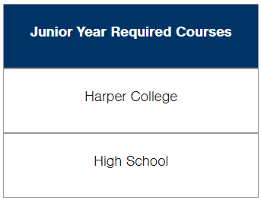
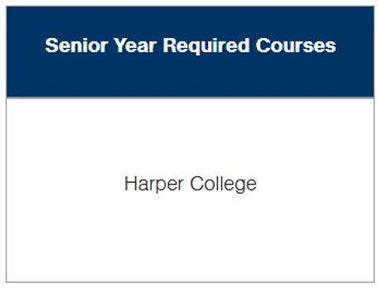
College Now Structure

Slide 12
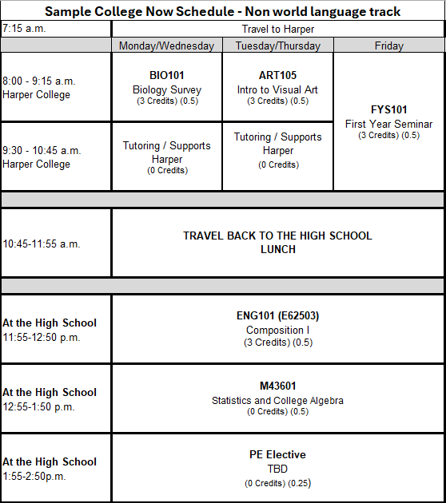
Sample First Semester Schedule

Slide 13
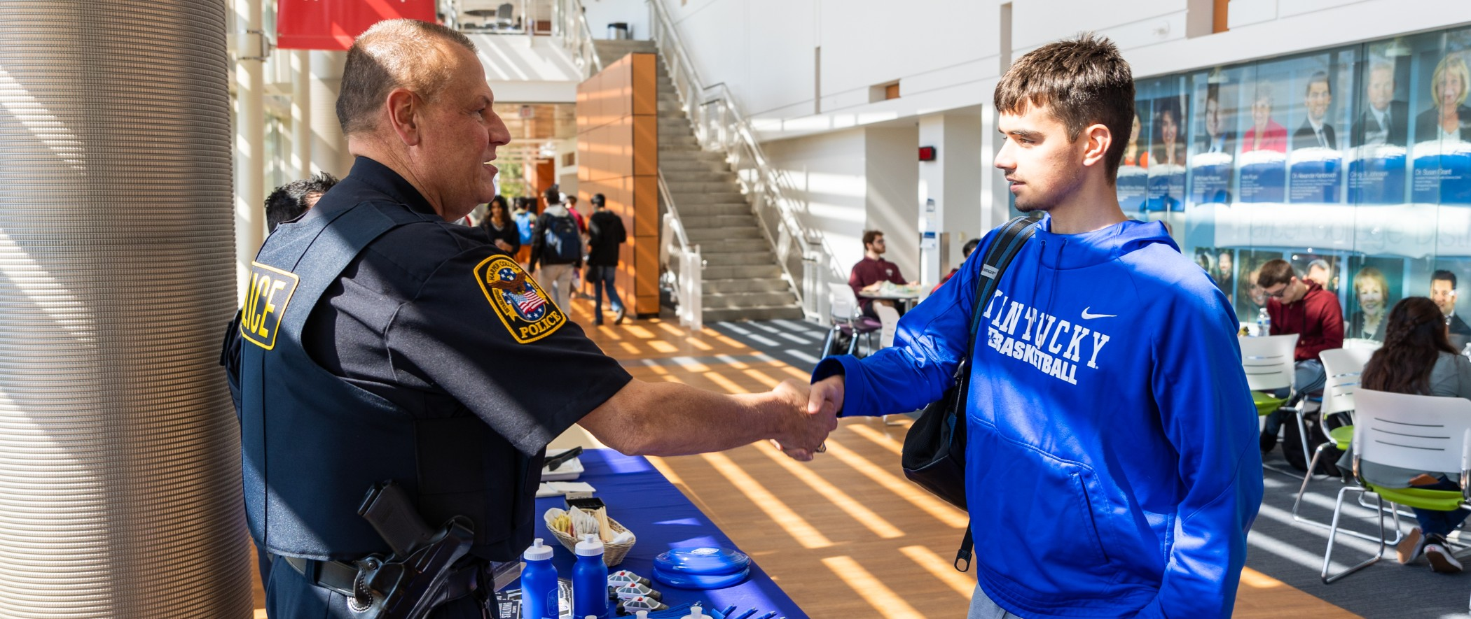

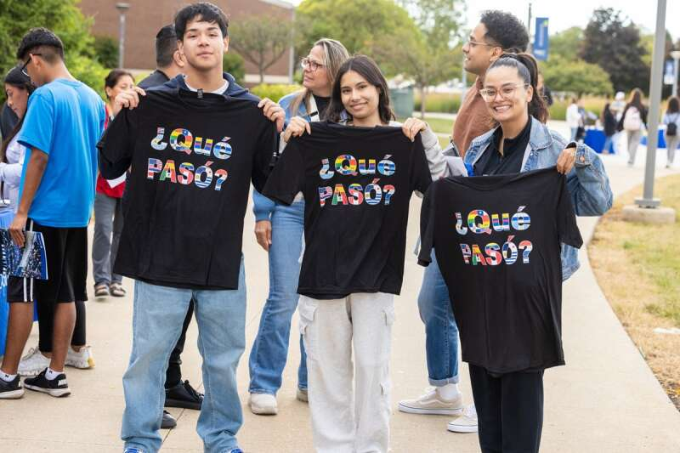

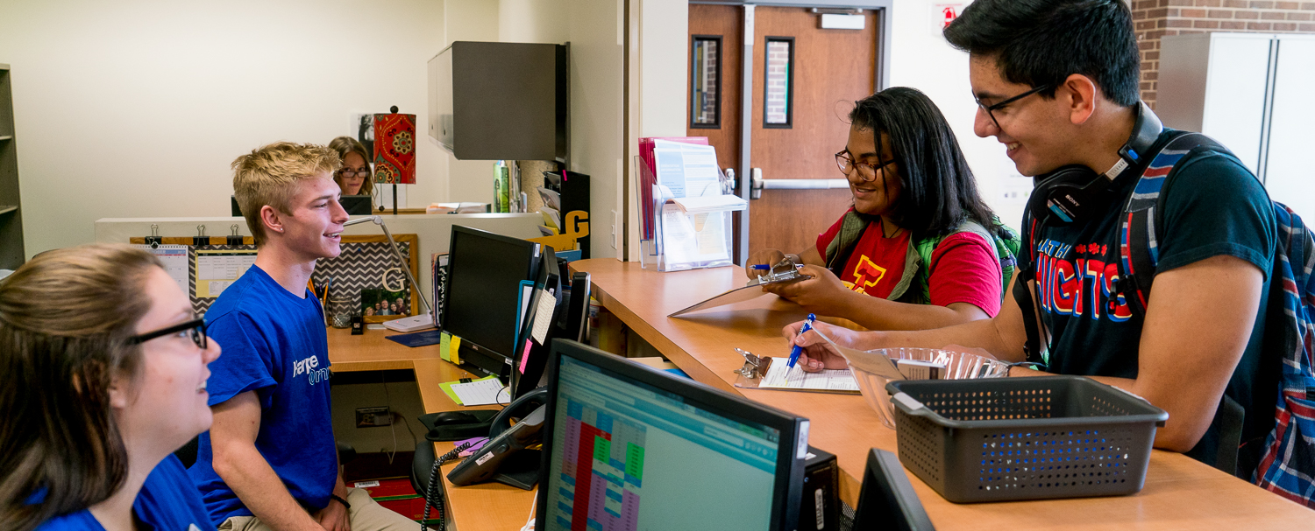
Support Services
Hubs
Library​
Advising​
Dual Credit Office​
Academic Support Center
Access and Disability Services​

Slide 14
College Now "Hubs"
Hubs are designated areas around campus to help students succeed based on their needs
Hubs identified:
  Academic support – Building F, first floor
  Cultural/Hangout - Building D, cultural center
  Quiet/Study - Building F, Library
  Recharge – Building D, Starbucks; Building A, Cafeteria
  Student Engagement – Building A, 3rd floor
Notes:
Lisa

Slide 15


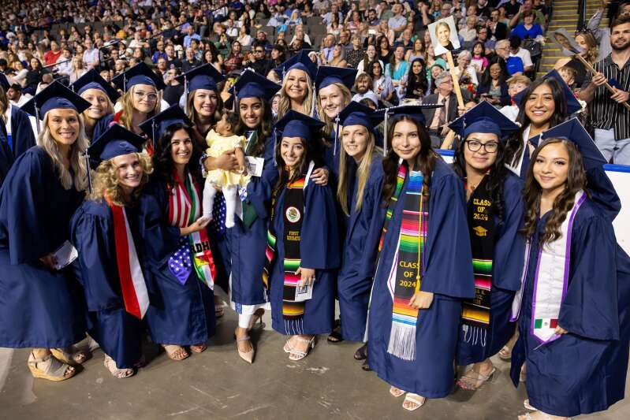

Save the Date for College now Graduation in 2028
Harper College Graduation
Class of 2028
Save the Date:
Friday, May 16th, 2028 2:00pm

Slide 16
Questions?

