Slide 1
Personal Assessment of the College Environment (PACE)
Summary of Findings

Slide 2
PACE Model National Initiative for Leadership & Institutional Effectiveness (NILIE) North Carolina State University
Climate Factors

Slide 3
Organizational Systems
Coercive: least conducive to productivity, job satisfaction, communication, & overall organizational climate
Competitive
Consultative
Collaborative: most conducive to productivity, job satisfaction, communication, & overall organizational climate

Slide 4
Instrumentation
46 items grouped under the 4 climate factors
Institutional Structure
Supervisory Relationships
Teamwork
Student Focus
Respondents rate these 4 factors on 5-point scale (1 = low . . . 5 = high)

Slide 5
Response Rates
Response Rates
Employee Group | Total Population | Surveys Completed | % Population Represented
Administrator | 48 | 42 | 87.5
Classified | 176 | 128 | 72.7
Supervisory/Confidential | 74 | 64 | 86.5
Faculty | 210 | 167 | 79.5
Professional Technical | 120 | 76 | 63.3
Campus Operations | 85 | 40 | 47.1
Did Not Respond |  | 10
Total Nov 2008 | 713 | 527 | 73.9
Total Apr 2005 | 781 | 416 | 53.3

Slide 6
Overall Climate Rating
Overall mean response: “healthy climate”
Mid-Consultative range
2005 | 2008
3.56 | 3.61

Slide 7
Overall Climate Factor Ratings
Highest rated climate factor: Student Focus
2005 | 2008
3.91 | 3.99

Slide 8
Overall Climate Factor Ratings
2008 Overall climate factor ratings by employee group
Administrator 4.00
Classified 3.76
Supervisory/Confidential 3.69
Faculty 3.48
Professional/Technical 3.64
Campus Operations 3.11
2005 Overall climate factor ratings by employee group
Administrative 3.82
Technical/Campus Operations 3.64
Administrative Support 3.61
Faculty 3.55

Slide 9
Highest Mean Item Ratings
Mean | 2008 | 2005
Students receive excellent education | 4.27 | 4.24
My job is relevant to mission | 4.20 | 4.34
HC prepares students for further education | 4.13 | 4.11
HC prepares students for careers | 4.09
Faculty meet needs of students | 4.04
Students satisfied w/ educational experience | 4.02
Classified personnel meet needs of students | 4.00
Non-teaching personnel meet needs of students | 3.96
My supervisor expresses confidence in my work | 3.96
My supervisor open to new ideas, etc | 3.90

Slide 10
Highest Mean Item Ratings in 2005 not repeated in 2008
The extent to which I am responsible for meaningful work: 4.34
The extent to which students receive an excellent education at this institution: 4.24
The extent to which my skills are appropriate for my job: 4.22
The extent to which accuracy is expected of me in my job: 4.20
The extent to which this institution prepares students for further learning: 4.11

Slide 11
Lowest Mean Item Ratings
Mean | 2008 | 2005
Information shared | 2.84 | 3.00
Decisions made at appropriate levels | 2.95 | 2.78
Cooperation exists | 3.02 | 2.92
I’m able to influence direction of HC | 3.09 | 2.91
Open & ethical communication practiced | 3.10 | 2.91
HC appropriately organized | 3.14 | 2.99
Opportunity for advancement w/in HC | 3.15
Teams used problem-solving techniques | 3.16
My work guided by clearly defined administrative processes | 3.2o
HC positively motivates my performance | 3.21

Slide 12
Climate Factors Ratings by All Employees
Factor | 2005 | 2008 | 2008 w/ adjunct faculty
Supervisory Relationships | 3.58 | 3.64 | 3.66
Institutional Structure | 3.15 | 3.24 | 3.28
Teamwork | 3.72 | 3.72 | 3.74
Student Focus | 3.99 | 3.99 | 4.00
Overall | 3.56 | 3.61 | 3.63

Slide 13
Rating of 2008 Harper College Climate Factors by Employee Groups
Employee Group | Supervisory Relations | Institutional Structure | Teamwork | Student Focus | Overall
Administrator | 4.04 | 3.78 | 4.16 | 4.17 | 4.00
Classified | 3.82 | 3.52 | 3.76 | 4.00 | 3.76
Super/Con | 3.68 | 3.37 | 3.86 | 4.05 | 3.69
Faculty (full-time) | 3.55 | 2.91 | 3.75 | 3.97 | 3.48
Professional Technical | 3.73 | 3.28 | 3.70 | 3.99 | 3.64
Campus Operations | 2.91 | 2.96 | 2.79 | 3.71 | 3.11

Slide 14
2008 Mean Climate Scores as Rated by Employee Groups

Slide 15
2008 Ratings of Climate F actors by Demographic Groups
Group | Supervisory Relations | Institutional Structure | Teamwork | Student Focus | Overall
Full-Time | 3.62 | 3.21 | 3.69 | 3.98 | 3.59
Part-Time | 3.97 | 3.67 | 4.03 | 4.13 | 3.92
Female | 3.78 | 3.33 | 3.84 | 4.07 | 3.71
Male | 3.48 | 3.15 | 3.54 | 3.88 | 3.48
White | 3.72 | 3.30 | 3.77 | 4.02 | 3.66
Other | 3.50 | 3.13 | 3.54 | 3.87 | 3.48

Slide 16
2008 Ratings of Climate Factors by Years of Service
Years | Supervisory Relations | Institutional Structure | Teamwork | Student Focus | Overall
Less than 1 | 4.28 | 4.07 | 4.33 | 4.36 | 4.24
1-4 | 3.78 | 3.42 | 3.80 | 3.92 | 3.70
5-9 | 3.48 | 3.15 | 3.55 | 3.96 | 3.51
10-14 | 3.59 | 3.05 | 3.66 | 4.07 | 3.54
15+ | 3.61 | 3.11 | 3.72 | 3.93 | 3.54

Slide 17
Harper’s Climate Compared to NILIE Norm Base
Climate Factor | Harper 2005 | Harper 2008 | NILIE Norm Base (n=65)
Supervisory Relationships | 3.58 | 3.64 | 3.63
Institutional Structure | 3.15 | 3.24 | 3.23
Teamwork | 3.72 | 3.72 | 3.68
Student Focus | 3.99 | 3.99 | 3.84
Overall | 3.56 | 3.61 | 3.56

Slide 18
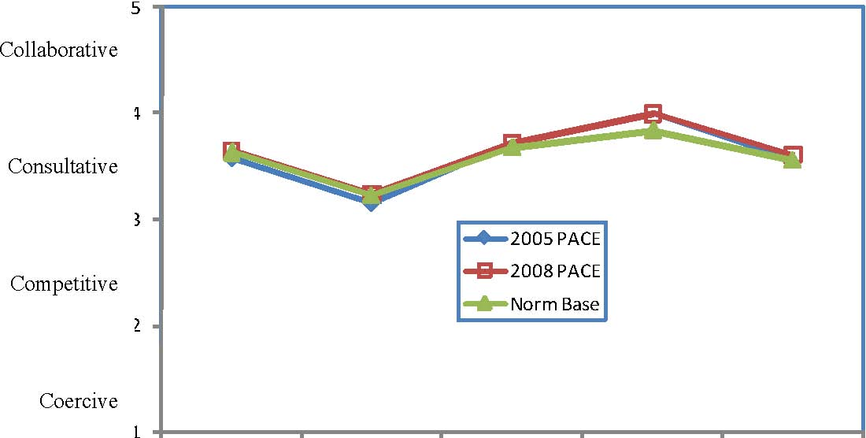
Harper College Climate Compared with the NILIE PACE Norm Base

Slide 19
2008 Customized Items (Harper only for 2008)
Item | Admin | Classified | Super Con | Faculty | Pro Tech | Campus Ops
Integrate Excellence | 4.17 | 3.86 | 3.83 | 3.19 | 3.77 | 2.90
Integrate Respect | 3.78 | 3.68 | 3.47 | 2.60 | 3.41 | 2.67
Integrate Integrity | 3.74 | 3.77 | 3.66 | 2.72 | 3.47 | 2.90
Integrate Collaboration | 3.64 | 3.63 | 3.48 | 2.64 | 3.45 | 2.76
Welcoming environment for underrep groups | 3.68 | 3.96 | 3.78 | 3.23 | 3.65 | 3.08
Learn about strengths | 4.39 | 3.81 | 3.86 | 3.78 | 3.80 | 3.21
I contribute to welcoming environment for underrep groups | 4.24 | 4.09 | 4.03 | 4.09 | 4.01 | 3.57
I apply strengths to my work | 4.21 | 4.13 | 3.91 | 4.11 | 3.92 | 3.76
Campus security provides for my safety | 4.36 | 3.87 | 3.91 | 3.87 | 4.05 | 3.79
Overall rating of HC climate | 4.02 | 3.79 | 3.71 | 3.10 | 3.52 | 2.90

