Slide 1

Tech Tuesday
DISCOVER WHAT YOU CAN DO WITH A CHROMEBOOK
Rebekah Noggle
Rnoggle@harpercollege.edu
&
Kerry Littel
KLittel@harpercollege.edu

Slide 2
What will you learn today?
Download Microsoft Office 365
Log Into your 365 account
Navigate on a Chromebook
Open a new document
Save a document
Share a document
Navigate the Office Toolbar

Slide 3
What questions do you have?
Contact Us!
Rebekah Noggle
Rnoggle@harpercollege.edu
&
Kerry Littel
KLittel@harpercollege.edu

Slide 4
Vocabulary
Mobile Device: a portable computing device designed to run most of its functions through the internet instead of internal hardware
Smartphone
Tablets
Chromebooks
App: Application; a program made to run on a mobile device

Slide 5

Vocabulary
Browser: an application that provides access to the internet
Chrome
Firefox
Microsoft Edge (Internet Explorer)
Safari

Slide 6
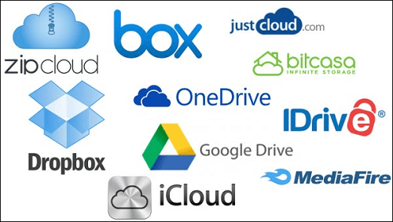
Vocabulary
Cloud Storage: Saving a file to a place on the internet that can be accessed from any place with an internet connection
Google Drive
OneDrive (Microsoft)
DropBox

Slide 7
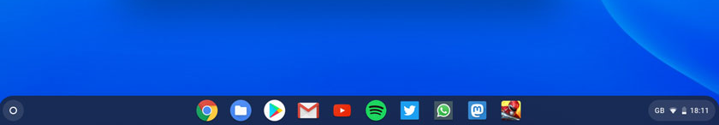
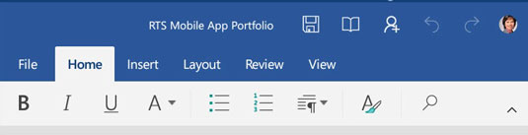
Vocabulary
Launcher: bar located at the bottom of the screen; will expand to show all apps on the Chromebook
Tool Bar: (Microsoft 365) The bar along the top of the screen that allows you to make changes to your document
Size
Bold, Italics, Underline
Change line spacing
And more!

Slide 8
Downloading Microsoft Office
Open Google App Store
Search for “Microsoft Office”
Click on INSTALL
When application finishes downloading press OPEN

Slide 9
Agenda
Download Microsoft Office 365
Log Into your 365 account
Navigate on a Chromebook
Open a new document
Save a document
Share a document
Navigate the Office Toolbar

