Slide 1

Tech Tuesday
Google Suite

Slide 2
What Will You Learn Today?
Vocabulary
Accessing Google Drive
Google Drive Dashboard
Creating a New Google Doc
Google Doc Features
Working Offline

Slide 3
Vocabulary
Browser – an application that provides access to the internet. Example: Chrome
Cloud Storage – Online ”place” that allows you to store files for free
Google Drive – a free service that allows you to store files online and access them anywhere using the cloud. It also gives you access to free web-based applications for creating documents, presentations, spreadsheets and more!

Slide 4
Vocabulary
Application (App) – a program made for use on a mobile device (tablet, smartphone, Chromebook, etc...)
Google Docs
for composing letters, essays, flyers, etc. (similar to Microsoft Word)
Google Sheets
for storing and organizing information (similar to Microsoft Excel)
Google Slides
for creating slide shows (similar to Microsoft Power Point)

Slide 5
Vocabulary
Chromebook Launcher - bar located at the bottom of the screen; will expand to show all apps on the Chromebook. Can access by selecting the circle in bottom-left corner OR by tapping the magnifying glass on your keyboard.
Google App Launcher – waffle icon that is displayed in the top-right corner of any Google page. It’s a shortcut to Google’s applications.

Slide 6
Vocabulary
Dashboard – your home screen for Google Drive
Toolbar – the bar located along the top of the screen that allows you to make changes to your document (size, bold, italics, underline, line spacing, etc...)
Offline – the ability to work on your documents anywhere regardless if you are connected to the internet

Slide 7
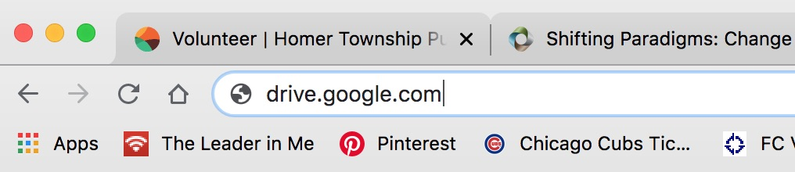
Accessing Google Drive
Option 1:
Download from the Play Store.
Once downloaded, Google Drive can be accessed from the Chromebook Launcher
Option 2:
Select the Google’s App Launcher near the top-right corner of any Google page (Google Search, Gmail, etc...)
Option 3:
Go to drive.google.com

Slide 8
Google Drive Dashboard

Slide 9
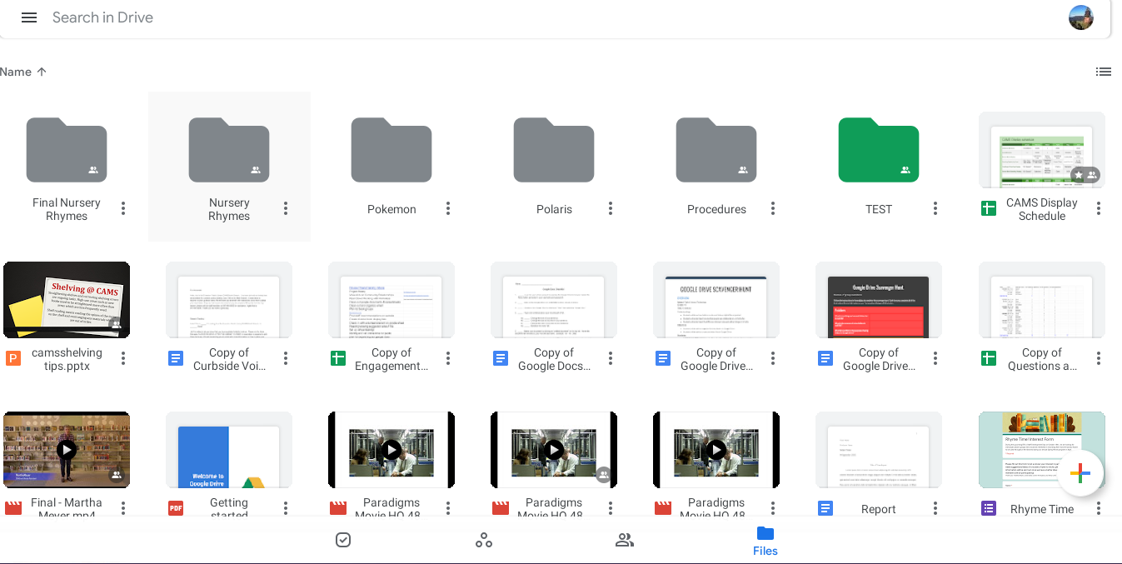
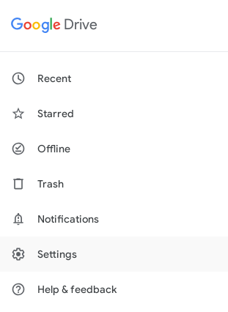
Google Drive Dashboard

Slide 10
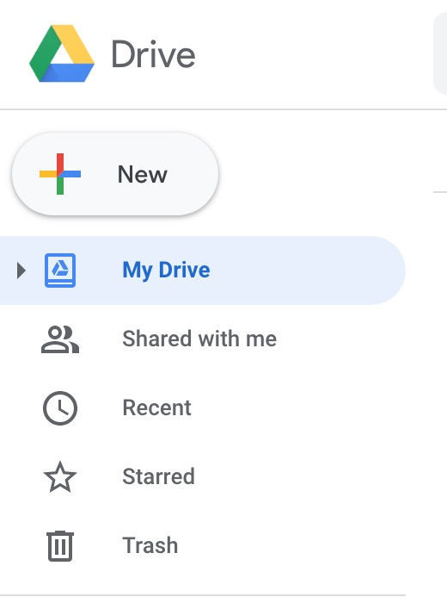

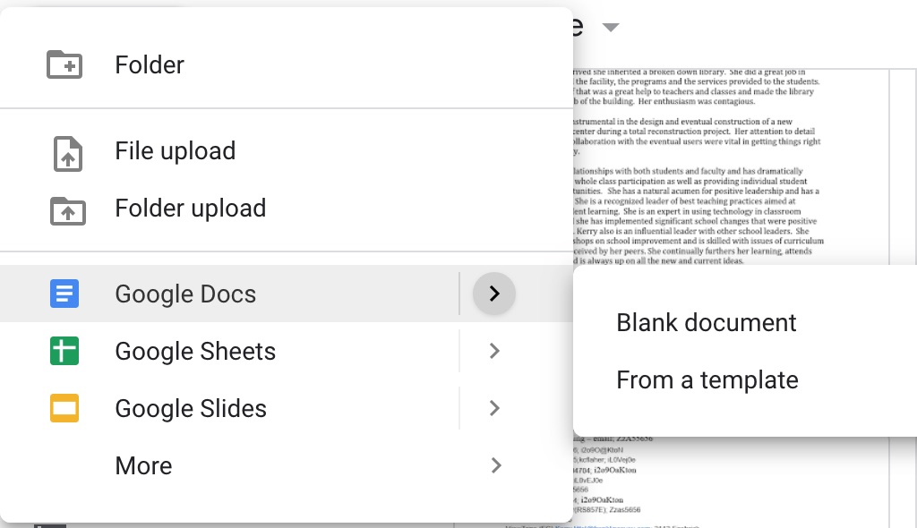
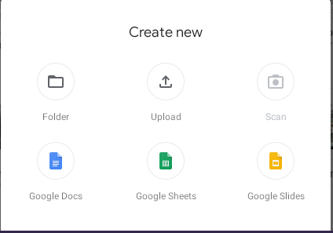
Creating a New Google Doc
From Google Drive Online
From Chromebook App

Slide 11
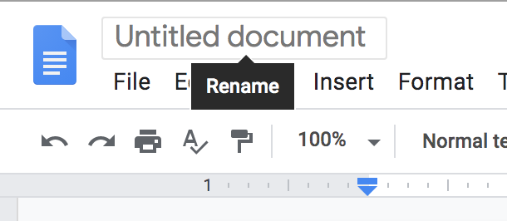
Google Doc Features

Slide 12

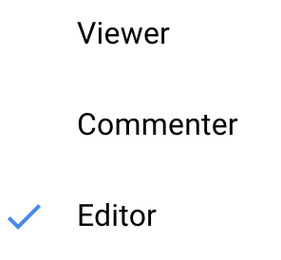
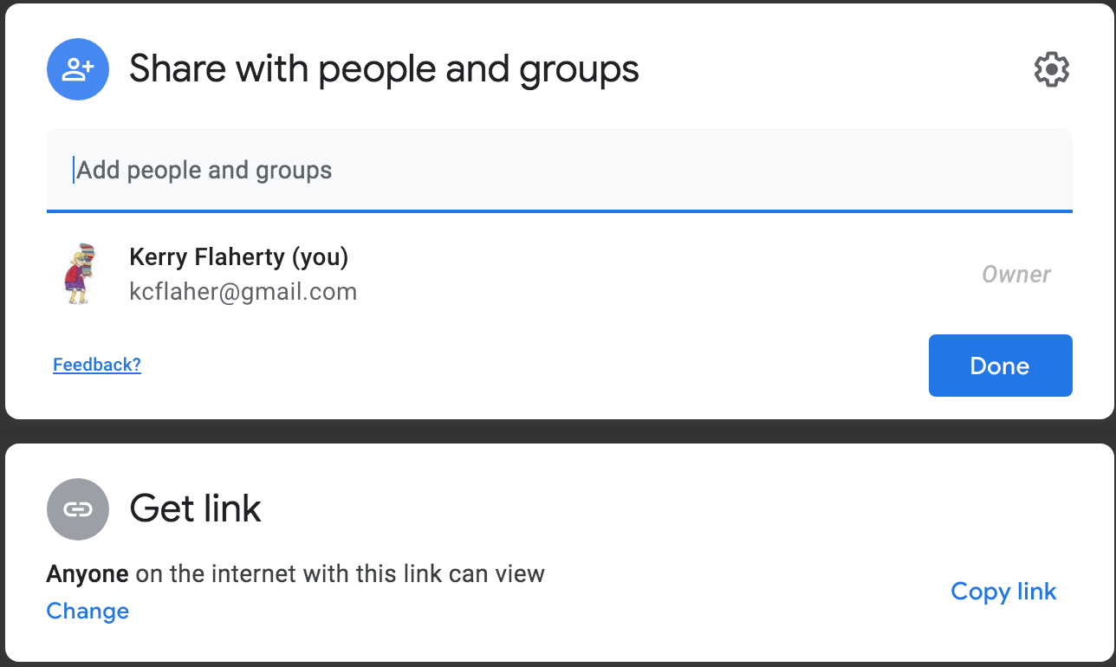
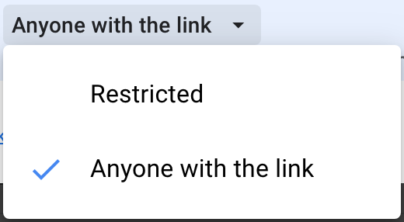
Sharing
3 Sharing Options – CHOOSE WISELY!!!
Viewer: can view the document only. Cannot share, edit or comment
Commenter: Can view the document and make comments, but cannot share or edit the document
Editor: can make changes, add comments and share the document with others.

Slide 13
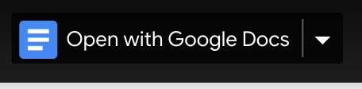
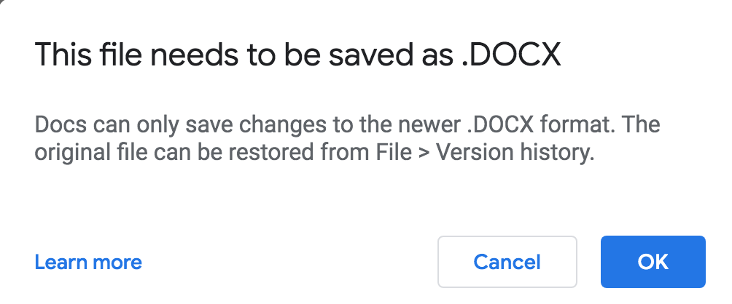
Uploading/Editing Office Files
Once you upload a Microsoft Office file, you'll be able to manage, organize, share, and access it from anywhere.

Slide 14
Working Offline?
No network connection? No problem! With Google Docs Offline, you can access Google Docs, Sheets, Slides, and Drive without connecting to the internet.

Slide 15
Thank You!
Any questions, please contact us:
Rebekah Noggle (rnoggle@harpercollege.edu)
Kerry Littel (klittel@harpercollege.edu)

