Slide 1
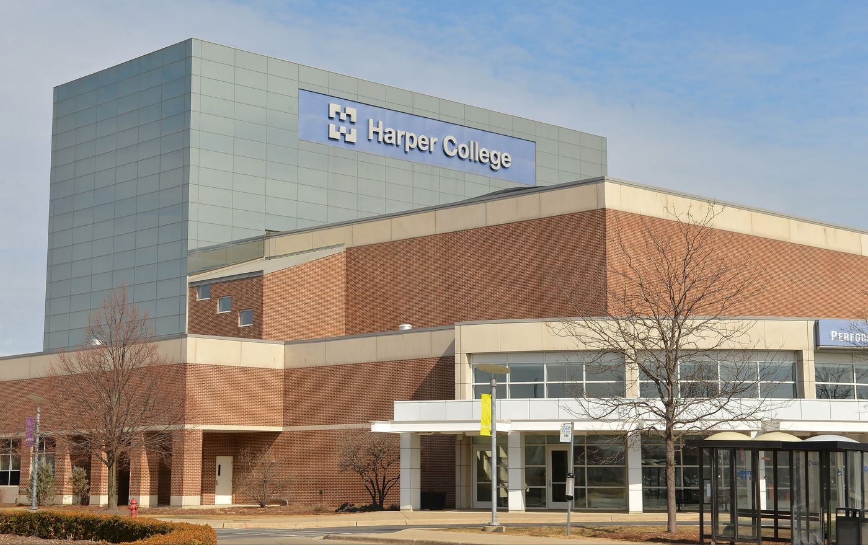
Tech Tuesday
Chromebook Tour

Slide 2
What Will You Learn Today?
Overview
Keyboard Shortcuts
Accessibility Shortcuts
Troubleshooting

Slide 3
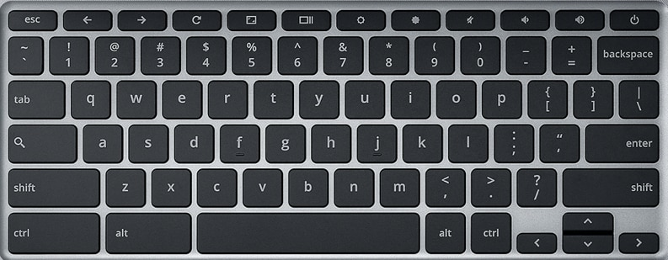
Keyboard Shortcuts

Slide 4
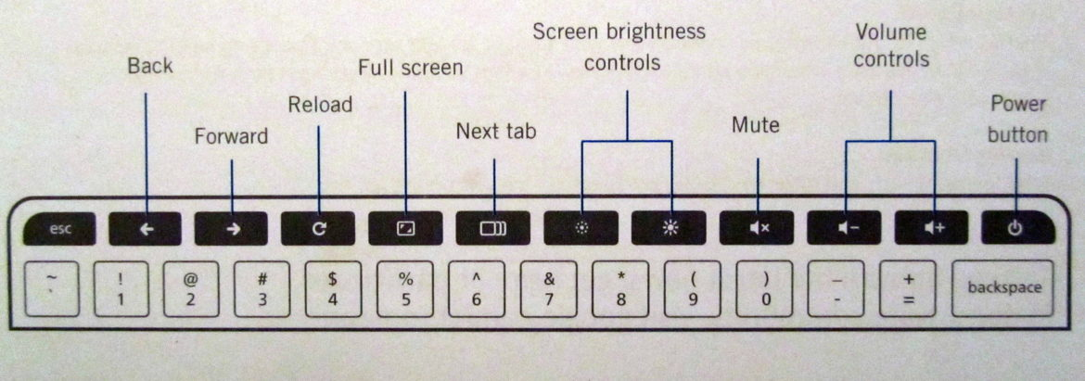
Keyboard Shortcuts

Slide 5
Keyboard Shortcuts
Search Device: (magnifying glass)
Open FullScreen Launcher: (shift +magnifying glass)
Switch back and forth between two applications: (alt +tab)
Full Screen Shot: (ctrl + )
Caps Lock: (alt + magnifying glass)
Split Screen: lock screen to left side (alt +[); lock screen to right side (alt +]); maximize current window (alt +=)
View additional shortcuts (ctrl +alt +?)

Slide 6
Accessibility Shortcuts
Magnify Whole Screen (ctrl + magnifying glass +m)
Magnify Part of Screen (ctrl +magnifying glass +d)
Display Zoom In (ctrl +shift + =)
Display Zoom Out (ctrl +shift + -)
High Contrast (ctrl +magnifying glass +h)
Chromebook Vox --spoken feedback (ctrl +alt +z)

Slide 7
Troubleshooting
It’s always good to restart your Chromebook at least once per day.
Too Slow?
Close tabs or programs you are not using
Close your browser and reopen it
Frozen?
Press SHIFT +ESC to force quit one or all programs
Press and hold the Power button for 3 seconds to force shut down.
Internet Not Connected?
Click on your WiFi symbol to make sure you are connected
Close and reopen your browser
Finally….
Before seeking any other help, try the tried and true...turn it all the way off and turn it on again.

Slide 8
Thank You!
Any questions, please contact us:
Rebekah Noggle (rnoggle@harpercollege.edu)
Kerry Littel (klittel@harpercollege.edu)

