Slide 1

Stress Management
Harper College Counselors
Larry Lasko
Anne Abasolo

Slide 2
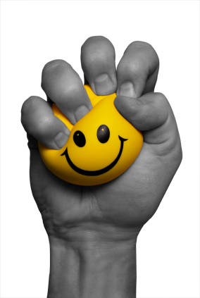
What is stress?
The body’s way of responding to demand.
Can be good or bad experiences
☺😐☹

Slide 3
What causes stress?
Survival stress: response to danger
Internal stress: worrying, emotional
Environmental stress: noise, crowding, pressure
Fatigue/over-load: built up over time

Slide 4

How does stress affect you?
Affects body and mind
Sickness
Tired
Unable to concentrate
Mental breakdown

Slide 5


Stress Facts
1 in 5 Americans experience “extreme stress”.
Stress is a normal part of college life. A certain level of stress is healthy and can be motivating. When stress goes beyond this level, it can become a problem.
8 out of 10 college students experience stress daily.

Slide 6
Types of Stress
Eustress 
Good stress
Some good stress is necessary
Motivates you to keep working
Distress
Bad stress
Too much to bear
Builds tension, no relief

Slide 7
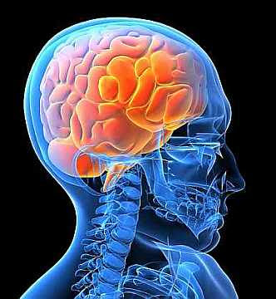
Psychological Affects 
Feeling hostile, angry, irritable
Feeling anxious, anxiety attacks
Depression or sadness
Complete withdrawal
Low self-esteem
Frustration and moodiness

Slide 8

Physical Affects 
Upset stomach, indigestion
Headache
Backache
Inability to sleep
Raised heart rate and blood pressure

Slide 9


Stress Triggers
Keep Track of what is stressful
Create strategies to deal with them

Slide 10
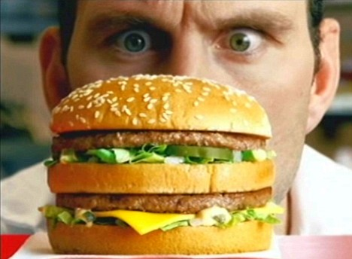

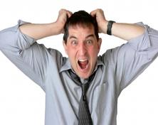

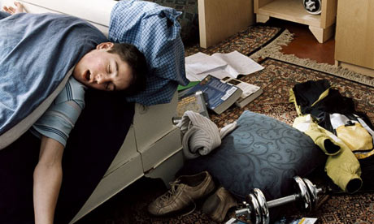
Unhealthy Ways of Coping

Slide 11

Healthy Ways of Coping
How will you deal with stress?

Slide 12
Stress – what can I do?
It may seem that there’s nothing you can do about your stress level.
The bills aren’t going to stop coming, there will never be more hours in the day for all your errands, and your classes, career or family responsibilities will always be demanding.
But you have a lot more control than you might think. In fact, the simple realization that you’re in control of your life is the foundation of stress management.
Managing stress is all about taking charge: taking charge of your thoughts, your emotions, your schedule, your environment, and the way you deal with problems. The ultimate goal is a balanced life, with time for school and work, relationships, relaxation, and fun – plus the resilience to hold up under pressure and meet challenges head on.

Slide 13
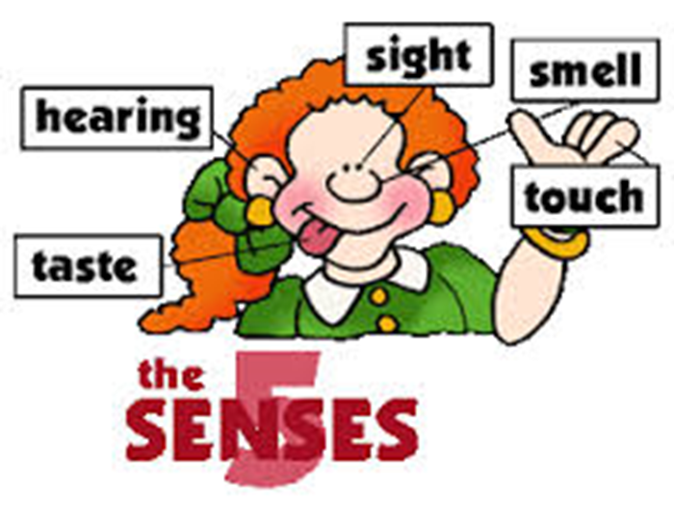
The basics of quick stress relief
The speediest way to stomp out stress is by engaging one or more of your senses—your sense of sight, sound, taste, smell, touch, or movement—to rapidly calm and energize yourself.
The key to practicing quick stress relief is learning what kind of sensory input helps your particular nervous system find calm and focus quickly.

Slide 14
How can I manage stress?
Coping mechanisms
Everyone is different
No one formula
How do you usually react under stress?

Slide 15
Over-excited stress response
If you tend to become angry, agitated, or keyed up, you will respond best to stress relief activities that quiet you down.

Slide 16
Under-excited stress response
If you tend to become depressed, withdrawn, or spaced out under stress, you will respond best to stress relief activities that are stimulating and that energize your nervous system.

Slide 17

Sights
If you’re a visual person, try to manage and relieve stress by surrounding yourself with soothing and uplifting images.
Try closing your eyes and imagining the soothing images.
Here are a few visual activities that may work as quick stress relievers:
  Look at a cherished photo or a favorite memento.
  Bring the outside indoors; buy a plant or some flowers to enliven your space.
  Enjoy the beauty of nature–a garden, the beach, a park, or your own backyard, sunset.
  Surround yourself with colors that lift your spirits.
  Close your eyes and picture a situation or place that feels peaceful and rejuvenating.

Slide 18

Sound
Are you sensitive to sounds and noises?
Are you a music lover?
If so, stress-relieving exercises that focus on your auditory sense may work particularly well.
Experiment with the following sounds, noting how quickly your stress levels drop as you listen:
Sing or hum a favorite tune.
Listen to uplifting music.
Tune in to the soundtrack of nature, crashing waves, the wind rustling the trees, birds singing.
Buy a small fountain, so you can enjoy the soothing sound of running water in your home or office.
Hang wind chimes near an open window.
Ocean waves
Relaxing White Noise

Slide 19

Smell & Scents
If you tend to zone out or freeze when stressed, surround yourself with smells that are energizing and invigorating.
If you tend to become overly agitated under stress, look for scents that are comforting and calming.
Light a scented candle or burn some incense.
Lie down in sheets scented with lavender.
Smell the roses—or another type of flower.
Enjoy the clean, fresh air in the great outdoors.
Spritz on your favorite perfume or cologne.
Women are 2x more sensitive to smell

Slide 20

Taste
Slowly savoring a favorite treat can be very relaxing, but mindless eating will only add to your stress and your waistline.
The key is to indulge your sense of taste mindfully and in moderation. Eat slowly, focusing on the feel of the food in your mouth and the taste on your tongue:
Chew a piece of sugarless gum.
Indulge in a small piece of dark chocolate.
Sip a steaming cup of coffee or tea or a refreshing cold drink.
Eat a perfectly ripe piece of fruit.
Enjoy a healthy, crunchy snack (celery, carrots, or trail mix).

Slide 21

Movement
Anything that engages the muscles or gets you up and active can work. Here are a few suggestions:
Run in place or jump up and down.
Dance around.
Stretch or roll your head in circles.
Go for a short walk or exercise.
Squeeze a rubbery stress ball.
  If you tend to shut down when you’re under stress, stress-relieving activities that get you moving may be particularly helpful.

Slide 22

Time Management 
  Enhances sense of control 
  Buying a planner for daily schedule 
  Making a to-do-list 
  Setting priorities ☑
  Use sticky notes

Slide 23
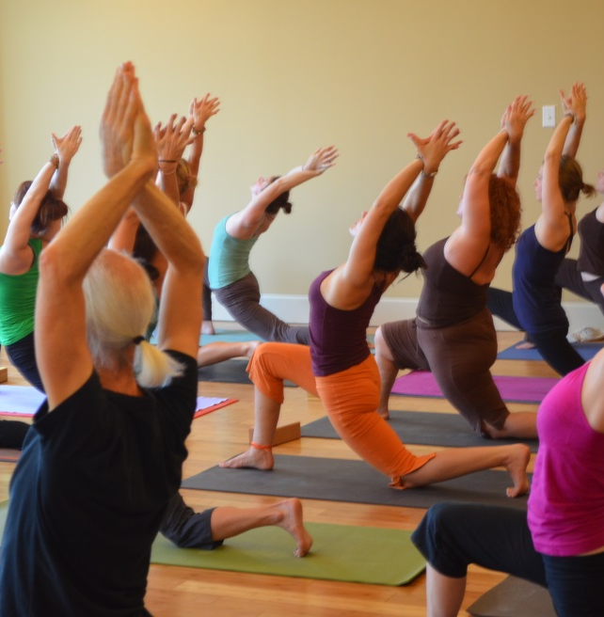
Yoga
  Decreases stress and tension
  Lowers blood pressure
  Emphasis on mind, body and spirit

Slide 24
Simple two minute yoga technique for stress
Stress Busting Yoga Techniques

Slide 25

Meditation
Breathing techniques
Lowers heart rate
Focuses on relaxation

Slide 26
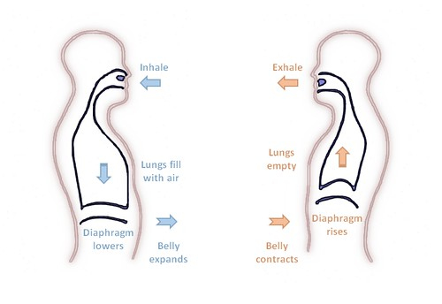
Diaphragmatic Breathing

Slide 27
Physiological effects of diaphragmatic breathing
Increase the amount of oxygen in our lungs, thus our bodies.
Heart rate slows
Blood pressure drops
Stimulates the vagus nerve which runs through the diaphragm, the calming nerve that activates the parasympathetic nervous system.

Slide 28
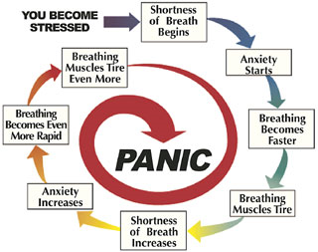
Breathing
When you are stressed be aware of your breathing.
Individuals who are stressed usually are taking shallow breaths.
To become calm take a few deep breaths.

Slide 29
Breathing
Stress/Anxiety
Shallow Breathing
Calm/Well-being
Deep Breathing

Slide 30
Mindful Breathing
3-minute Mindful Breathing Meditation

Slide 31
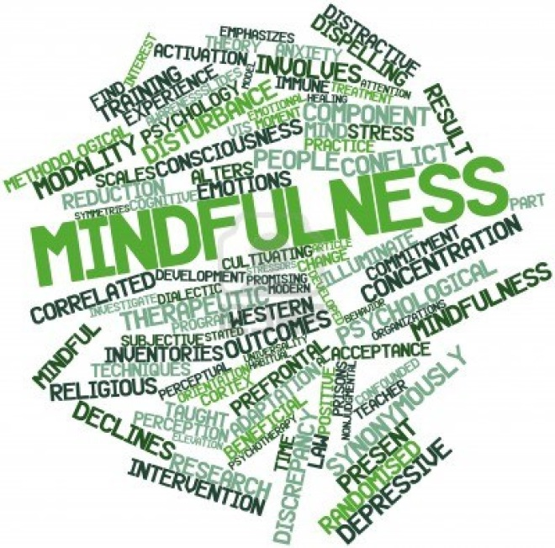
Mindfulness
Being present with experience
Focus on the now
Breathing, focusing, and listening techniques
Beautiful Piano Music
Stress relief
Piano Music

Slide 32
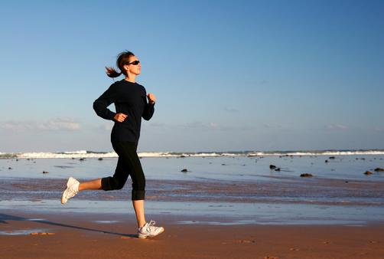
Exercise
30-60 minutes cardio per day
Pumps up endorphins
Improves your mood

Slide 33
Progressive muscle relaxation exercise
Progressive muscle relaxation exercise

Slide 34
Guided Visualization: A Way to Relax, Reduce Stress:
Guided Meditation: A Forest Walk

Slide 35
Change stress invoking self-talk
Erroneous exaggerated self-talk can increase our anxiety levels and thus create more stress.
These stress provoking thoughts perpetuate fears and reinforce worrying.
The following are two basic errors in fearful thinking:
  Overestimating a negative outcome
  Underestimating your ability to cope.
Restructuring unhelpful self talk

Slide 36

Sleep and Rest
Helps to relax
Sleep deprivation increases stress

Slide 37

Positive Thinking
Expressing gratitude
Looking at the bright side

Slide 38

Journals and Writing
Expressing feelings through writing
Writing down stressors as they happen

Slide 39

Talk To Someone
Harper College Counseling Center - 847-925-6393
ULifeline - Your online resource for college mental health
Need help now?
Text "START" to 741-741 or call 1-800-273-TALK (8255)
Friend, family, boy/girlfriend
Important to vent and express
feelings

Slide 40
References
Ulifeline
The American Institute on Stress: Stress in College Students
The Mayo Clinic: Stress Management
ABC News: Time Management
Yoga for Stress Management
Notes:
http://www.ulifeline.org/
http://www.stress.org/college-students/
http://www.mayoclinic.org/healthy-living/stress-management/basics/stress-relief/hlv-20049495
http://abcnews.go.com/Health/StressCoping/story?id=4672836
http://www.webmd.com/fitness-exercise/features/yoga-for-stress-management

